Slide 1
Motor phase amplitude modulations during imagined movements
Neuromatch 2022
Brenda Liu | Jessica Alexander | Juan Pablo Botero Kurt Lehner | Lavanya Mysuru Krishnamurthy

Slide 2
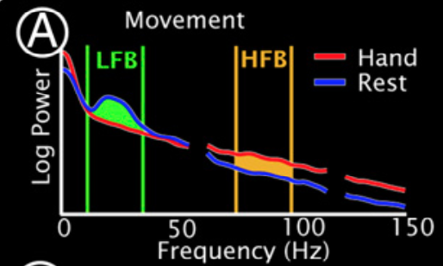
Background
relative power in beta frequency decreases within motor cortex during movement (event related desynchronization, ERD)
Miller et al. (2010)

Slide 3
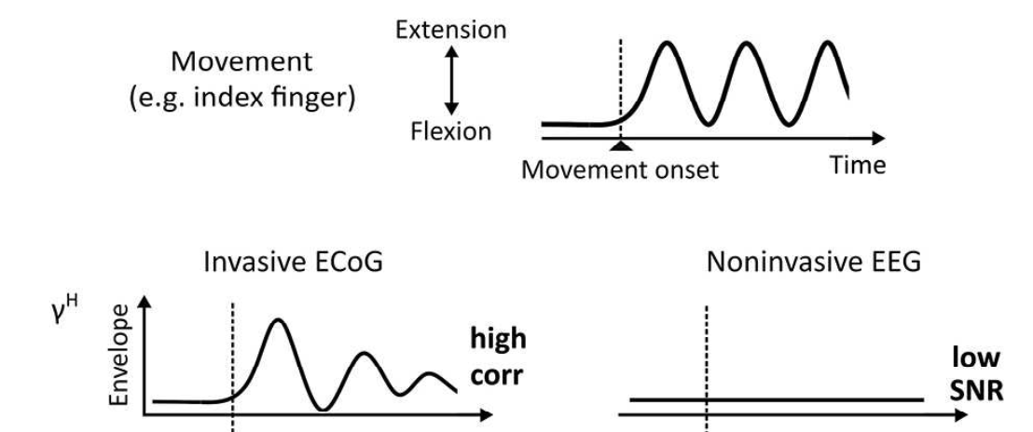
Background
relative power increases in high gamma correlate with dynamic movement features (movement related amplitude modulation, MAM)
Unterweger et al. (2020)

Slide 4
Aims
Replicate prior ERD and MAM findings with the Miller dataset
Investigate how power modulations during imagined movement differ with prior findings in actual movements
Hypotheses
Similar ERD in beta frequency between actual and imagined
Attenuated MAM in high gamma frequency between actual and imagined

Slide 5
Data
ECoG recordings from subjects undergoing treatment for medically refractory epilepsy
Two interleaved tasks at rate of once per second (1 Hz), alternating between task and rest, on-screen cue:
hand (synchronous flexion/extension of all fingers)
tongue (protrusion/retraction of tongue with mouth open)
Two conditions: real movement, imagined movement
Dataglove or EMG to verify absence of movement during imagined condition

Slide 6
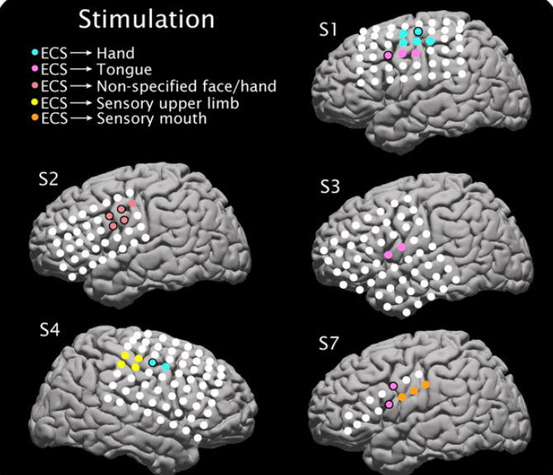
Data
Electrocortical mapping for five participants (for clinical purposes)
Provides indication of electrodes where stimulation causes movement
Analyzed S1, S3, and S4
Miller et al. (2010)

Slide 7
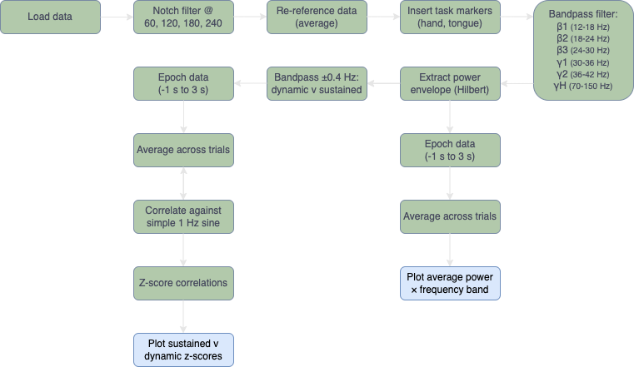
Methods
to be updated

Slide 8
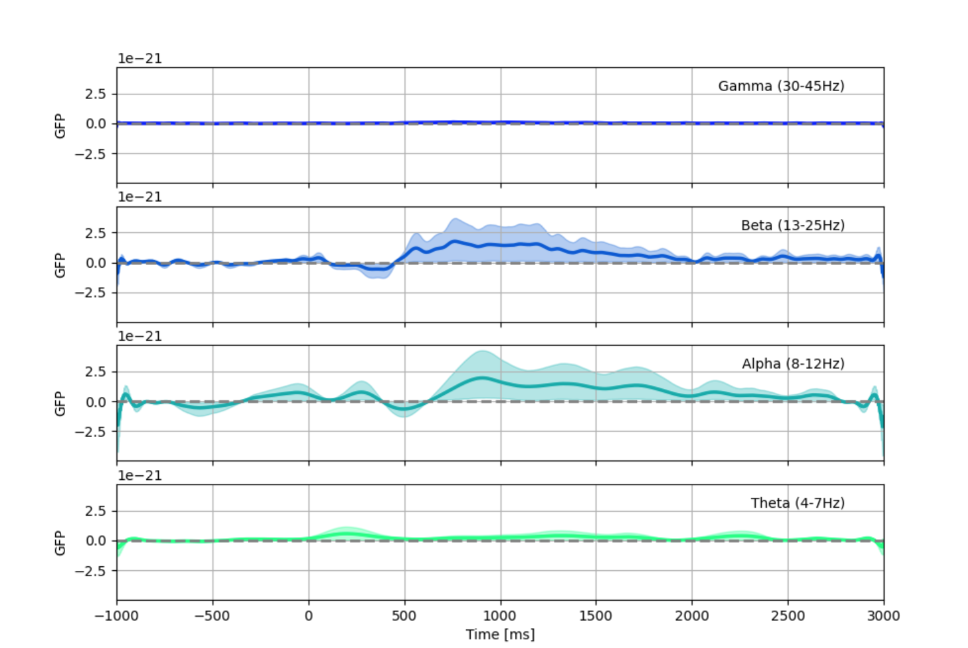
Results | ERD S1 Hand
actual movement
imagined movement
to be updated
add slides: S4 hand, S1 tongue, S3 tongue

Slide 9
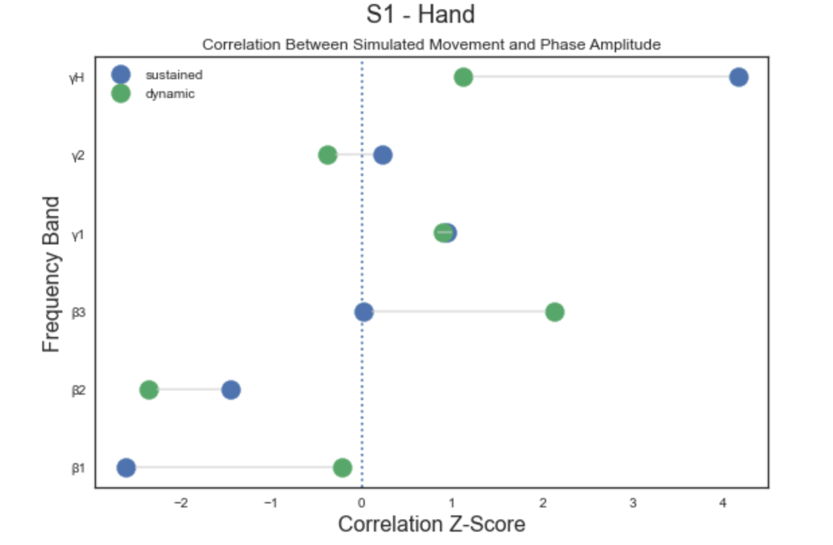
Results | MAM S1 Hand
actual movement
imagined movement
to be updated
add slides: S4 hand, S1 tongue, S3 tongue
maybe better way to compare between actual and imagined?

Slide 10
Conclusions
which stats to demonstrate similarity between conditions?
motor planning? Nakayashiki
to be updated

Slide 11
Limitations
time constraints (other analyses to perform? data cleaning?)
specific subject population reduces generalizability
to be updated

Slide 12
References
Miller, K. J., Schalk, G., Fetz, E. E., den Nijs, M., Ojemann, J. G., & Rao, R. P. N. (2010). Cortical activity during motor execution, motor imagery, and imagery-based online feedback. PNAS, 107(9), 4430–4435.
Miller KJ. A library of human electrocorticographic data and analyses. Nat Hum Behav. 2019 Nov;3(11):1225-1235.
Unterweger, J., Seeber, M., Zanos, S., Ojemann, J. G., & Scherer, R. (2020). ECoG Beta Suppression and Modulation During Finger Extension and Flexion. Frontiers in Neuroscience, 14, 35.

Slide 13
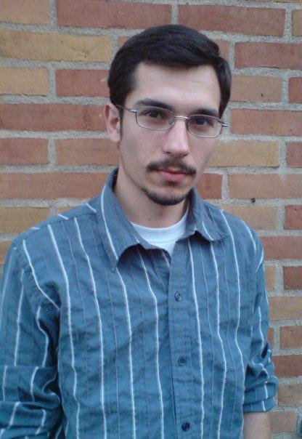
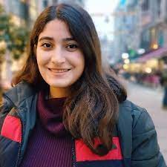


Thanks!
Dr. José Biurrun Manresa, Project TA
Anis Zahedifard, Pod TA
Neuromatch Organizers and Volunteers
Dr. Jason Ritt, Project Mentor

