Slide 1
Project Overview
Health Information System for CEMA API-First Architecture for Program and Client Management
Built with FastAPI & React
Backend hosted on Render
Frontend deployed on Firebase
SQLite for simplicity and portability
Fully RESTful API with OpenAPI docs

Slide 2
Key Requirements from CEMA
Develop an API-first health management system
Enable creation of health programs (e.g., HIV, TB, Malaria)
Register clients and manage enrollments
Support multiple program enrollments per client
Implement client search functionality
Build a basic UI to demonstrate API integration

Slide 3
Technologies Used
Layer | Tech Stack
Backend | FastAPI, SQLAlchemy, SQLite
Frontend | React (Vite), Tailwind CSS
Hosting | Render (API), Firebase (UI)
Auth & Docs | JWT Auth, OpenAPI Docs
Testing | Pytest

Slide 4
API-First Approach
Designed API routes and schemas first
Ensured complete backend before frontend
Used OpenAPI docs for testability and external integration
Allowed independent frontend or system clients

Slide 5
Demo & Testing
Live Demo: Link to UI
API Docs: Link to Swagger api documents
Pytest-based automated backend testing
Manual testing through the frontend for enrollment flows

Slide 6
UI Preview
Home Page / Dashboard
Create Program
Register Client
Enrollment screen
Search & Client Profiles

Slide 7
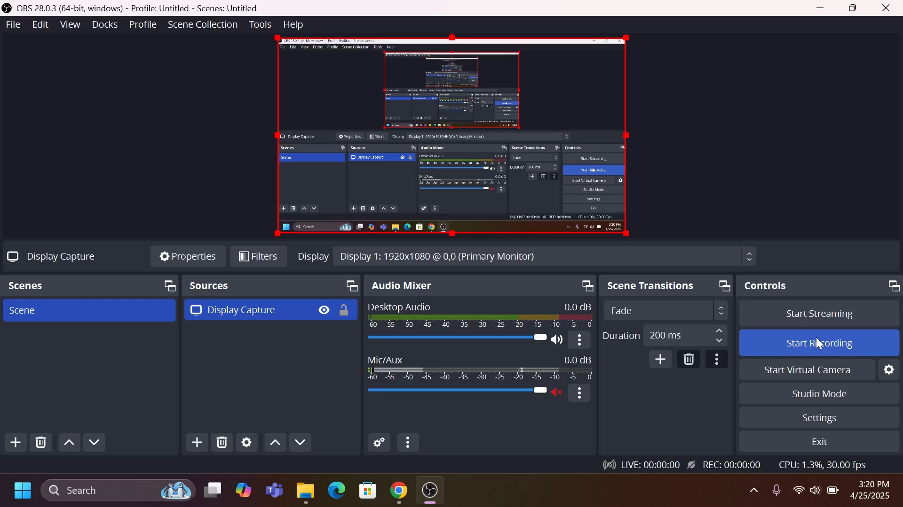
DEMO

Slide 8
Conclusion
Met API-first client-program enrollment system
Built for extensibility and real-world integration
Modular and scalable foundation
Clean separation between API and UI layers

