Slide 1
CS 112 · COMPUTER PROGRAMMING FOR CS · SUMMER 2026
Grid Data to Working Systems
National electricity grid network analysis · GridCare-Lite · ClinicCare-Lite
10 / 44 / 55
3
134
utilities · substations · lines
applications built
automated tests
Notes:
Add team member names to this slide before presenting. Opening line: one dataset about Ghana's power grid, taken all the way from raw CSVs to analysis, then two working applications in two different domains. Everything shown is reproducible from the repository.

Slide 2
One project, three connected components
1 · Grid analysis
2 · GridCare-Lite
3 · ClinicCare-Lite
Ghana's grid as a graph
Outage & maintenance desktop app
Clinic administration web app
Clean, validate, merge three CSVs
NetworkX: centrality, communities, bridges
N-1 contingency: remove each substation
Folium map + Streamlit dashboard
Log outages against real substations
Work orders: assign, schedule, complete
4 roles, enforced in the service layer
Audit trail + live reports
Health tasks, uploads, categorical review
Messaging, announcements, reminders
Strictly administrative - never diagnostic
Private engagement, aggregate analytics
pandas · NetworkX · Plotly
Tkinter · SQLite · bcrypt
Flask · Bootstrap · JSON
Data flows left to right: the analysis output is the applications' reference data.
Notes:
The connection matters: the cleaned substation data from component 1 becomes the reference data GridCare-Lite validates outages against. ClinicCare-Lite reuses the engineering approach - logic layer, role checks, tests - in a domain where privacy is the point.

Slide 3
COMPONENT 1
National Electricity Grid Network Analysis
44 substations, 55 lines, one question: which failures would split the country?
Notes:
Section handoff - whoever presents component 1 takes over here.

Slide 4
The dataset: real geography, generated numbers
10
44
55
seed 42
utilities - ECG, NEDCo, GRIDCo, VRA + WAPP neighbours
substations with region, voltage, capacity, age
transmission & distribution lines
identical CSVs for every team, every run
Synthetic by design. Real utility names and towns, generated capacities, connections and ages. Findings are statements about this dataset - never about Ghana's actual grid.
utilities.csv - who operates (like airlines.csv in the OpenFlights layout)
substations.csv - the nodes: location, region, voltage tier, capacity, year, status
lines.csv - the edges: endpoints, voltage, length, capacity, operational status
Notes:
Key caveat is a grading criterion: utility names and towns are real, every number is synthetic from a seeded generator - so all teams work on identical data and nothing here describes Ghana's actual grid. Totals: 6,946 MVA, 5,462 km of lines, commissioning years 1967-2022.

Slide 5
Cleaning and validation: verified, not assumed
Missing-value tokens normalised, whitespace stripped, numerics coerced, duplicates dropped
Primary keys unique; every line endpoint resolves to a real substation
Coordinates inside West Africa - a swapped lat/lon would wreck every map and distance
Categorical fields against expected sets; no self-loops; no future commissioning years
Validators proven by tests that plant defects and assert they are caught
The finding hiding in the row count
44 substations in the register 42 nodes if you build the graph naively
Two substations have no lines at all - Conakry Hub and Savelugu. Building from the edge list silently drops them (the brief's sample does). We add nodes first, keep the isolates visible, and report them as a coverage finding.
Notes:
The pipeline treats generated data like a real asset register export. Every check logs a result even when it finds nothing - a step that found nothing is still a step we checked. The planted-defect tests prove the validators actually catch orphaned lines and swapped coordinates.

Slide 6
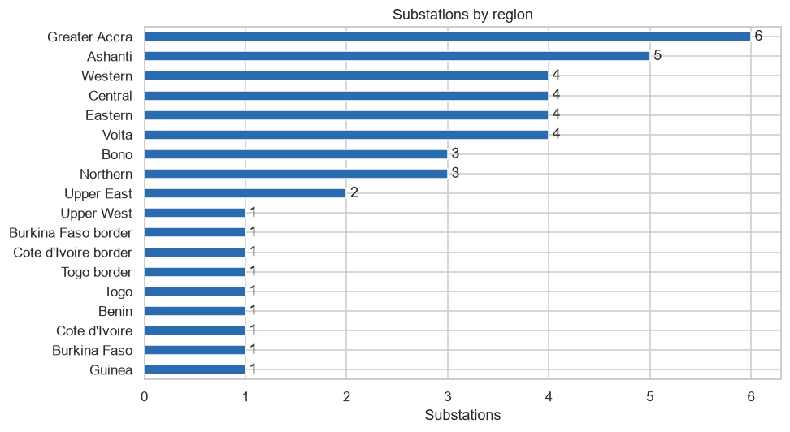
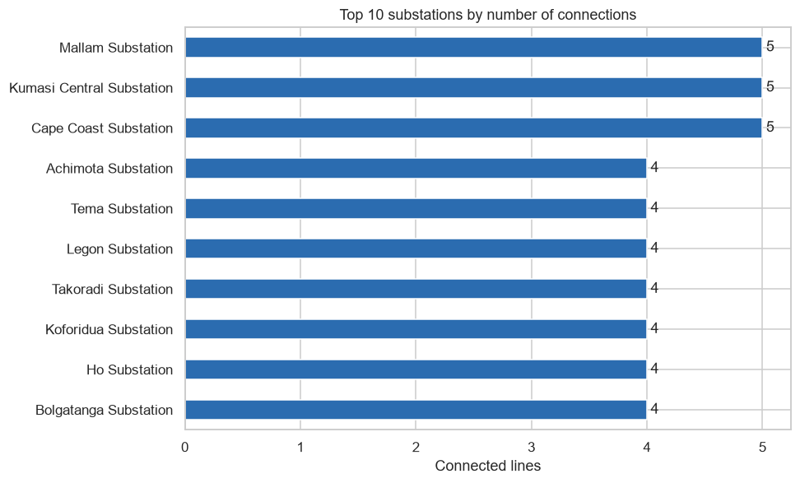
Exploring the grid: where the assets are
Greater Accra densest (6); the northern third thinnest - and Savelugu's missing lines make it worse than it looks
Most-connected: Mallam, Kumasi Central, Cape Coast at 5 lines each - counted across both endpoints
Notes:
Left: Greater Accra leads with 6 substations; the single-substation 'regions' at the bottom are cross-border WAPP points. Right: Mallam, Kumasi Central and Cape Coast tie at 5 connections - remember those three names for the N-1 slide.

Slide 7
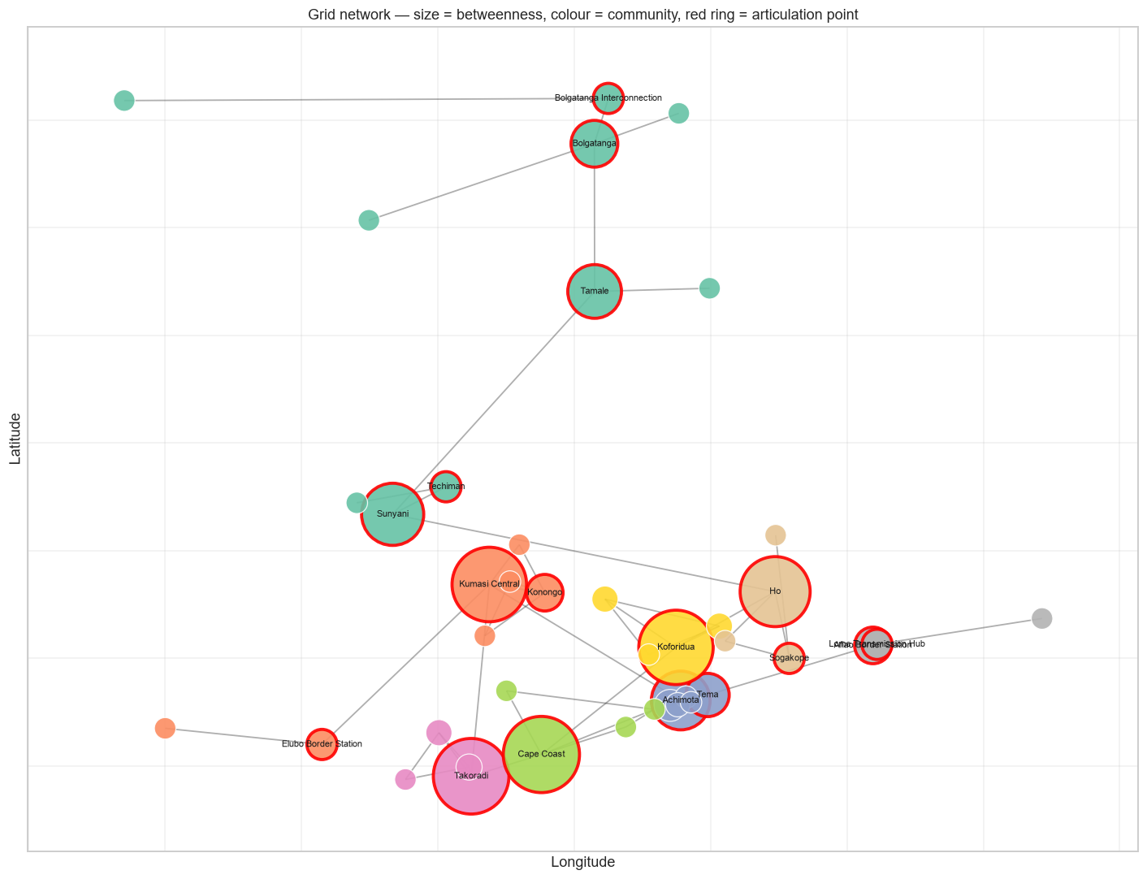
The grid as a graph
density
0.064
diameter
14 hops
avg path
5.41 hops
modularity
0.730
bridges
21 (16 inter-regional)
articulation points
17
Notes:
One figure, whole story: nodes at real coordinates, sized by betweenness, coloured by detected community, red ring = articulation point. The red chain down the middle is the backbone. Communities come out as unions of adjacent regions - the graph rediscovers geography.

Slide 8
N-1 contingency: same degree, opposite consequences
Mallam
Cape Coast
degree 5
degree 5
0
21
substations cut off
of 41 remaining - half the country
Connection count is not criticality. What matters is whether a node's links are redundant mesh or the only chain - which is what betweenness and articulation points measure.
Notes:
The headline finding. We removed every substation in turn, not just the busiest. Mallam and Cape Coast both have 5 connections - the joint maximum. Losing Mallam strands nobody; its links are redundant local mesh. Losing Cape Coast strands 21 of the remaining 41 - it is a link in the only west-east chain. Degree cannot tell you which failures matter; articulation analysis can. Cross-checked brute-force removal against nx.articulation_points - exact match.

Slide 9
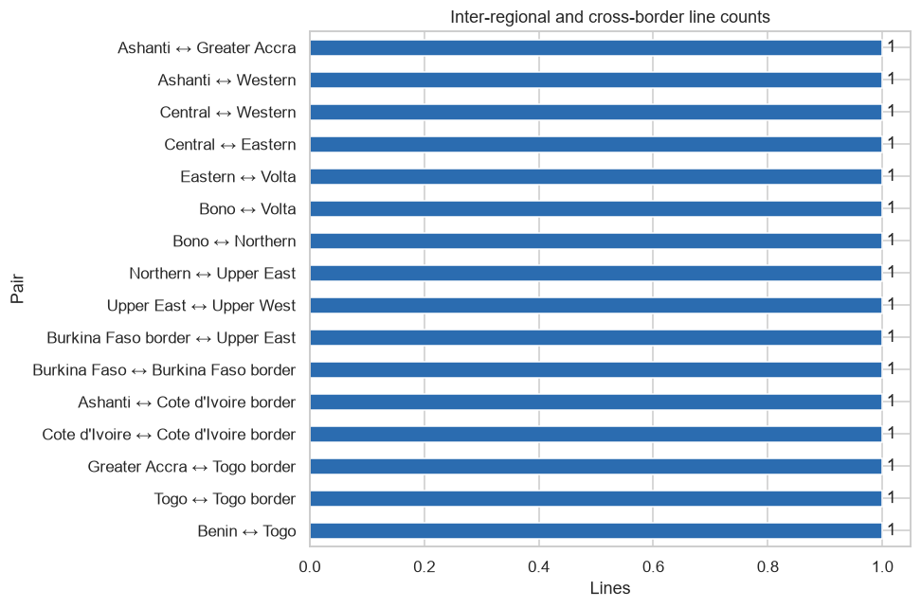
Every inter-regional corridor is a bridge
Each corridor = one line = one bridge: no alternative route between any two regions
Interactive layers: substations by voltage, lines by status, lines by utility (Folium)
Streamlit dashboard: overview, filterable network, capacity map, N-1 ranking
Line lengths verified against coordinates - routing factor 1.05-1.30, none impossible
Structural proxies on synthetic data - where a real power-flow study would look first, not operational findings.
Notes:
Merged-data analysis found each region pair joined by exactly one line; the bridge analysis confirms all 16 inter-regional corridors are bridges - redundancy exists inside regions and nowhere between them. That is the clearest investment signal this analysis can produce. Everything lands in an interactive Folium map and a four-tab Streamlit dashboard - live demo at the end.

Slide 10
COMPONENT 2
GridCare-Lite
The outage-to-resolution workflow as a desktop application - four roles, one audit trail.
Notes:
Section handoff to the GridCare presenter.

Slide 11
Four roles, one workflow, rules in one place
Engineer
Administrator
Technician
Customer service
logs outages against real substations, with severity
creates work orders, assigns technician + date
sees only their own queue; starts and completes work
logs complaints, links them to known outages
Outage lifecycle
Open
In Progress
Resolved
Enforced, not suggested
engineer reports
technician starts
work completed
Illegal transitions are refused with the allowed states named. Completing a work order resolves its outage in the same step - the two records can never disagree. Every change lands in status_history: who, when, old, new.
Work order
Pending
Scheduled
Completed
admin creates
technician + date
resolves the outage
Notes:
Design decision worth defending: the GUI never touches SQL. Every operation goes through services.py, which re-checks the caller's role and the legal status transitions - hiding a button is presentation, the service check is the security. Substations come from the component-1 cleaned data, so an outage physically cannot reference an asset that does not exist.

Slide 12
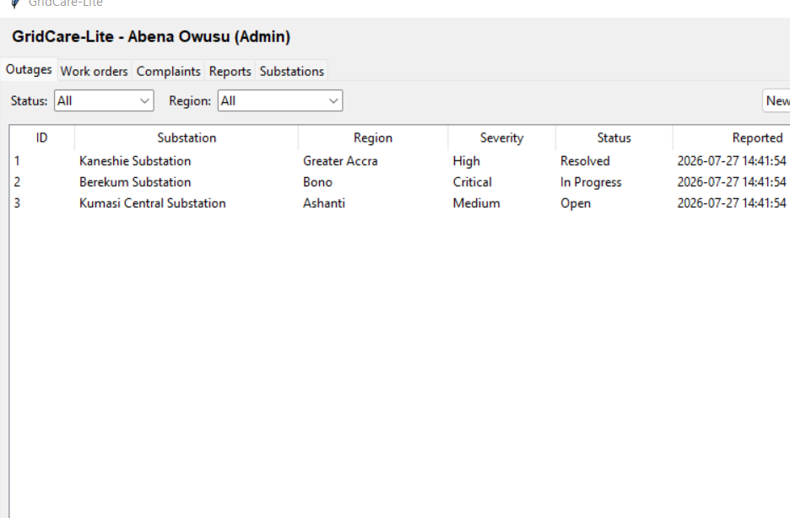
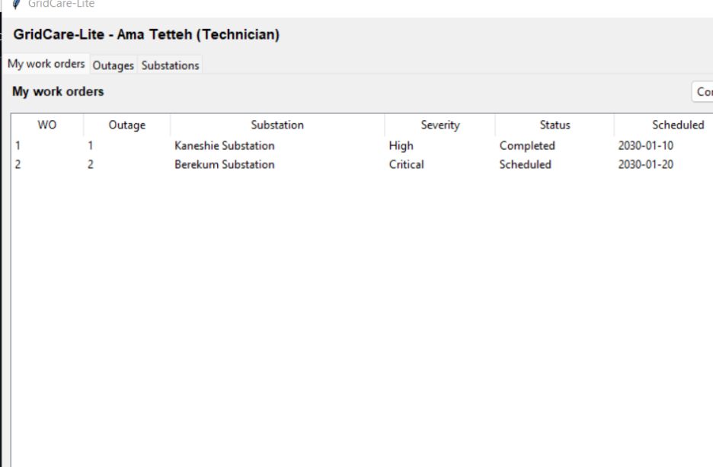
The same system, seen by two roles
Administrator - all outages, five tabs
Technician - own queue only, three tabs
Notes:
Left: the admin sees five tabs and every outage. Right: technician Ama sees three tabs and only her own two work orders - the filtering is in the service layer query, not the widget. Acting on someone else's order by id is refused too, and there is a test for exactly that.

Slide 13
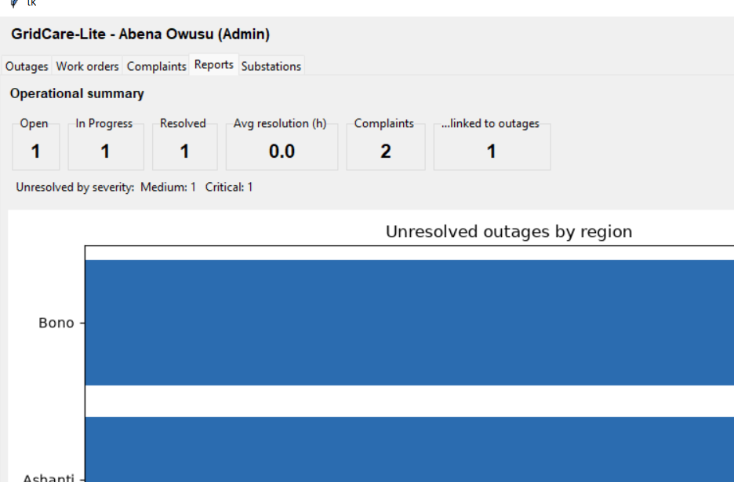
Reports that move, errors that explain
Open / In Progress / Resolved counts, unresolved by severity and region
Average resolution time from the audit timestamps (27.0 h on seeded data)
Duplicate guard: second outage on a substation asks 'separate incident?'
Dates validated properly - 2026-13-45 and yesterday both refused
Every failure path shows a message; nothing crashes the app
Notes:
Reports recompute from the database every time the tab is shown - resolve an outage and the numbers move. The error cases are demo material: duplicate outage warning with an are-you-sure, invalid dates including 2026-13-45, completion without notes refused, wrong technician refused.

Slide 14
COMPONENT 3
ClinicCare-Lite
Clinic administration on the web - where the hardest requirement is what the system must never do.
Notes:
Section handoff to the ClinicCare presenter.

Slide 15
Administrative by design - never diagnostic
The system says
The system never says
"The 'Systolic' column is missing."
"The date field is empty on row 4."
"Submission received - on time."
"Reviewed - Needs Follow-up. Notes from your clinician: ..."
"Your blood pressure is dangerous."
Any interpretation of a submitted value
Any score, grade or risk rating on health data
Any comparison of one patient with another
Categorical review outcomes - Pending · Reviewed-Normal · Needs Follow-up · Escalated - set only by the clinician, never computed. A numeric grade is rejected as invalid (tested).
Notes:
The brief makes this a hard requirement and the rubric enforces it: a system that interprets health data loses the marks regardless of code quality. Our boundary is testable: review outcomes are categorical and a numeric grade is rejected as invalid; the completeness checker has no code path comparing a value to a threshold - a test submits an alarming reading and asserts silence.

Slide 16
Architecture: access control lives in one file
Browser
Routes
guards.py
Models
Bootstrap + client-side validation
auth · clinician · patient
roles + ownership
entities
utils/
email
JSON store
validators · files · completeness · analytics
dry-run outbox / SMTP
atomic writes
Patient A requesting patient B's record: 404 - existence not confirmed (tested)
Wrong role on a URL: 403; no session: redirect to login (tested)
Uploads: .txt/.csv/.pdf only, 5 MB cap, renamed patientID_taskID.ext, path-traversal refused
Secrets only from .env; the app refuses to start without a real secret key
Notes:
Three Flask blueprints; every data touch goes through guards.py - two role decorators plus ownership helpers. Foreign records 404 rather than 403, so a response never confirms a record exists. Storage is JSON per the spec, behind a store module doing atomic temp-file-and-replace writes under a lock - covers the truncation bug the brief warns about, plus crash safety.

Slide 17
Submit → check → review → notify
1 · Assign
2 · Submit
3 · Review
4 · Notify
clinician creates task, patients notified
upload checked: type, size, structure
categorical outcome + notes
dashboard, inbox and email
Rejected with reasons: "The 'Systolic' column is missing. Fix the issues above and submit again - nothing was stored." Structure only, meaning never.
Appointments: booked by the clinician, reminded once 24 h ahead (send_reminders.py), attendance drives analytics
Messaging: pairwise threads, 5-second polling, permanent 'not monitored - not for emergencies' notice
Announcements: publish/expiry dates, urgent ones also emailed to every patient
Notes:
The completeness check runs on the raw bytes before anything is stored - an incomplete file is rejected with the exact problems named and nothing persists. Every step notifies in-app, with email alongside (dry-run outbox in demos). Resubmission allowed before review and flagged; locked after.

Slide 18
Privacy engineering, not privacy promises
Private engagement
Aggregate analytics
Scoped access
+10 EP on-time submission, +5 attendance
Streak resets on a late submission
Owner-only page - no ranking API exists
Test asserts no leaderboard function
Completion rate, pending reviews, turnaround
No-show rate by week from attendance
No patient id or name on the page (tested)
Patients see their own history only
Foreign records 404 - existence hidden
Threads strictly pairwise
Inbox returns recipient-only mail
Clinician limited to own clinic's patients
Notes:
Three deliberate designs. Engagement: points and streaks are visible only to their owner - the module has exactly one read function and a test asserts no leaderboard-shaped API exists; the brief's rationale: ranking patients leaks who is keeping up with their care. Analytics: clinic aggregates only, no patient named - asserted in a route test. Access: ownership helpers make cross-patient reads unreachable, and unknown records are indistinguishable from forbidden ones.

Slide 19
134 automated tests, negative cases first
Every item on the brief's test lists mapped to a named test
Validators proven against planted defects - orphaned line, swapped coordinates
Security as assertions: cross-patient 404, wrong-role 403, pairwise-only threads
Boundary as a test: alarming health value passes the checker with zero comment
Manual GUI pass on top - which is what caught the path-separator defect
Notes:
Strategy: rules live in a logic layer, so most tests hit that layer directly; route tests then verify the web boundary - status codes and who can reach what. More failure-path tests than happy-path throughout, because the rubric's test lists are about invalid input and unauthorised access. Fresh state per test: in-memory SQLite for GridCare, temp-dir JSON stores for ClinicCare.

Slide 20
Defects we found, and what found them
Found by writing a test
Found by walking the UI
Found by writing the report
D1 - misleading error order
D2 - Windows path separators
D5 - number typed from memory
Starting an unassigned work order said 'assigned to a different technician'. Status check now runs before ownership; the message names the real problem.
Stored submission paths used backslashes - display broke, JSON non-portable. Invisible to tests; obvious in the browser. Paths now stored POSIX-style.
Prose said 13 inter-regional lines; computed value is 16. Every number in prose must come from output - corrected and logged.
Notes:
Six defects logged with causes, fixes and retests. The point of this slide: three different nets caught three different bugs - tests, walking the real UI, and writing the report. Each catch is exactly the reflection material the rubric asks for.

Slide 21
How we worked, and what we'd say honestly
Process
Limitations
Branch per feature, pull requests, one review before merge
Commit messages that explain the why - the history reads as a build log
Reports, diagrams, test plan and user guides live in docs/, versioned with the code
Seeded data + pinned requirements: identical setup on every machine
All grid numbers synthetic - structural proxies, not operational findings
JSON storage has no indexing; the store interface was designed for a SQLite swap
Polling, not WebSockets, for messaging - the spec allowed either
Email exercised in dry-run; live SMTP deliberately kept out of coursework
Notes:
Left: the working process - feature branches and PRs with one review, meaning commits, the docs pack in the repo, everything reproducible from clone to demo. Right: limitations stated plainly - the rubric rewards knowing them. Future work: SQLite behind ClinicCare's store interface, real load data for the grid, appointment self-scheduling.

Slide 22
LIVE DEMO
From outage to resolution, from task to review
GridCare-Lite: engineer → admin → technician → resolved · ClinicCare-Lite: assign → submit → review → notified
134
3
6
tests passing
working systems
defects logged & fixed
Notes:
Hand off to the live demo. Good closing line before questions: three systems, one discipline - rules in one place, tests before screens, and honesty about what synthetic data can and cannot say.

