Slide 1
Music Wrapped
An interactive music-discovery system with K-means personality archetypes
and cosine-similarity recommendations.
Jesse Boakye · Kenneth Son · Luis Zarate · Ralph Lewis
CPTS 315 — Data Mining · Spring 2026 · Washington State University

Slide 2
Beyond "top 10 similar songs"
Why pair a content-based recommender with a Wrapped-style report?
• Most class-project recommenders stop at a ranked list of similar songs.
• Spotify Wrapped became a cultural moment because the presentation of audio analytics is engaging — not because the underlying recommender is novel.
• We pair a content-based recommender with a six-slide "Wrapped" report — mood, archetype, audio DNA, recs, hidden gems.
• Forces a complete data-mining pipeline: preprocessing, EDA, clustering, similarity, evaluation.
STATEMENT OF THE QUESTION
Can a content-based system using K-means archetypes and cosine-similarity ranking produce a recommendation experience that is:
• algorithmically defensible — better than random on standard offline metrics?
• interpretable to a non-technical audience?
• worth shipping as an interactive demo?
2 / 12

Slide 3
Dataset & technology stack
Spotify Music Dataset (Kaggle) — static catalog, no API calls, content-based by necessity
4,494
8
26
~20 KB
tracks after dedupe + clean
shared audio features
playlist-source genres
persisted personality model
MODELING FEATURES (MIN-MAX SCALED)
danceability · energy · valence · acousticness · instrumentalness · speechiness · tempo · loudness
STACK
• Python · pandas · NumPy · scikit-learn — preprocessing, K-means, PCA, cosine similarity, silhouette
• matplotlib · seaborn — EDA + report figures
• Streamlit · Plotly — interactive single-page demo with cached data + artifact loading
• joblib — persists scaler + KMeans + label map (`personality_v1.joblib`, ~20 KB)
3 / 12

Slide 4
End-to-end pipeline
Seven phases — every stage feeds a Wrapped slide
1
Preprocess
Concat 2 CSVs · dedupe by track_id · MinMax scale 8 features
2
EDA
Distributions · correlations · genre balance · mood quadrants · PCA
3
Cluster
K-means K=2..10 · two tracks (raw vs PCA-6) · pick K=6
4
Recommend
User profile = mean(seed) · cosine sim · α=0.95 popularity blend
5
Mood
Rule-based valence/energy thresholds (0.6 high / 0.35 low)
6
Hidden gems
Top-decile similar · adaptive popularity ceiling · disjoint from recs
7
Demo
Streamlit single-page app · 6 sequential Wrapped slides
4 / 12

Slide 5
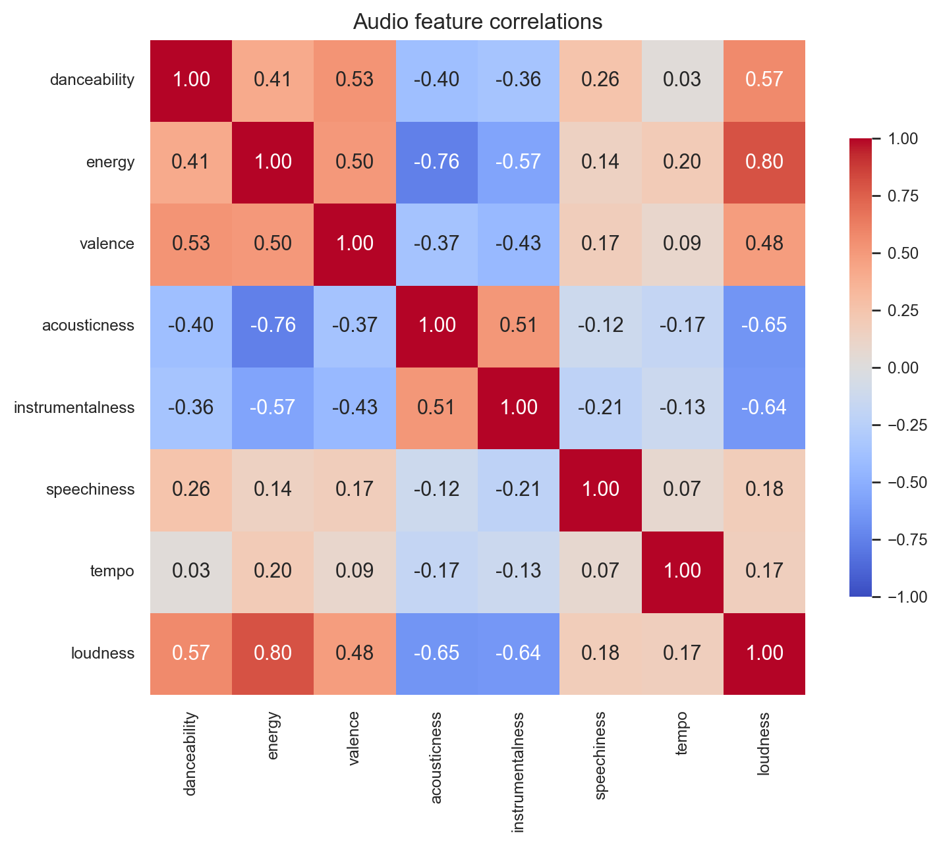
EDA findings shaped the rest of the pipeline
Three decisions came directly from looking at the data
01
Strong feature redundancy
energy ↔ loudness ρ = 0.80 · acousticness ↔ energy ρ = -0.76. Six PCA components hit 95% variance — motivates the PCA-vs-original clustering experiment.
02
Genre-skewed catalog
Top 7 genres hold 300–560 tracks; sparse genres (disco, soca, mandopop) under 30. Bucketed into "other" for evaluation to avoid tiny-sample noise.
03
Mood threshold tuning
Valence × energy quadrants populated, but the textbook 0.5 split left low-energy/high-valence sparse. Retuned to high ≥ 0.6, low-valence < 0.35.
Audio feature correlations (8×8)
5 / 12

Slide 6
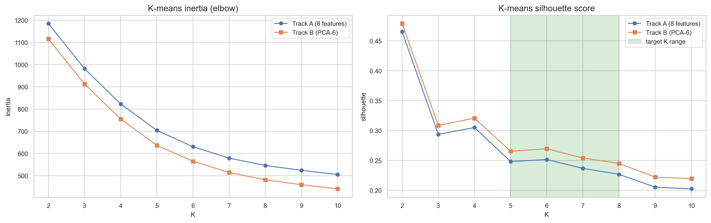
Choosing K — two-track experiment
K-means on original 8 features (Track A) vs 6-component PCA (Track B), K = 2..10
DECISION RULE
• Pure silhouette peaks at K=2 — useless for archetype labels.
• Restrict to K ∈ [5, 8] (plan target).
• Drop any K with a cluster < 2% of catalog.
• Pick highest silhouette in the band.
• If two tracks within 0.02 silhouette: prefer Track A for interpretability.
WINNER
K = 6, Track A
Elbow + silhouette across K. Highlighted band = demo target K ∈ [5, 8].
Silhouette 0.252 ± 0.0001 across 5 random seeds — stable.
6 / 12

Slide 7
Six music personality archetypes
Manual labels driven by centroid feature profiles + per-cluster top-genre composition
01
02
03
Lofi Wanderer
Night Driver
Life of the Party
high acoustic + instrumental, low energy. Lofi · jazz · world.
low-acoustic, high-energy, low-valence. Moody mainstream.
highest danceability + valence + energy. Latin · pop · hip-hop.
04
05
06
The Old Soul
The Sonic Architect
Acoustic Storyteller
very low energy, very high acoustic + instrumental. Wellness · classical · ambient.
electronic instrumentals · deep house. "Here for the production, not the lyrics."
vocal acoustic mid-tempo. Latin · ambient · pop classics.
7 / 12

Slide 8
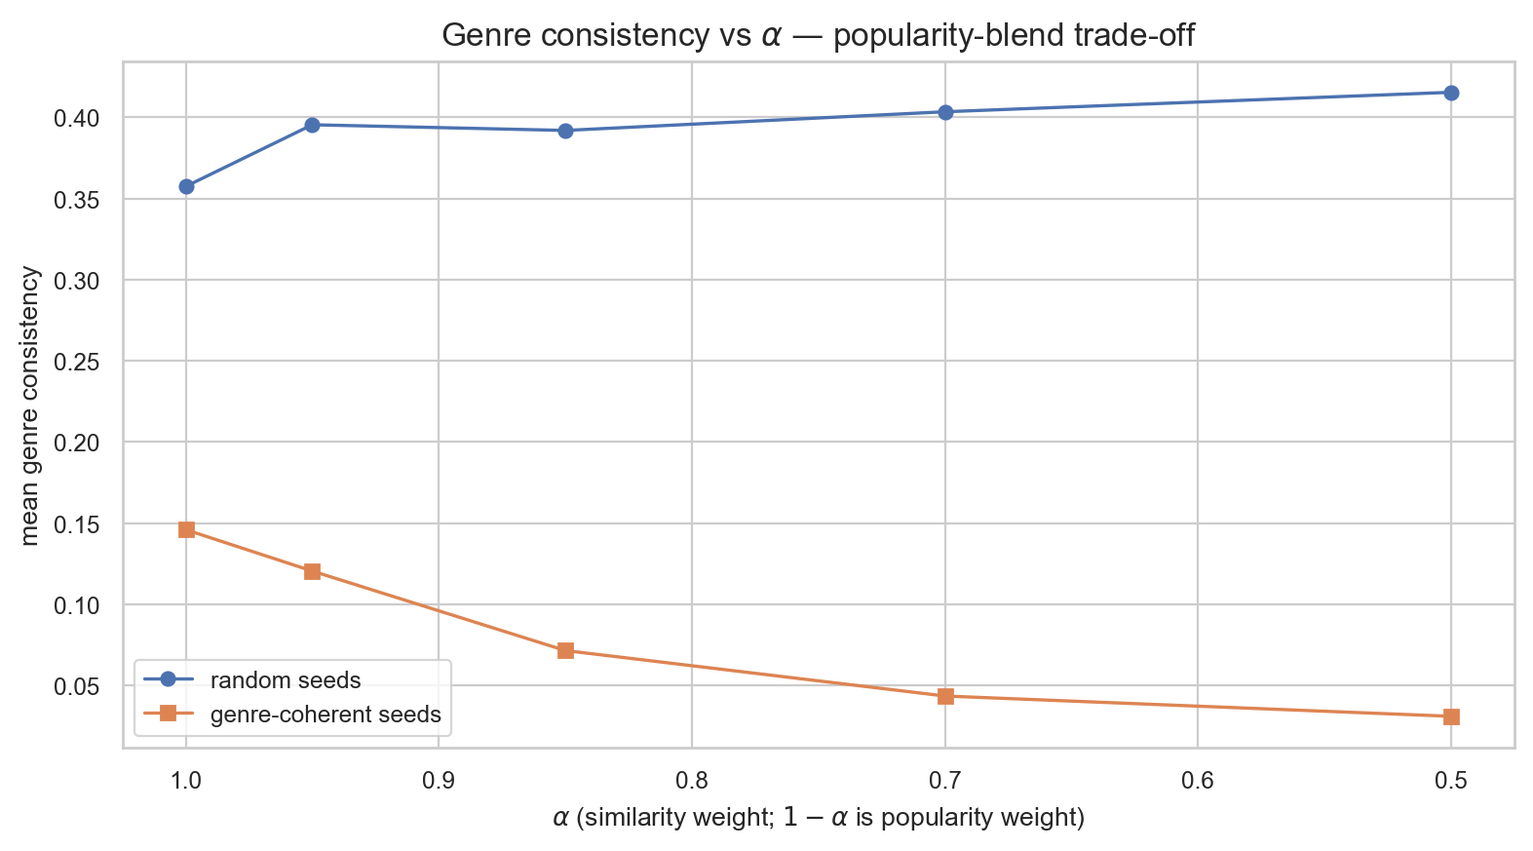
Recommendation engine
Cosine similarity to the user's average profile, with a small popularity nudge
BLENDED SCORE
final(t) = α · cos(t, x̄) + (1-α) · pop(t)/100
x̄ = mean of seed audio features · cos = cosine similarity · pop = Spotify popularity in [0,100]
α = 0.95
Genre consistency vs α — focused users lose 47% relevance going 1.0 → 0.85.
Why α = 0.95 (not the textbook 0.85): alpha sweep showed α=0.85 cuts genre consistency from 0.16 to 0.08 for focused users — a 47% loss. α=0.95 keeps a small popularity nudge for cold-start without crushing relevance.
8 / 12

Slide 9
Streamlit demo: six Wrapped slides
`streamlit run app/streamlit_app.py` — single-file, single-page, sticky picker at top
SLIDE 1
SLIDE 2
SLIDE 3
Music in Numbers
Your Mood
Music Personality
Counts, top genres, top artists from the user's selection.
Mood label + valence/energy scatter against catalog backdrop.
Archetype label + cluster centroid radar.
SLIDE 4
SLIDE 5
SLIDE 6
Audio DNA
Top Recommendations
Hidden Gems
User profile vs. catalog mean — dual radar.
Ranked table with similarity progress bars.
Lower-popularity matches with similarity + popularity bars.
Catalog + personality artifact loaded once via @st.cache_resource · per-track genre hidden from rec/gems tables (dataset's playlist_genre is noisy)
9 / 12

Slide 10
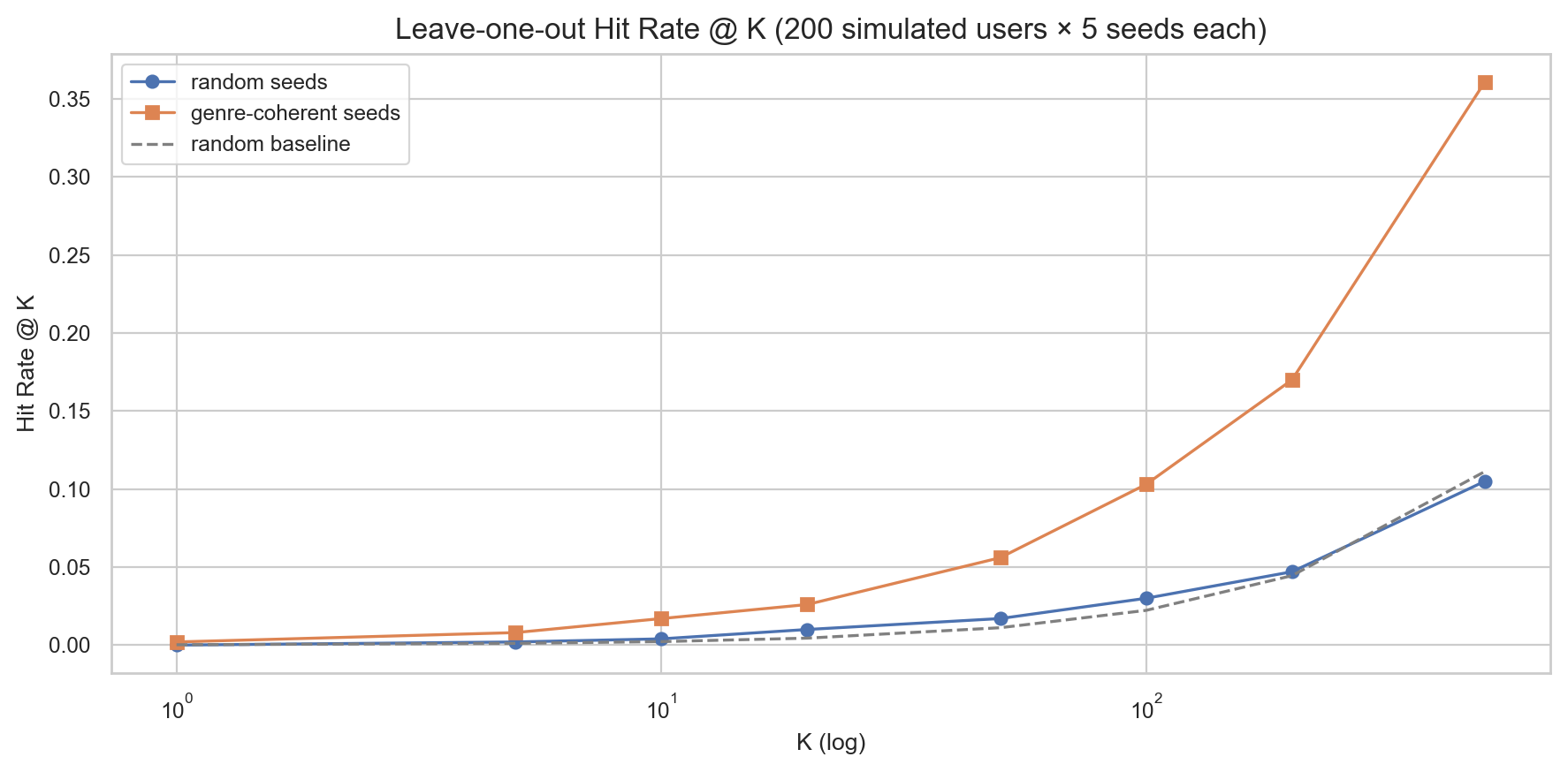
Evaluation — leave-one-out + metric comparison
200 simulated users × 5 seeds = 1,000 LOO trials per strategy
HEADLINE NUMBERS — GENRE-COHERENT SEEDS
Hit @ 10
8× random baseline (0.2%)
1.6%
Median rank
2.4× better than random (2,247)
950 / 4,494
MRR
vs ~0.001 for random seeds
0.0104
Hit Rate @ K (log scale) — genre-coherent vs random vs baseline.
Recovered similarity
rank inflation = dataset density, not model failure
0.936
10 / 12

Slide 11
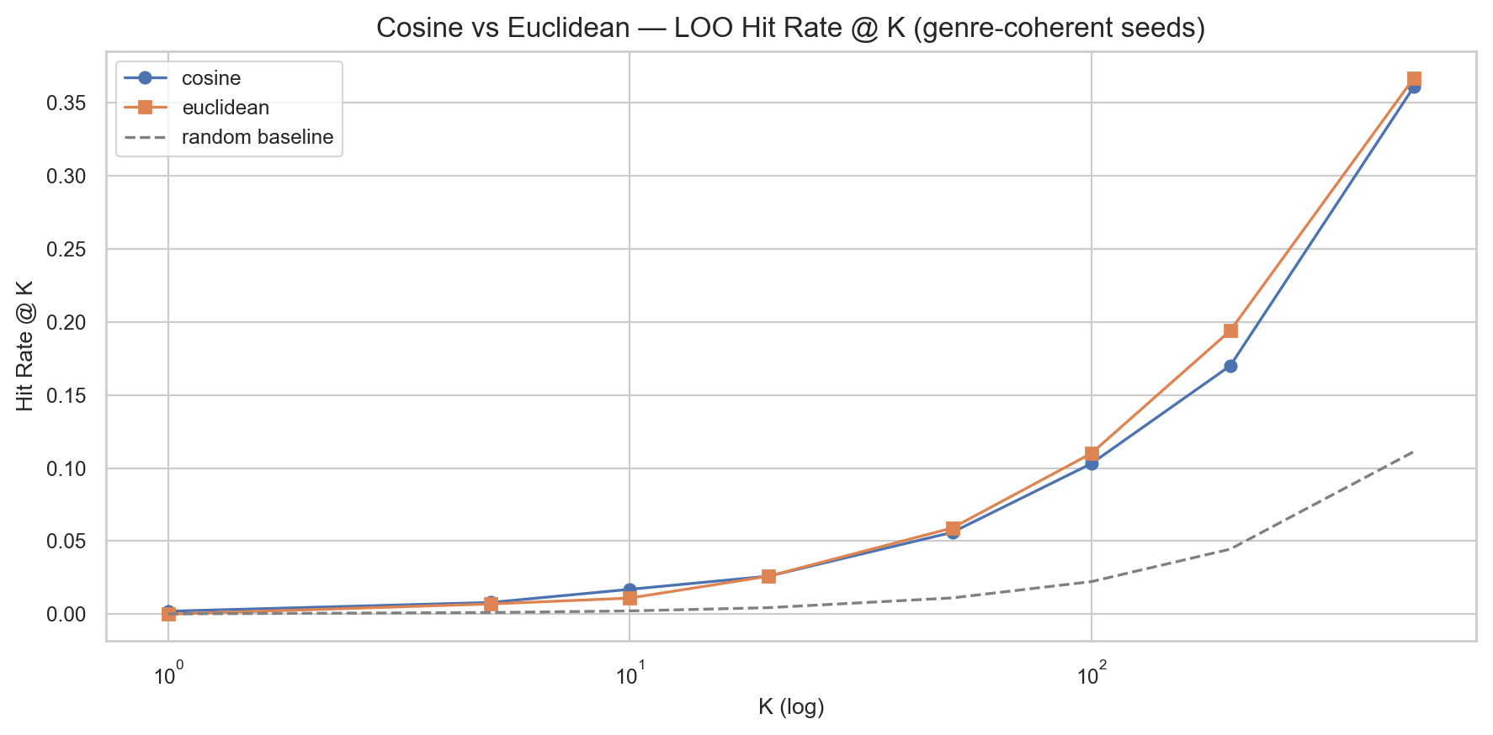
Cosine vs Euclidean — closing Phase 6
Same 1,000 LOO trials, two ranking metrics
WINNERS BY METRIC
metric
cosine
euclidean
winner
Hit @ 5
0.012
0.010
cosine +20%
Hit @ 10
0.016
0.014
cosine +14%
MRR
0.0104
0.0094
cosine +11%
Hit @ 50
0.066
0.072
euclidean +9%
Median rank
951
989
cosine
Hit Rate @ K (log scale) — cosine and Euclidean track closely.
Decision: keep cosine. Precision wins where users actually look (top of the list), and the directional-similarity story is cleaner.
11 / 12

Slide 12
Limitations · future work · thank you
WHAT'S HONEST ABOUT THE LIMITATIONS
FUTURE WORK
• No user behavior data — content-based by necessity.
• Dataset density: 4,494 tracks in [0,1]⁸ make absolute Hit@10 small (~1.6%).
• playlist_genre is noisy — the same song appears under different labels per source playlist. Hidden from per-track display.
• K-means and cosine treat all 8 features equally.
• Weighted cosine — variance-inverse over the seed selection.
• GMM personality — soft labels ("60% Night Driver, 30% Lofi Wanderer").
• Mood trajectory playlists — calm → upbeat sequencing.
• Popularity-residual hidden gems via regression.
• Live Spotify API integration with 30s previews.
Thank you · Questions?
github.com/jesseboakye/315FinalProject

