Slide 1
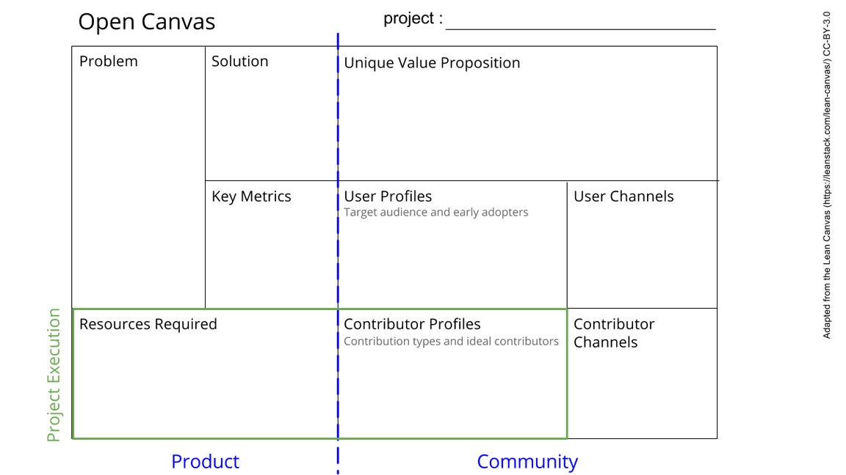
Cavendish torsion balance
-We want to measure Newton’s gravitational constant (G)
-We want to prove it is possible to do a reasonably complex measurement in the station
Do Cavendish experiment
Comparison with literature value.
Consistency of result.
-Heavy Balls
-Torsion Balance
-Laser, mirrors, optic path
-Camera/optic sensor
-Vibration free space
-Some T control if vibrations low enough
-Vacuum would improve accuracy
See next slide for instructions!
Notes:
Go to File > Make a Copy… to make your own canvas
See next slide for instructions

Slide 2
