Slide 1
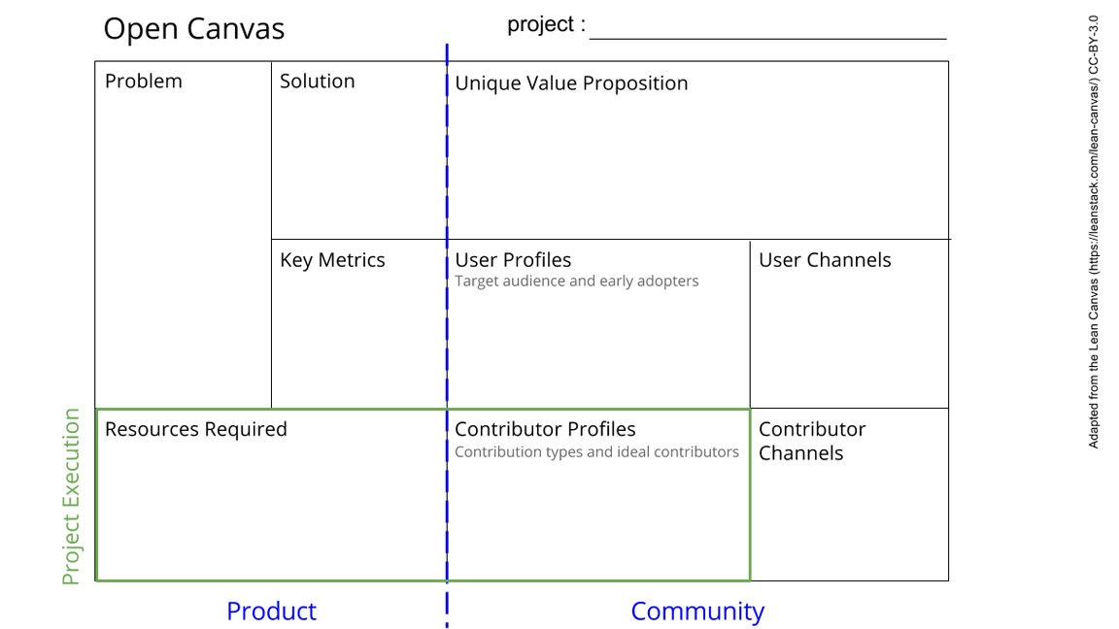
PTB (Prep The Box)
We want to conduct experiments of grid in the box.
The box is not yet suited for conducting experiments. It has no power supply and no system control and the box is not wind and water tight
We want to prep the box for all the components and the experiment you want to conduct.
We will make the box earth, wind and water tight and make sure that all elements are standardized
We offer a standardized off grid lab that each researcher can either fill with its own experiments and support modules. It is completely modular and can be used in many different ways.
Spray it with water,
Measure mag. Field in experiment box.
Measure temperature w.r.t. the outside. Check if modules can be switched around
N.v.t.
The users are the fellow students in the building process. The final product can be widely used by experimental physicists.
Rails or other suspension system, Isolation material, Magnetic isolation. A solid outside shell. Pointy roof. Proper (slide) door.
We will mainly contribute ourselves, with additional help from the experts and our mentor. The other groups will contribute by setting their requirements for their components
We will discuss in class or approach experts by mail or in person.
See next slide for instructions!
Notes:
Go to File > Make a Copy… to make your own canvas
See next slide for instructions

Slide 2
