Slide 1
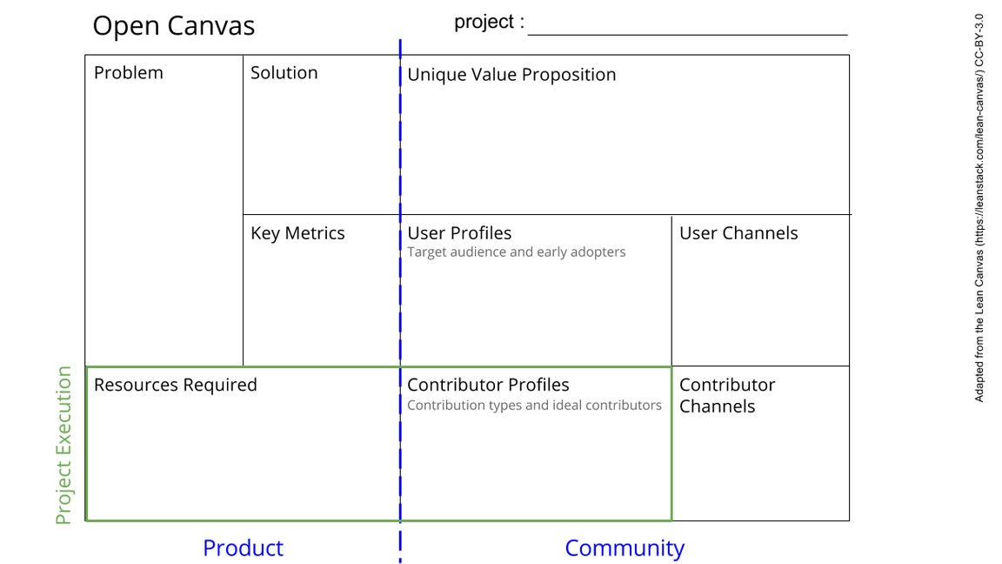
Temperature Controller
The experiments usually operate normally at specific temperatures so the measurements can be easily affected by this factor
Control and stabilize the temperature as well as to measure it
Solving the problem of the impact of wrong temperature on the experiments
Never worry again about not having the appropriate values because of the temperature of the environment in which the experiment happens.
Accuracy of the measurement
Range of adjustment
By making possible users understand the importance of the product
For those who are interested in knowing the exact temperature when making experiments and desire a stable one.
Arduino, Temperature Sensor(s), breadboard, Resistors, wires, diode, possibly batteries, alligator clips, transistor, LED, Thermoelectric Cooler Module
Someone who is involved with electronics and can help us with the material.
By the success and the demand of the product
See next slide for instructions!
Notes:
Go to File > Make a Copy… to make your own canvas
See next slide for instructions

Slide 2
