Slide 1
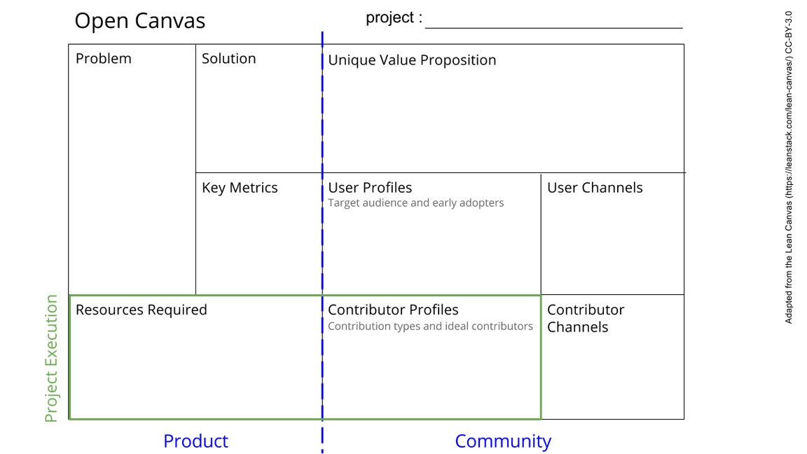
Hardware
Outline the parts of experiment(s)
->Collecting whats needed,
wire the sub and central facillities
You shall not worry about transferring and saving data (in combination with software group that is).
Collecting input and output ideas of other groups and make them compatible
Collecting/structure the ideas of the Cohort
Provide the hardware for data transfer/display
Install the hardware
The data transfer has to work (use dummy data file for testing). Maybe test transmission speed /bandwidth
-Discuss with software group for hardware reqs.
-Software group
-Experimentalists
Your subproject informations,
Wires (…),
Rasperry Pi, SD, Software, Screen
-Power supply, box design, environment control groups
-Experimentalists (???)
-Discuss with relevant groups, so basically everyone (?)
-Creating a list of general questions
See next slide for instructions!
Notes:
Go to File > Make a Copy… to make your own canvas
See next slide for instructions

Slide 2
