Slide 1
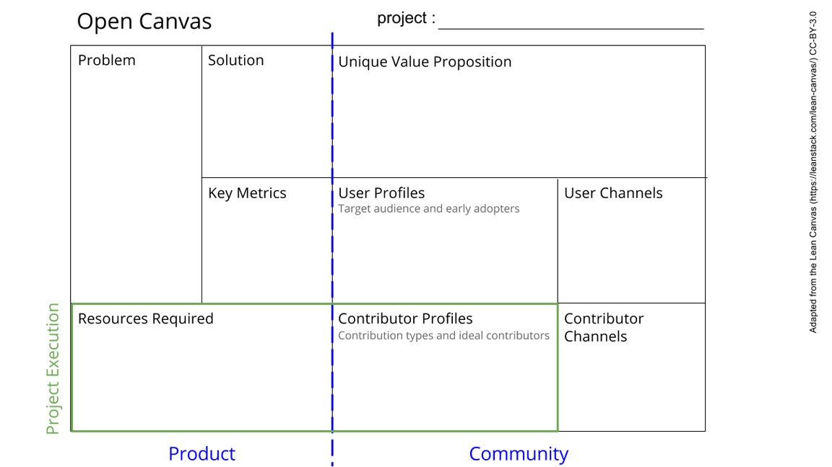
Hardware
Outline the parts of experiment(s)
->Collecting whats needed,
wire the sub and central facillities
Collecting/structure the ideas of the Cohort
Provide the hardware for data transfer/display
Install the hardware
The data transfer has to work
Your subproject informations,
Wires (…),
Rasperry Pi, SD, Software, Screen
See next slide for instructions!
Notes:
Go to File > Make a Copy… to make your own canvas
See next slide for instructions

Slide 2
