Slide 1
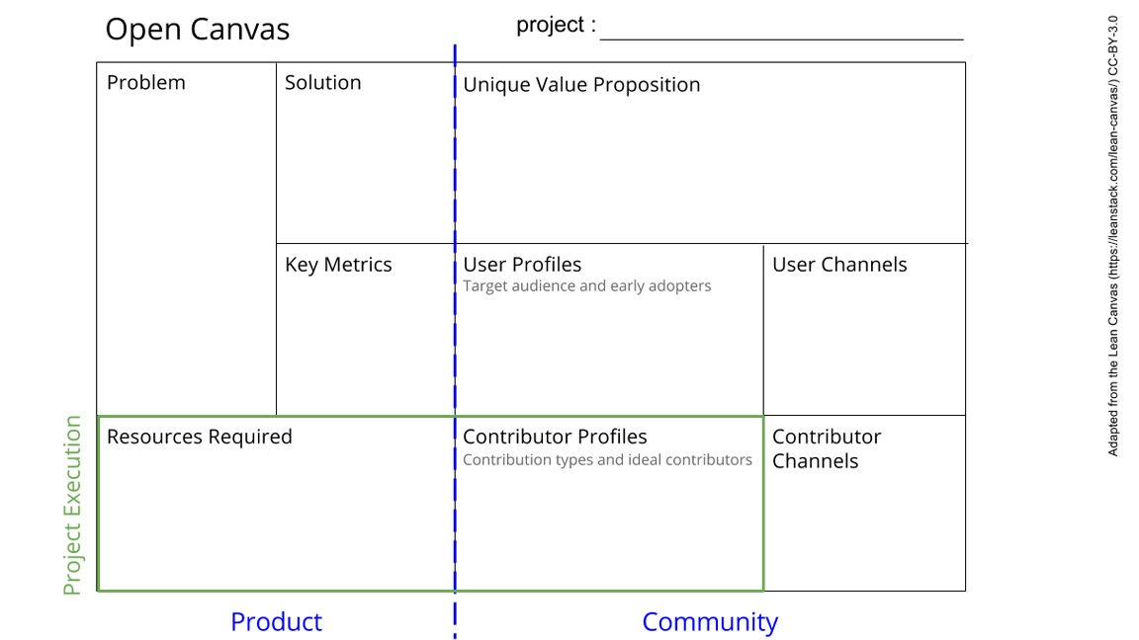
Power supply
Stable, off-grid
power supply
Voltage control
AC/DC?
(flexibility)
Solar panel +
battery + vc
Open source simple hardware setup for solar power supply
Difference made: small scale and mobile solution
Power output
/load
Stabilty
size
Presenting our project
to the cohort on GitLab
and Teams
People who want to do off-grid science
In this project: Devices from other
sub-projects
Solar panel, battery, voltage control
Expertise: Dante Killian, electronics open source material
Input: requirements of other projects
Electronics expert (Dante Killian)
Open sourced project shared with cohort
Teams chat with experts
See next slide for instructions!
Notes:
Go to File > Make a Copy… to make your own canvas
See next slide for instructions

Slide 2
