Slide 1
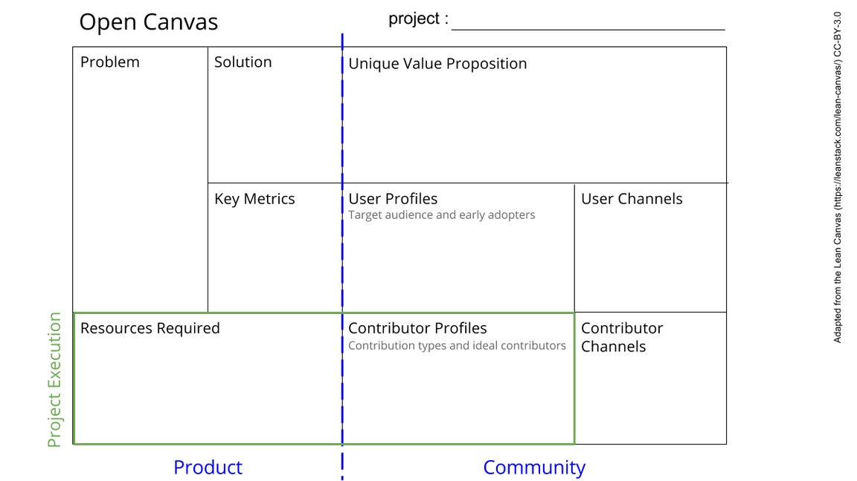
Sample preparation module
Preparing samples off-grid without contamination.
Toxic fumes that are released during sample preparation.
Airtight sample box, perhaps with a window with gloves so the box does not have to be opened while working.
Ventilation to carry away fumes.
Clean and easy sample preparation without having to access a lab
Measuring the airflow.
Having multiple experiments in the box that need sample preparation.
Asking users for improvements.
Users of the ‘big box’ that have to prepare a sample for their experiment.
Ventilator, airtight lock & tape, building material, retractable pipe, power cord, lamp, glass/plastic window, gloves, power strip for inside.
Expertise: basic construction, power circuit, lab-user
Hardware: drill
Someone that regularly prepares samples that can give the minimal requirements.
Handyman
Reaching out to experts.
Making the design open-source.
See next slide for instructions!
Notes:
Go to File > Make a Copy… to make your own canvas
See next slide for instructions

Slide 2
