Slide 1
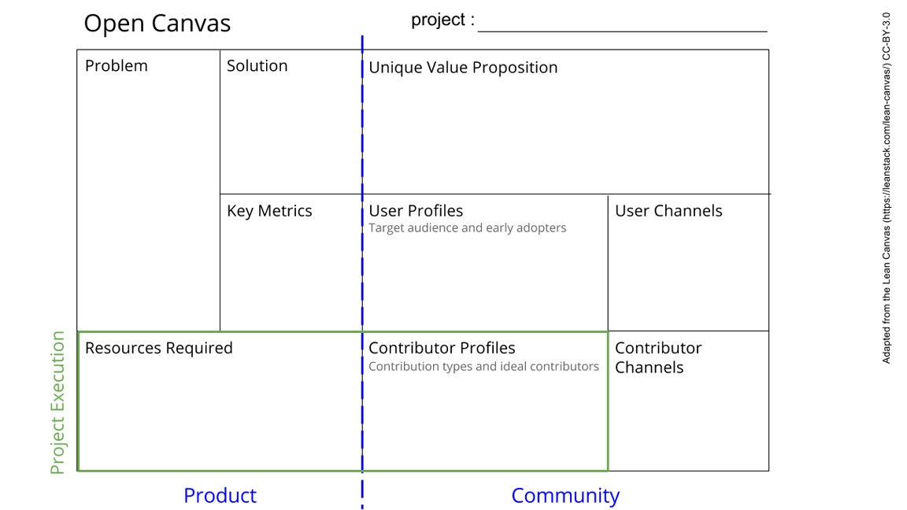
See next slide for instructions!
Notes:
Go to File > Make a Copy… to make your own canvas
See next slide for instructions

Slide 2
