Slide 1
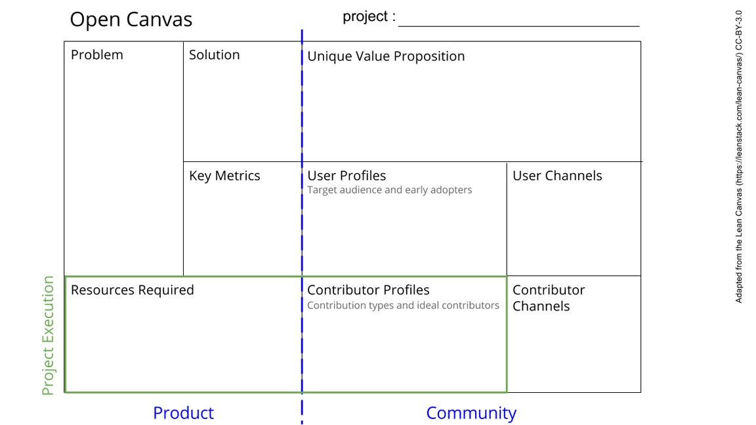
Software by Nikita, Jonno, Ravi
The raw data from the sensors is not processed
The processed data is not displayed
There is no way to control the sensors
Make an intuitive UI that shows the current sensor values and can send data to sensor
The interface allows users to actually use the experiment box. It will make the product a low
The data is correctly displayed and devices can be controlled. Tested with artificial data stream..
A display
A raspberry pi (or another device)
An SD card for storage
Data from the sensors
Python expert/raspberry pi expert
See next slide for instructions!
Notes:
Go to File > Make a Copy… to make your own canvas
See next slide for instructions

Slide 2
