Slide 1
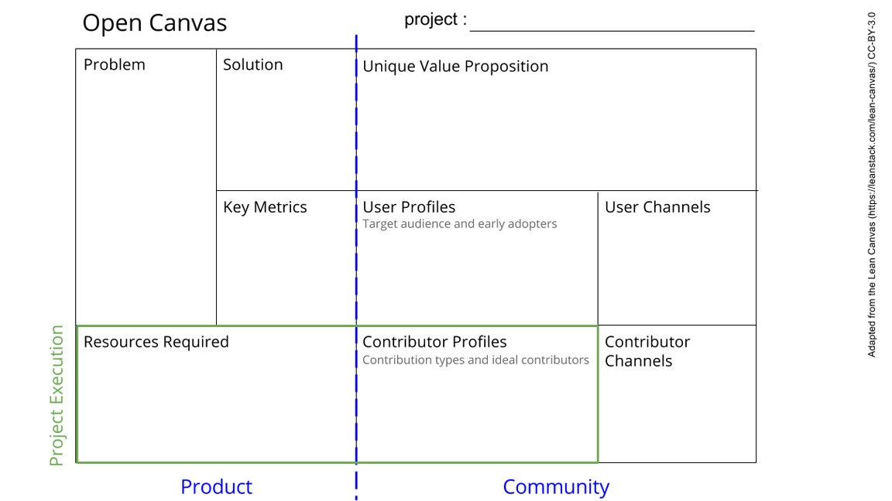
Hardware
Outline the parts of experiment(s)
->Collecting whats needed,
wire the sub and central facillities
-For the box to function as intended in its entirety, data transfer between measurement stations/sensors needs to be transferred to a central place for display/extraction
-Input and output ideas of other groups need to be considered and made compatible
Collecting/structure the ideas of the Cohort
Provide the hardware for data transfer/display
Install the hardware
The data transfer has to work, with an adeque number of inputs (decided by input of other groups). Transfer speed/bandwidth should be tested. Signal-to-noise ratio should be minimilized.
-Discuss with software group for hardware requirements
-Software group
-Experimentalists (both other groups and general users of the off-grid measurement station)
-Information on other subprojects,
-Electrical wires, means of shielding or differential signalling, microcontroller (raspberry pie).
-Input from mentor (Kira) and (possibly) Dante (expert)
-Power supply, box design, environment control groups
-Groups designing experiment modules
-Discuss with relevant groups with
-A general list of questions for data input groups
See next slide for instructions!
Notes:
Go to File > Make a Copy… to make your own canvas
See next slide for instructions

Slide 2
