Slide 1
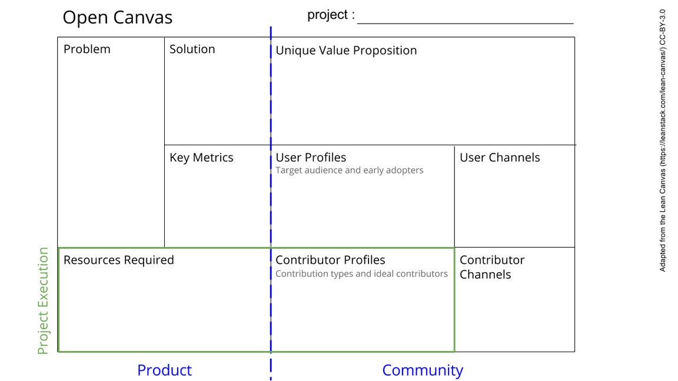
Software by Nikita, Jonno, Ravi
The raw data from the sensors is not processed
The processed data is not displayed
There is no way to control the sensors
Make an intuitive UI that shows the current sensor values and can send data to sensor. It should also be able to save the data for analysis.
We will make sure that even people that do not have programming experience or knowledge can still use our device.
Our project will also greatly simplify the use of the box.
It is also needed to connect the different parts of the box to be able to do a cohesive measurement.
The data is correctly displayed and devices can be controlled. This can be tested with artificial data stream.
You should be able to use the interface with very minimal training. (no programming knowledge needed, only a small one page explanation about the program)
They have basically no other options apart from writing a program themselves. What we should do is make a program that is good enough that they will not want to write their own.
Our early adopters will be the people that build the sensors. They will rely on our interface to do measurements. The final users will be the people that make use of the measurement station. They will need it to controll the device and make actual use of it.
A display and raspberry pi (could also be combined as an external laptop)
Data from the sensors
Python knowledge about GUIs and controller
Know which protocols are used
Packages for those protocols and labphew package
Power supply for raspberry pi or to (slowly charge laptop)
The contributors will be people on the internet that made open source packages.
Ideally, a contributor has extensive programming knowledge and has worked with interfacing before.
The other contributors will be the people that provided the data and hardware.
Once people want to introduce new sensors, our program should be good enough to build upon. This way they will not have write their whole thing from scratch but can use/edit/incorporate our program.
See next slide for instructions!
Notes:
Go to File > Make a Copy… to make your own canvas
See next slide for instructions

