Slide 1

Defense in Depth for Operations!
So much to say... limit this to a few approaches based on my view of budget and impact.
...
Source picture: Black Hills Info Security
Notes:
Polleverywhere:
https://pollev.com/jessefmoore821
Spreadsheet of Tools/Projects:
https://docs.google.com/spreadsheets/d/1PLm37YWcV9dAwEAPx5p71aL2DtW3wJBzwRfMjdetcwQ/edit?usp=sharing
Verizon DBIR: 2022-data-breach-investigations-report-dbir.pdf (verizon.com)

Slide 2
Disclaimer
Following presentation contains my thoughts, ideas and opinions. They do not represent those of my current or past employers.
Any events, characters and company depicted in the course of this presentation are purely fictitious. Any similarity to actual events, characters and company is merely coincidental. <-Like South Park!
Do not use these tactics/techniques presented for evil.
Notes:
Example of Disclaimer:
CISA Compiles Free Cybersecurity Services and Tools for Network Defenders | CISA
This is not a comprehensive list of things...

Slide 3
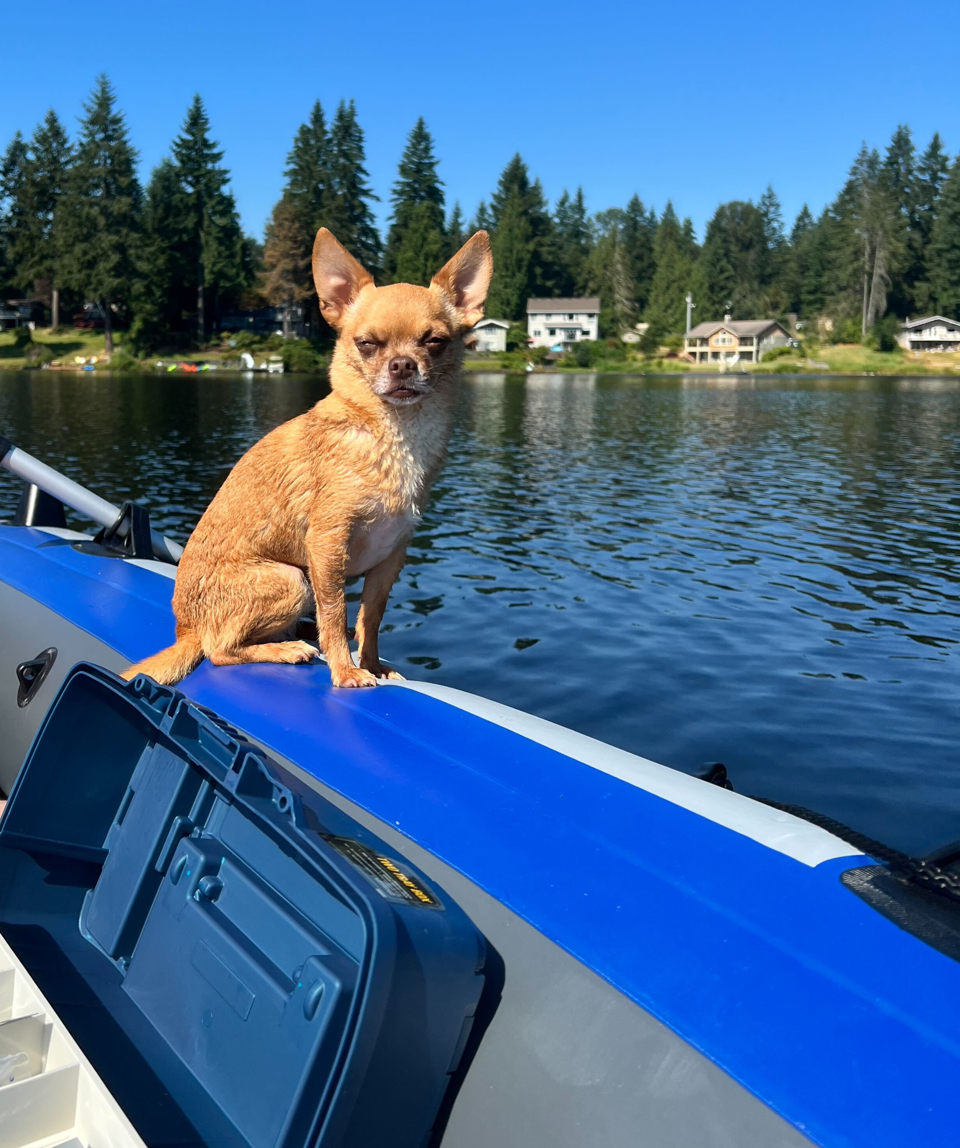
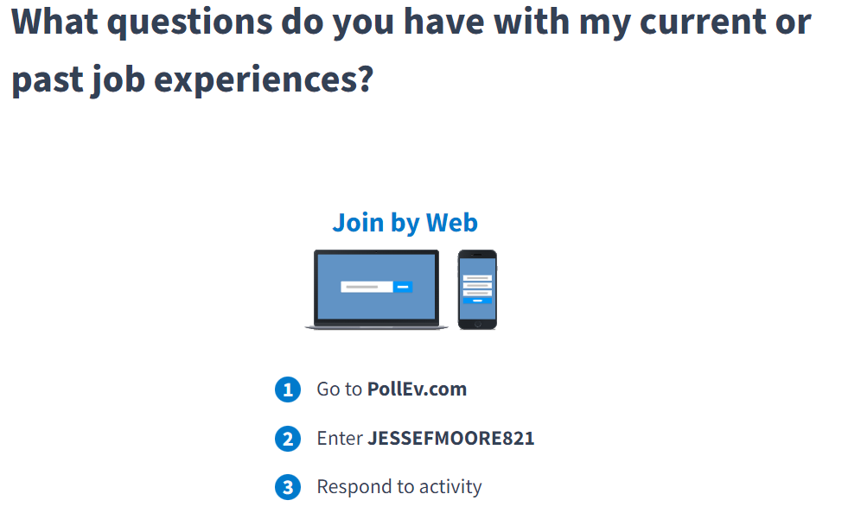
Who is this?
Currently- Pet parent! And Risk Advisor that serves on the Leadership team at UWB
Past stuff:
    SIEM-As-A-Service
    Vulnerability-As-A-Service
    Pentest, Forensics, Incident Response, Risk
https://pollev.com/jessefmoore821
Admin at Nintendo for 10 years
  Education:
    Master of Science, Cybersecurity & Info Assurance
    50+ Industry Certifications
  https://www.linkedin.com/in/jessefmoore/
Notes:
Stories/Reasons: I am A..., Who Helps..., Because... These experiences have shaped my perspectives. Hope to be helpful
Rather than SIEM do logging with Sysmon
Rather than scan with NeXpose or Nessus do WinUpdate4Biz, SCCM/PatchMyPC, WSUS, Firewall(Public2Private), etc

Slide 4
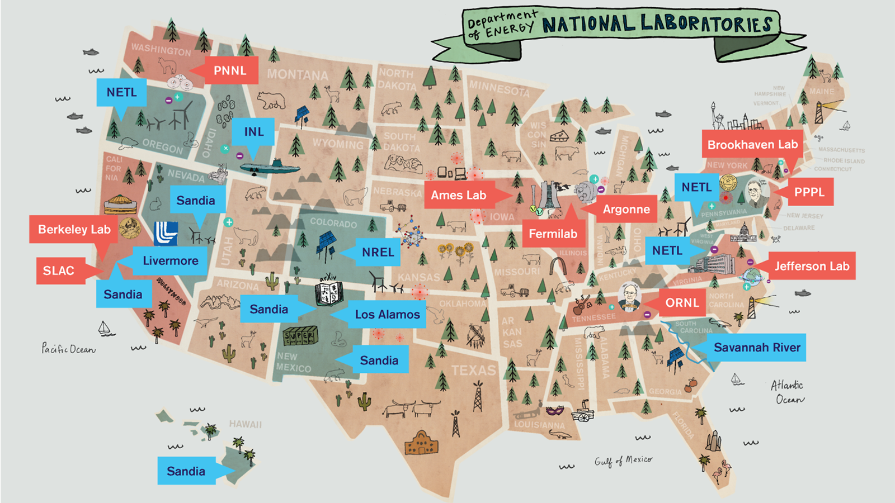
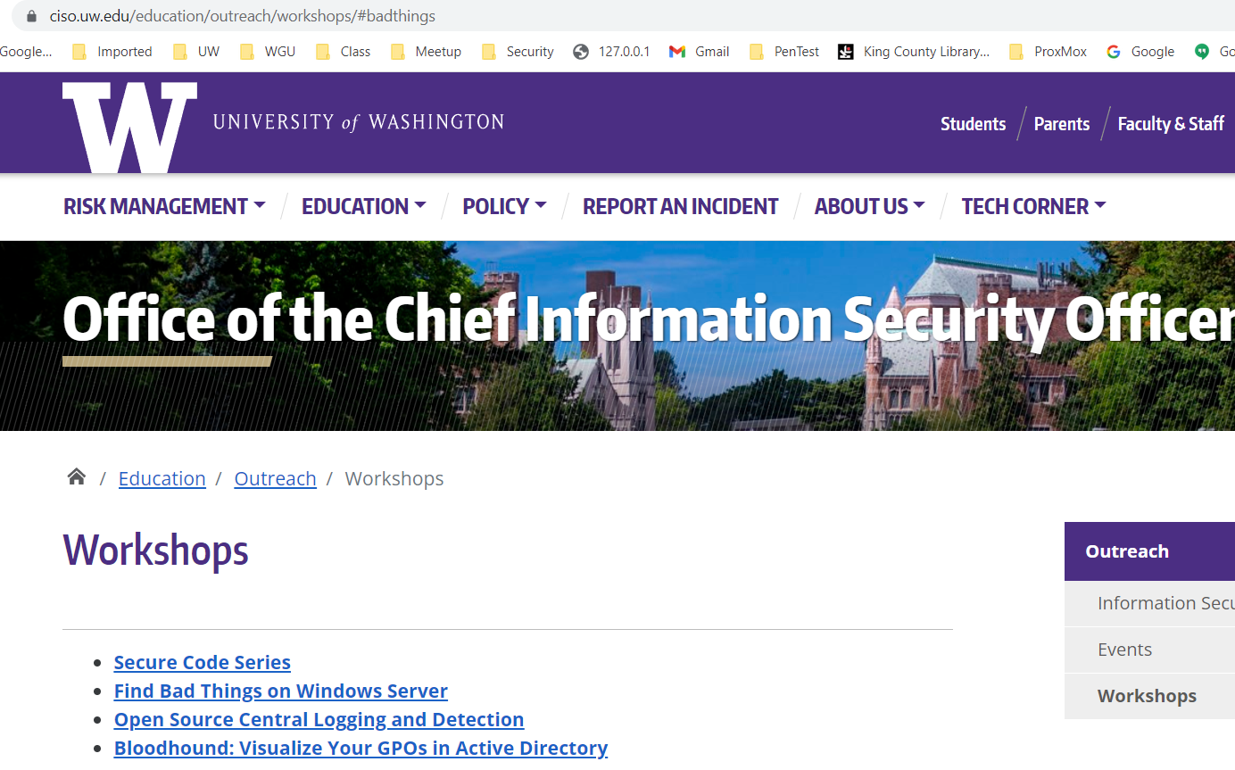
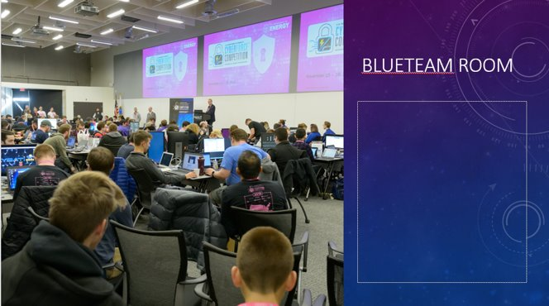
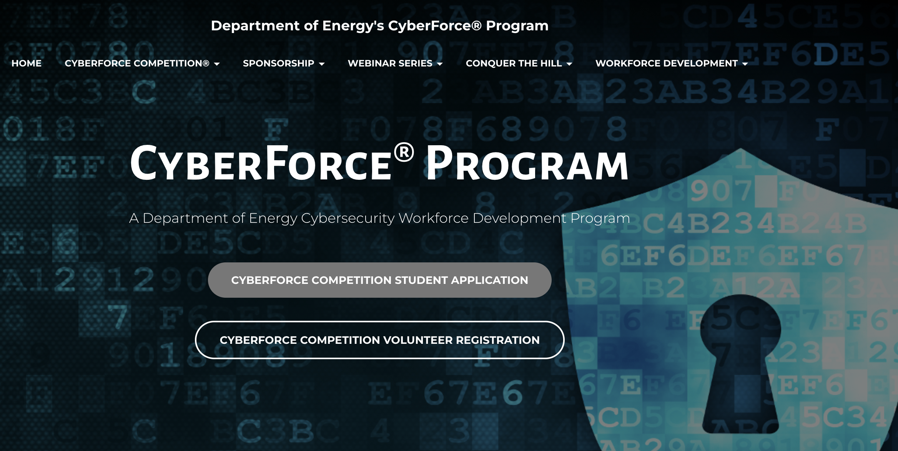
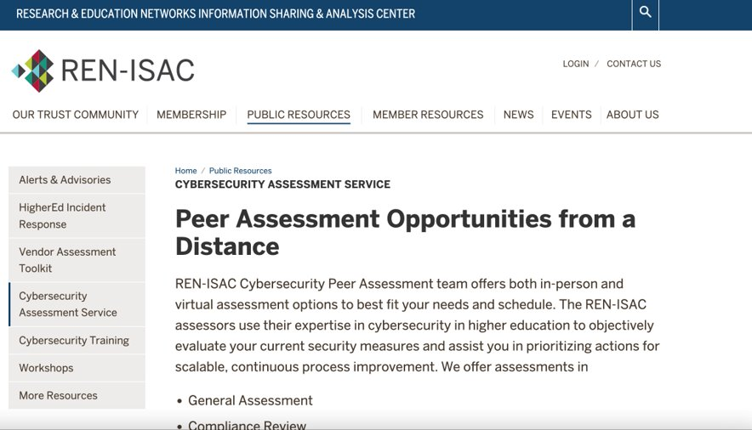
What has Jesse Been up to?
…
I’ve been working on building CyberForce Comp.
https://tinyurl.com/cybforce
REN-ISAC Pentester
CISO workshops; https://ciso.uw.edu/education/outreach/workshops/#badthings
Notes:
Added what the Students would see at every Cyber Attack, and hint, please have memory Forensics and Sysmon, EDR, etc
CyberForce: Velociraptor, Blueteam Defense tools against Red and Dev Red Team vulns
Training; Phish with device codes, Setup C2 and obfuscate payload, and how to enum Teams and Search email.

Slide 5
Agenda -Blazing a Path to the Future
Help stop worrying if news items affect you
Move from Believing 2Knowing!
Notes:
Stories/Reasons: I am A..., Who Helps..., Because...
Email everyone you know letting them know you would never ask for gift cards or wire transfers
Security is my after work hobby, so I am passionate about it.

Slide 6
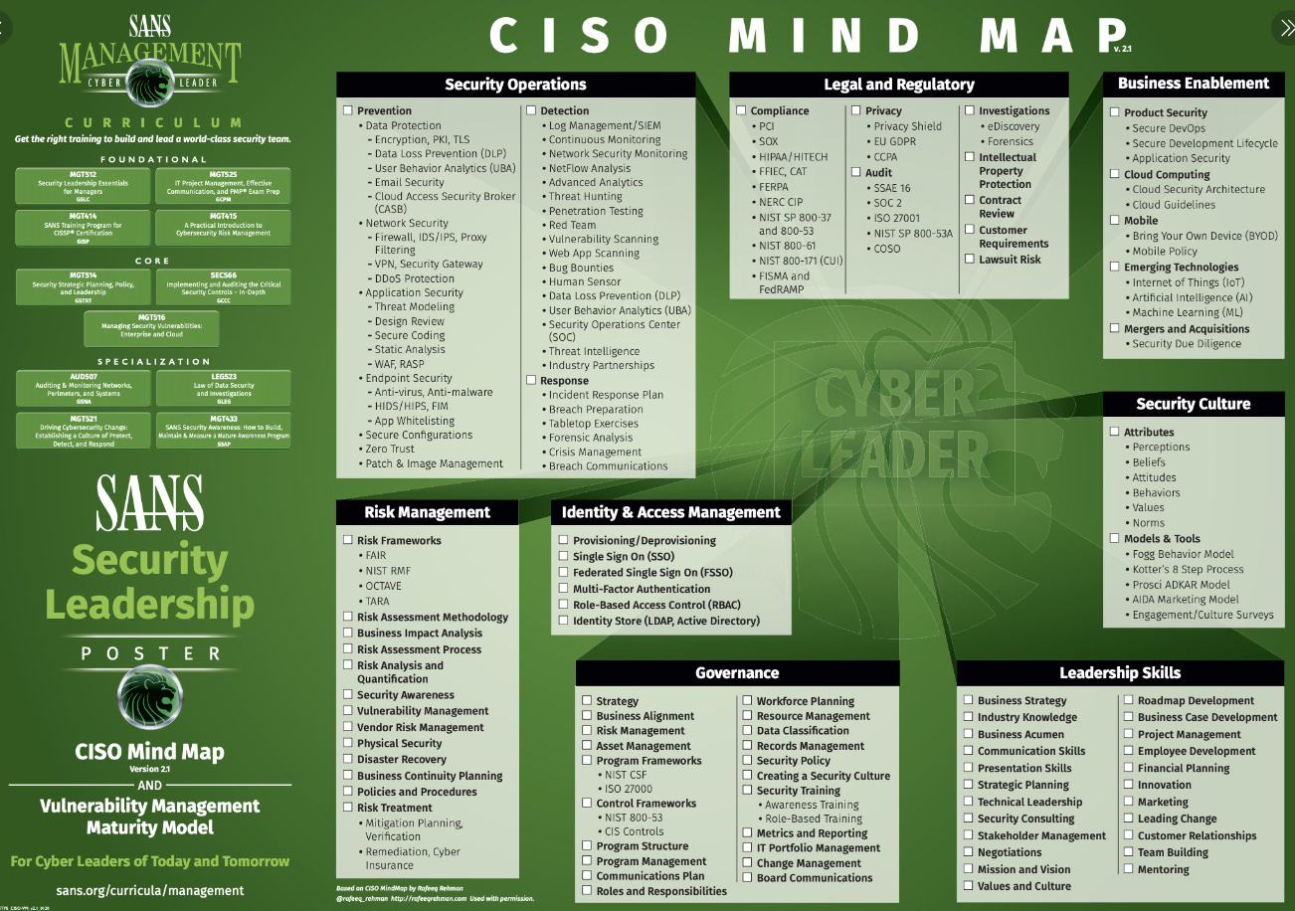
https://pollev.com/jessefmoore821
https://tinyurl.com/cisotweet
Notes:
Polleverywhere
https://pollev.com/jessefmoore821
SANS Institute on Twitter: "Do you have the latest SANS #cybersecurity posters like this gem, #CISO Mind Map, from SANS Security Leadership? Download your copy: https://t.co/EGtTUwZEFr https://t.co/ruc8cu85sI" / Twitter
https://twitter.com/SANSInstitute/status/1263825718024310784/photo/1
https://rafeeqrehman.com/wp-content/uploads/2023/03/CISO_Mindmap-2023.pdf

Slide 7
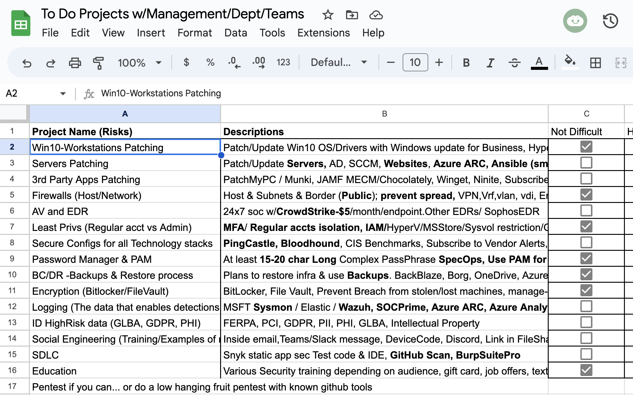
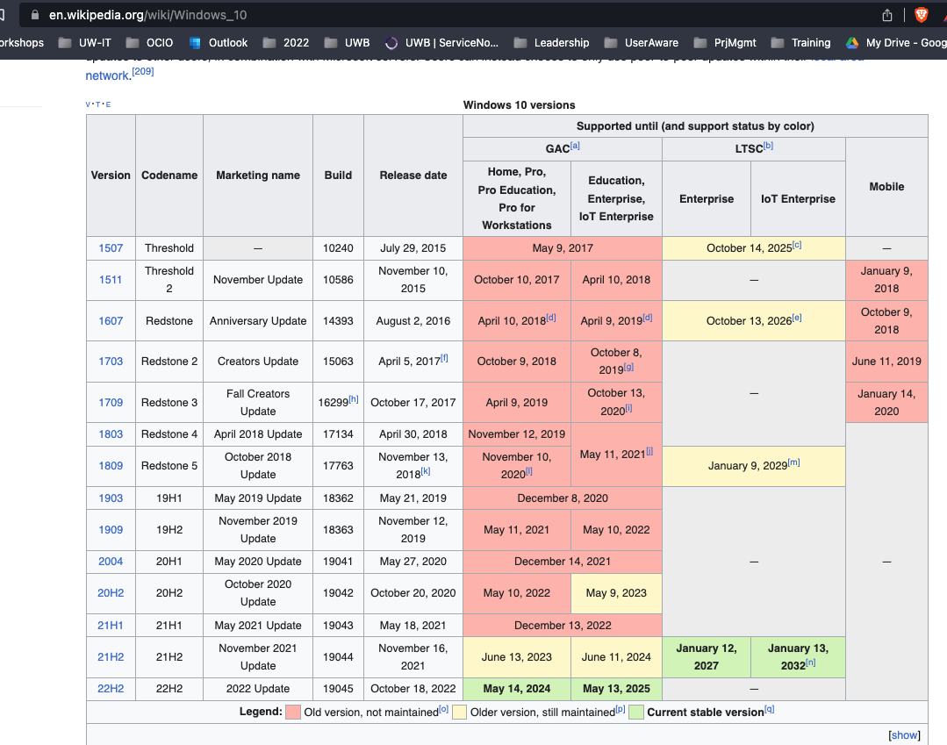
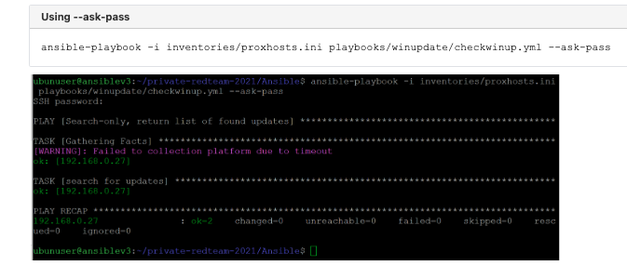
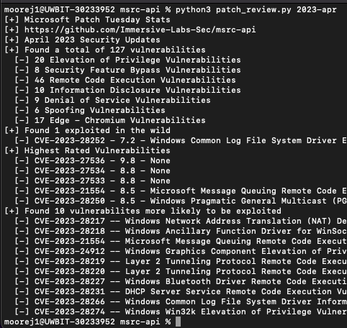
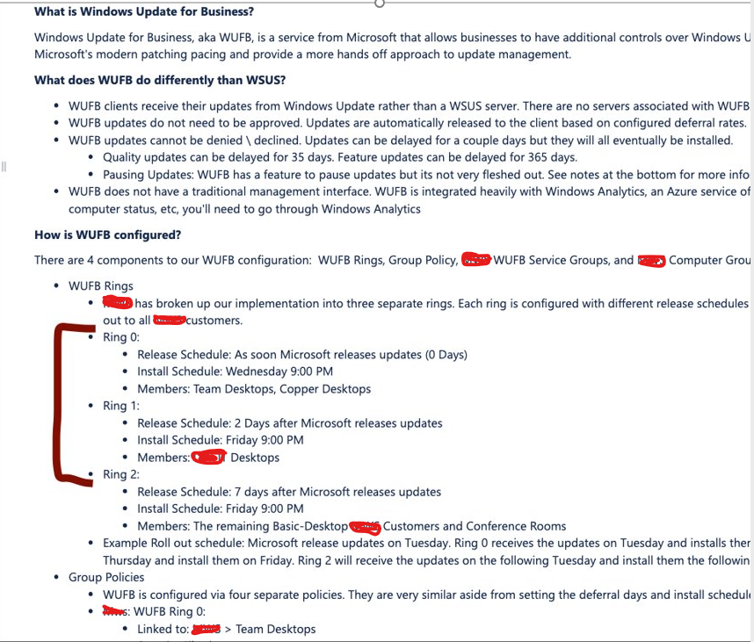
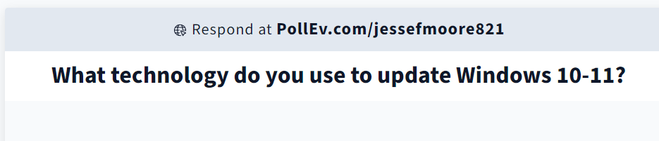
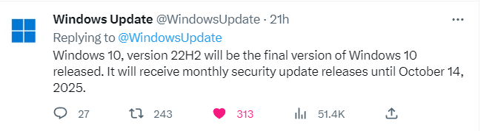
Security Tools Projects
https://tinyurl.com/xlsProj
https://pollev.com/jessefmoore821
Notes:
Windows 10 Enterprise LTSC 2021 expires 2027:
https://learn.microsoft.com/en-us/lifecycle/products/windows-10-enterprise-ltsc-2021
UW GoogleSheets:
https://docs.google.com/spreadsheets/d/14SuyZOHVYs3PnGzfu_sTUigj2LVNbl02fkV0HtJ6fnA/edit?usp=sharing
GAP Analysis and NIST-SP-800-30 as a risk assessment...
CIS Navigator --> https://www.cisecurity.org/controls/cis-controls-navigator/
4.2
Establish and Maintain a Secure Configuration Process for Network Infrastructure
End-of-Support Software Report List (cisecurity.org)
Time to Patch – Krebs on Security
Maybe look at Winget, AutoUpdate Windows, Ansible, Chocolatley, AutoPatch via Azure tenant/inTune
Vulnerability Summary for the Week of August 15, 2022 | CISA
Cyber Defence News for Blue & Purple Teams | Ollie | Substack
Whats Shodan or Censys.io look like for your Public IPs?
https://holisticinfosec.blogspot.com/2016/12/the-dfir-hierarchy-of-needs-critical.html
FuzzySecurity/WWHF-WayWest-2022 at fba2475d2f8dc7b7999cc5994ac340ca1db62090 (github.com)
Download Local Administrator Password Solution (LAPS) from Official Microsoft Download Center
TrimarcJake/Locksmith: A tiny tool to identify and remediate common misconfigurations in Active Directory Certificate Services (github.com)

Slide 8

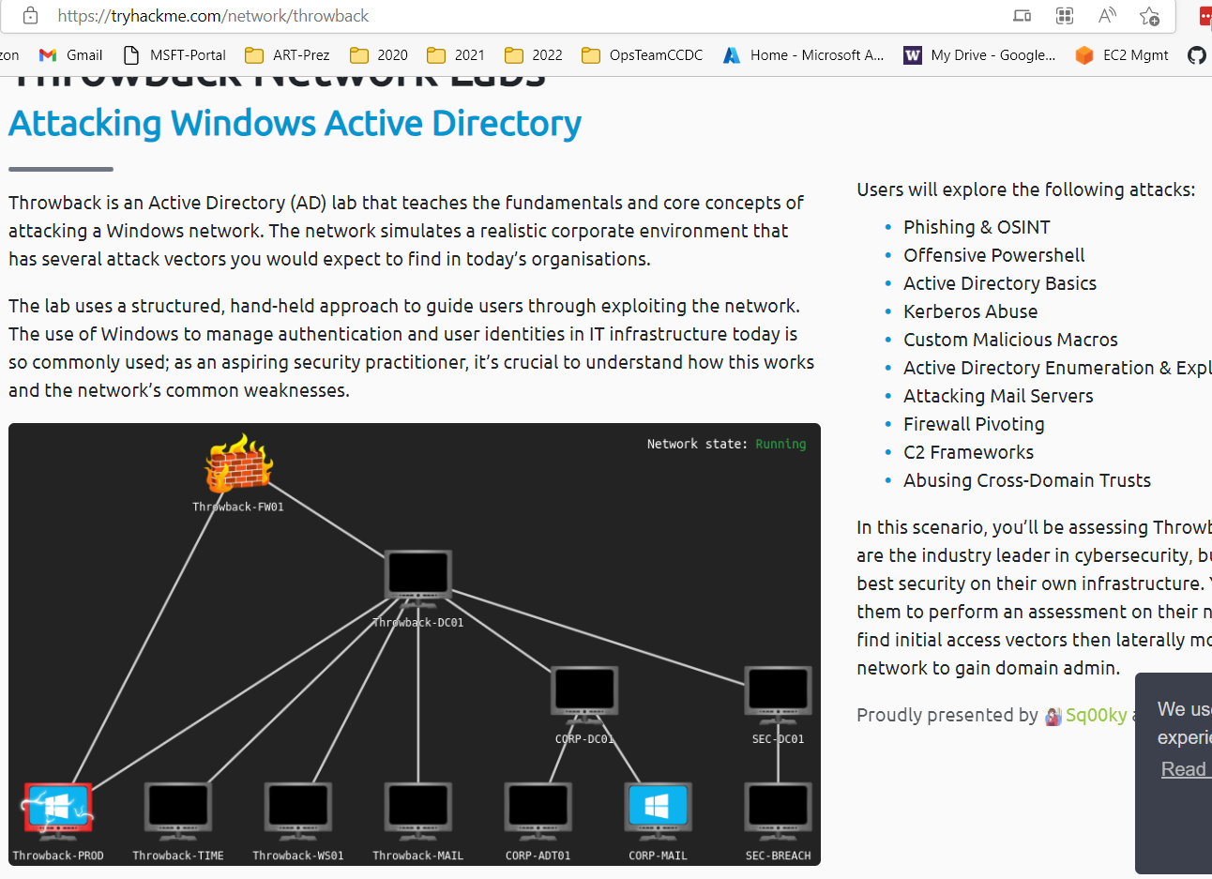
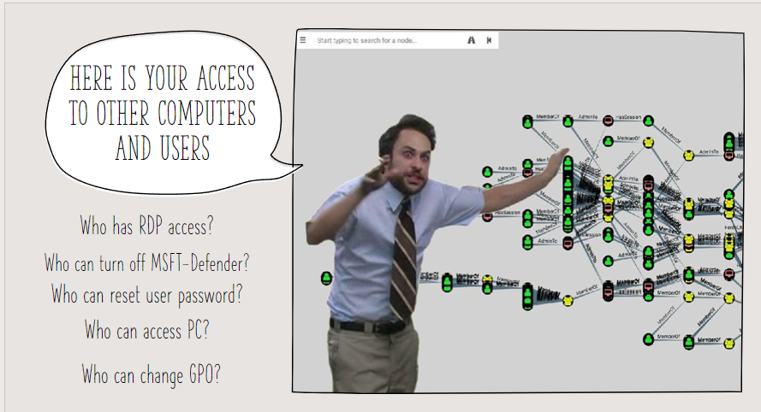
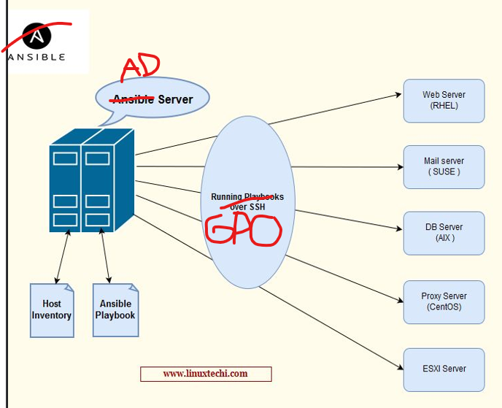
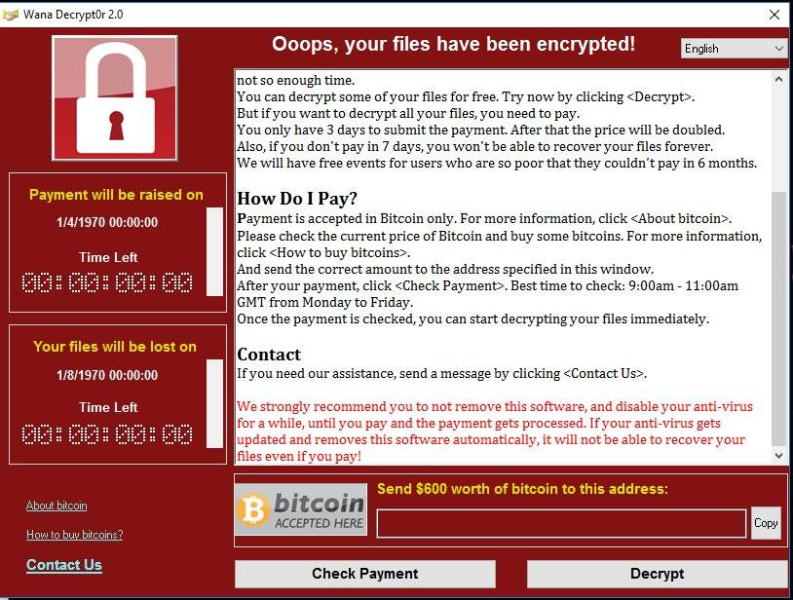
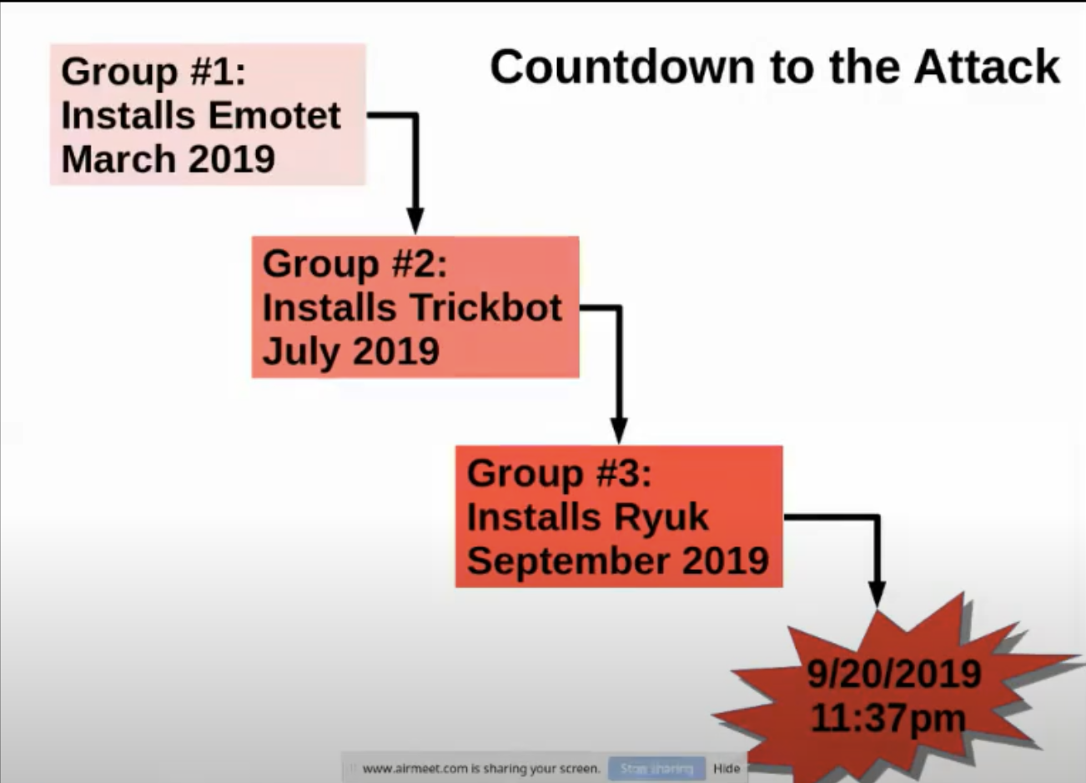
Agenda #1 stop worrying ?--> Active Directory
what about all the steps while they are in?
Northshore School district System admins share their experience: https://tinyurl.com/NSRan
Notes:
Move Public to Private.
files/translate_f.pdf at main · silence-is-best/files (github.com)
https://tinyurl.com/NSRan
The hateful eight: Kaspersky’s guide to modern ransomware groups’ TTPs | Securelist
Jessica from Microsoft (IR at the time):
https://twitter.com/jepaynemsft/status/1255991971845308416
https://attack.mitre.org/groups/

Slide 9
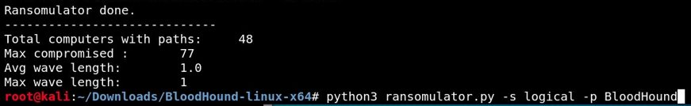
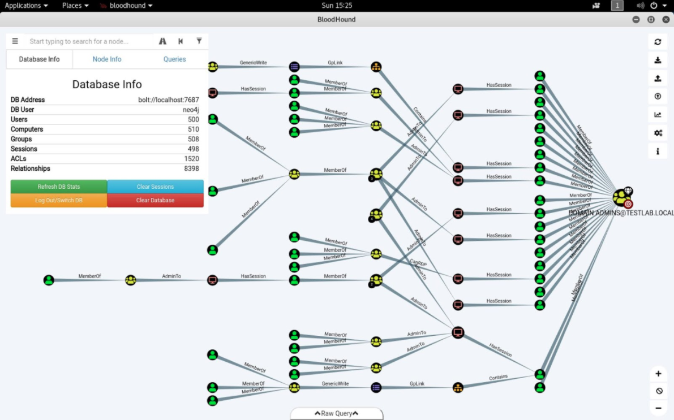
Who wants to Simulate Ransomware in Active Directory???
https://tinyurl.com/RansomWS
Notes:
Exchange and BloodHound maps...
04262018-Webcast-Toxic-Waste-Removal-by-Andy-Robbins.pdf (blackhat.com)
AD Mitigations:
https://www.youtube.com/watch?v=vga7A2tYejE&t=5s
Simulate Ransomware: sudo git clone https://github.com/zeronetworks/BloodHound-Tools/tree/main/Ransomulator
sudo apt-update
sudo apt-upgrade
sudo apt-get install python3-pip
sudo apt-cache madison neo4j
python3 -m pip install neo4j
python3 -m pip install neo4j-driver
pip3 install cornershot
root@kali:~/Downloads/BloodHound-linux-x64/BloodHound-Tools/
python3 ransomulator.py -p BloodHound

Slide 10
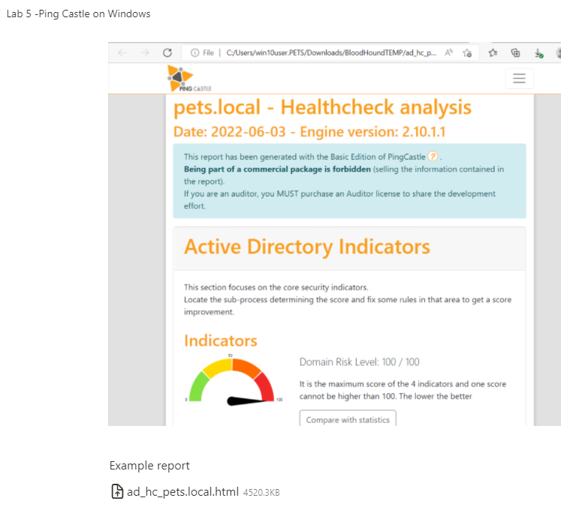
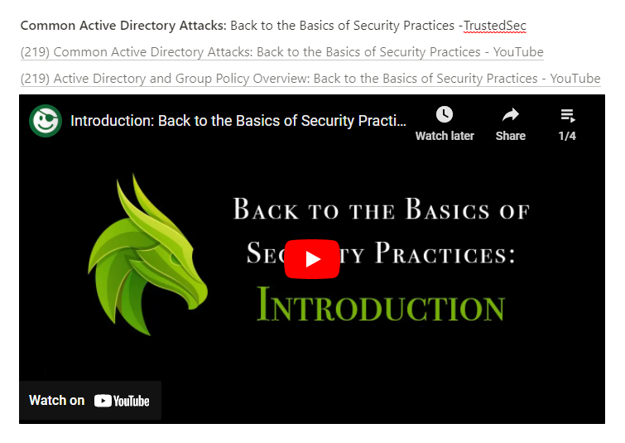
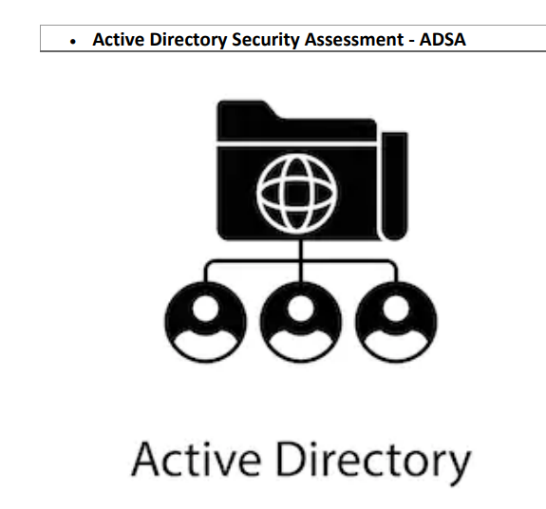
AD Assessment -->"Defense in Depth"
https://tinyurl.com/WSBloodHound
https://tinyurl.com/ADefence
https://tajdini.net/blog/penetration/active-directory-penetration-mind-map/
Notes:
Pentesting:
Active Directory Penetration Mind Map – Mahyar Notes (tajdini.net)
TrustedSec -Back to the Basics of Security Practices
https://www.youtube.com/watch?v=dJT2pVNAbfA&list=PLk-dPXV5k8SEtiTgi9wgxmDS0CCZQur6H
PingCastle AD Assessment
https://www.pingcastle.com/download/
Active Directory On-Demand Assessment
https://learn.microsoft.com/en-us/services-hub/health/getting-started-ad

Slide 11

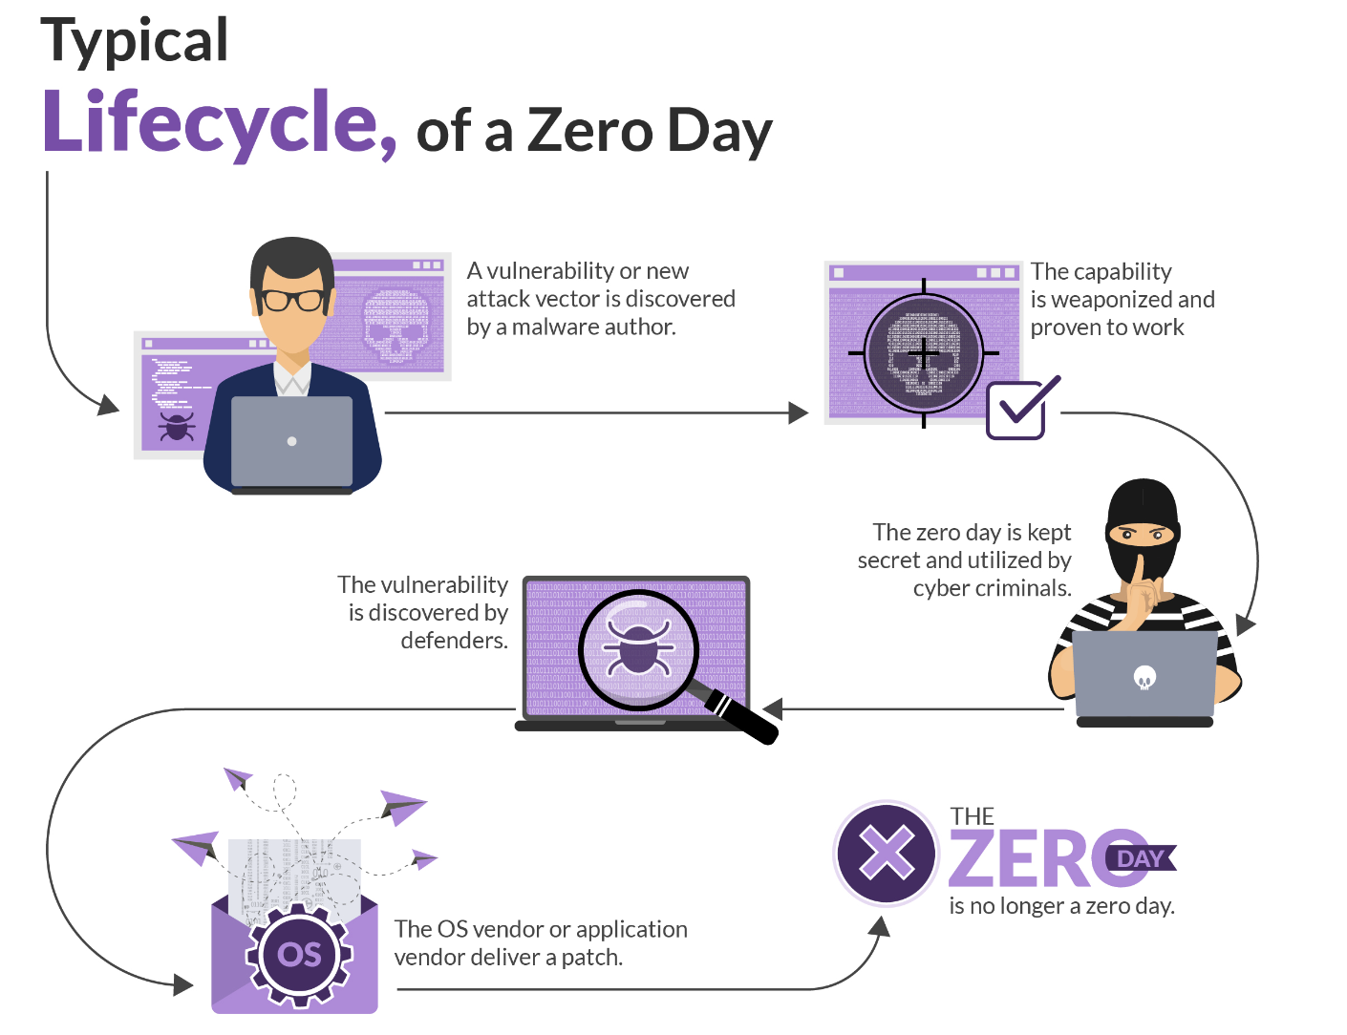
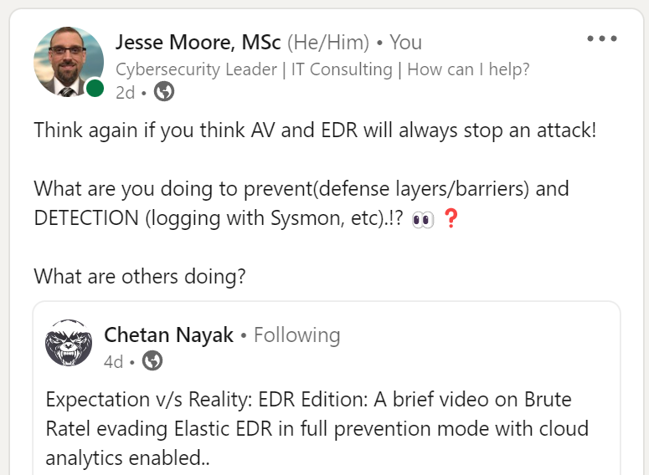
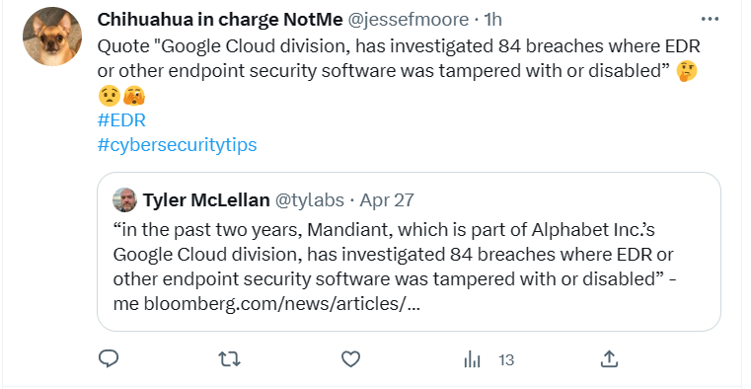
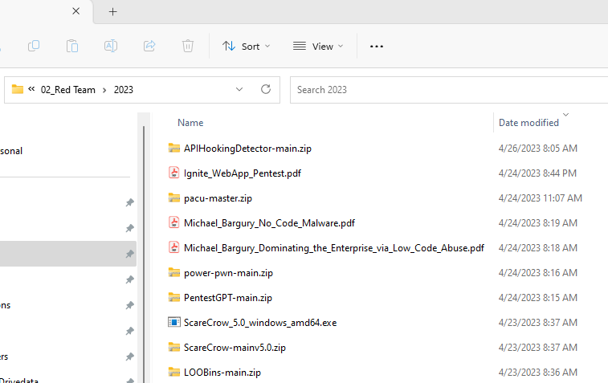
Defense in depth!
https://thedfirreport.com/
https://tinyurl.com/BruteRatel
Notes:
https://thedfirreport.com/
Brute Ratel:
https://www.youtube.com/watch?v=hAHkJSPCc2A

Slide 12
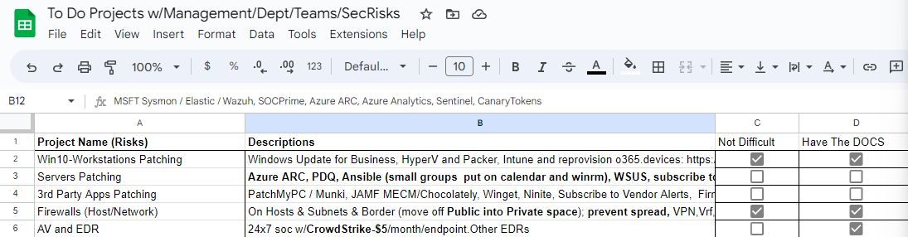
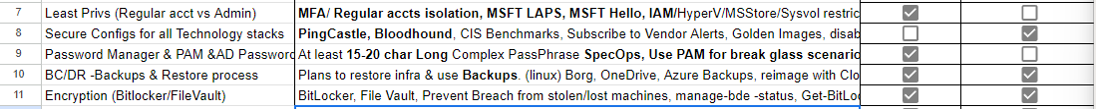
-->Stop watching the news?
https://tinyurl.com/xlsProj
Notes:
ASSUME EMAIL FILTERS... ProofPoint etc.
Assumes Exchange fixed.
Lots of odd devices like Switches, routers, iOT, raspberryPi can be automated with Ansible..
Obtain Vendor security alerts.
https://www.cisa.gov/known-exploited-vulnerabilities-catalog
CIS BIA
https://bia.cisecurity.org/
Controls to use or think about
https://atc-project.github.io/react-navigator/
CyberForce and logging …. Its tough to see what happens on systems. Need to rely on Win Defender, AMSI for Memory, and EDR and logs to review…
chains/basic_pivot/recap/response.md · main · cfc-redteam-dev / 2022 / general / playbook · GitLab
Ansible for Windows Updates for Servers.
https://grizzly-dibble-cdb.notion.site/Ansible-WindowsUpdate4Servers-71dfb596b0ca4c3c8edae5eb05451d6b
@_wald0 azure github
End-of-Support Software Report List (cisecurity.org)
Time to Patch – Krebs on Security
Maybe look at Winget, AutoUpdate Windows, Ansible, Chocolatley, AutoPatch via Azure tenant/inTune
Vulnerability Summary for the Week of August 15, 2022 | CISA
Cyber Defence News for Blue & Purple Teams | Ollie | Substack
Whats Shodan or Censys.io look like for your Public IPs?
https://holisticinfosec.blogspot.com/2016/12/the-dfir-hierarchy-of-needs-critical.html
Blue-Team-Tools/windows_hardening.cmd at main · WGU-CCDC/Blue-Team-Tools (github.com)

Slide 13
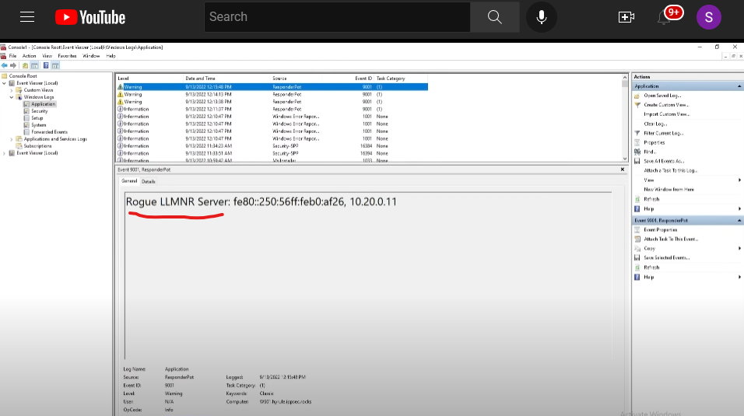
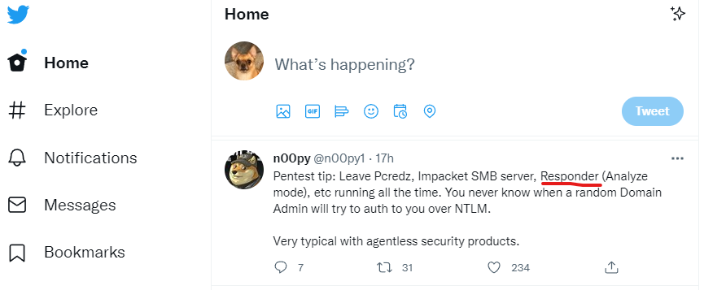
Early warning detection system (LLMNR) NOT in the News... waaay better.
https://tinyurl.com/EarlyDetections
https://twitter.com/jessefmoore
Notes:
(19) Detecting Responder via LLMNR Honey Tasks on User Workstations – YouTube
https://www.youtube.com/watch?v=h_cWWL-yyb0&t=295s
Twitter Defender: https://twitter.com/GossiTheDog/status/1578313384298094592?s=20&t=I8HGr3JHIo-7XCneXSZmOQ
Me using Impacket: https://screencast-o-matic.com/watch/c3QIFGVOFmz
Hacker Methodology handbook
TRÄW🤟 on Twitter: "6. "Hacker Methodology Handbook" by Thomas Bobeck https://t.co/LbFW8LmgOP" / Twitter
Twitter API:
https://screencast-o-matic.com/watch/c3QFqHVOwRy
Twitter Pentester/Red Teamer:
https://twitter.com/n00py1/status/1577045510036557824
Responder:
https://screencast-o-matic.com/watch/cqiveFOp0E
Slack to Responder:
https://screencast-o-matic.com/watch/cYfV024AGF
TableTop Exercise
https://bnb.silverday.de/

Slide 14
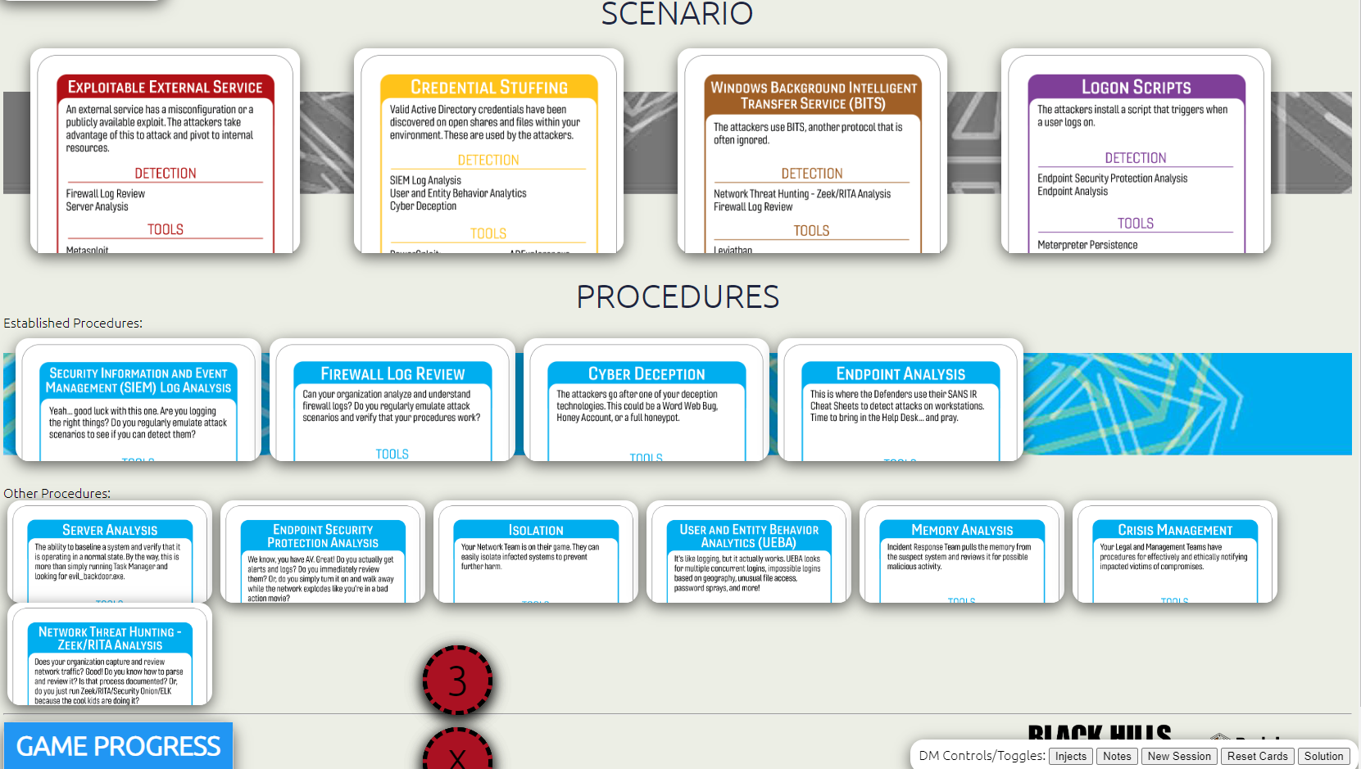
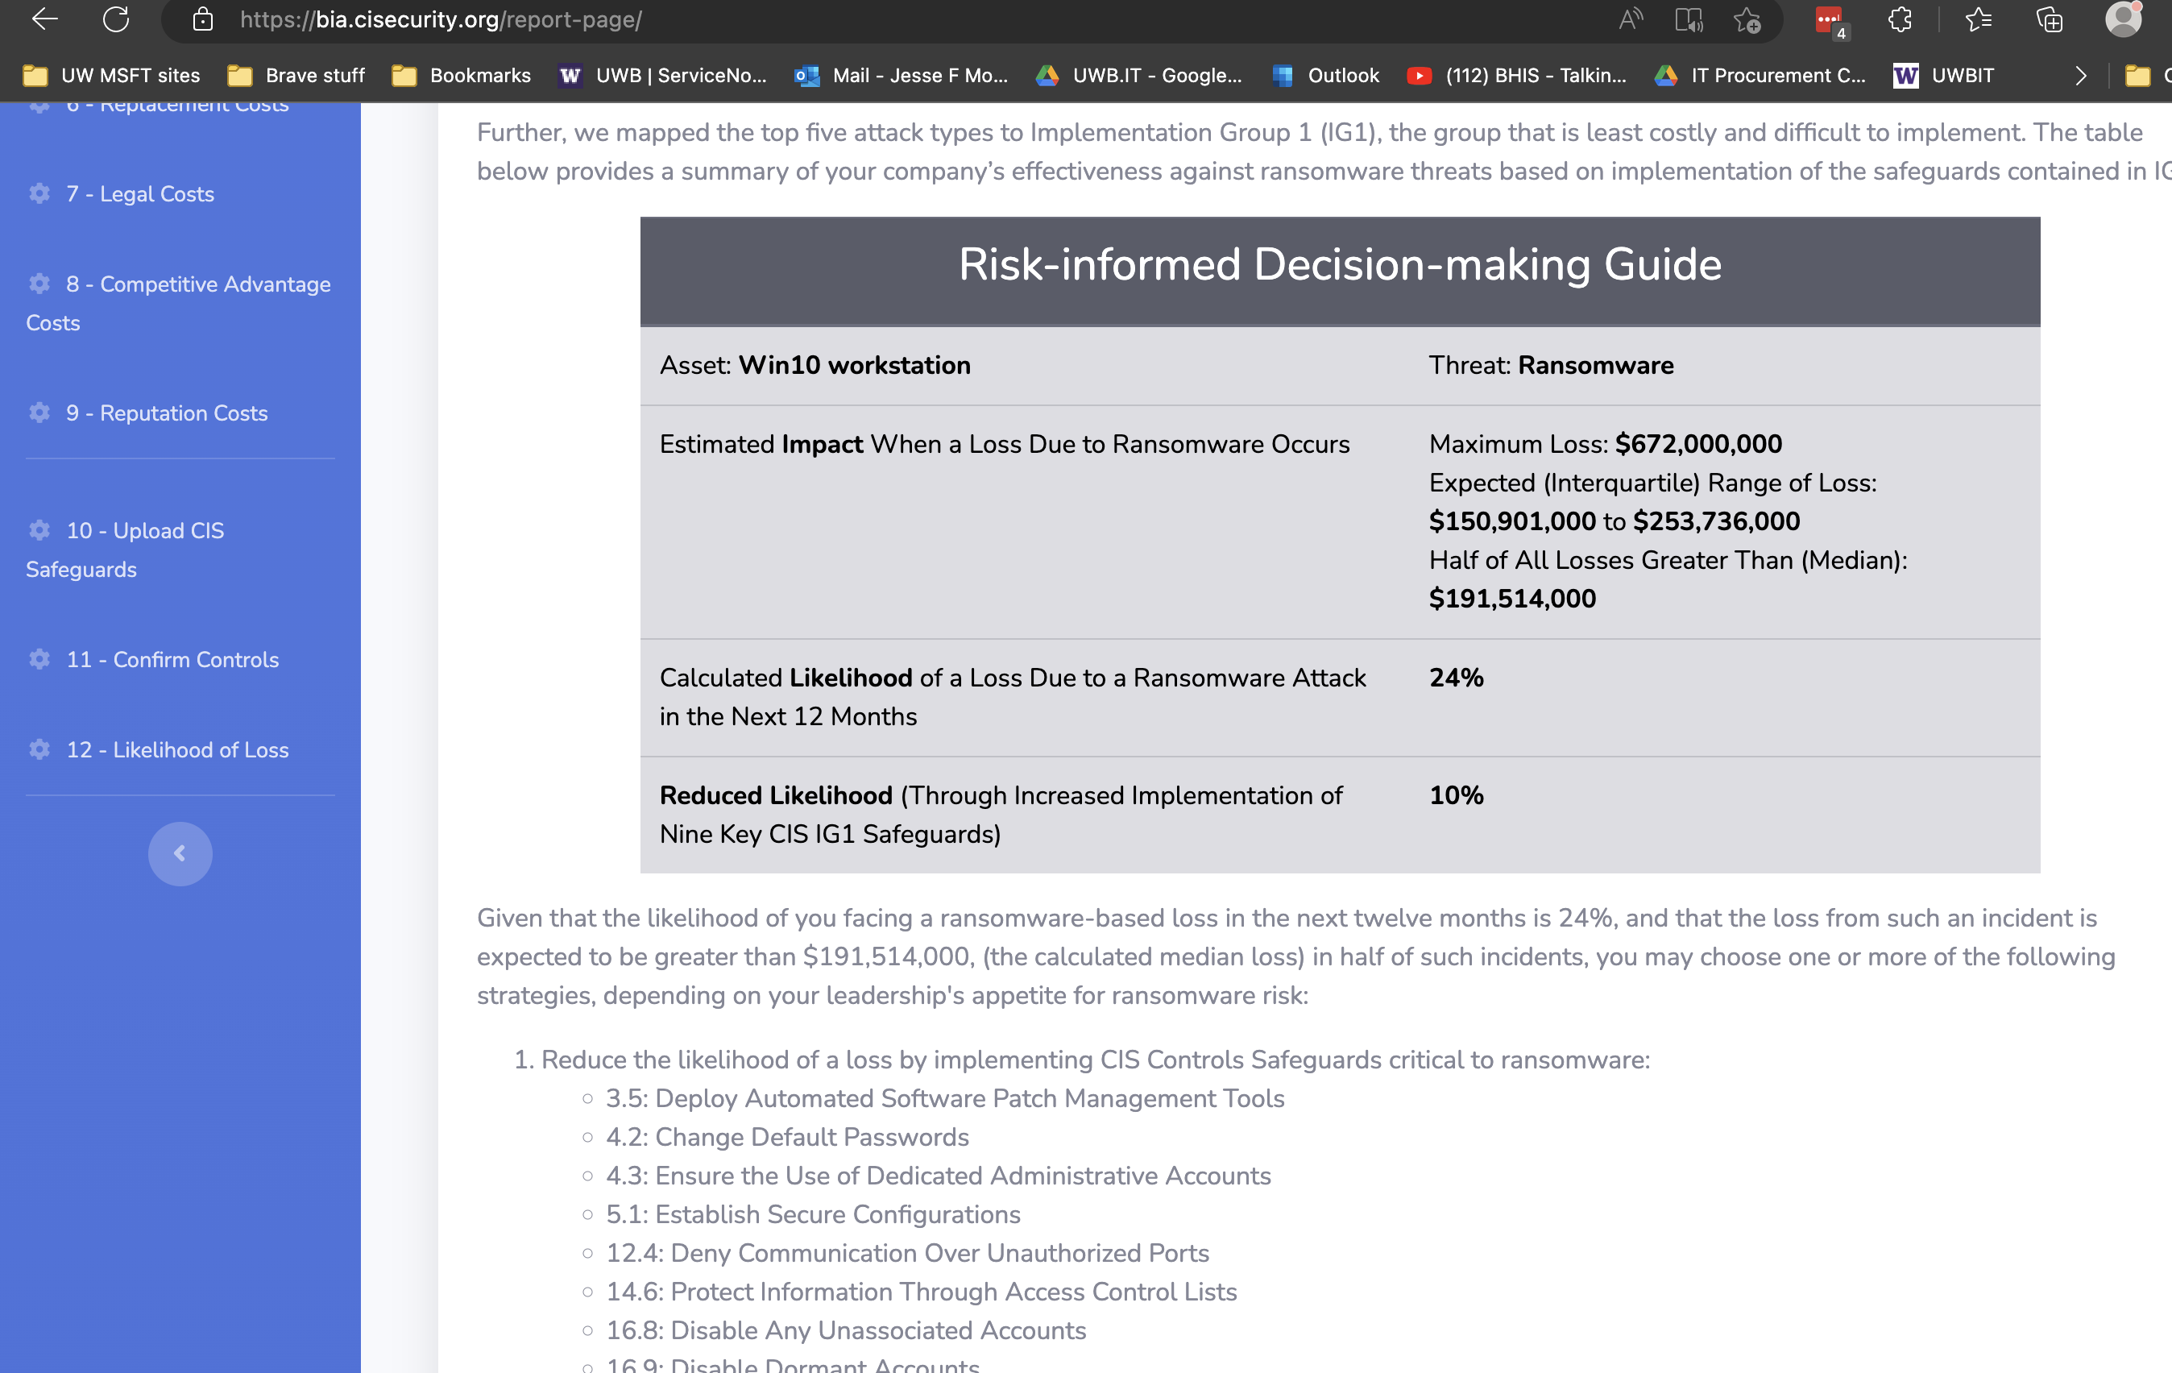
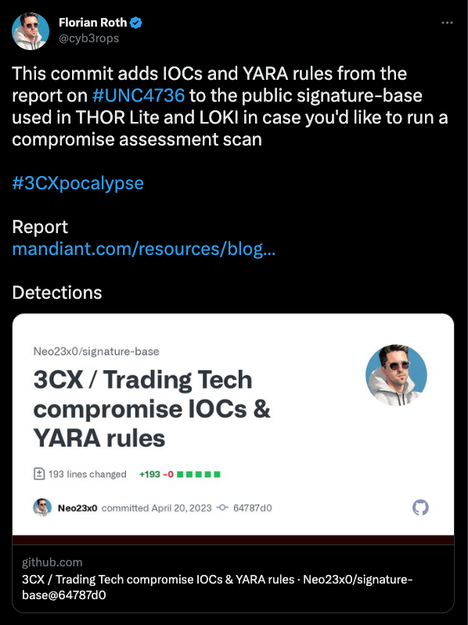
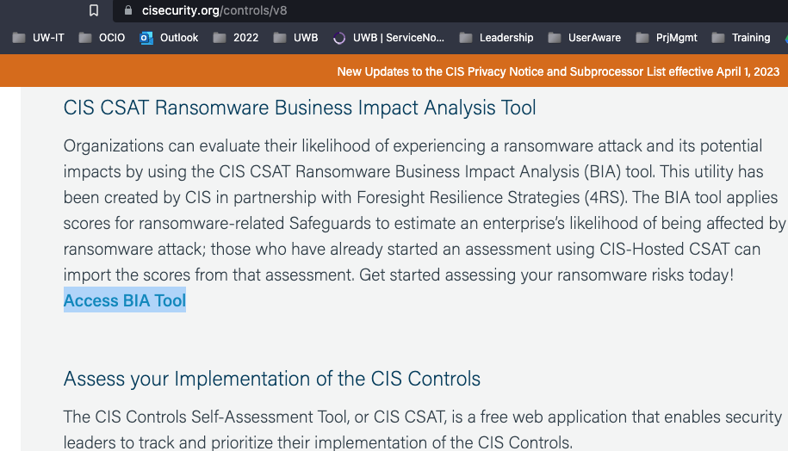
If you can't defense in depth?
https://www.nextron-systems.com/thor-lite/
https://bia.cisecurity.org
https://play.backdoorsandbreaches.com/
Notes:
ASSUME EMAIL FILTERS... ProofPoint etc.
Assumes Exchange fixed.
CISA Services:
https://www.cisa.gov/resources-tools/services?page=1
CIS BIA
https://bia.cisecurity.org/
THOR Lite: https://www.nextron-systems.com/thor-lite/
TableTop
https://play.backdoorsandbreaches.com/
Controls to use or think about
https://atc-project.github.io/react-navigator/
CyberForce and logging …. Its tough to see what happens on systems. Need to rely on Win Defender, AMSI for Memory, and EDR and logs to review…
chains/basic_pivot/recap/response.md · main · cfc-redteam-dev / 2022 / general / playbook · GitLab
Ansible for Windows Updates for Servers.
https://grizzly-dibble-cdb.notion.site/Ansible-WindowsUpdate4Servers-71dfb596b0ca4c3c8edae5eb05451d6b
@_wald0 azure github
End-of-Support Software Report List (cisecurity.org)
Time to Patch – Krebs on Security
Maybe look at Winget, AutoUpdate Windows, Ansible, Chocolatley, AutoPatch via Azure tenant/inTune
Vulnerability Summary for the Week of August 15, 2022 | CISA
Cyber Defence News for Blue & Purple Teams | Ollie | Substack
Whats Shodan or Censys.io look like for your Public IPs?
https://holisticinfosec.blogspot.com/2016/12/the-dfir-hierarchy-of-needs-critical.html
Blue-Team-Tools/windows_hardening.cmd at main · WGU-CCDC/Blue-Team-Tools (github.com)

Slide 15

Take aways
Moving from believing to knowing!
Active Directory Risks & Tips
Hire AD Experts to review your AD!!! AND OR a PENTeSTER!!!
Help stop worrying if news items affect you
Project (Risk /Controls) Plan.
https://tinyurl.com/xlsProj
https://bia.cisecurity.org
https://www.nextron-systems.com/thor-lite/
Workshops and other materials for Admins
BloodHound & PingCastle
https://tinyurl.com/WSBloodHound
https://tinyurl.com/EarlyDetections
https://play.backdoorsandbreaches.com/
SOURCE: https://www.blackhillsinfosec.com/prompt-zine/
Notes:
AI and ChatGPT... How adversaries are creating Malware and other things much faster.
Low- code pwn-code
Sooner or later it should be consider neglect of due diligence and of due care.... if you are not hiring a pentester to ensure security.
Policies--> https://www.cisecurity.org/controls/v8
Backdoors & Breaches
https://www.cisa.gov/resources-tools/services?page=1
MSFT AD Assessment
https://learn.microsoft.com/en-us/services-hub/unified/health/getting-started-adsecurity
Trimarc
https://www.hub.trimarcsecurity.com/post/securing-active-directory-performing-an-active-directory-security-review
SpecterOps
https://posts.specterops.io/attacking-azure-azure-ad-and-introducing-powerzure-ca70b330511a
Semperis
https://www.semperis.com/solutions/uncover-active-directory-attack-paths/
BlackHIllsInfosec
https://www.blackhillsinfosec.com/tag/active-directory/
PingCastle, PurpleKnight, BloodHound, GoodHound
CISA
https://csrc.nist.gov/projects/ransomware-protection-and-response
Take assessment: https://github.com/cisagov/cset/releases/tag/v10.3.0.0

Slide 16

Thank you!
@jessefmoore on Twitter
Collab at work: moorej1@uw.edu
Notes:
Tips and Tactics: Ransomware (nist.gov)
Release Ransomware Readiness Assessment CSET v10.3 · cisagov/cset (github.com)
CIS CSAT Ransomware Business Impact Analysis tool: https://bia.cisecurity.org/?next=/dashboard/
https://home.treasury.gov/system/files/126/ofac_ransomware_advisory_10012020_1.pdf
https://iclg.com/practice-areas/sanctions/usa

