Slide 1

Capstone Project (TPOT)
UW Cybersecurity project
UW Tacoma

Slide 2
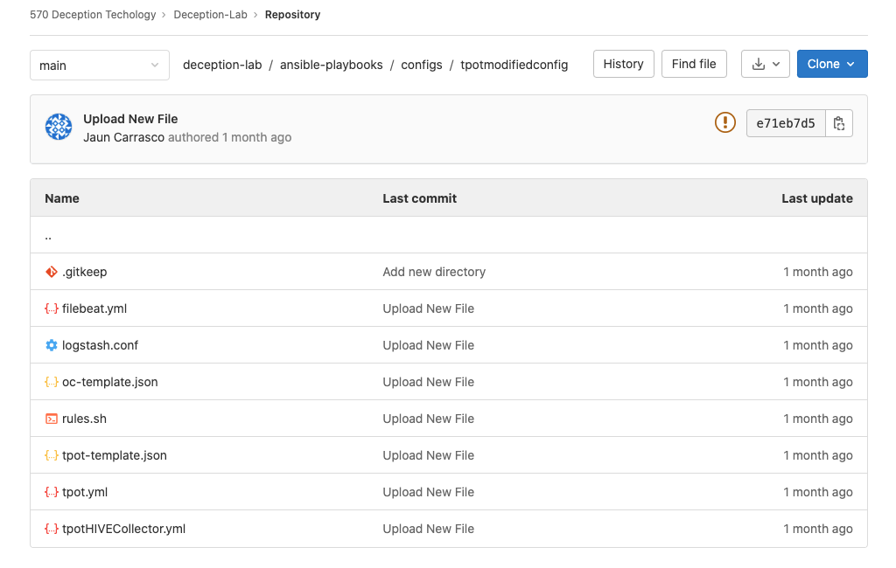
Deception Tech Team:
Focus on CanaryTokens and TPOT.
UW Masters' students helping document and create cybersecurity solutions.
https://gitlab.com/deception_capstone/deception-lab/-/tree/main/ansible-playbooks/configs/tpotmodifiedconfig
Notes:
https://gitlab.com/deception_capstone/deception-lab/-/tree/main/ansible-playbooks/configs/tpotmodifiedconfig

Slide 3
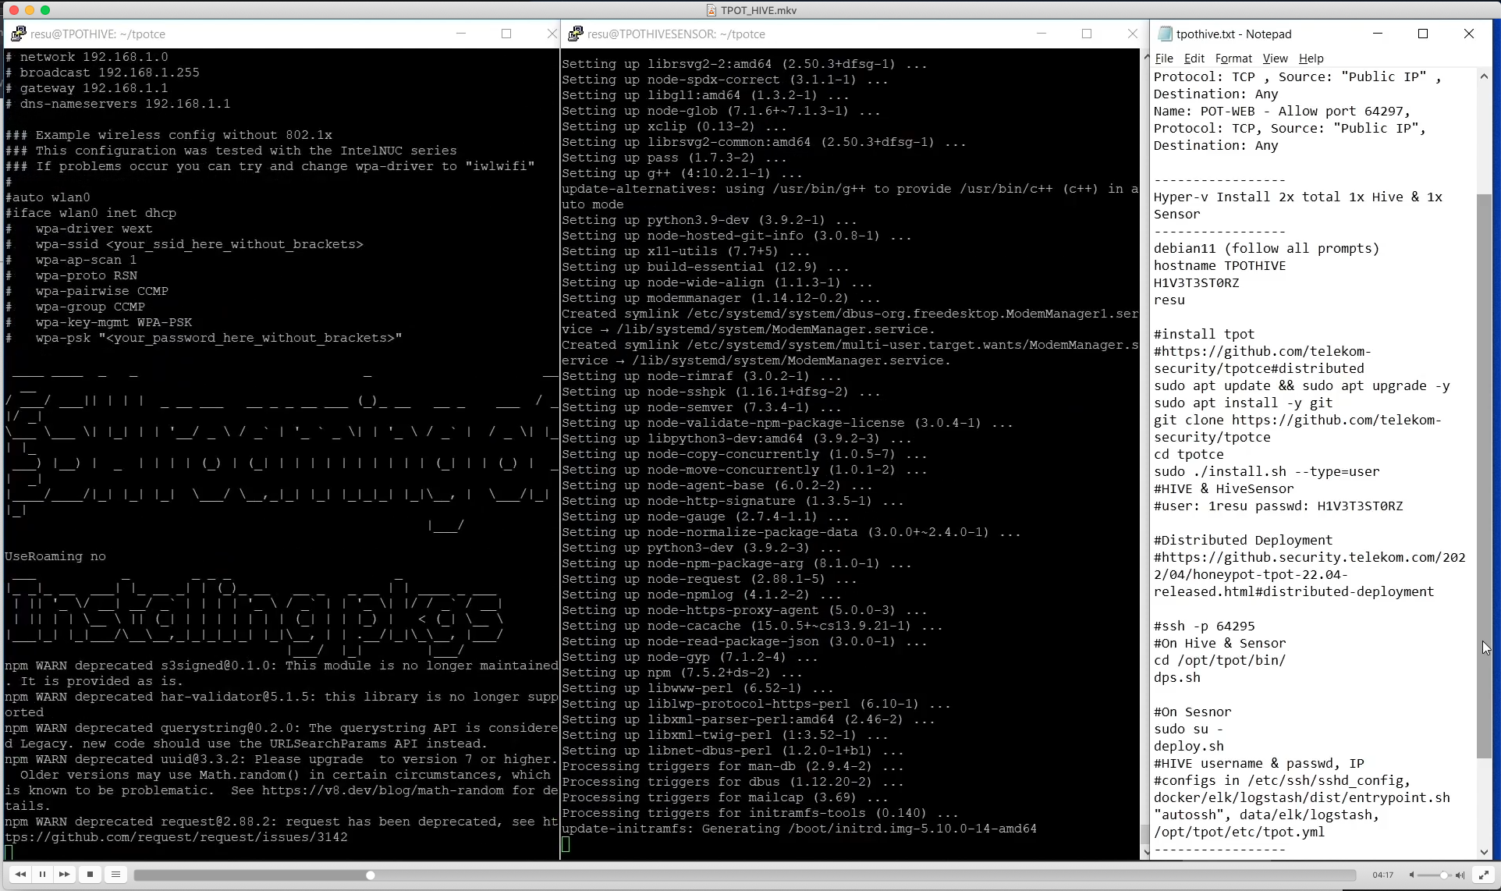
Cybersecurity consultants to help Admins deploy TPOT.
Students provided Video.
https://drive.google.com/u/0/uc?id=1ojCK7mvNsQvnW5NMEa_3dFVdbYJ6hsTR&export=download
Notes:
https://drive.google.com/u/0/uc?id=1ojCK7mvNsQvnW5NMEa_3dFVdbYJ6hsTR&export=download

Slide 5
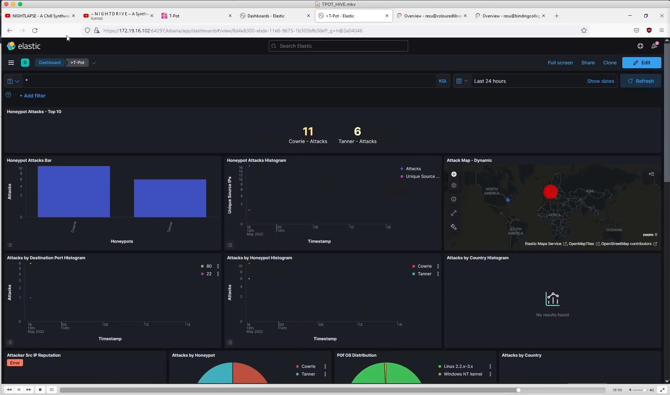
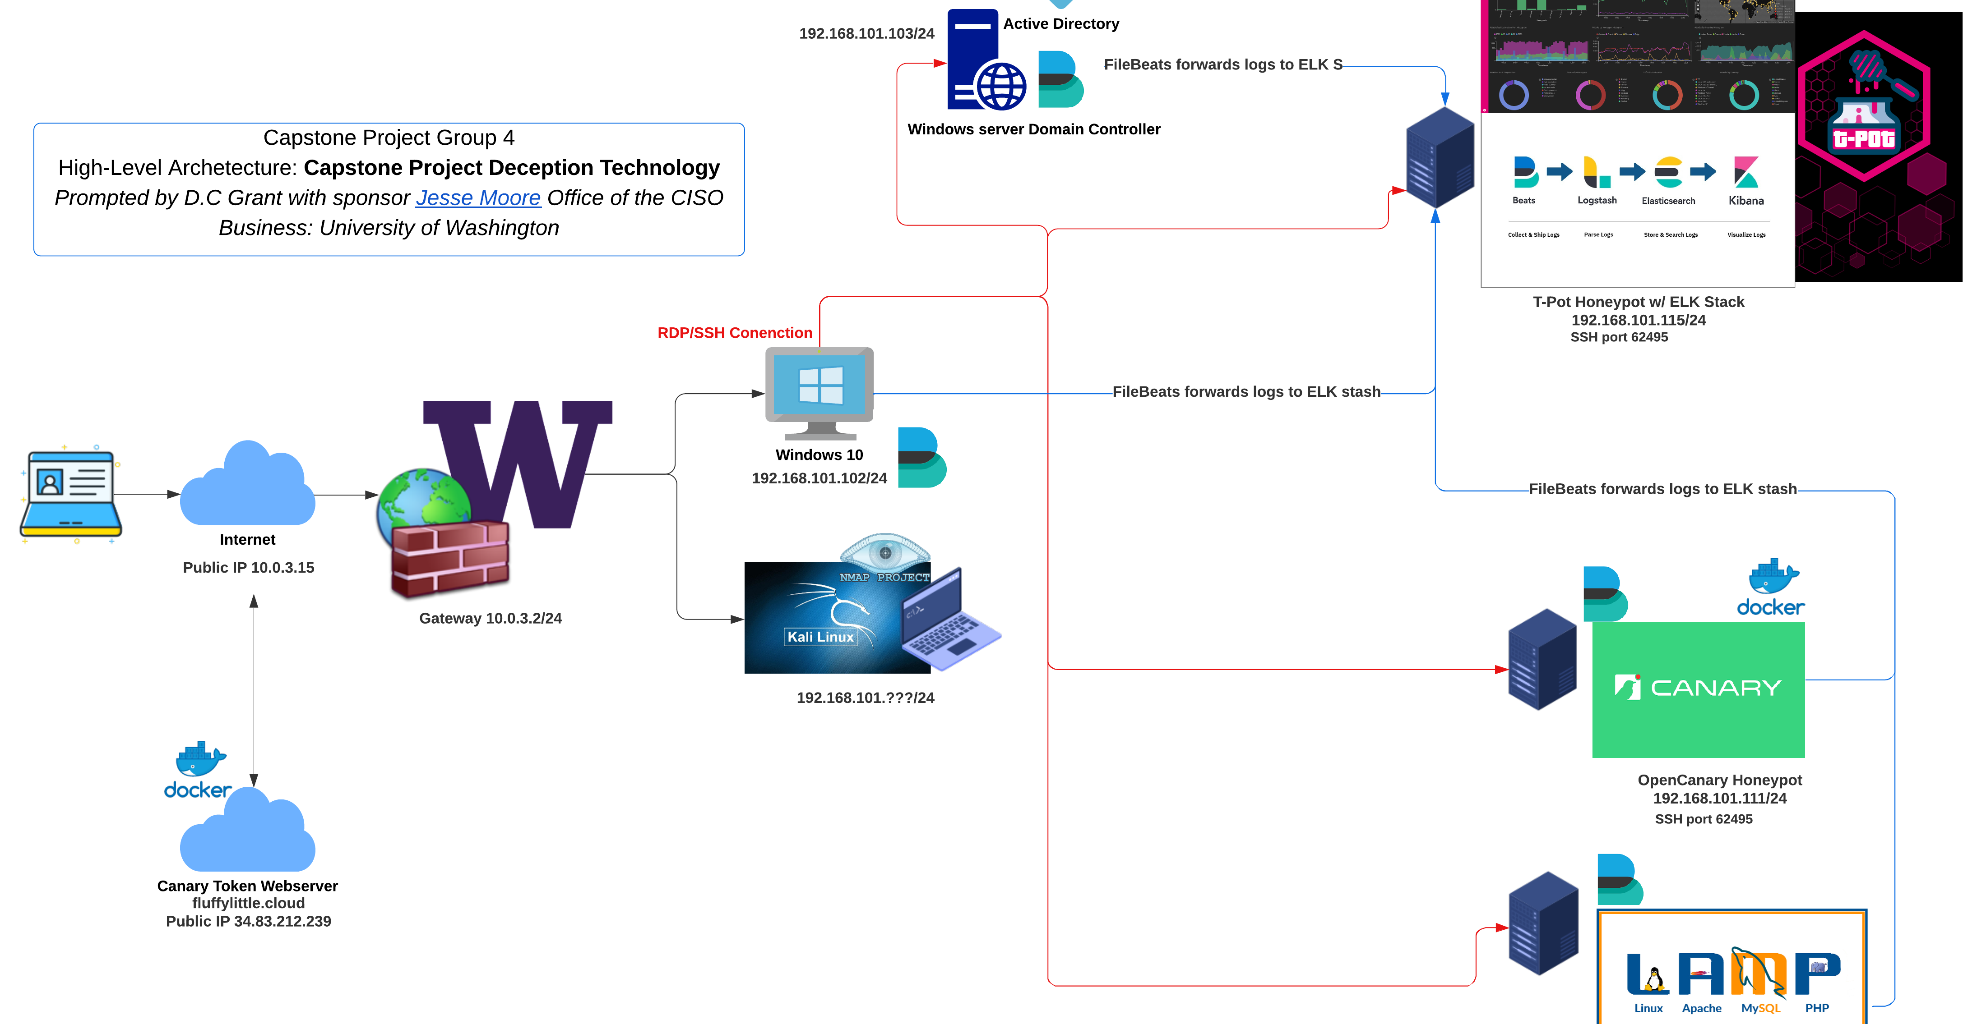

Slide 6
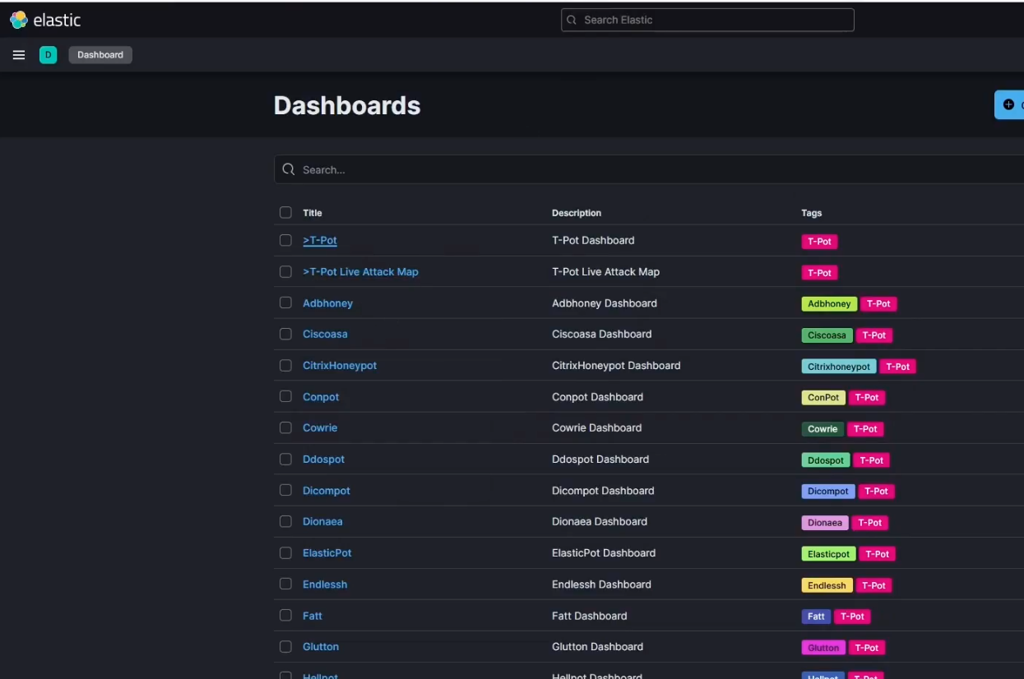

title
Let's collaborate with faculty/students

Slide 7

Questions?
Notes:
Download video of how to create a HoneyPot:
https://drive.google.com/file/d/1ojCK7mvNsQvnW5NMEa_3dFVdbYJ6hsTR/view?ts=6282880f
Ansible TPOT:
https://gitlab.com/deception_capstone/deception-lab/-/tree/main/ansible-playbooks/configs/tpotmodifiedconfig

