Slide 1

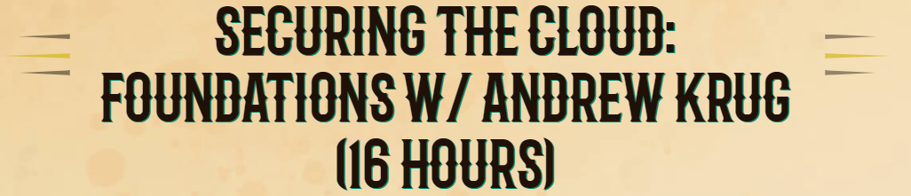

Secure Cloud Debrief

Slide 2
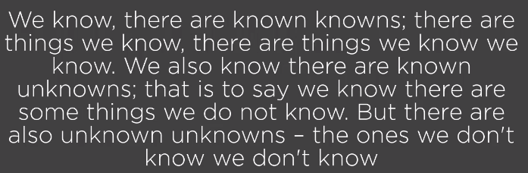
“\
- Donald Rumsfeld quote…

Slide 3


Overview
Four days…
Securing the Cloud: Foundations w/ Andrew Krug - Training (wildwesthackinfest.com)

Slide 4

Day1
Credential leaks are still the #1 cause of AWS Security Incidents

Slide 5
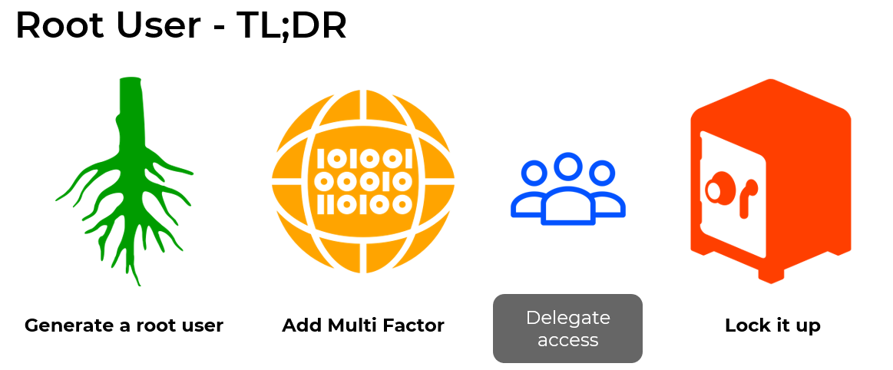
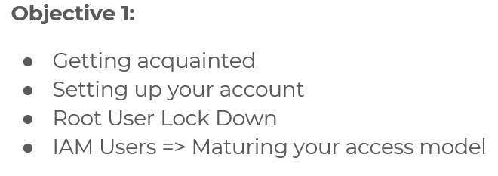
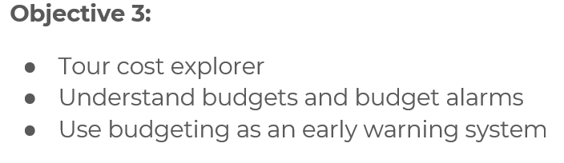
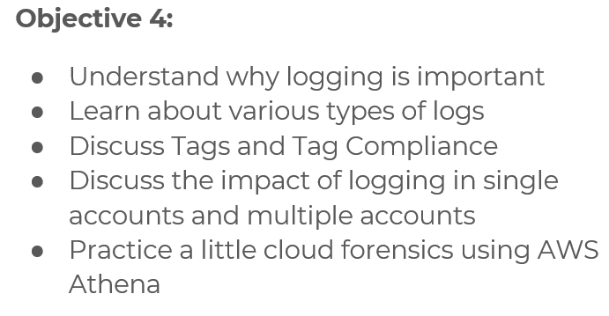
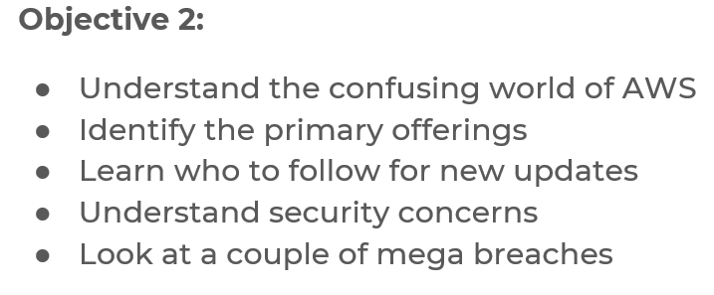
Day1

Slide 6
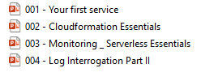
Day2
Create Service, accounts, s3, etc with CloudFormation Templates

Slide 7
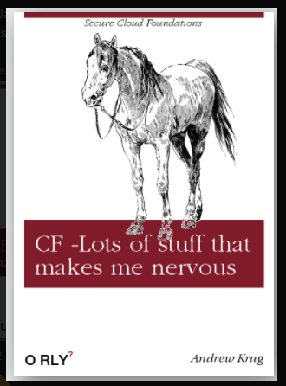
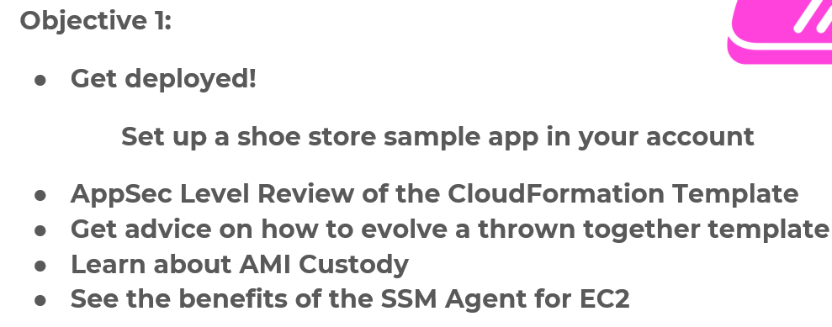
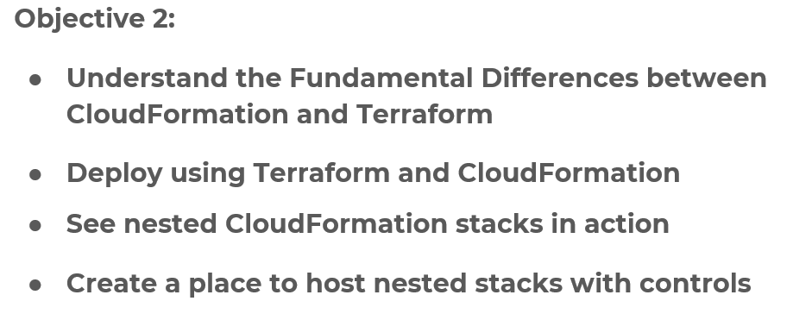
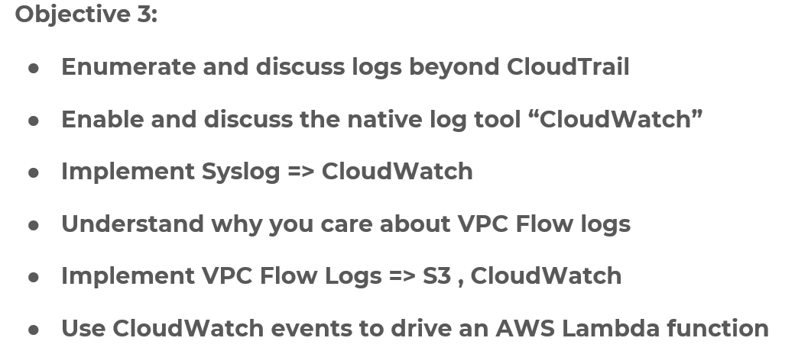
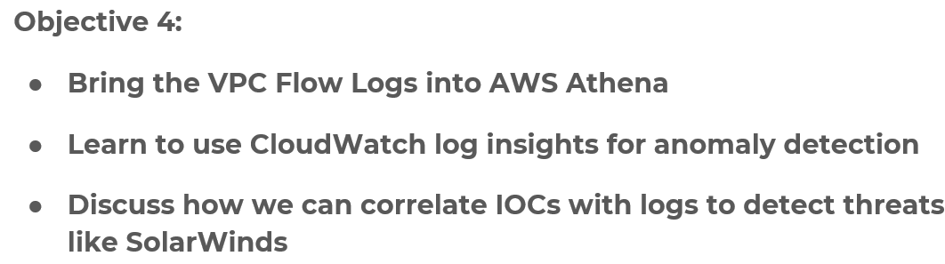
Day2

Slide 8
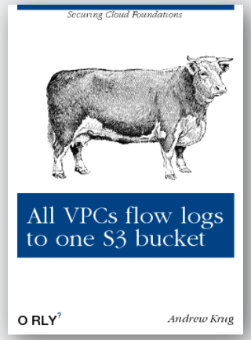
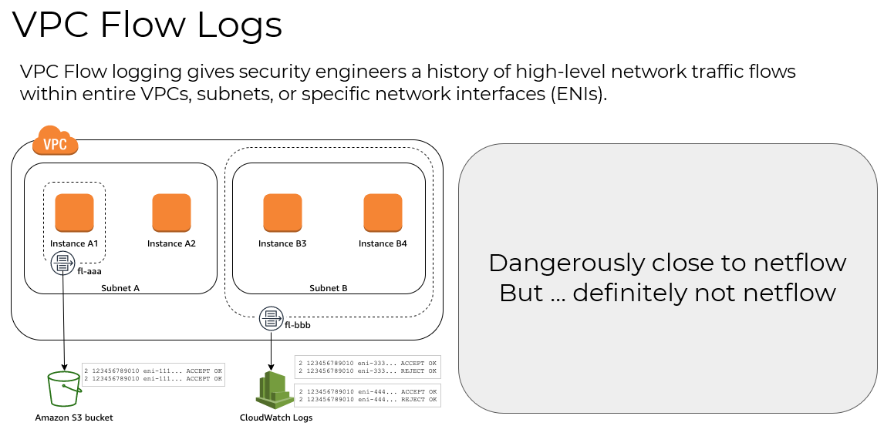
Day2 extend: VPC logs

Slide 9
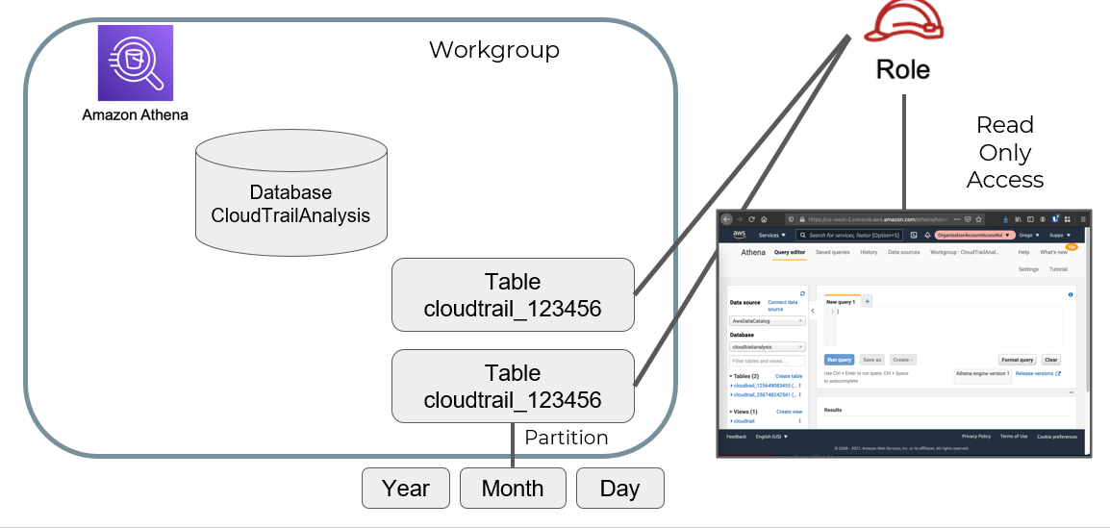
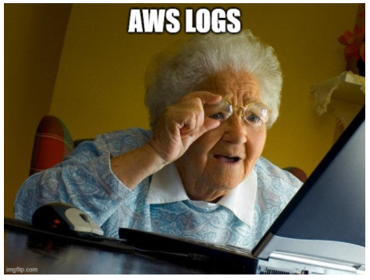
Day2 extend: Athena

Slide 10
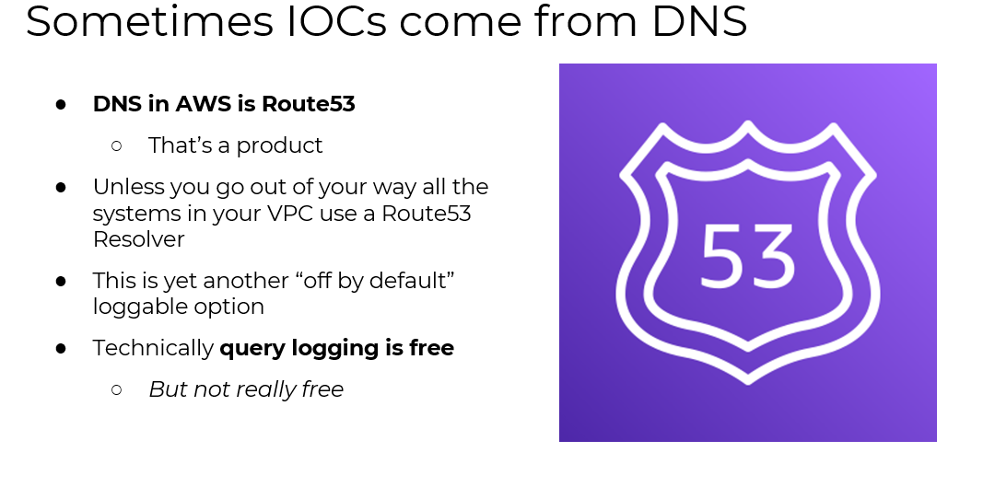
Day2 extend: DNS

Slide 11
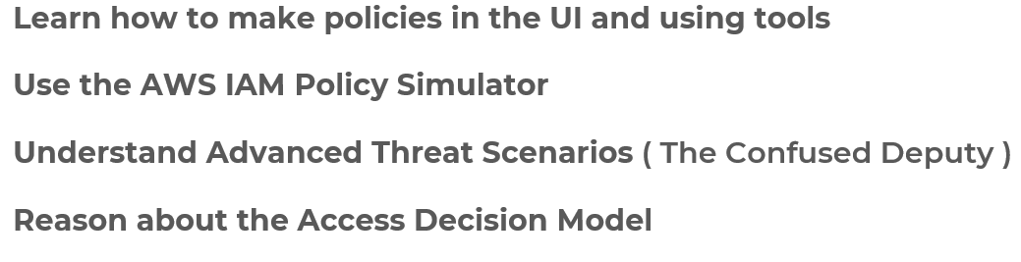
Day 3 –JUST Identity Access Mgmt
IAM Policy Deep Dive

Slide 12
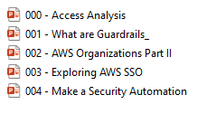
Day 4

Slide 13
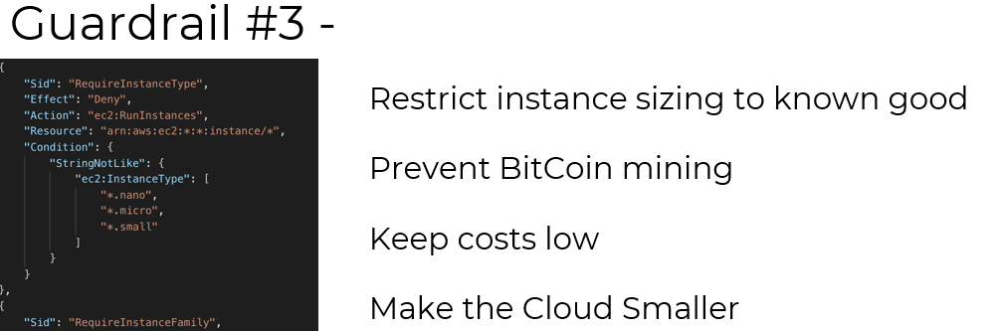
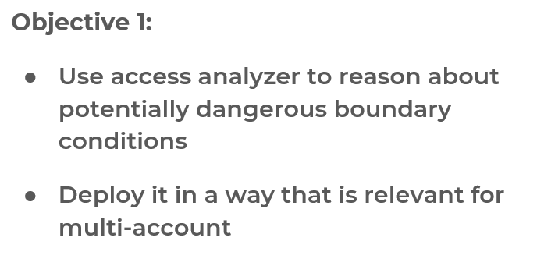
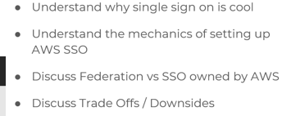
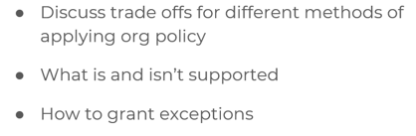
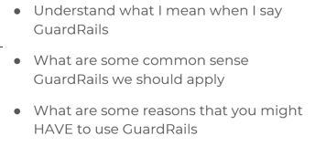
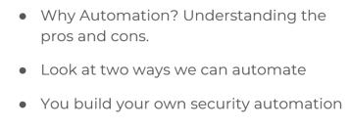
Day4 extend:

Slide 14
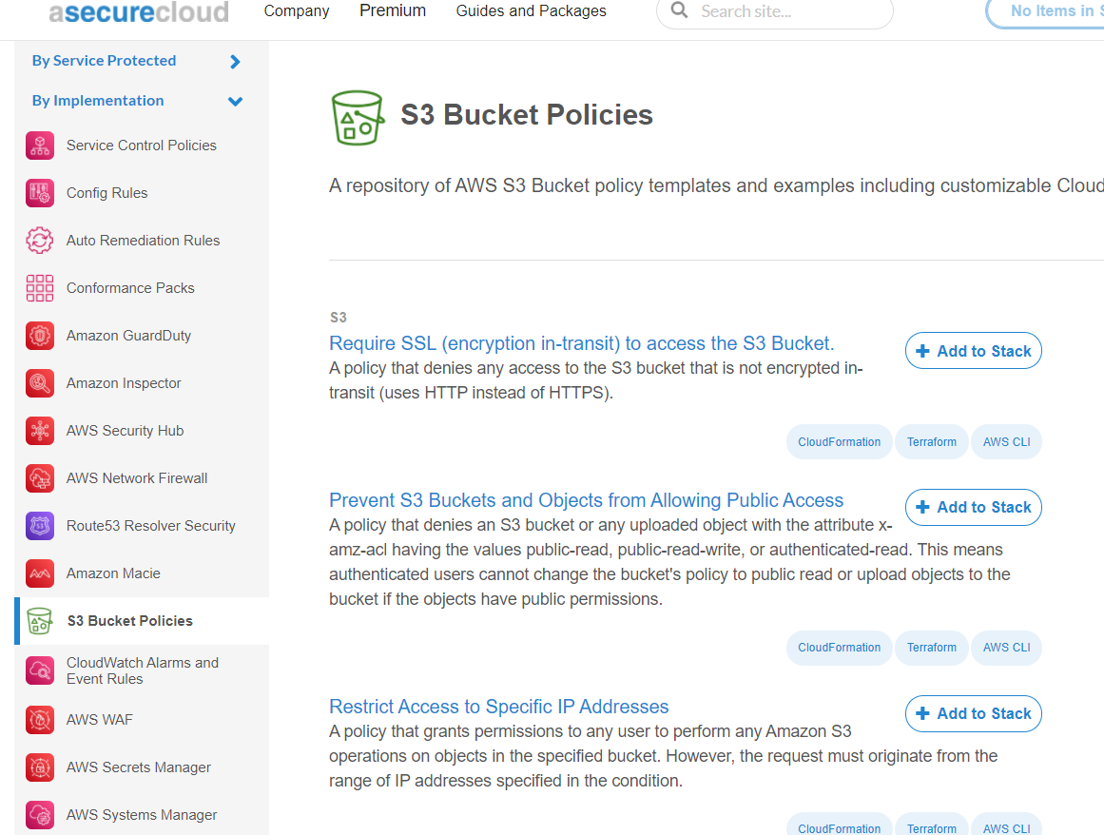
Policies
AWS Service Control Policy (SCP) Repository (asecure.cloud)

Slide 15





Secure Configs at Cloud level? & OS Level? Policies? SCP?
Questions to ponder for CISO office???
How many UW AWS accounts are there? Root only? UW-IT provides Root... however the root person can add additional account.
How many S3 buckets? Predate secure by default, should we alert them?
VPC and logs? How do we do IR/Monitor in the cloud? Athena
AWS DNS? How do we protect the cloud?
Lamda functions to tear down if CloudWatch alerts... bitcoiner, time limits for Devs...

