Slide 1

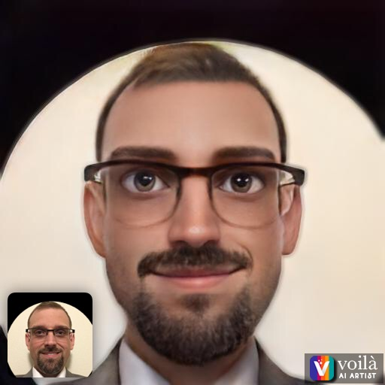
Cybersecurity Advisor
University of Washington
Notes:
I work at the University of Seattle/Bothell
I'm a GOOD hacker (super computer user) versus the bad hackers are Evil.... and help others protect against them evil doers.
I Help Leadership and Managers of orgs and departments about IT-Security concerns.
Example: Don't give someone that contacted you via text or email money via : Gift Cards, Amazon, GooglePlay, Xbox live, etc.
Xmas, disasters (COVID, Earthquake, Hurricane), etc.

Slide 2

Path
Notes:
Path to cybersecurity advisor was by Education and Friends helping me learn and helping me get a job.
A lot of late nights learning via YouTube, and Google and Forums (discord, slack, twitter, etc)
Good things will happen!
We are not alone and there is a whole world around us to help!
We all can't know everything so I picked what I love (Cybersecurity) and learned everything there is about it to share with others.

Slide 3



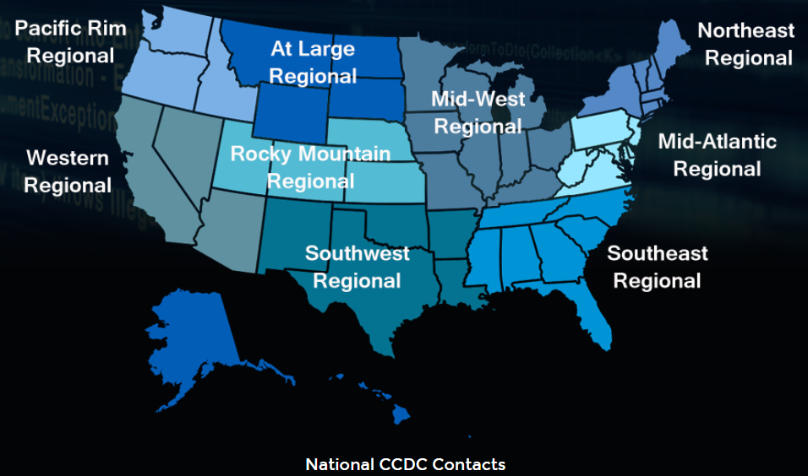
Cybersecurity training Examples;
National Collegiate Cyber Defense Competition (nationalccdc.org)
https://www.blackhillsinfosec.com/30-things-to-get-you-started/
Notes:
https://www.blackhillsinfosec.com/30-things-to-get-you-started/
https://www.hackthebox.eu/
https://tryhackme.com/
National Collegiate Cyber Defense Competition (nationalccdc.org)
Fun at CCDC: curl parrot.live

Slide 4

QUESTIONS?
Notes:
So at this time; I'm inviting you to ask questions.
https://www.polleverywhere.com/free_text_polls/REMSOwnNHMK69iEDPkkT6
What is interesting that you Learned for Cybersecurity!

