Slide 1
Misconfigurations Cyber Criminals hope you missed in Active Directory
...
Notes:
Spreadsheet of Tools/Projects:
https://docs.google.com/spreadsheets/d/1PLm37YWcV9dAwEAPx5p71aL2DtW3wJBzwRfMjdetcwQ/edit?usp=sharing
Verizon DBIR: 2022-data-breach-investigations-report-dbir.pdf (verizon.com)

Slide 2
Disclaimer
Following presentation contains my thoughts, ideas and opinions. They do not represent those of my current or past employers.
Any events, characters and company depicted in the course of this presentation are purely fictitious. Any similarity to actual events, characters and company is merely coincidental. <-Like South Park!
Do not use these tactics/techniques presented for evil.
Notes:
Example of Disclaimer:
CISA Compiles Free Cybersecurity Services and Tools for Network Defenders | CISA

Slide 3
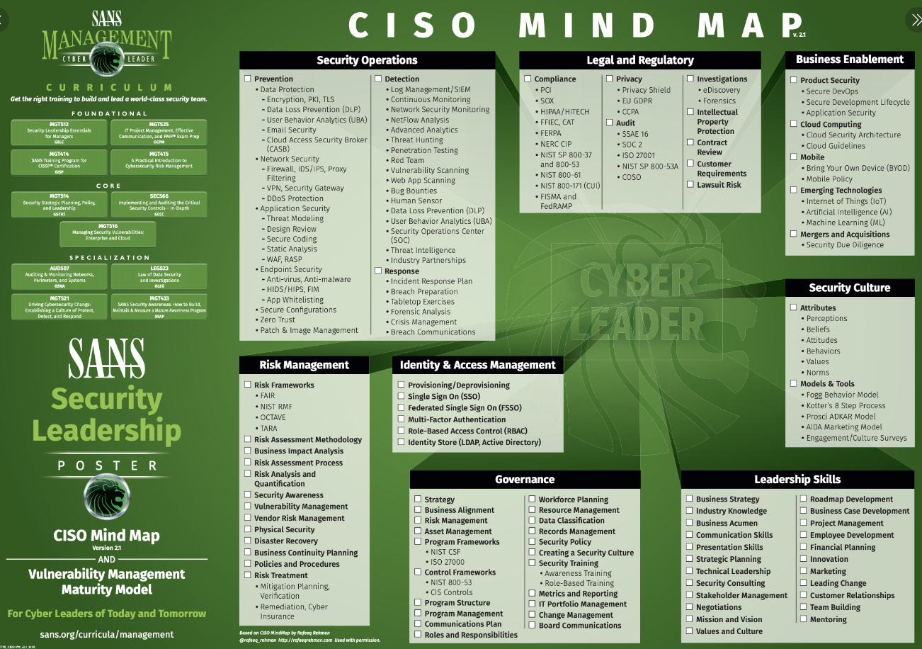
https://tinyurl.com/cisotweet
Notes:
SANS Institute on Twitter: "Do you have the latest SANS #cybersecurity posters like this gem, #CISO Mind Map, from SANS Security Leadership? Download your copy: https://t.co/EGtTUwZEFr https://t.co/ruc8cu85sI" / Twitter
https://twitter.com/SANSInstitute/status/1263825718024310784/photo/1

Slide 4
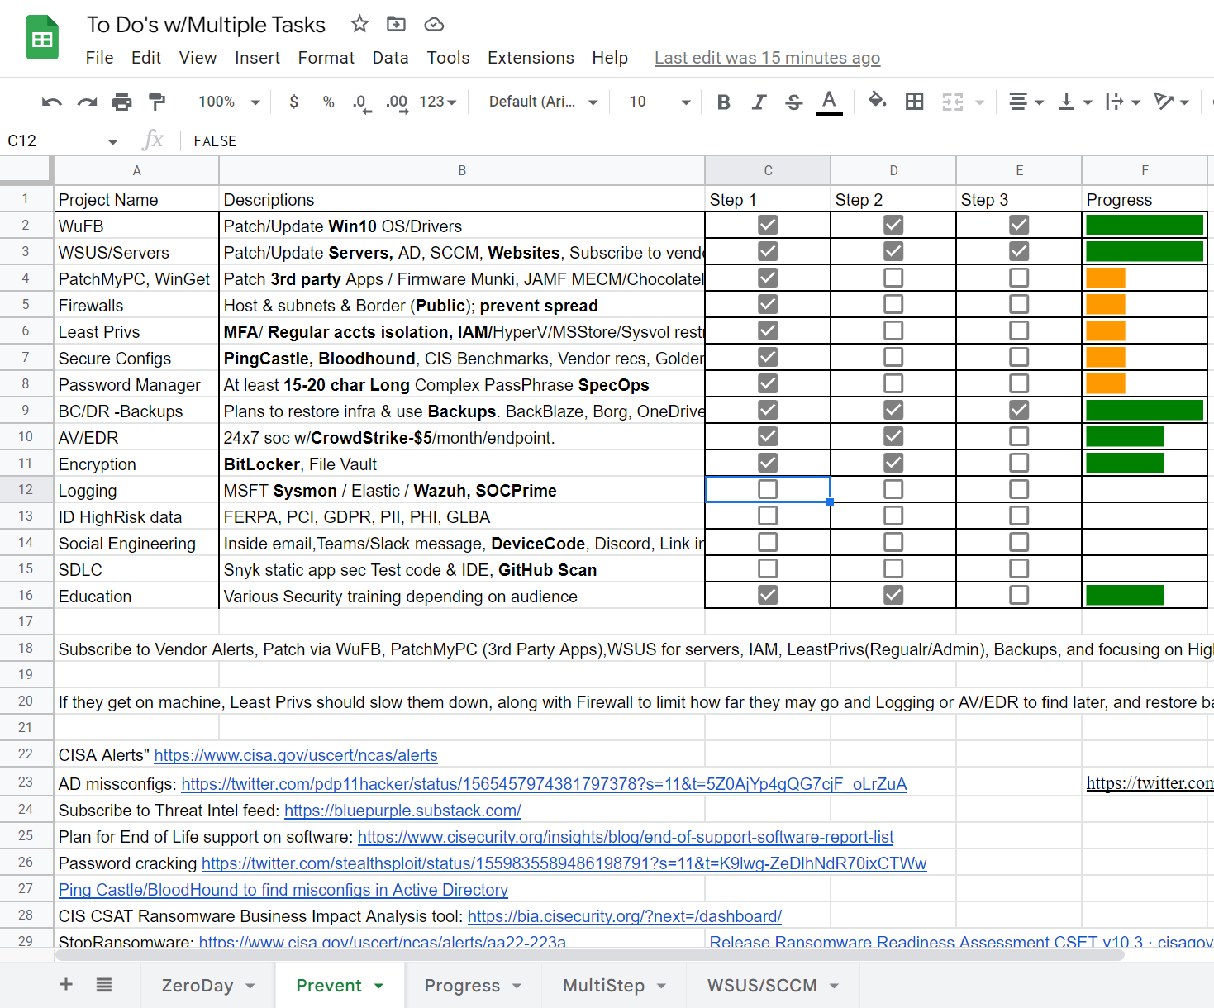
Security Projects (Security Pan/Program?)
https://tinyurl.com/xlsProj
Notes:
UW GoogleSheets:
https://docs.google.com/spreadsheets/d/14SuyZOHVYs3PnGzfu_sTUigj2LVNbl02fkV0HtJ6fnA/edit?usp=sharing
Ransomware Protection in Windows
Sophos Central – IT Connect (uw.edu)
End-of-Support Software Report List (cisecurity.org)
Time to Patch – Krebs on Security
Maybe look at Winget, AutoUpdate Windows, Ansible, Chocolatley, AutoPatch via Azure tenant/inTune
Vulnerability Summary for the Week of August 15, 2022 | CISA
Cyber Defence News for Blue & Purple Teams | Ollie | Substack
Whats Shodan or Censys.io look like for your Public IPs?
https://holisticinfosec.blogspot.com/2016/12/the-dfir-hierarchy-of-needs-critical.html
FuzzySecurity/WWHF-WayWest-2022 at fba2475d2f8dc7b7999cc5994ac340ca1db62090 (github.com)

Slide 5
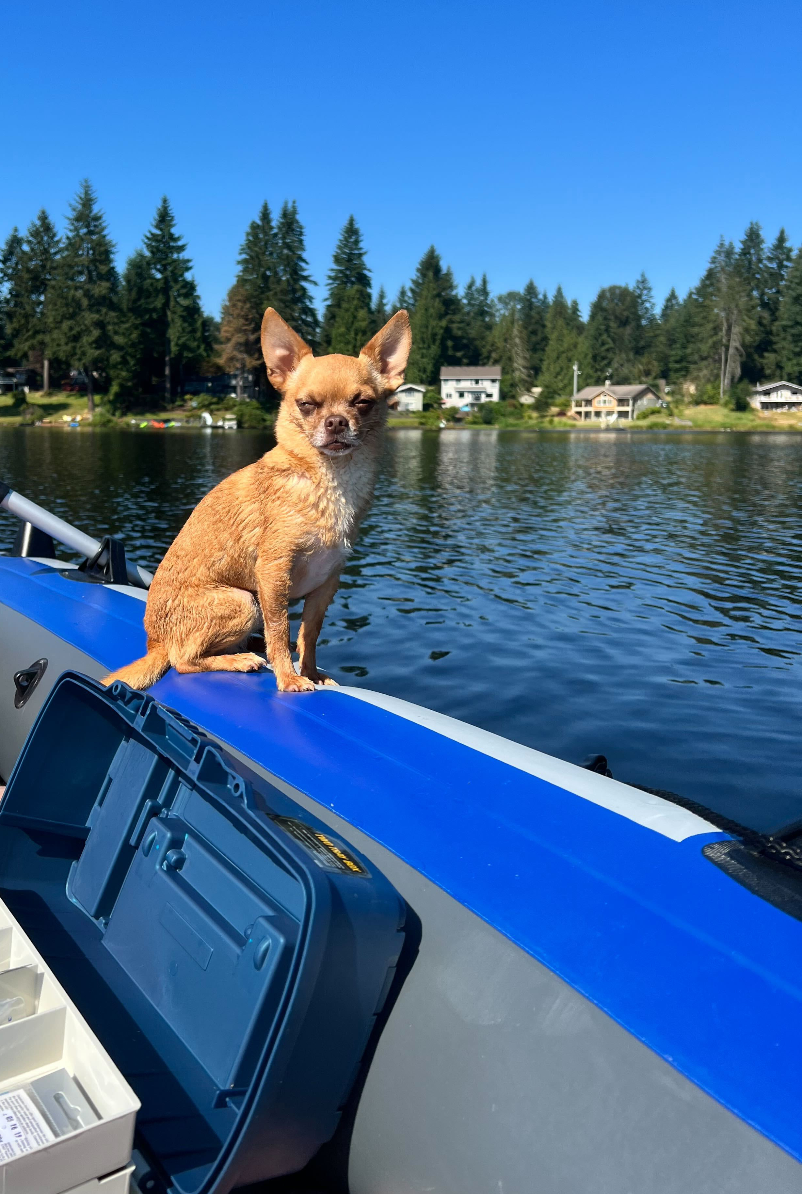
Who is this?
  Currently:
    Proud Pet Parent!!! -->Rocky
    Sr. Cybersecurity Advisor
Past….
SIEM as a Service
Vulnerability Service
Digital Forensics
Implement Cybersecurity initiatives WuFB, LAPS, Secure GPOs, IR, Backups BC/DR
  Education:
    Master of Science, Cybersecurity & Info Assurance
    50+ Industry Certifications
  https://www.linkedin.com/in/jessefmoore/
Notes:
Stories/Reasons: I am A..., Who Helps..., Because...
Email everyone you know letting them know you would never ask for gift cards or wire transfers
Security is my after work hobby, so I am passionate about it.

Slide 6
Agenda
Find Active Directory Misconfigs
Help stop worrying if news items affect you
Workshop material for Admins
Notes:
Stories/Reasons: I am A..., Who Helps..., Because...
Email everyone you know letting them know you would never ask for gift cards or wire transfers
Security is my after work hobby, so I am passionate about it.

Slide 7
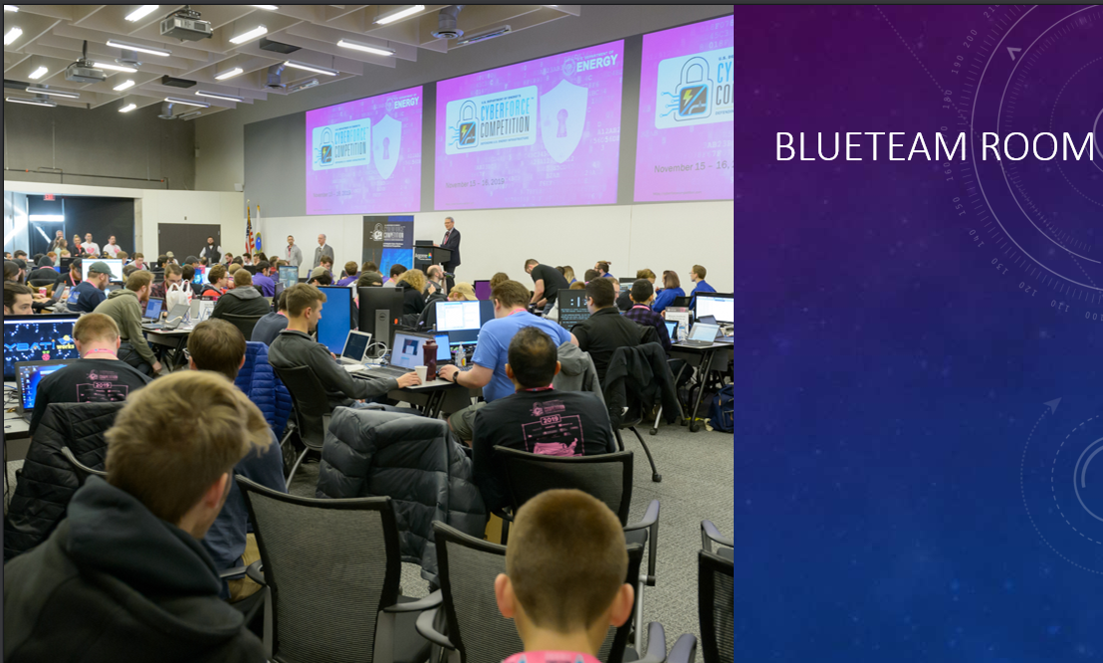
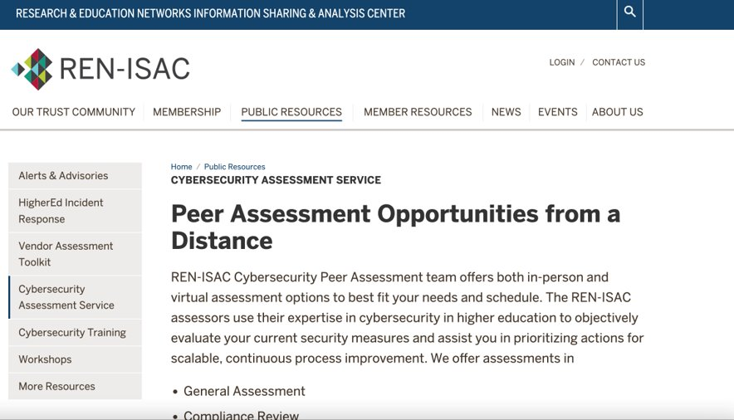
What has Jesse Been up to?
Since we last met…
I’ve been working on building CyberForce Comp.
https://tinyurl.com/cybforce
REN-ISAC Pentester
CISO workshops; https://ciso.uw.edu/education/outreach/workshops/#badthings
Notes:
CyberForce: Velociraptor, Blueteam Defense tools against Red and Dev Red Team vulns
Training; Phish with device codes, Setup C2 and obfuscate payload, and how to enum Teams and Search email.

Slide 8
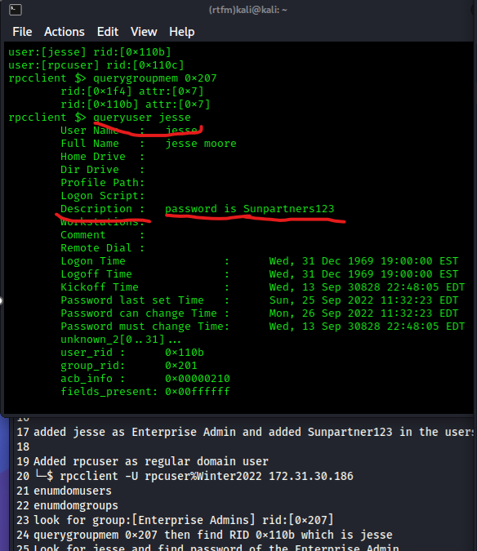
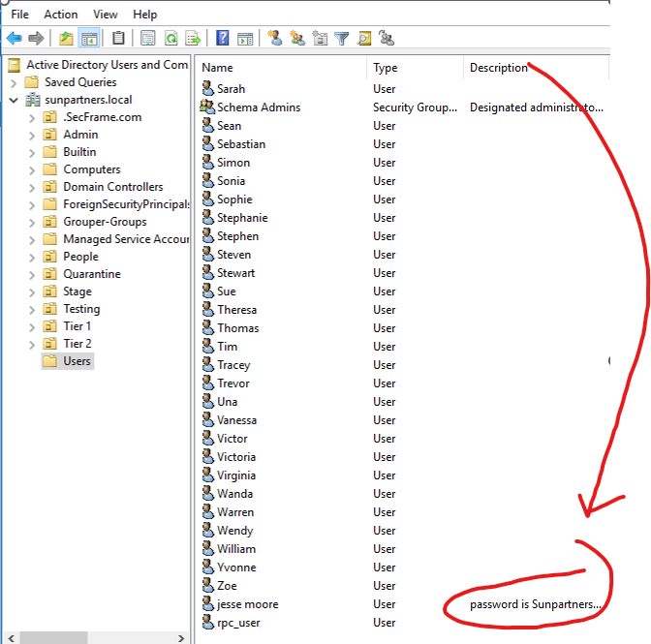
AD Misconfig using regular domain user

Slide 9
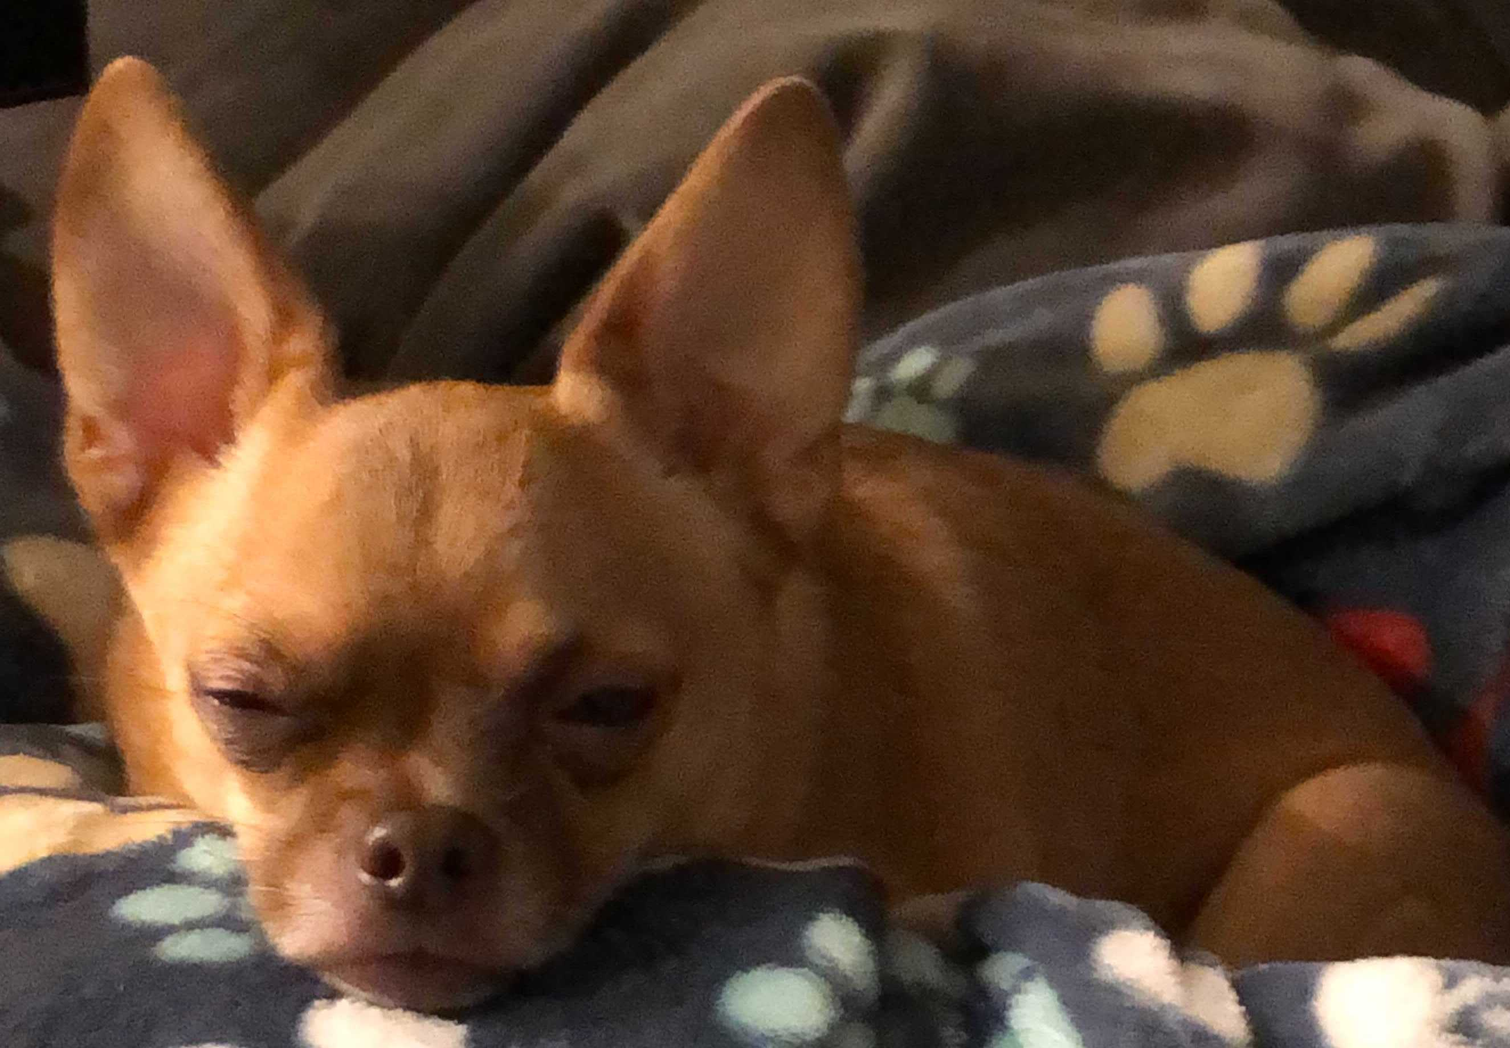
misconfig at Home?
Windows Update on​​​
Router/WiFi default pass, Firmware update
Turn on Encryption: File Vault & Bitlocker
Sophos Home https://home.sophos.com/en-us
OneDrive Cloud: https://screencast-o-matic.com/watch/c3Qv34VtipM
Notes:
OneDrive Recovery:
https://screencast-o-matic.com/watch/c3Qv34VtipM
Restore from BackBlaze:
https://screencast-o-matic.com/watch/c3QuqvVtcqw
Sophos Home
https://home.sophos.com/en-us
Borg Backup for Linux
https://borgbackup.readthedocs.io/en/stable/installation.html

Slide 10
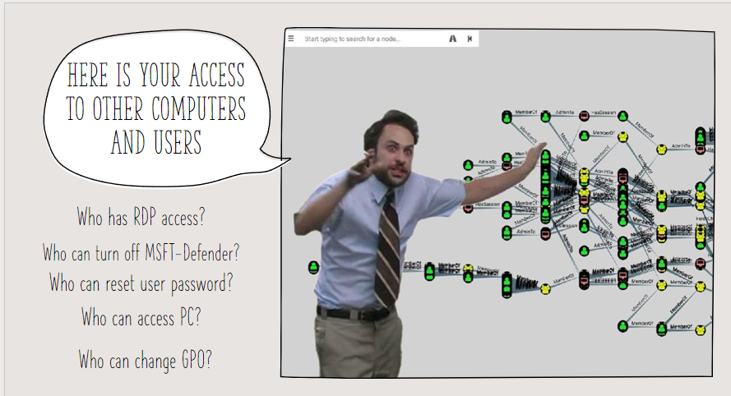
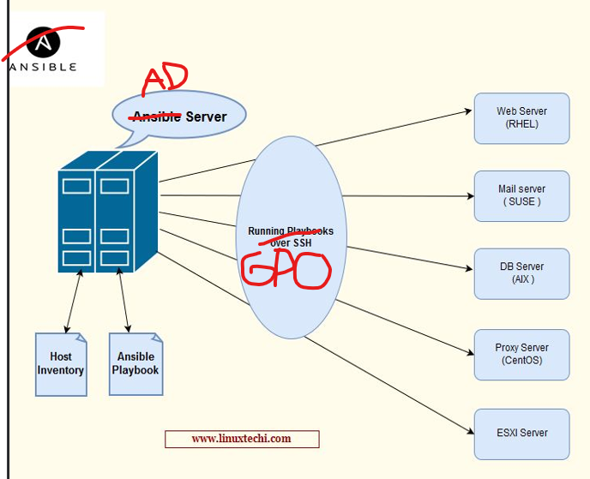
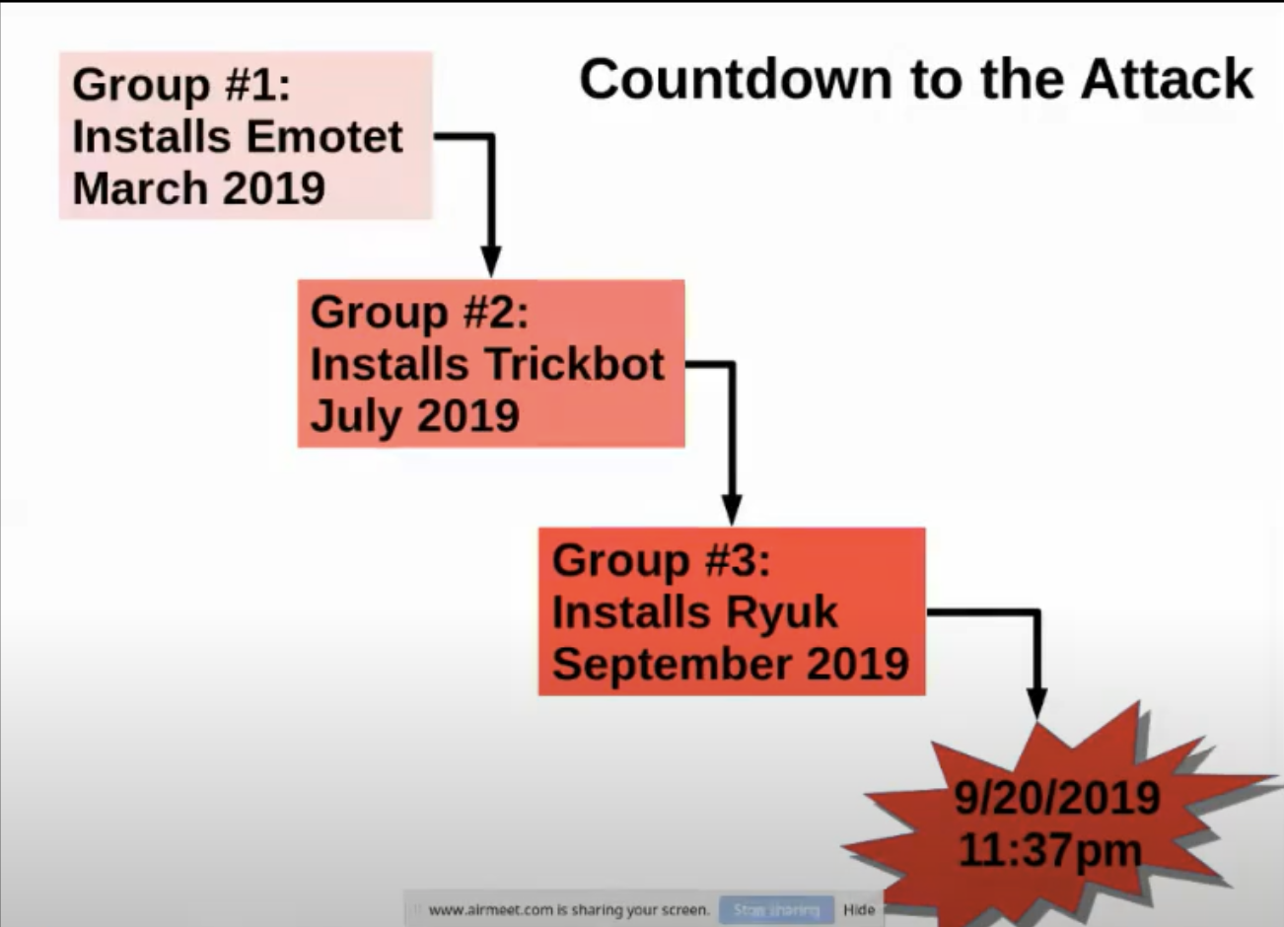
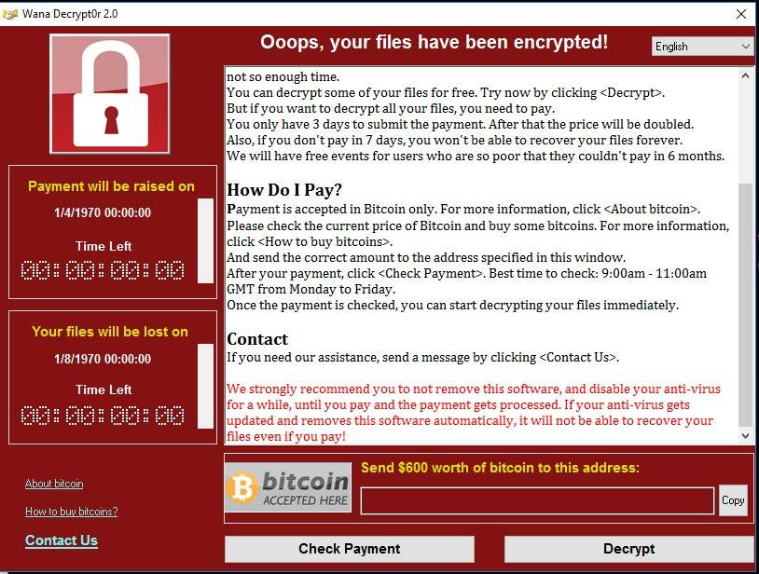
School Active Directory hit by Ransomware! School had Insurance!!!
what about all the steps while they are in?
Northshore School district System admins share their experience:
https://www.youtube.com/watch?v=HwfRxjV2wok
Notes:
files/translate_f.pdf at main · silence-is-best/files (github.com)
The hateful eight: Kaspersky’s guide to modern ransomware groups’ TTPs | Securelist
Jessica from Microsoft (IR at the time):
https://twitter.com/jepaynemsft/status/1255991971845308416
https://attack.mitre.org/groups/

Slide 11
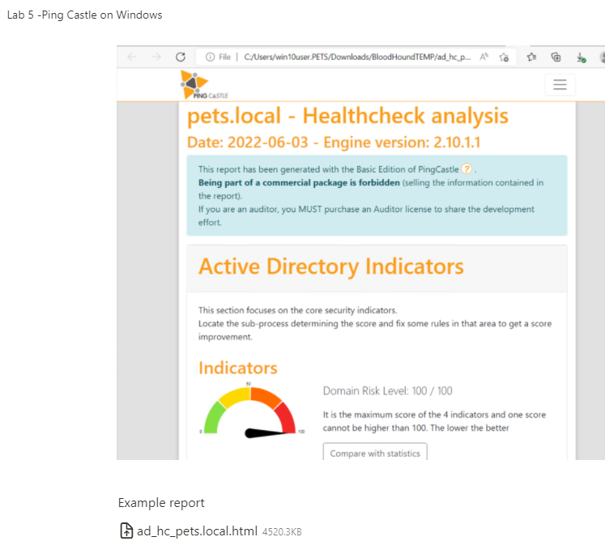
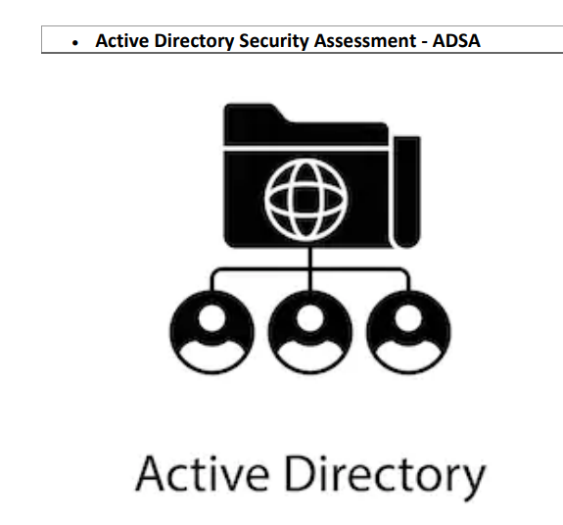
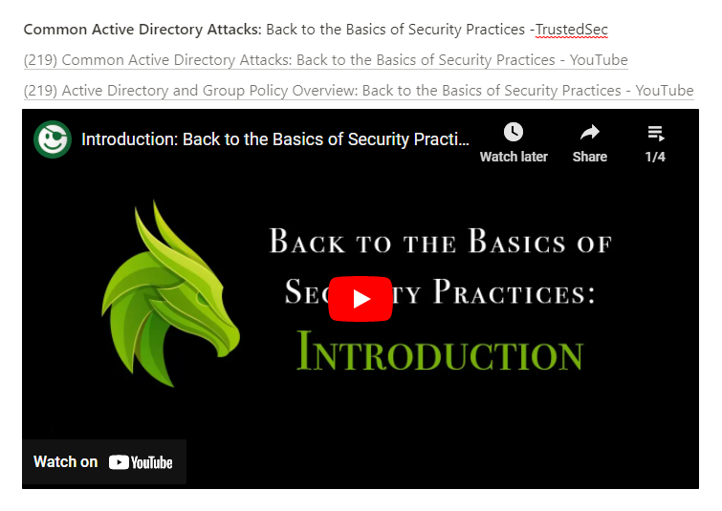
AD Assessment
https://tinyurl.com/WSBloodHound
https://tinyurl.com/ADefence
Notes:
TrustedSec -Back to the Basics of Security Practices
https://www.youtube.com/watch?v=dJT2pVNAbfA&list=PLk-dPXV5k8SEtiTgi9wgxmDS0CCZQur6H
PingCastle AD Assessment
https://www.pingcastle.com/download/
Active Directory On-Demand Assessment
https://learn.microsoft.com/en-us/services-hub/health/getting-started-ad

Slide 12
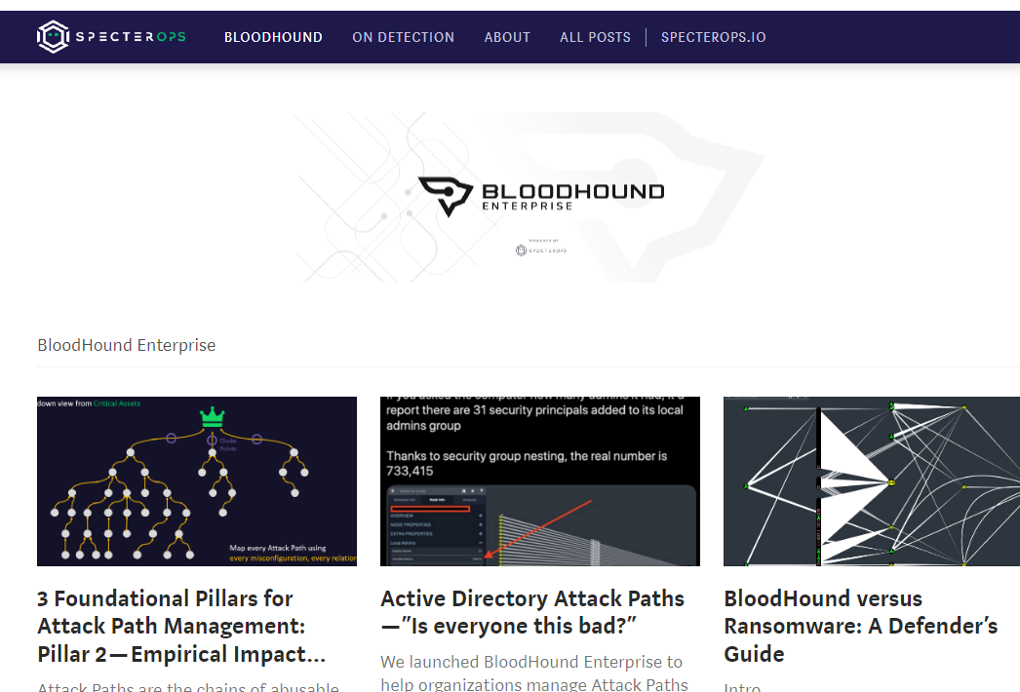
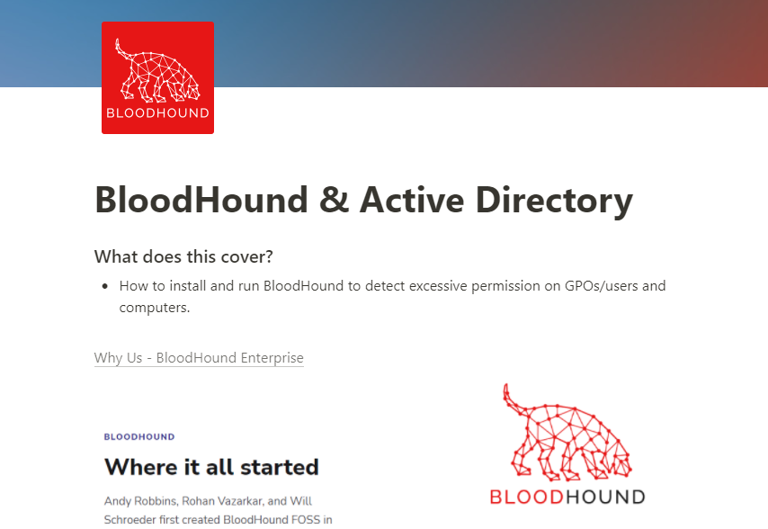
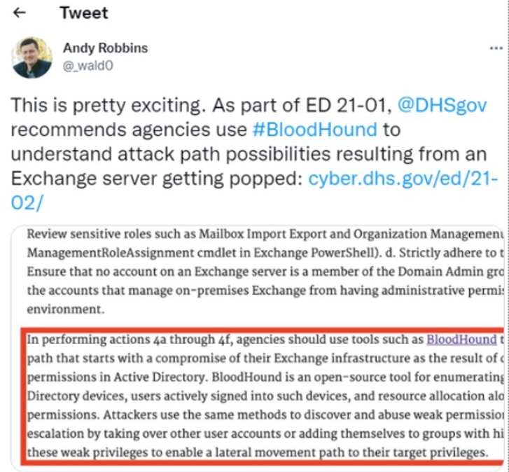
AD Assessment Part 2
https://tinyurl.com/WSBloodHound
Notes:
https://grizzly-dibble-cdb.notion.site/BloodHound-Active-Directory-8771c2bd8f11403cbd108b83d97f3053

Slide 13

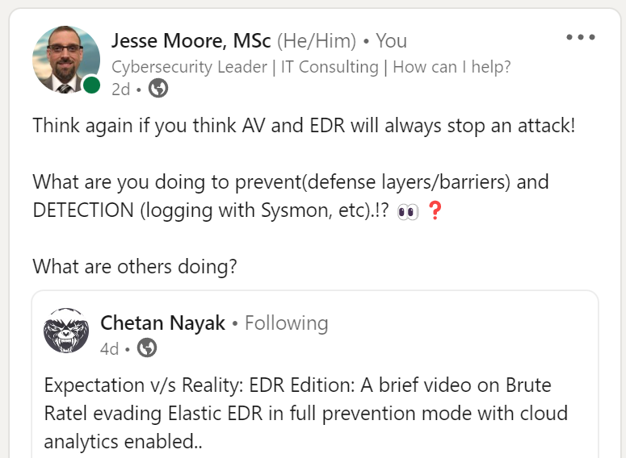
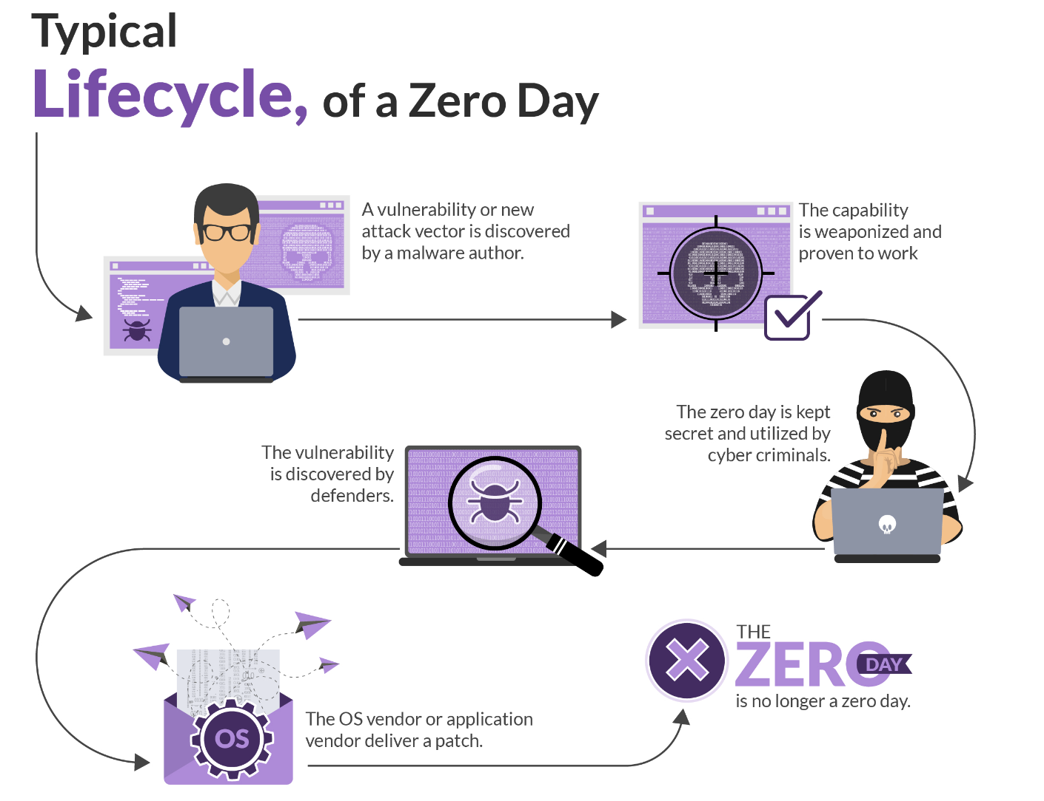
Go over an attack
https://thedfirreport.com/
https://tinyurl.com/BruteRatel
Notes:
https://thedfirreport.com/
Brute Ratel:
https://www.youtube.com/watch?v=hAHkJSPCc2A

Slide 14
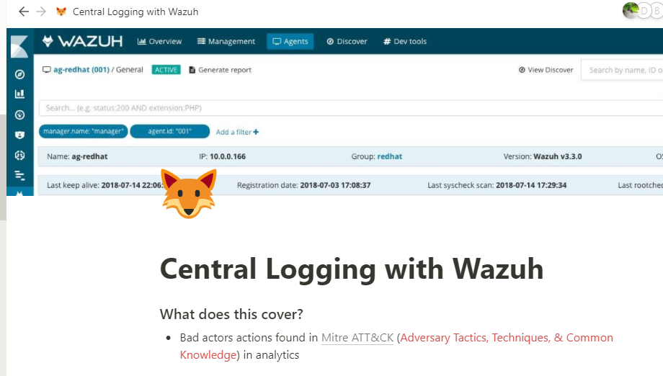
If its not logged it didn’t happen!
Need the right data aka such as Sysmon
https://tinyurl.com/wazuhWS
Notes:
https://grizzly-dibble-cdb.notion.site/Central-Logging-with-Wazuh-278119388a16411e9cf2ae6ba39a90c8
The DFIR Report – Real Intrusions by Real Attackers, The Truth Behind the Intrusion
Sept 6th
Over the past several years, the education sector, especially kindergarten through twelfth grade (K-12) institutions, have been a frequent target of ransomware attacks
The 18 CIS Critical Security Controls (cisecurity.org)

Slide 15
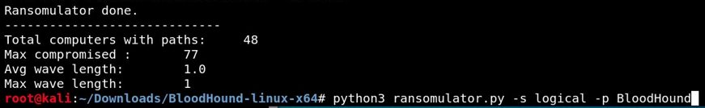
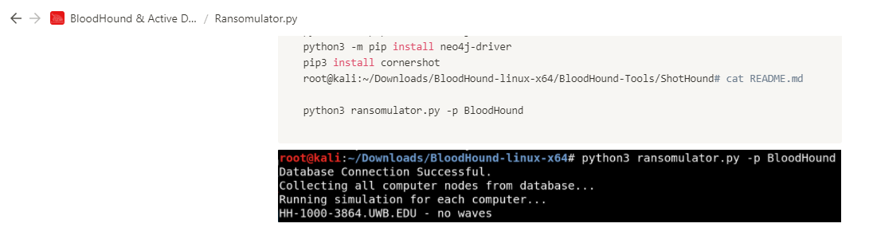
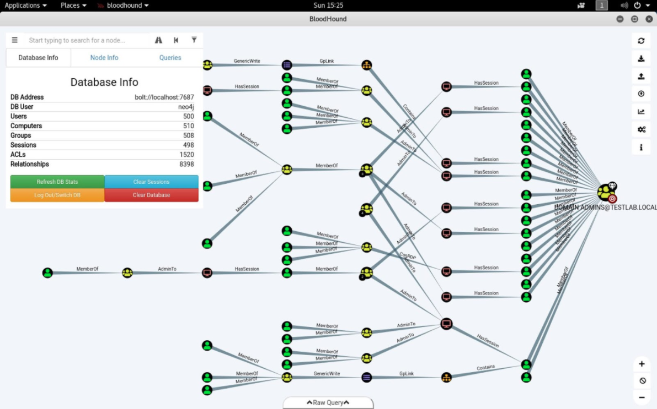
TIP: Simulate Ransomware in Active Directory.
https://tinyurl.com/RansomWS
Notes:
AD Mitigations:
https://www.youtube.com/watch?v=vga7A2tYejE&t=5s
Simulate Ransomware: sudo git clone https://github.com/zeronetworks/BloodHound-Tools/tree/main/Ransomulator
sudo apt-update
sudo apt-upgrade
sudo apt-get install python3-pip
sudo apt-cache madison neo4j
python3 -m pip install neo4j
python3 -m pip install neo4j-driver
pip3 install cornershot
root@kali:~/Downloads/BloodHound-linux-x64/BloodHound-Tools/
python3 ransomulator.py -p BloodHound

Slide 16
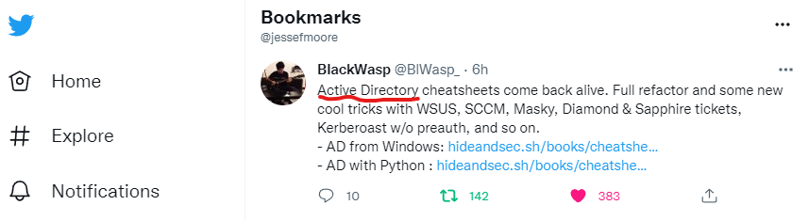
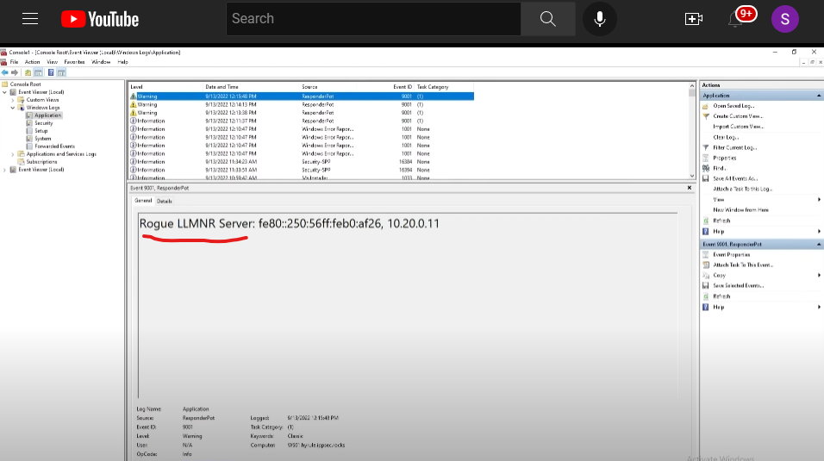
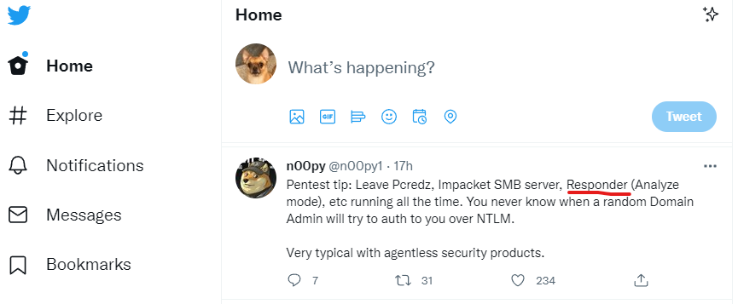
TIP: Early warning detection system (LLMNR and Twitter?)
https://twitter.com/jessefmoore
https://tinyurl.com/EarlyDetections
Notes:
(19) Detecting Responder via LLMNR Honey Tasks on User Workstations – YouTube
https://www.youtube.com/watch?v=h_cWWL-yyb0&t=295s
Twitter API:
https://screencast-o-matic.com/watch/c3QFqHVOwRy
Twitter Pentester/Red Teamer:
https://twitter.com/n00py1/status/1577045510036557824
Twitter on finding SHARES in AD
https://twitter.com/mpgn_x64/status/1572968433465032705?s=20&t=ZRlajZnT3l9Irgzum-53Vw
Responder:
https://screencast-o-matic.com/watch/cqiveFOp0E
Slack to Responder:
https://screencast-o-matic.com/watch/cYfV024AGF
AD CheatSheets: https://hideandsec.sh/books/cheatsheets-82c/page/active-directory

Slide 17

















Steps to move thru your machine
Source: https://www.microsoft.com/security/blog/2020/04/28/ransomware-groups-continue-to-target-healthcare-critical-services-heres-how-to-reduce-risk/
https://tinyurl.com/StepsInsideNet
Notes:
https://www.microsoft.com/security/blog/2020/04/28/ransomware-groups-continue-to-target-healthcare-critical-services-heres-how-to-reduce-risk/
RDP brute force is trying to reuse passwords... HAVEIBEENPWNED
Vuln on Internet –see it with Shodan or nmap or other free tools to find CVEs and easily exploit.
Weak application settings... Patch, secure configs, GPO settings, firewall, segmentaion, logging, etc
Responder:
https://screencast-o-matic.com/watch/cqiveFOp0E

Slide 18
Admin Tools ; slow down hacker... to ease your mind...when news hits!
WSUS Patch servers
Password Managers
WuFB Patch oS/Drivers WS
DR/BC (BACKUPS)to Recover from incident
PatchMyPC 3rd party Apps
Bitlocker, Filevault prevent lost data
EDR, Anti Virus​​ (turn off AV?)
SCCM/MECM Software update/Patch
Logging (Wazuh, Elastic, splunk, Sentinel, Azure Log Analyzer) find malicious/audit
Vendor best practice 2Secure
End Of Life software
2FA Apps/email SPAM appliance
Pentest high impact (finable, etc) systems
Firewall, VPN on Host & Network for Public/Private
https://www.cisa.gov/stopransomware/ransomware-guide
LAPS && Separate admin w/Regular
Label High Risk data
Notes:
https://www.cisa.gov/stopransomware/ransomware-guide
https://www.cisecurity.org/insights/blog/end-of-support-software-report-list
https://www.cisa.gov/uscert/ncas/bulletins
https://www.cisa.gov/uscert/ncas/alerts
https://bluepurple.substack.com/
https://krebsonsecurity.com/category/patches/
Whats Shodan or Censys.io look like for your Public IPs?
https://holisticinfosec.blogspot.com/2016/12/the-dfir-hierarchy-of-needs-critical.html
FuzzySecurity/WWHF-WayWest-2022 at fba2475d2f8dc7b7999cc5994ac340ca1db62090 (github.com)
https://www.cisecurity.org/terms-and-conditions-table-of-contents/cis-endpoint-security-services-via-crowdstrike

Slide 19
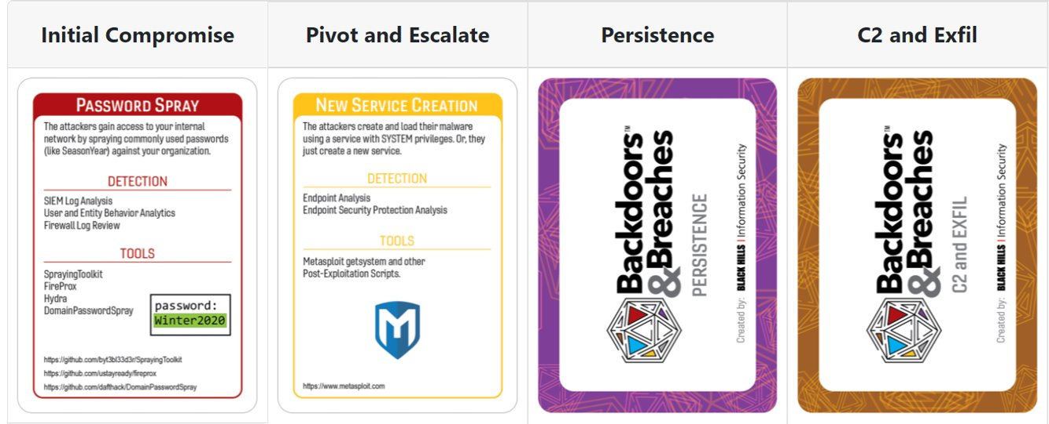
TableTop scenario to plan for
Scenario Developed:
  Add Computers to Domain, Turn off Defender, && run exploits (ransomware)
OR Table-Top: https://bnb.silverday.de/
Notes:
https://bnb.silverday.de/

Slide 20
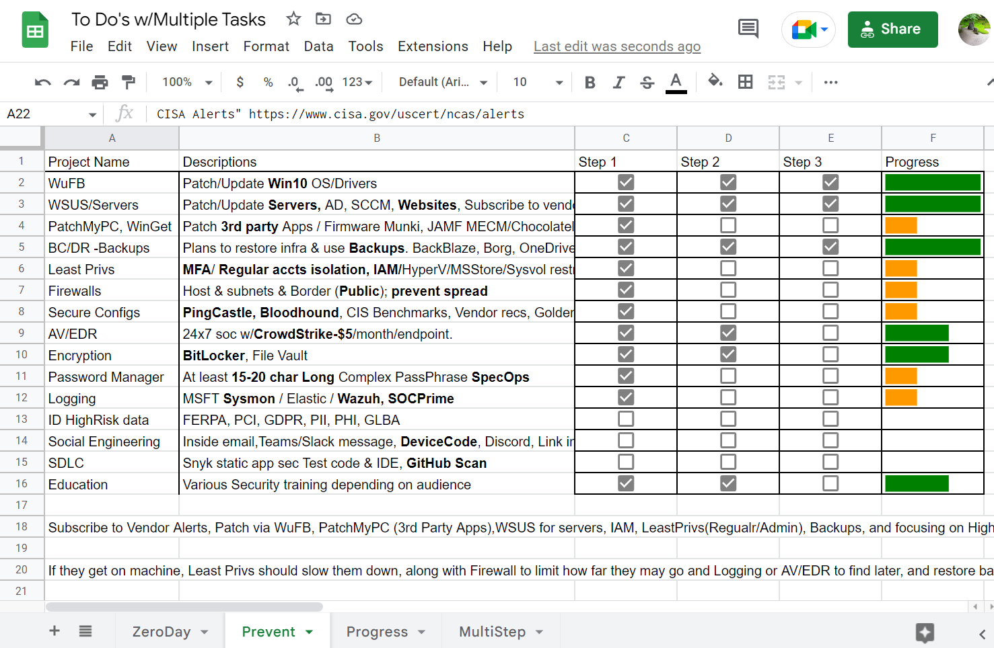
Security Projects to help you sleep better…
https://tinyurl.com/xlsProj
Notes:
UW GoogleSheets:https://docs.google.com/spreadsheets/d/1PLm37YWcV9dAwEAPx5p71aL2DtW3wJBzwRfMjdetcwQ/edit?usp=sharing
@_wald0 azure github
What are more areas that need to be focused on?
-Security controls builtin: GPO/Reg keys/ASR/SMB attack slow down(Win11 insider), first setup as Audit mode.
-Firewall to block Powershell.exe out to the Internet from endpoint or network
Mac/Linux: AuditD, Sysmon
MFA
Admin connect to 445 and regular users don’t. Use Palantir SACL
HoneyTokens
Allow teams to be creative 10% of the time to prevent burnout
Cultivate Healthy team that works together (Management)
Backups
Identity lifecycle
Patch mgmt. across platforms (Cloud/Mac/Windows/Linux/Containers)?
AD Mindmap:
https://tajdini.net/blog/penetration/active-directory-penetration-mind-map/
Ransomware Protection in Windows
Sophos Central – IT Connect (uw.edu)
End-of-Support Software Report List (cisecurity.org)
Time to Patch – Krebs on Security
Maybe look at Winget, AutoUpdate Windows, Ansible, Chocolatley, AutoPatch via Azure tenant/inTune
Vulnerability Summary for the Week of August 15, 2022 | CISA
Cyber Defence News for Blue & Purple Teams | Ollie | Substack
Whats Shodan or Censys.io look like for your Public IPs?
https://holisticinfosec.blogspot.com/2016/12/the-dfir-hierarchy-of-needs-critical.html
FuzzySecurity/WWHF-WayWest-2022 at fba2475d2f8dc7b7999cc5994ac340ca1db62090 (github.com)

Slide 21
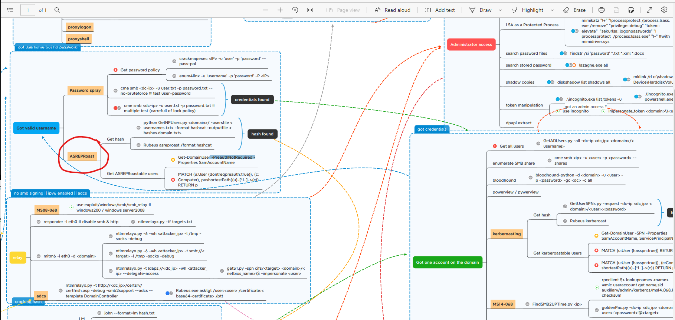
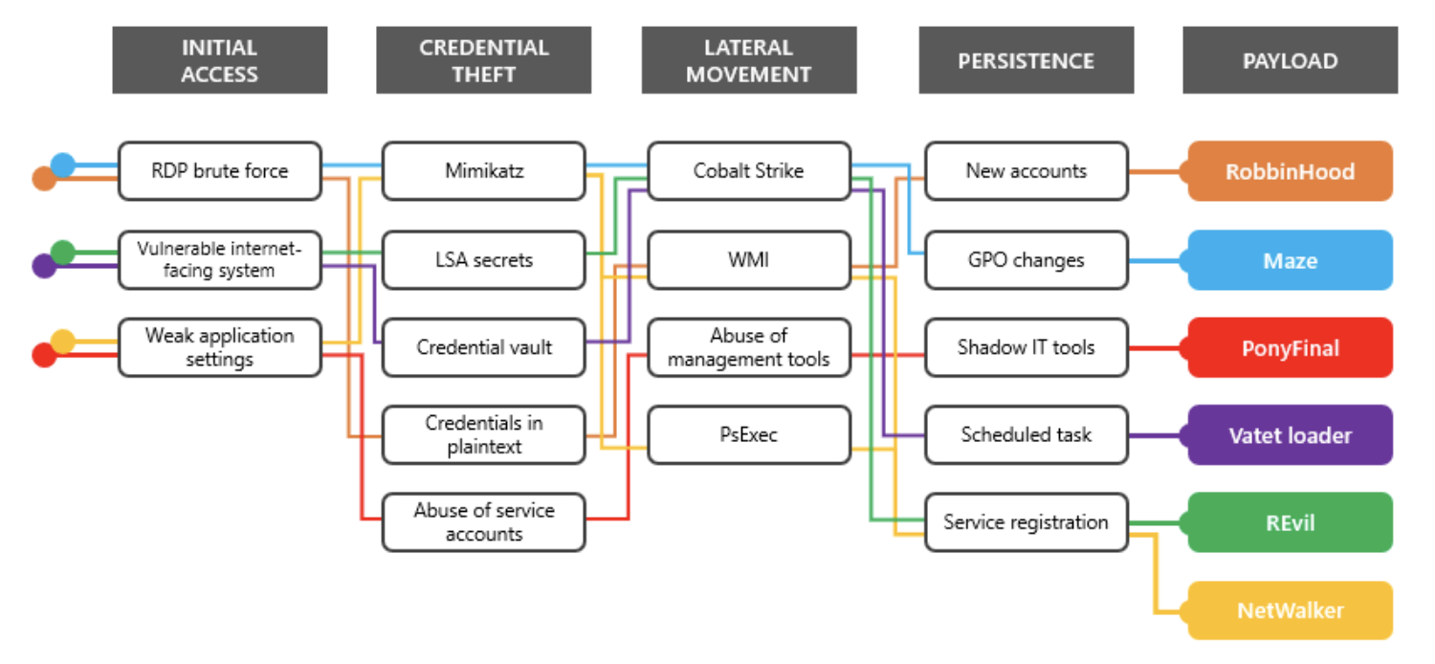
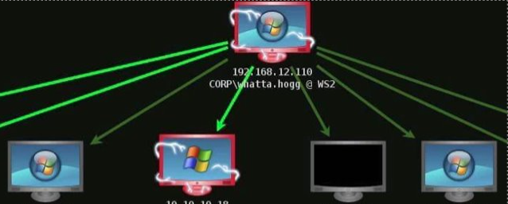
What you can’t See or Know; = What You can’t Detect/Prevent!
https://tinyurl.com/SlackFuzzy
https://tinyurl.com/ADMindmap
Notes:
REFERENCES
https://tajdini.net/blog/penetration/active-directory-penetration-mind-map/
https://tinyurl.com/ADMindmap
Impacket and Exfiltration Tool Used to Steal Sensitive Information from Defense Industrial Base Organization | CISA
No-cost cyber hygiene services: Cyber Hygiene Services and Ransomware Readiness Assessment.
FuzzySecurity/WWHF-WayWest-2022 (github.com)
https://github.com/FuzzySecurity/WWHF-WayWest-2022
Slack cookies stealer
https://www.youtube.com/watch?v=63TA4qspUjI
https://www.ninjaone.com/blog/sccm-vs-wsus-what-you-need-to-know/
WSUS
https://labs.nettitude.com/blog/introducing-sharpwsus/
https://github.com/nettitude/SharpWSUS
https://github.com/ctxis/wsuspect-proxy
SCCM
https://labs.nettitude.com/blog/introducing-malsccm/
https://github.com/PowerShellMafia/PowerSCCM
https://github.com/Mayyhem/SharpSCCM
https://tools.thehacker.recipes/mimikatz/modules/dpapi/sccm
https://github.com/GhostPack/SharpDPAPI
https://posts.specterops.io/the-phantom-credentials-of-sccm-why-the-naa-wont-die-332ac7aa1ab9

Slide 22
Take Aways…
Workshops: Protect AD with BloodHound, PingCastle, Wazuh (SIEM,XDR,FIM,CISBenchmarks,HID)
Project Plan: Spreadsheet to research, Patching, Configurations, and Get money/People trained
While you wait to “Hire a Hacker” to find GAPS look into CrowdStrike$5 SOC
https://tinyurl.com/JesseShare
Notes:
https://tinyurl.com/JesseShare
https://1drv.ms/u/s!AvDzzfldf6vDguJMC8lHXD8FF7B1dA?e=KuBa05
Part 1: Ransomware Prevention Best Practices:
https://www.cisa.gov/stopransomware/ransomware-guide

Slide 23
Thank you!
Outside of work: jessefmoore@gmail.com
@jessefmoore on Twitter
Collab at work: moorej1@uw.edu
Notes:
Tips and Tactics: Ransomware (nist.gov)
Release Ransomware Readiness Assessment CSET v10.3 · cisagov/cset (github.com)
CIS CSAT Ransomware Business Impact Analysis tool: https://bia.cisecurity.org/?next=/dashboard/
https://home.treasury.gov/system/files/126/ofac_ransomware_advisory_10012020_1.pdf
https://iclg.com/practice-areas/sanctions/usa

Slide 24
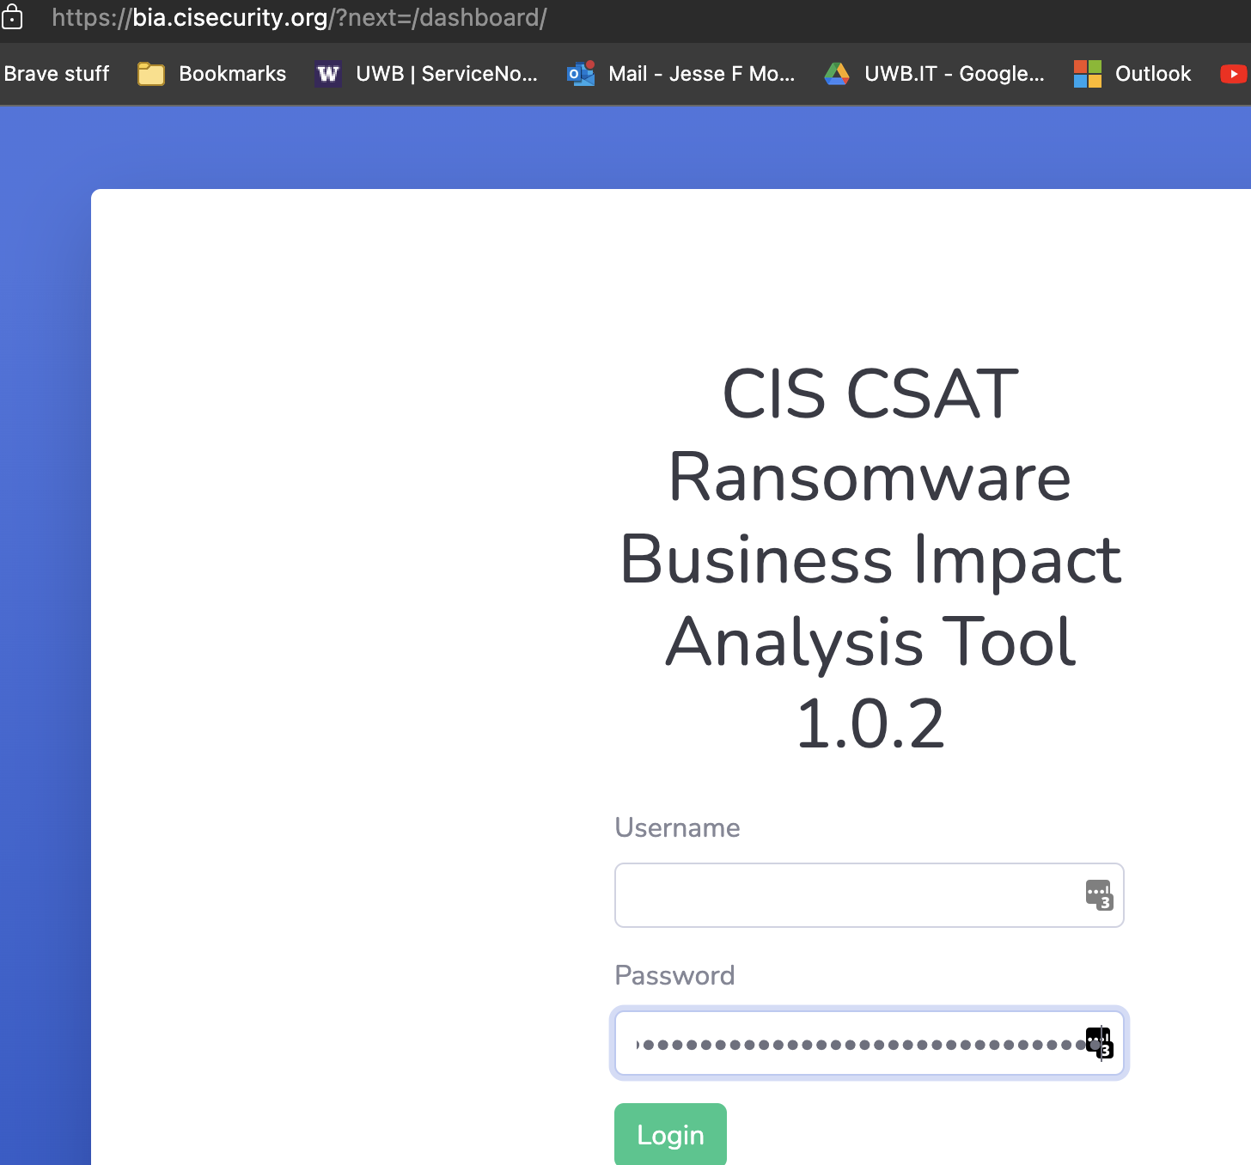
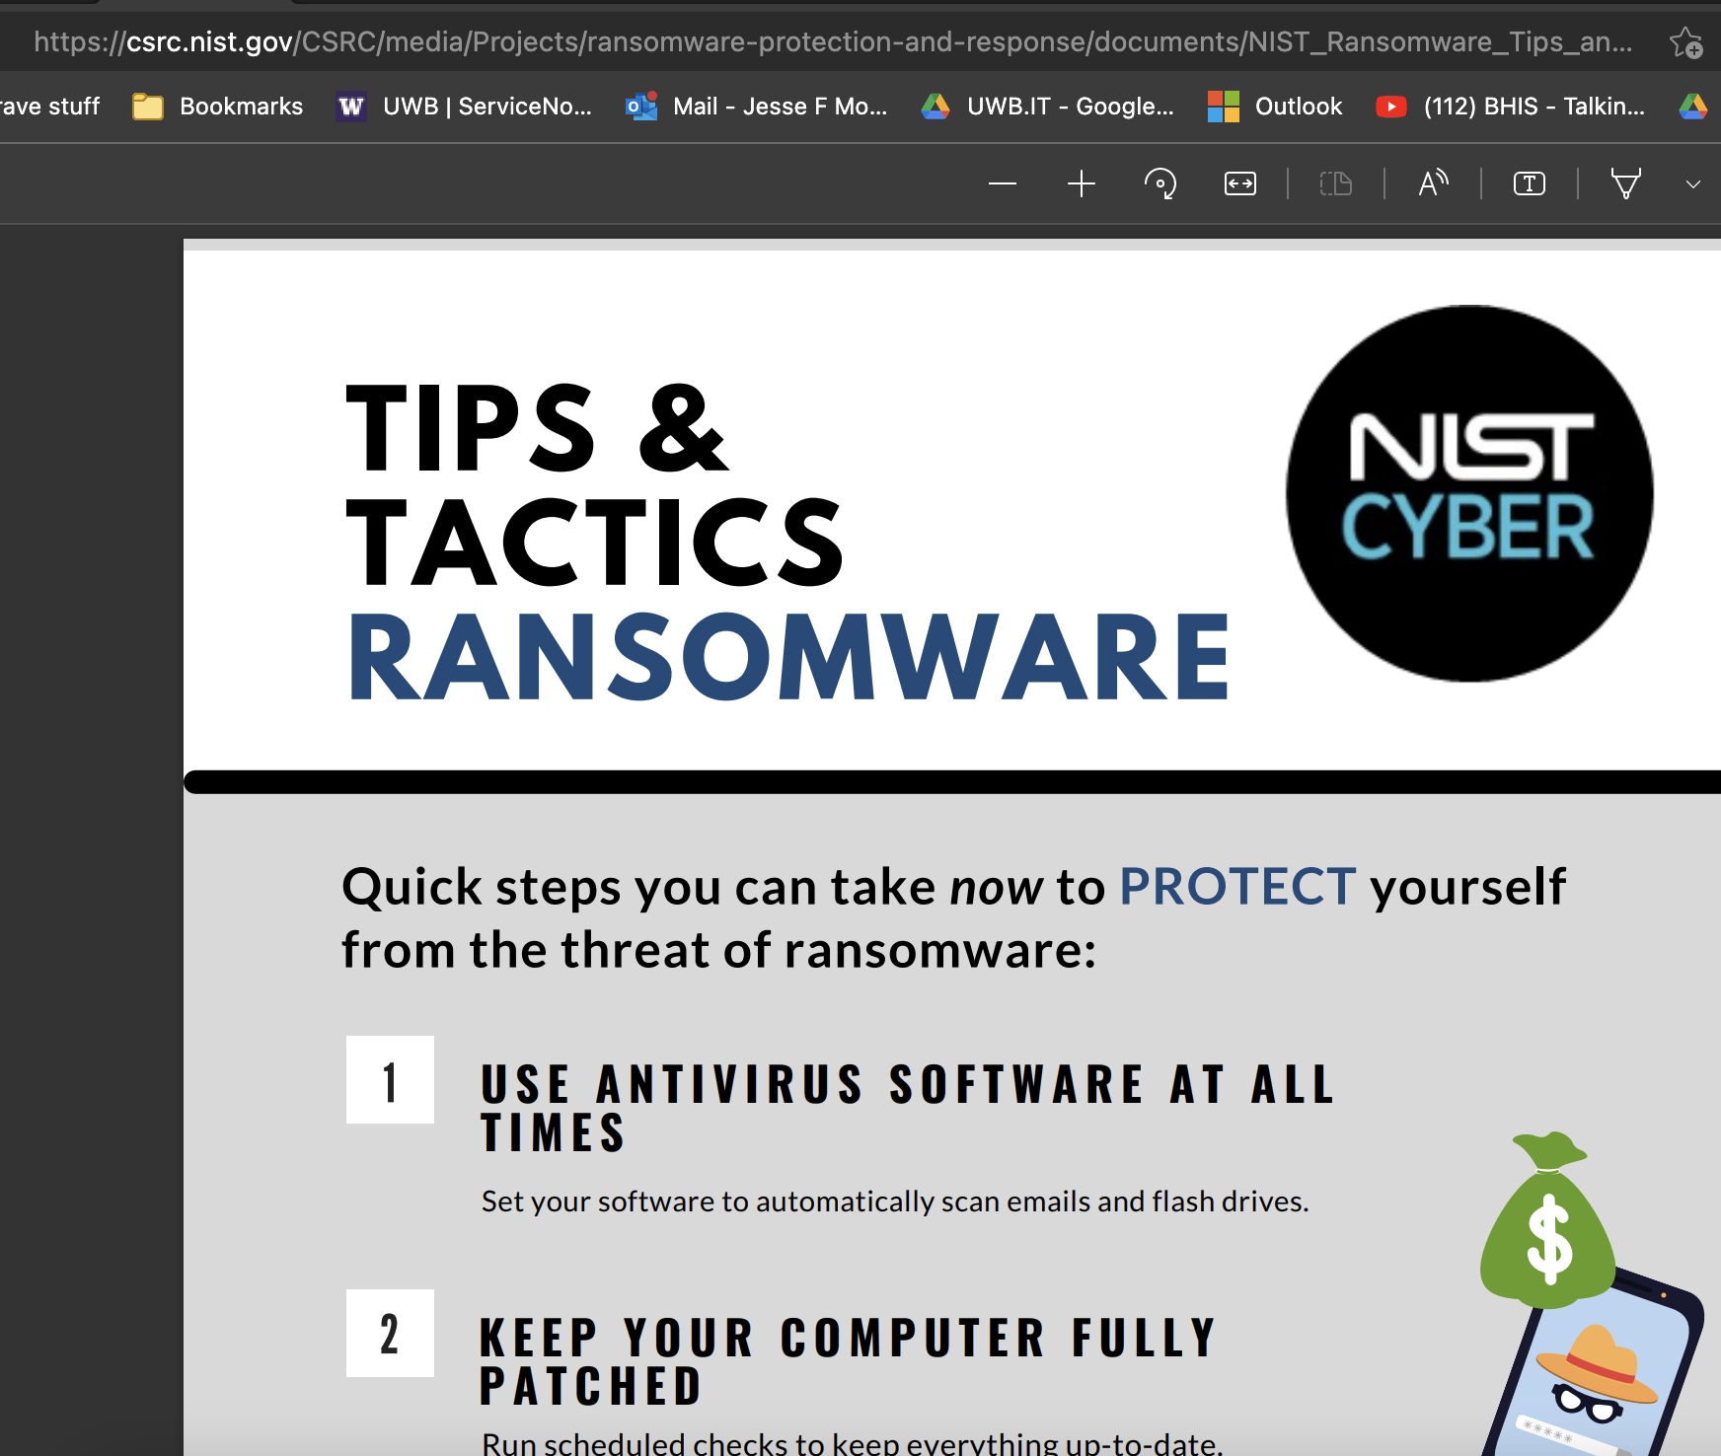
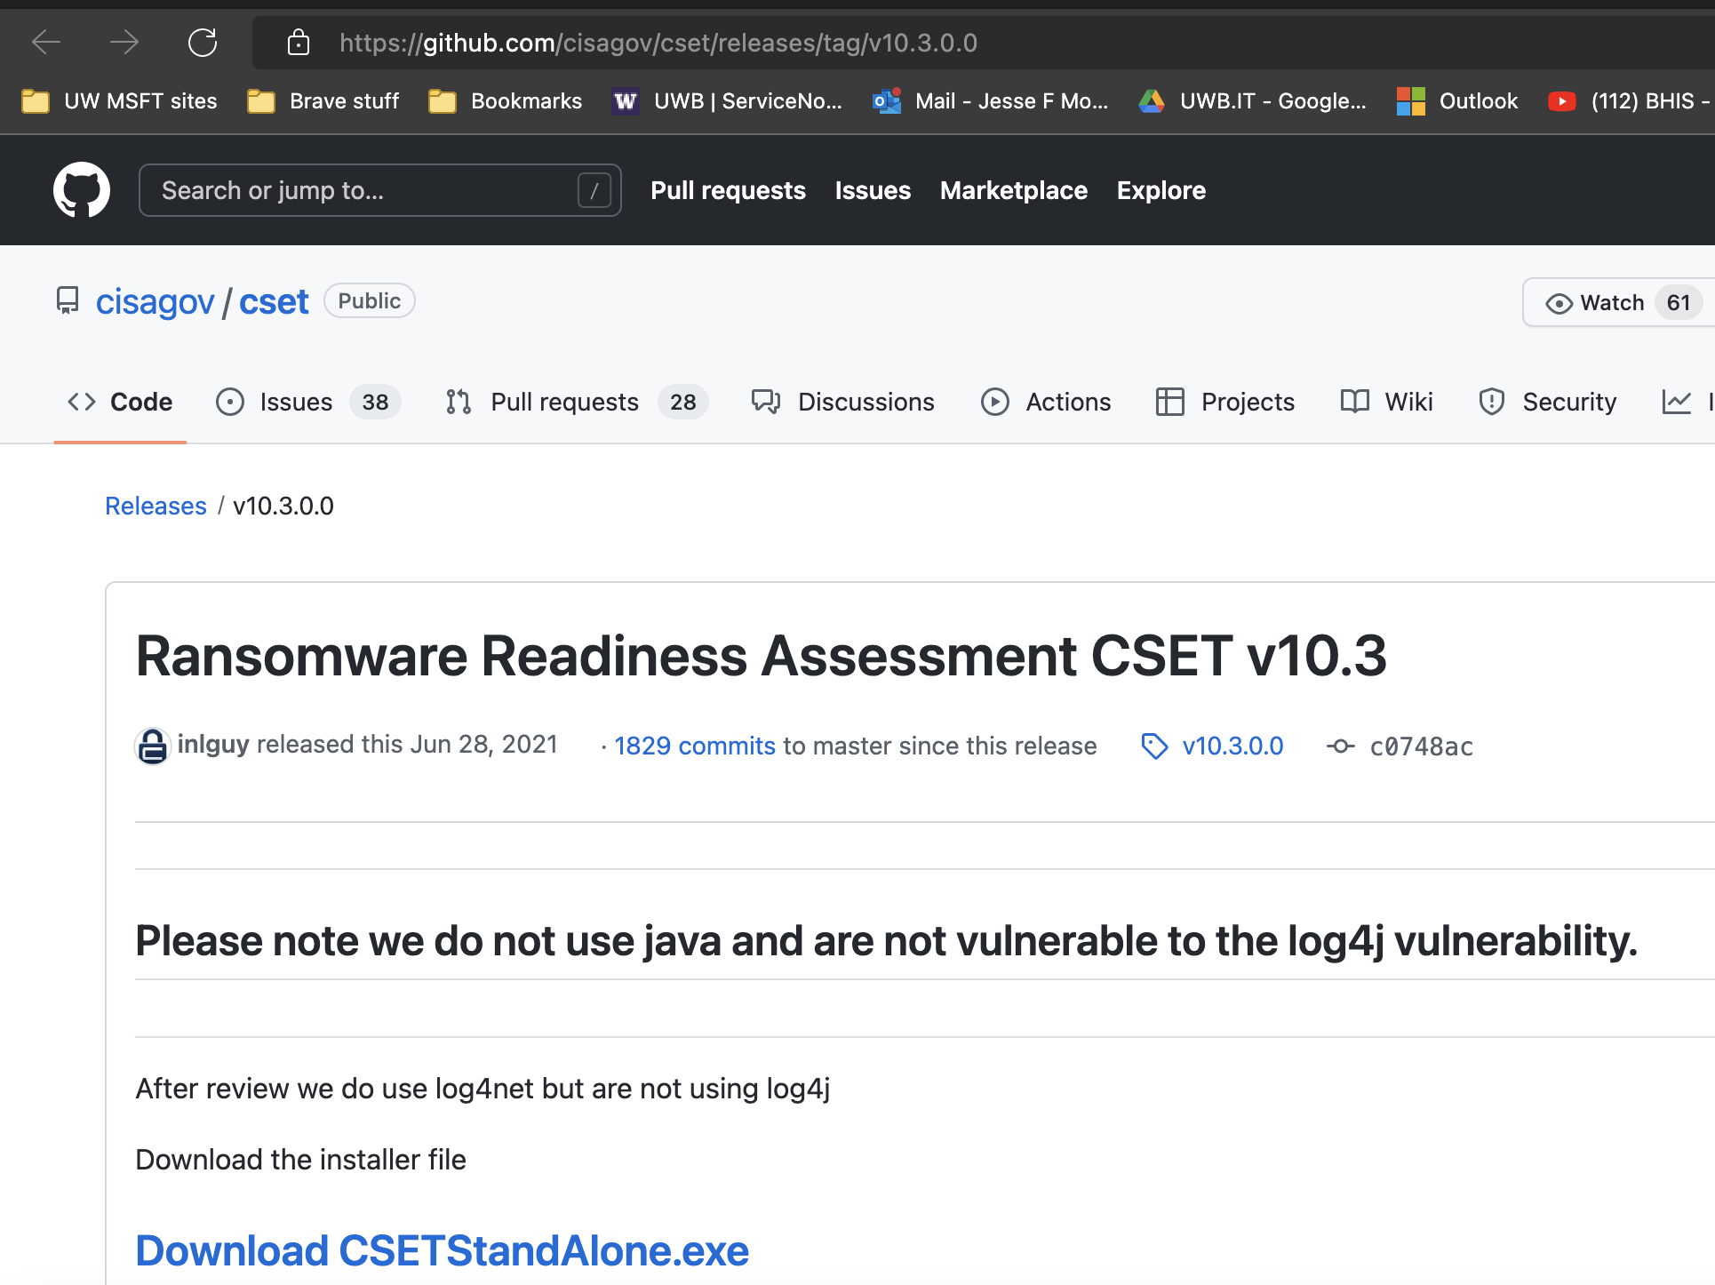
Other Tools
CIS CSAT Ransomware Business Impact Analysis tool: https://bia.cisecurity.org/?next=/dashboard/
Release Ransomware Readiness Assessment CSET v10.3 · cisagov/cset (github.com)
Tips and Tactics: Ransomware (nist.gov)
Notes:
Ransomware Protection and Response | CSRC (nist.gov)
CSET Video: https://www.youtube.com/watch?v=ELbvQTl4xmU
https://twitter.com/aprilmardock/status/1567316804112109568?s=20&t=GIavTIJT-gqt8cxUkTt6bQ
The Essentials — K12 SIX

