Slide 1


Mrfloppymcdoppy
Kratos Support Box/XSS
Notes:
Intro-Mrfloppymcdoppy/ Army Signal Officer/ Transitioning into Cybersecurity

Slide 2

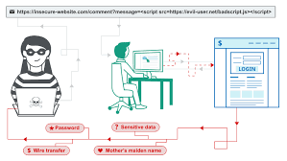
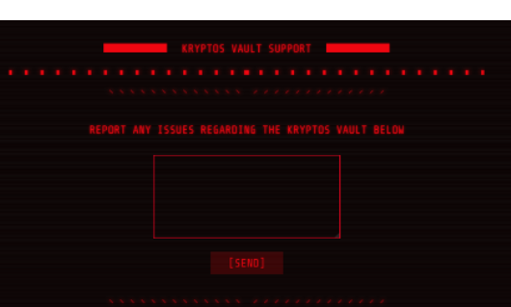
Today’s Topics
Kryptos Support Box
XSS Scripting
Cookie Injection
Host Header Authentication Bypass

Slide 3
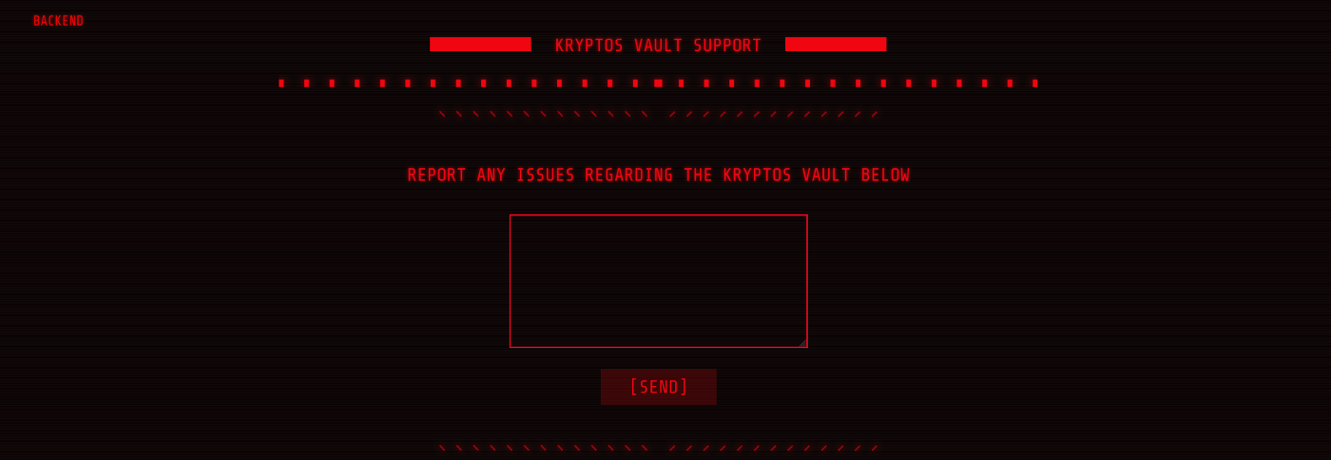
Kryptos Support cyber apocalypse web application

Slide 4
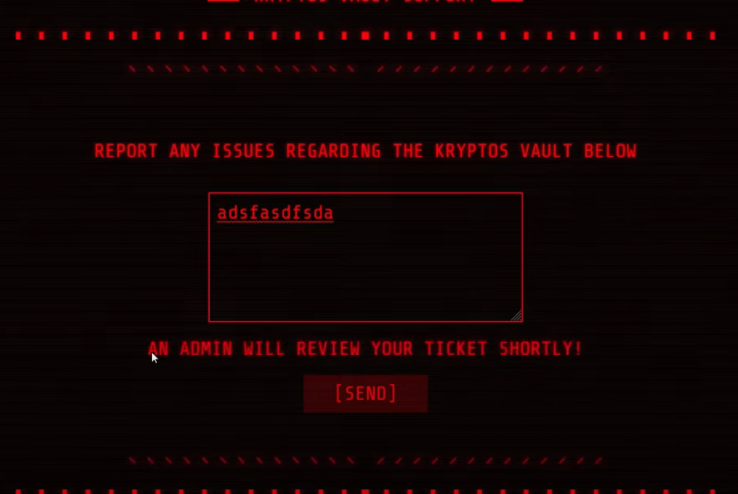
Kryptos Support cyber apocalypse web application
During a CTF if an “Admin” will be involved it means that there is a user interaction of some kind. Using this information we can assume that we can get away with some type of Cross Site Scripting.
Using a cookie stealing script command combined with pipedream.com /request bin, we can capture the admin’s cookie in our webhook.

Slide 5

Cross Site Scripting
Cross-Site Scripting (XSS) attacks are a type of injection, in which malicious scripts are injected into otherwise benign and trusted websites

Slide 6
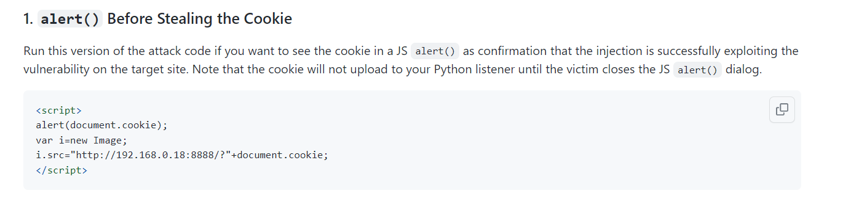
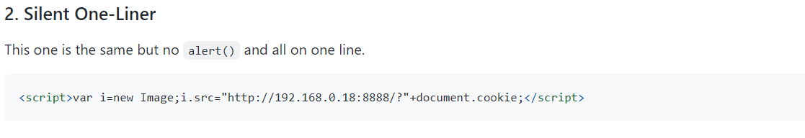
Different cookie stealing scripts

Slide 7
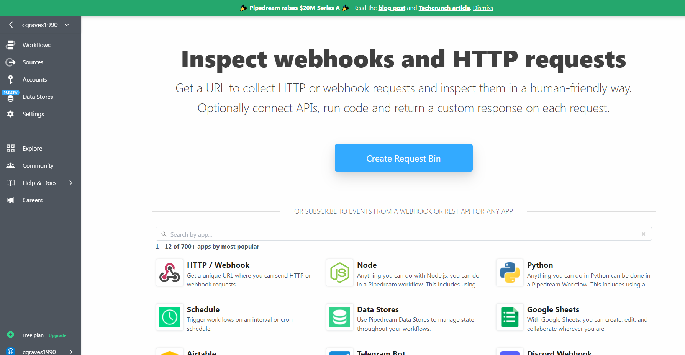
Webhook
Pipedream/HTTP Request
Webhook grabs cookie using our Javascript insertion

Slide 8
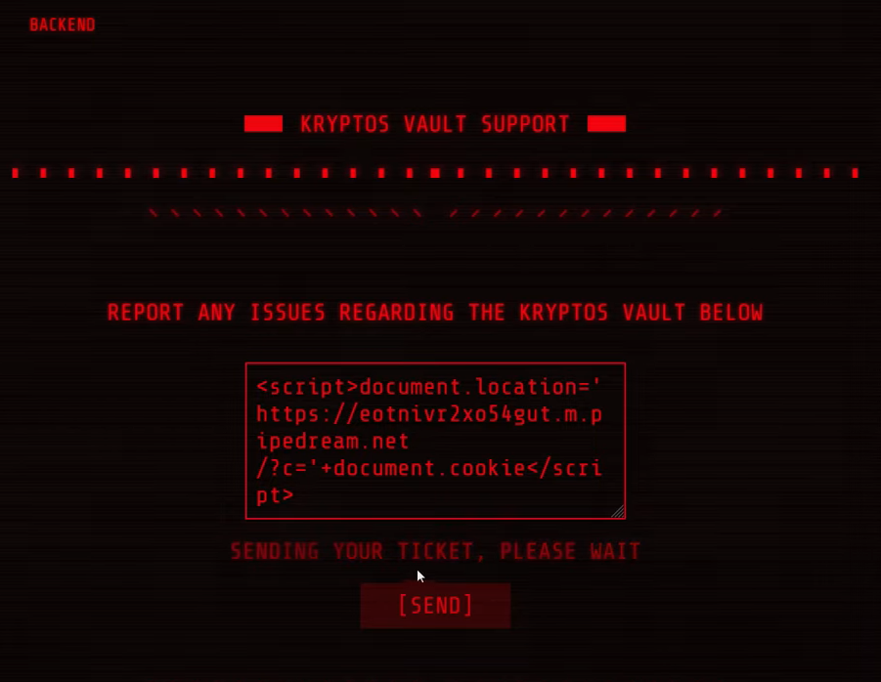
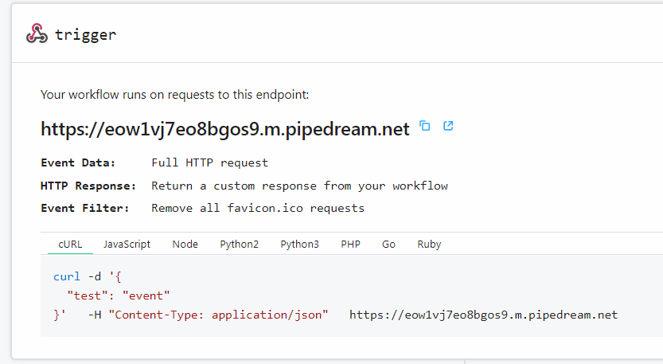
SQLI Cookie stealing script

Slide 9
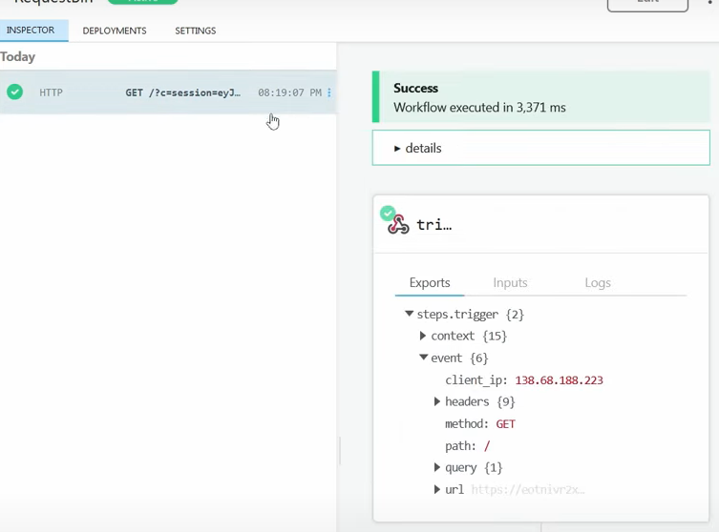
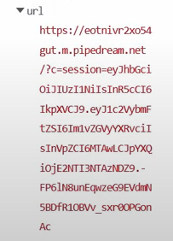
Cookie Capture

Slide 10
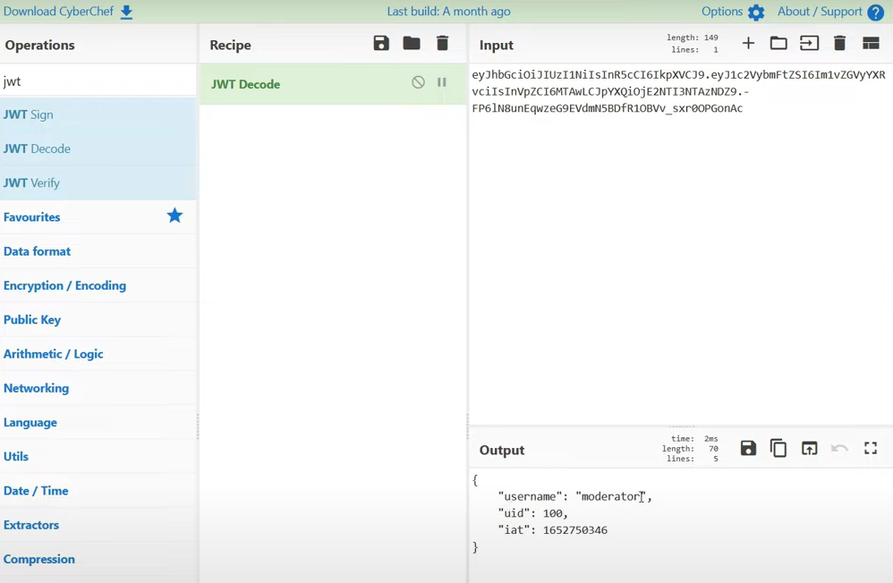
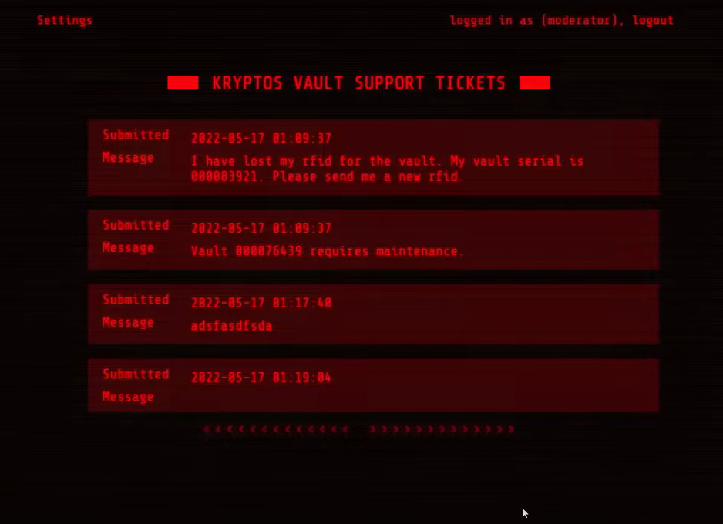
Cookie Deciphered

Slide 11
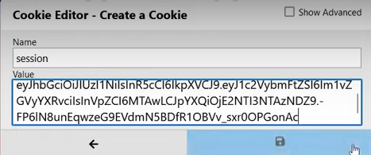
Escalating Privileges to Moderator using cookie editor

Slide 12
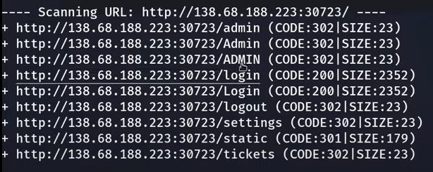
DIRBuster results

Slide 13
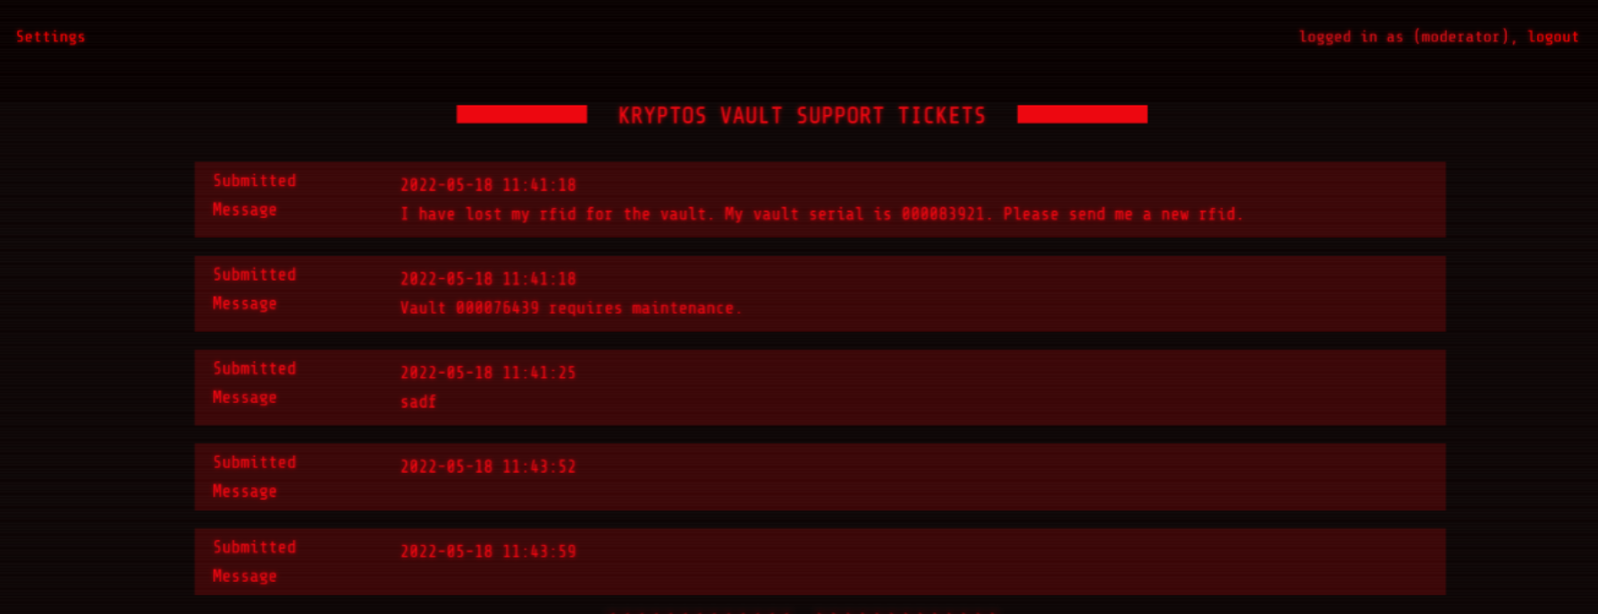
/tickets

Slide 14
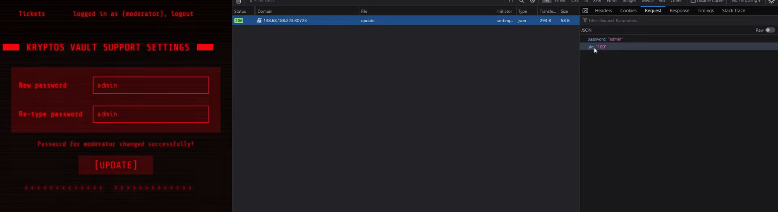
Using settings to reset the admin password
Moderatior UID is 100
Typically Web Admin UID’s are 0 or 1 and we can kind of guess here
We can use Burpsuite to edit request to try to find the admin.

Slide 15
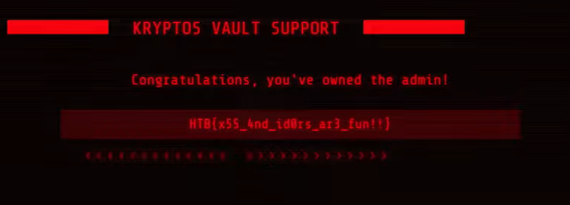
The Flag!

Slide 16

Thank You

Slide 17
Practice
https://xss-game.appspot.com/

Slide 18
Resources
https://www.getvero.com/resources/webhooks/
https://www.crowdstrike.com/cybersecurity-101/sql-injection/
https://pipedream.com/
https://infosecwriteups.com/cyber-apocalypse-ctf-2022-web-kryptos-support-write-up-2cf5057c4161
https://www.youtube.com/watch?v=_n-RTUDUrW0

