Slide 1
The Hippocampus
AKA: the most over-studied region in the brain!
(measured in £/gram)
Systems Neuroscience
December 2, 2016
Peter Latham
Notes:
update first homework

Slide 2
Outline
What does the hippocampus actually do?
How do we figure out how it does it?
Network dynamics (whiteboard).
The normative approaches.
The modelling approach.

Slide 3
In the early days, the hippocampus was heavily implicated in memory formation and transfer. That’s because of HM (Henry Molaison):
He developed intractable epilepsy at age 13.
At 27 (in 1953), surgeons removed his bilateral medial temporal lobe, including the hippocampal formation, amygdaloid complex and entorhinal cortex.
The good news: his epilepsy was cured.
The bad news: he couldn’t form new episodic memories.
He could learn things like tennis or piano (procedural memory), but he had no explicit memory of learning them.
He had retrograde amnesia: he could not remember most events in the one- to two-year period before surgery, nor some events up to 11 years before, meaning that his amnesia was temporally graded.

Slide 4
In the early days, the hippocampus was heavily implicated in memory formation and transfer. That’s because of HM (Henry Molaison):
He developed intractable epilepsy at age 13.
At 27 (in 1953), surgeons removed his bilateral medial temporal lobe, including the hippocampal formation, amygdaloid complex and entorhinal cortex.
The good news: his epilepsy was cured.
The bad news: he couldn’t form new episodic memories.
He could learn things like tennis or piano (procedural memory), but he had no explicit memory of learning them.
He had retrograde amnesia: he could not remember most events in the one- to two-year period before surgery, nor some events up to 11 years before, meaning that his amnesia was temporally graded.

Slide 5
Conclusion: the hippocampus is a scratch pad; it remembers things quickly, and slowly transfers them to your cortex, where they remain for decades.
That’s a sensible system:
you form episodic memories immediately, which means you have to learn fast.
however, fast learning means old memories are quickly overwritten.
the hippocampus learns quickly but doesn’t store things for long; the cortex learns slowly (presumably from the hippocampus), but stores things for a very long time.
But quickly and slowly are relative:
HM could not remember most events in the one- to two-year period before surgery, nor some events up to 11 years before.

Slide 6
Theorists worked half-heartedly on this problem, but not much progress was made (except perhaps by Stefano Fusi, but the jury is still out).
That’s because we have absolutely zero good models for memory storage.
In 1971, John O’Keefe discovered (as usual, quite by accident) place cells in hippocampus.
Now theorists had something they could sink their teeth into, and they spent a lot of time modeling place cells.
But, as is usually, the case, things are more complicated than they seem at first: the hippocampus is not just about place.

Slide 7
Place cells remap.
context A
context B
place fields

Slide 8
Cells in hippocampus code for more than just place.
context A
context A
Y₋
position 1
X₊
position 2
“+” is rewarded at both positions.
Contexts A and B: different flooring and visual cues.
X₊
Y₋
context B
context B
Y₊
X₋
X₋
Y₊
Komorowski, Mann and Eichenbaum, J. Neurosci. 29:9918-9929 (2009)

Slide 9
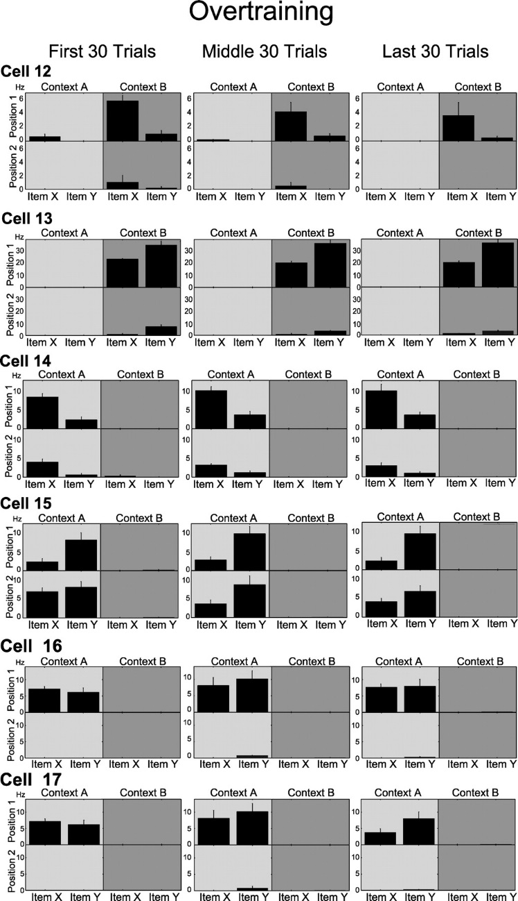
context A
context B
position 1
position 2
activity in hippocampus is telling you about the structure of the environment.

Slide 10
Finally, in 2004 grid cells appeared.
These are cells that fire in lots of different places.

Slide 11
place cell
grid cell
sensible representation
of space
crazy representation
of space

Slide 12
Finally, in 2004 grid cells appeared.
These are cells that fire in lots of different places.
Why grid cells are a crazy idea for representing space:
- if a single place cell fires you know more or less where you are
- if a single grid cell fires you have no idea
But it’s more efficient. (As we’ll see.)
But it’s way too efficient! (As we’ll see.)
Grid cells remain a mystery, in my humble opinion.

Slide 13
Given all this data, what are we going to do?
Three main options:
Take the normative approach: guess a function for the hippocampus; ask how it should be carrying out that function; perform experiments to confirm or rule out your theory.
Explain phenomena that is observed in the hippocampus.
Work on something else.
my personal favorite

Slide 14
The normative approach first (it’s more fun).
What problem is the hippocampus solving?
It’s not figuring out where you are.
Place cells don’t tell you where you are.
Figuring out where you are relative to local landmarks is easy.
Figuring out context – which determines what actions are available to you – is hard.

Slide 15
The normative approach first (it’s more fun).
What problem is the hippocampus solving?
My guess: the hippocampus is inferring context.
That is a really hard problem:
P(context|sensory data) ∝ P(sensory data|context) P(context)
context: sitting in a lecture
sensory data: depends on which lecture, who’s talking, what you’re
looking at, …
a very complicated distribution.

Slide 16
The normative approach first (it’s more fun).
What problem is the hippocampus solving?
My guess: the hippocampus is inferring context.
Hippocampus is ideally suited to this task, in the sense that it gets input form all areas of the brain.
As far as I know, however, there has been essentially no work done on this.
It’s sort of easy to see why: it’s really, really hard.

Slide 17
The normative approach first (it’s more fun).
What problem is the hippocampus solving?
My guess: the hippocampus is inferring context.
Hippocampus is probably also involved in memory transfer to cortex (remember the retrograde amnesia of HM).
This is an easier problem, but progress has still been slow.

Slide 18
Probably because a normative approach to the hippocampus is so hard, people have mainly focused on explaining phenomena:
build a network model of place fields
build a network model of grid cells
People have also asked a very sensible question: why grid cells?
So far they haven’t answered it.
In my humble opinion.
First, though, some background on network dynamics.
Which will involve a mild detour on the whiteboard.

