Slide 1
Bank Customer Churn
AI Boot Camp – Project 2
Module 16 & 17

Slide 2

The Artificial Intelligence and Data Team
Rebecca Carr
Jesse Gunter
Marianne Mittelstadt
Steve Vierling
Notes:
Marianne

Slide 3
Project Overview
Bank Europe understands that it is more expensive to bring on new customers and is concerned with customer churn, the number of customers who are closing accounts. The Artificial Intelligence and Data Team has been tasked to better understand what leads a customer to close an account with the bank and develop predictive models that could be used to develop loyalty programs and retention campaigns targeted to reduce churn.
Notes:
Mittelstadt

Slide 4
Data Collection, Clean-Up, and Exploration
The team reviewed different data sources and chose a bank customer churn dataset from Kaggle.com as it closely aligned with the objective and contained different types of data.
The Customer-Churn_Records.csv was downloaded from Kaggle.com and read into a Jupyter notebook.
The team evaluated the dataset and using .info() function and determined the following:
13 numeric columns with 2 of the numeric columns containing indexes that would need to be removed from modeling data
4 object columns with 1 considered to not contribute to model performance (customer surname)
The team decided to use One Hot Encoder and Ordinal Encoder to encode the remaining 3 object columns
Upon review of correlation between target (“Exited”) and the other columns, the team uncovered a high correlation between the column “Complain” and “Exited” indicating a potential data leak so the column was removed from the dataset.
From this dataset, initial training and testing datasets were established using the train_test_split function from scikit-learn and utilized in the modeling effort.
Additionally the X-train and X_test data was scaled using the StandardScaler() function
Notes:
Rebecca

Slide 5
Modeling Approach
The dataset contained a column labeled “Exited”, which indicated if the customer left the bank and was used as the churn target (y).
As a baseline model, the team chose to start with logistic regression as it is a statistical method for predicting binary outcomes from data.
All other models were compared to the baseline model and include:
Support Vector Machines (SVM)
K-Nearest Neighbors (KNN)
Decision Trees
Random Forest
XGBoost
A pipeline utility was developed to streamline the data clean up and running multiple models
Notes:
Rebecca

Slide 6

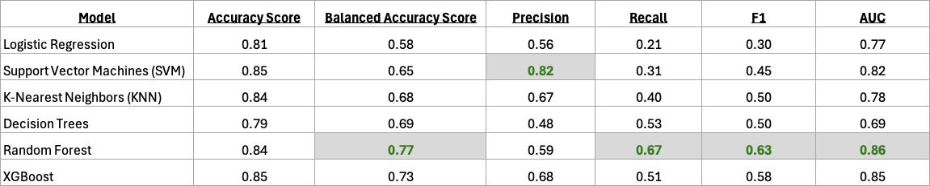
Initial Results
Comparison of accuracy score for each model shows the highest accuracy in the SVM and XGBoost models.
However, the team was working with an imbalanced dataset with churn present in only 20% of the dataset so other measurements were evaluated too.
Balanced accuracy score – metric used to evaluate performance when dealing with imbalanced datasets
Precision – indicates the accuracy of the positive predictions
Recall – measures the ability of the model to find all the relevant cases (true positives)
F1- harmonic mean of the precision and recall, providing a balance between the two
AUC – performance measurement at various threshold settings representing the area under the curve
The random forest model had the highest score in 4 out of 5 of the additional metrics evaluated.
Notes:
Jesse

Slide 7
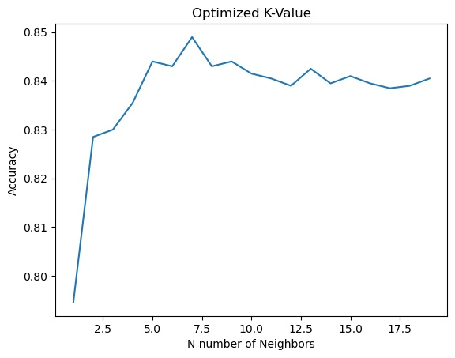
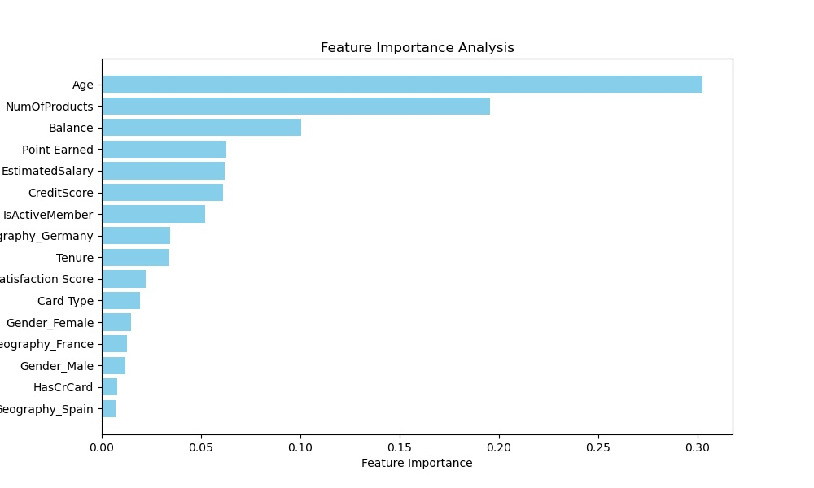
Model Optimization
One hot encoder and ordinal encoders were used during initial clean up giving additional features to evaluate
KNN – A for loop was utilized to find the optimal value of the k parameter (graph on right)
Random Forest – Feature importance analysis was evaluated with Geography_Spain as least important and Age being the most (graph on right)
SVM – GridSearchCV was used to identify the best C (controls regularization), gamma (defines how far a single training example’s influence reaches, and kernel parameters.
Decision Trees – GridSearchCV was used to identify the best max depth, min samples split, min samples leaf, and criterion
XGBoost - GridSearchCV was used to identify n_estimators, max depth, learning_rate, and subsample
Notes:
Jesse

Slide 8
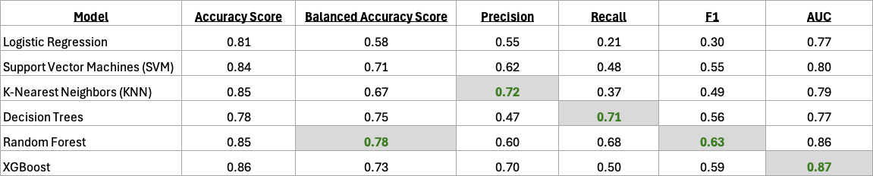
First Optimization Results
The KNN model had the most positive improvements with the optimizations with improvements in balanced accuracy score, recall and F1 while SVM had the most improvement in both precision and AUC.
The random forest model scored highest in 2 out of the 5 metrics for imbalanced data with balanced accuracy at 0.78 and F1 at 0.63.
The first optimization results indicate that the organization should use the random forest model to build out their loyalty and retention programs.
Notes:
Steve

Slide 9
Additional Questions and Next Steps
Additional Questions
The team found the high feature importance of age and number of products interesting and given more time would look further into those features.
Next Steps
The team recommends further optimizations on the random forest model and would pursue feature engineering, RandomizedSearchCV, and K-Fold Cross-Validation.
Additionally strategies like SMOTE and oversampling should be pursued to balance the dataset.
Notes:
Steve

Slide 10


Questions?

Slide 11

The End

