Slide 1
Speech to Text Summarization App
AI Boot Camp – Project 3
Module 23 & 24

Slide 2

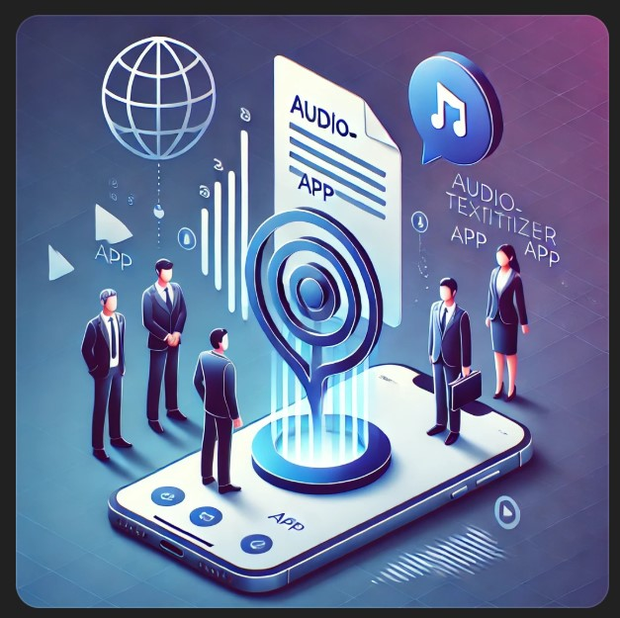
The Development Team
Jesse Gunter
Mark Johnson
Marianne Mittelstadt
Tanya Soriano
Ethan Wyman
Notes:
Mark

Slide 3
Project Objectives
Most publicly traded companies have quarterly earnings calls where the company’s management team discusses the financial performance, future plans, and answers questions from investors and analysts
These calls provide valuable insights into current performance and management perspective; however, analysts and investors may not have the time to sit through the earnings call
To address this challenge the team has developed an application where an audio file could be uploaded and the app would translate speech to text, provide a summary and then also translate into other languages
During development, the team recognized there could be broader usages
Notes:
Mark

Slide 4


Approach in Achieving Project Goals
MP3 File
Speech to Text Transformation
Text to Summary Transformation
Text Summary Translated to Different Languages
User Interface
HTML and python used to develop user interface
Whisper was utilized to transform speech into a text file
GPT-3.5-turbo was utilized to translate the summary into different languages
Any MP3 file can be uploaded through the interface
GPT-3.5-turbo was utilized to summarize the text file generated with Whisper
Cost Comparison for Summarizing an Earnings Call (Example)
Let’s assume an earnings call transcript has 10,000 words (~15,000 tokens and the summary out put in 500 words (~750 tokens).
Notes:
Mark

Slide 5
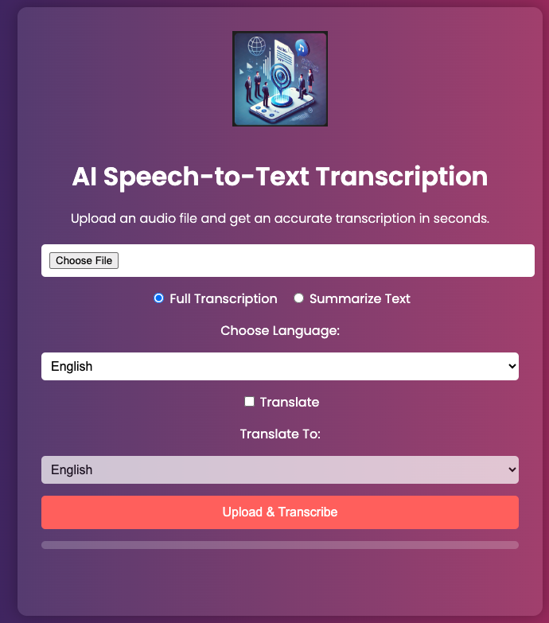
User Interface
An interface was developed that allows the user to upload a MP3 to be summarized and translated
The front end was developed in HTML and python code drives the back end of the user interface
How it works:
User chooses an audio file to upload
Radio button selection of Full Transcription or Summarize Text
Choose Language: Select from drop down the language of the audio file
Check box selection of if user wants it translated to different language
Translate To: Select from drop down the language to translate into (French, Spanish, Japanese)
Upload & Transcribe kicks off the process
Can download after process is complete
Notes:
Jesse

Slide 6
Whisper
Whisper is an OpenAI developed AI model that is highly accurate in transcribing speech into text
The Whisper AI model was trained on 680,000 hours of multilingual supervised data from the internet
Whisper supports speech to text in over 90 languages
The team utilized Whisper to transcribe an audio file in English to an English text file
The team used Nvidia’s Q3 FYFY25 Financial Results.mp3 during the development of project
A Whisper confidence score was calculated using log probabilities – calculated as the average log probability of the predicted tokens within a transcription – 83.7% confidence score on the Nvidia transcription
Notes:
Ethan

Slide 7
Tokenization
The text input is first broken down into tokens, which are used by the GPT-3.5 Turbo model
Different tokenizers were explored by the team and although cl100k_base is the OpenAI recommended choice the team utilized the bert-based-uncased tokenizer to utilize a different technology called for in the project
Bert-based-uncased was a good choice as it is ideal for nuanced interpretation
The transcription of the Nvidia financial call was over 10,000 tokens so a chunking function was also utilized
Notes:
Ethan

Slide 8
Text Summarization
OpenAI provides an API solution which allowed the team to utilize GPT-3.5 Turbo to take the text output from the Whisper model and summarize
GPT-3.5 Turbo text summarization allows for flexibility with prompts and provides abstractive summarization
To ensure the text does not exceed limitations a chunk text function was created that divided the input text into a max length equal to 4,000
The chunks were summarized and then joined for a combined summary, which could be output to the user interface and saved
The chunk text function utilizes the AutoTokenizer from the bert-base-uncased model offered through Hugging Face
Notes:
Tanya

Slide 9
Summarization Translation
Among all the capabilities of GPT-3.5 Turbo, the team also utilized its API to translate text from one language to another
A function was created that takes two arguments: the text to translate and target language
The openai.completions.create() method was used to send a text completion request and asks the API to translate the text into the target language
The language translation function also uses the chunk text function to ensure the text does not exceed limitations
Notes:
Tanya

Slide 10
Additional Thoughts…
Performance metrics
To develop a confidence score for both the summarization and the translation, a comparison to human summarizations and translations is needed
Although a doable approach, comparisons to human summarizations and translations is difficult and can be expensive
Given more time the team would explore different ways to develop a confidence score in an efficient manner
Summarization models
The team explored different pre-trained models to summarize the transcription text including Mistral 7b openorca.Q6_K.gguf
However, the team had difficulty integrating the model into the developed code so moved to a streamlined approach of using GPT-3.5 Turbo for ease of use and less local resources required
Given more time the team would look to expand to more languages and test input of other languages
Notes:
Marianne

Slide 11

Demonstration

Slide 12


Questions?

Slide 13
Appendix

Slide 14

References
Nvidia https://events.q4inc.com/attendee/313193359/guest
AmongMedium https://medium.com/@kharatmoljagdish/using-openai-whisper-python-library-for-speech-to-text-dda4f558fccc
AmongWhisper https://github.com/openai/whisper
AmongFFmpeg https://www.wikihow.com/Install-FFmpeg-on-Windows
AmongHuggingFace https://huggingface.co/TheBloke/Mistral-7B-OpenOrca-GGUF/blob/main/mistral-7b-openorca.Q6_K.gguf
AmongMistral https://docs.mistral.ai/getting-started/models/models_overview/

Slide 15
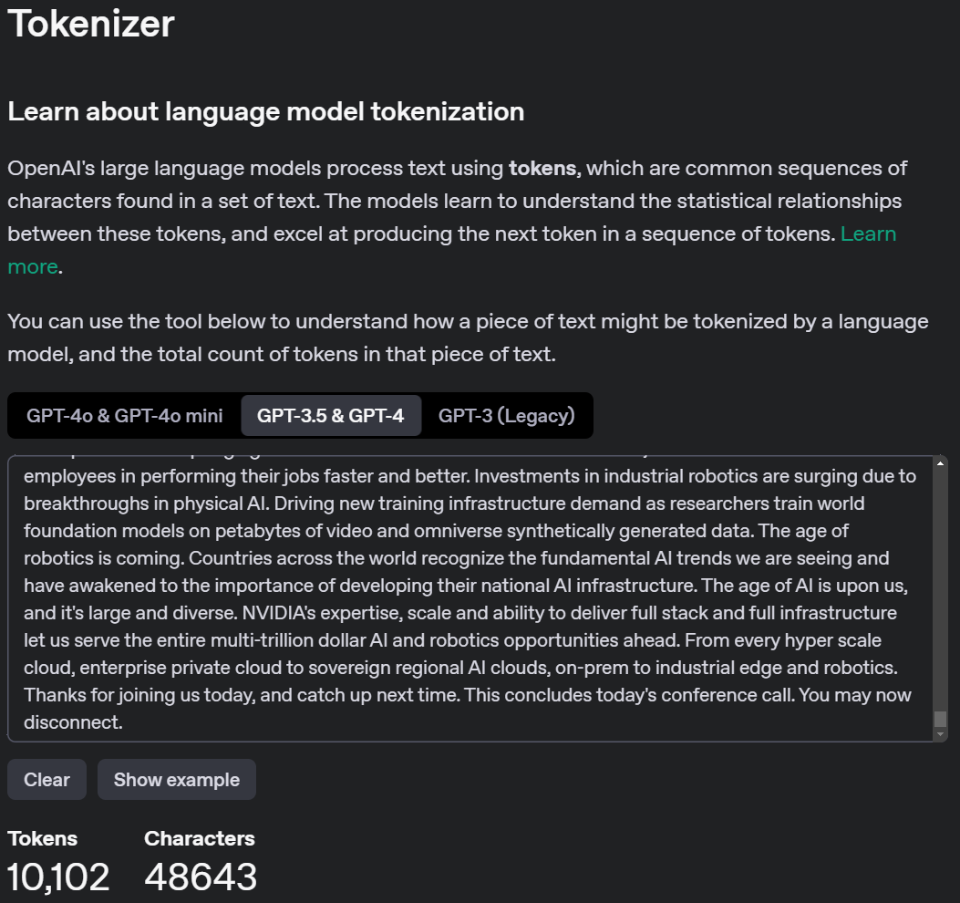
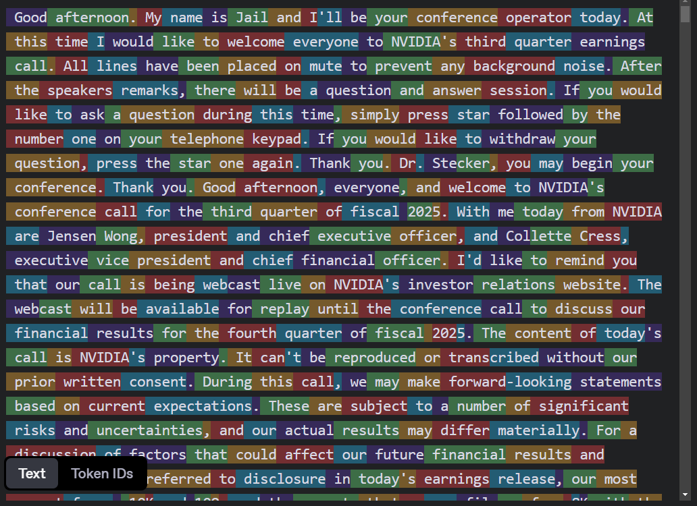
Tokenizer

Slide 16

The End

