Slide 1
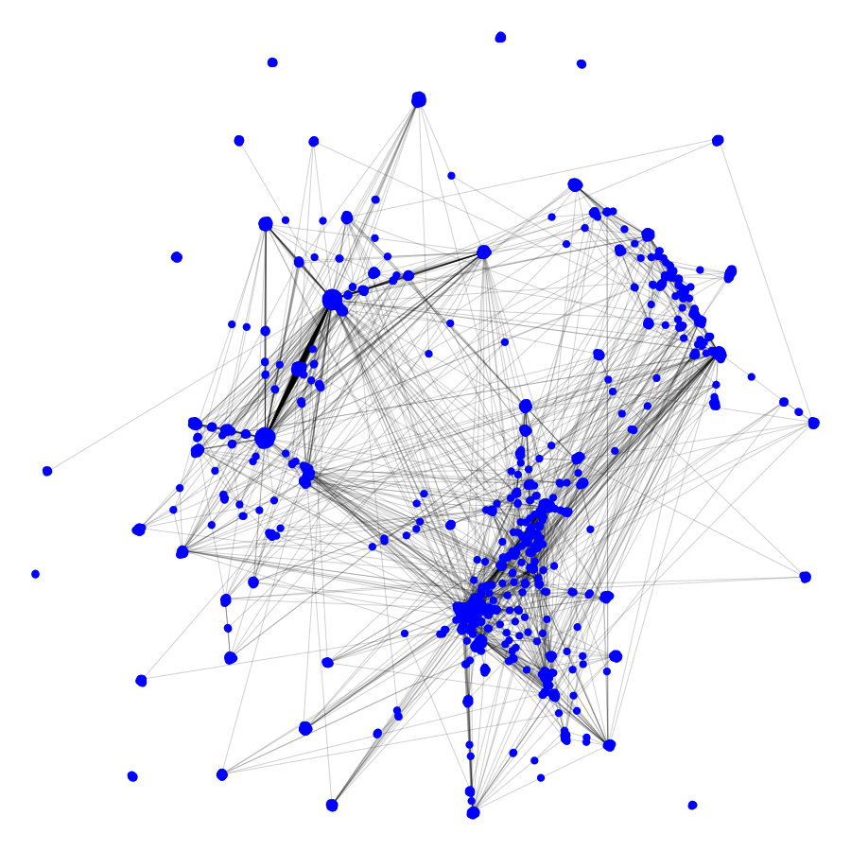
Additive manufacturing networks
Understanding and engaging with AM
Problem: decentralized, self-regulating “communities of innovation” (COIs) in AM
Radical leveling technology (Snow, 2015) combines high threat potential with low regulation potential
Goal: understand and effectively engage with decentralized COIs
Approach: “big data SNA” study of COI structural dynamics over time
Network analysis of COIs
COI as network structure
Nodes: individuals, institutions
Ties: collaboration, citation, discussion
COI comprises multiple ‘layers’ of interaction
Primary academic research
Patent applications
Social/online communities
Mining information from networks
Key actors
Emergent sub-communities
Cross-pollination between groups
Example citation network:
“fused deposition”
Applications and expansions
Deliverable: multi-use platform to visualize and analyze self-regulating COIs
AM, biotech, open-source, etc
Potential use cases:
Identifying key actors to maximize engagement efficacy
Scoping near-term growth areas of R&D
Assessing impact of “corporatization”
Areas of collaboration at NPS:
CORE and CODA labs (large-scale analysis)
RoboDojo (direct engagement)

