Slide 1
Lecture 3
CSE 331

Slide 2
Stable Matching Problem
Problem Statement
Problem Definition
Algorithm
Implementation
Analysis

Slide 3
Proof of Correctness: Gale-Shaply

Slide 4
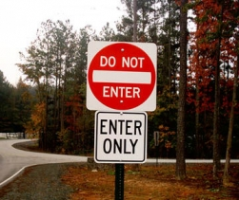
Proof technique de jour
Proof by contradiction
Assume the negation of what you want to prove
After some reasoning
Source: 4simpsons.wordpress.com

Slide 5
CSE191 Flavor
Prove there are infinitely many prime numbers
Assume there are finitely many primes and call them P = {p₀, p₁, …, p_{n}}
Consider the number q = p₀p_{1…}p_{n} + 1
  The number q is not in P and is therefor composite
  As such, q must be divisible by some p_{i} in P
However, q/p_{i} has a remainder of 1 for all p_{i} in P
Therefore, q is prime which is a contradiction
There must be infinitely many primes!

Slide 6
Now a CSE331 flavor proof by contradiction

Slide 7
GS algo outputs a stable matching
Lemma 1: GS outputs a perfect matching S
Lemma 2: S has no instability

Slide 8
Two obervations
Obs 1: Once m is engaged he keeps getting
engaged to “better” women
Obs 2: If w proposes to m’ first and then to m
(or never proposes to m) then she
prefers m’ to m

Slide 9
Proof of Lemma 1
Lemma 1: GS outputs a perfect matching S
Assume S is not a perfect matching
There exists a woman w who is single
The woman w must have proposed to all n men and they all rejected her or moved to a better woman
Therefor, all n men are engaged (by observation 1) to the remaining n-1 women
Contradiction since there is no polygamy in the algorithm

Slide 10
Proof of Lemma 2
By contradiction
w’ last proposed to m’
Assume there is an instability (m,w’)
m prefers w’ to w
m
w
w’ prefers m to m’
m’
w’

Slide 11


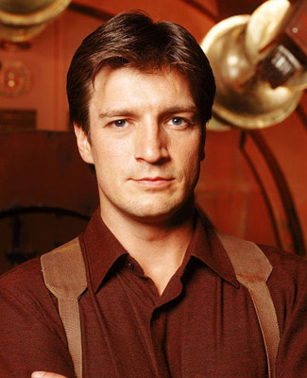
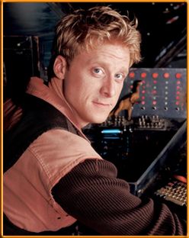
Contradiction by Case Analysis
Depending on whether w’ had proposed to m or not
Case 1: w’ never proposed to m
w’ prefers m’ to m
By Obs 2
m
Assumed w’ prefers m to m’
w’
Source: 4simpsons.wordpress.com

Slide 12
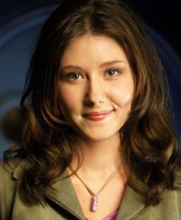

Case 2: w’ had proposed to m
w’
Case 2.1: m had accepted w’ proposal
m is finally engaged to w
m
Thus, m prefers w to w’
4simpsons.wordpress.com
By Obs 1
Case 2.2: m had rejected w’ proposal
m was engaged to w’’ (prefers w’’ to w’)
By Obs 1
m is finally engaged to w (prefers w to w’’)
By Obs 1
m prefers w to w’
4simpsons.wordpress.com

Slide 13
Overall structure of case analysis
Did w’ propose to m?
Did m accept w’ proposal?
4simpsons.wordpress.com
4simpsons.wordpress.com
4simpsons.wordpress.com

Slide 14
More formal proof in notes

Slide 15

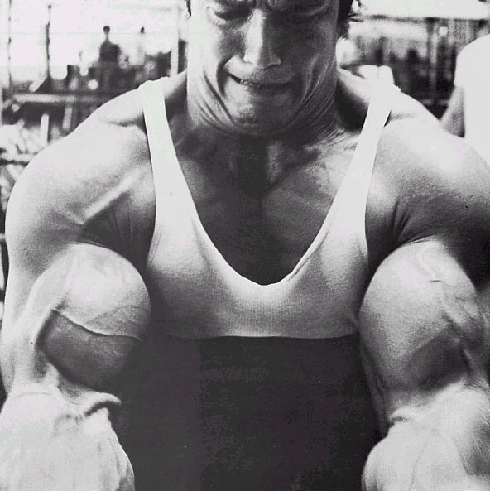
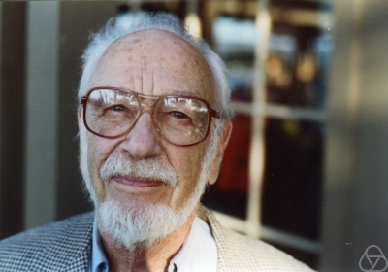
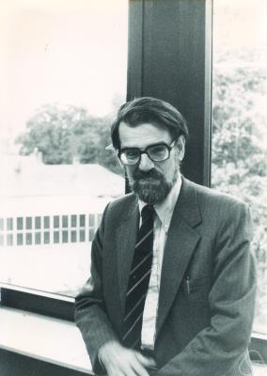
Main Steps in Algorithm Design
Problem Statement
Problem Definition
Algorithm
n!
Implementation
And now:
Runtime analysis
Analysis
Correctness Analysis

Slide 16



Definition of Efficiency
An algorithm is efficient if, when implemented, it runs quickly on real instances
Implemented where?
Platform independent definition
What are real instances?
Worst-case Inputs
N = 2n² for SMP
Efficient in terms of what?
Input size N

Slide 17
Definition-II
Analytically better than brute force
n!
How much better? By a factor of 2?

Slide 18
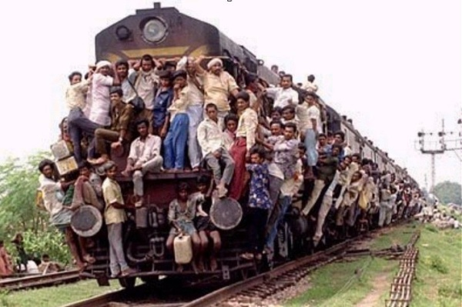
Definition-III
Should scale with input size
If N increases by a constant factor,
so should the measure
Polynomial running time
At most c.N^{d} steps (c>0, d>0 absolute constants)
Step: “primitive computational step”

Slide 19
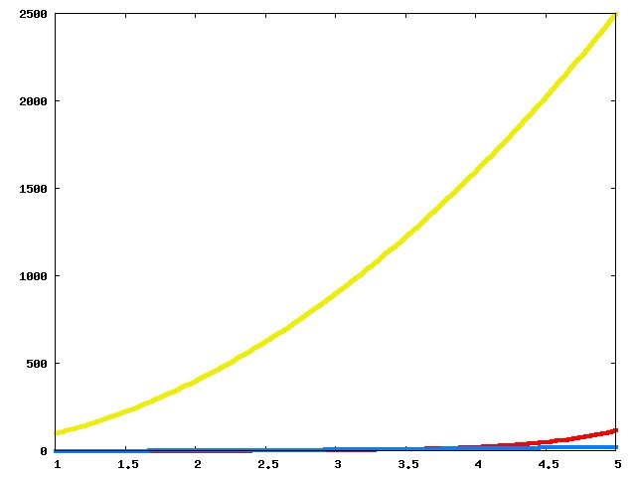
Which one is better?

Slide 20
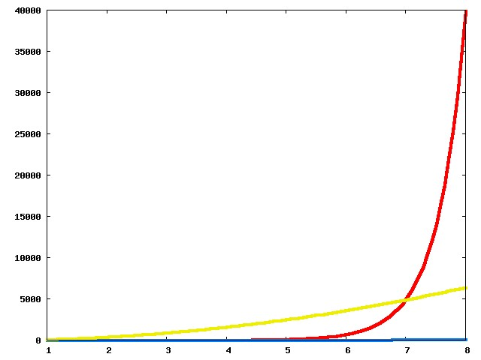
Now?

Slide 21
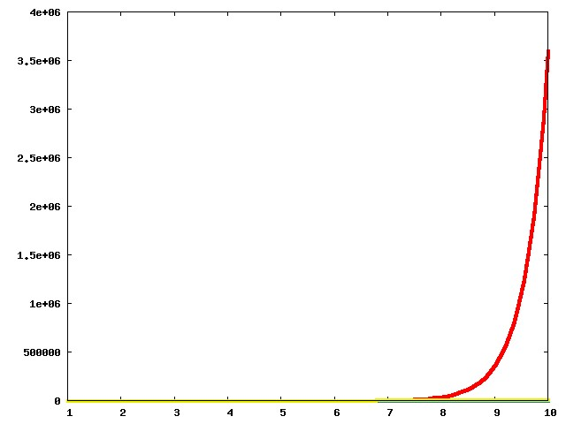
And now?

Slide 22
The actual run times
n!
100n²
Asymptotic View
n²

Slide 23
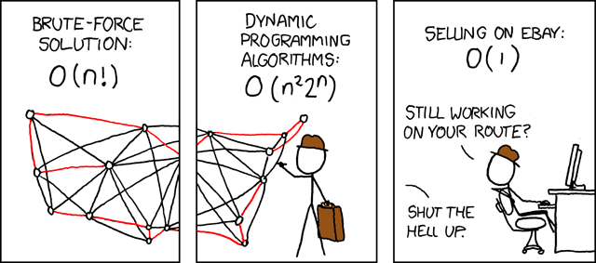
Asymptotic Analysis
Travelling Salesman Problem
(http://xkcd.com/399/)

Slide 24
Asymptotic Notation
O is similar to ≤
Ω is similar to ≥
Θ is similar to =

Slide 25
g(n) is O(f(n))
c*f(n) for some c>0
g(n)
n
n₀

Slide 26
g(n) is Ω(f(n))
g(n)
ε*f(n) for some ε>0
n
n₁

Slide 27
Run time of an algorithm
(Worst-case) run time T(n) for input size n
Maximum number of steps taken by the algorithm for
any input of size n

Slide 28
Gale-Shapley Algorithm
Initially all men and women are free
While there exists a free woman who can propose
Let w be such a woman and m be the best man she has not proposed to
w proposes to m
If m is free
(m,w) get engaged
Else (m,w’) are engaged
If m prefers w’ to w
w remains free
Else
(m,w) get engaged and w’ is free
Output the engaged pairs as the final output. These engaged pairs get married.

Slide 29
Implementation Steps
How to represent the input?
How do we find a free woman w?
How would w pick her best unproposed man m?
How do we know who m is engaged to?
How do we decide if m prefers w’ to w?

Slide 30
Arrays and Linked Lists
n numbers a₁,a₂,…,a_{n}
Last
Front
1
a₁
a₁
a₂
a₃
a_{n}
2
a₂
3
a₃
Array
Linked List
Access ith element
O(1)
O(i)
Is e present?
O(n)
(O(log n) if sorted)
O(n)
Insert an element
O(n)
O(1) given pointer
n
a_{n}
Delete an element
O(n)
O(1) given pointer
Static vs Dynamic
Static
Dynamic

Slide 31
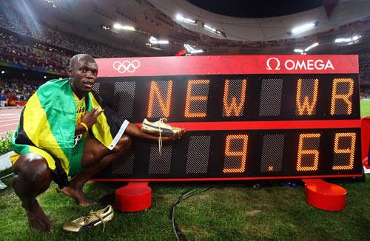
Today’s first goal
O(n²) implementation of the Gale-Shapley algorithm
More practice with run time analysis

Slide 32
Gale-Shapley Algorithm
At most n² iterations
Initially all men and women are free
While there exists a free woman who can propose
Let w be such a woman and m be the best man she has not proposed to
w proposes to m
O(1) time implementation
If m is free
(m,w) get engaged
Else (m,w’) are engaged
If m prefers w’ to w
w remains free
Else
(m,w) get engaged and w’ is free
Output the engaged pairs as the final output. These engaged pairs get married.

Slide 33
Puzzle
Prove that any algorithm for the SMP takes Ω(n²) time

Slide 34
Main Steps in Algorithm Design
Problem Statement
Problem Definition
Algorithm
n!
“Implementation”
Analysis
Correctness Analysis

