Slide 1
Lecture 6
CSE 331

Slide 2
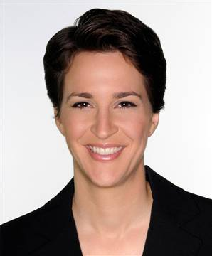









Checking for a path by inspection

Slide 3
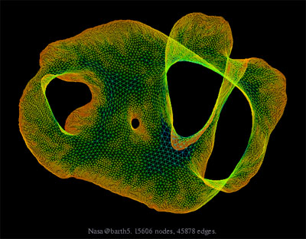
What about large graphs?
s
t
Are s and t connected?

Slide 4
Brute-force algorithm?
List all possible vertex sequences between s and t
O(n^{n}) such sequences
Check if any is a path between s and t

Slide 5

Algorithm motivation
all

Slide 6
Distance between u and v
Length of the shortest length path between u and v
Distance between and ?
3

Slide 7
Breadth First Search (BFS)
Is s connected to t?
Build layers of vertices connected to s
L_{j} : all nodes at distance j from s
L₀ = {s}
Assume L₀,..,L_{j} have been constructed
L_{j+1} set of vertices not chosen yet but are connected to L_{j}
Stop when new layer is empty

Slide 8
Exercise
Prove that L_{j} has all nodes at distance j from s

Slide 9
BFS Tree
BFS naturally defines a tree rooted at s
Add non-tree edges
L_{j} forms the jth “level” in the tree
u in L_{j+1} is child of v in L_{j} from which it was “discovered”
1
7
1
L₀
2
3
L₁
2
3
8
4
5
4
5
7
8
L₂
6
6
L₃

Slide 10
Connected Component
Connected component (of s) is the set of all nodes connected to s

Slide 11
Algo to compute the connected component of s?

Slide 12
Computing Connected Component
Explore(s)
Start with R = {s}
While exists (u,v) edge v not in R and u in R
Add v to R
Output R

Slide 13
Prove:
Explore(s) = ConnectedComp(s)
Lemma 1: If w is in R then s is connected to w
Lemma 2: If s is connected to w then w is in R

Slide 14
BFS
all

Slide 15
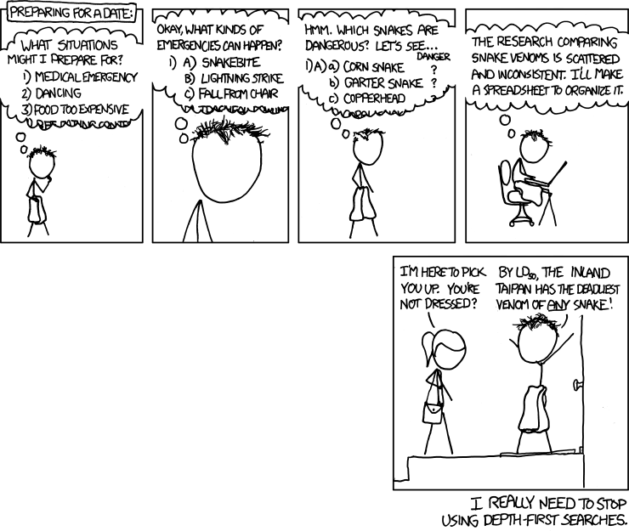
Depth First Search (DFS)
http://xkcd.com/761/

Slide 16
DFS(u)
Mark u as explored and add u to R
For each edge (u,v)
If v is not explored then DFS(v)

Slide 17
Why is DFS a special case of Explore?

Slide 18
A DFS run
Every non-tree edge is between a node and its ancestor
1
DFS(u)
1
7
u is explored
2
2
3
For every unexplored
neighbor v of u
8
4
DFS(v)
4
5
5
DFS tree
6
6
3
8
7

Slide 19
Connected components are disjoint
Either Connected components of s and t are the same or are disjoint
Algorithm to compute ALL the connected components?
Run BFS on some node s. Then run BFS on t that is not connected to s

Slide 20

Today’s agenda
Run-time analysis of BFS and DFS

Slide 21

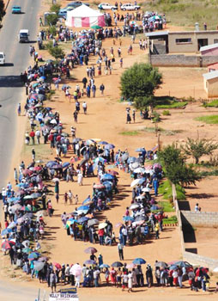
Stacks and Queues
Last in First out
First in First out

Slide 22
But first…
How do we represent graphs?

Slide 23
Graph representations
0
1
1
1
0
0
Better for sparse graphs and traversals
1
0
0
Adjacency matrix
Adjacency List
O(1)
(u,v) in E?
O(n) [ O(n_{v}) ]
O(n)
All neighbors of u?
O(n_{u})
O(n²)
Space?
O(m+n)

Slide 24
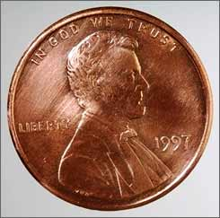
2 # edges = sum of # neighbors
2m = Σ_{u in V} n_{u}
Rest of the graph
Give 2 pennies to each edge
Total # of pennies = 2m
n_{v}=3
u
n_{u}=4
v
Each edges gives one penny to its end points
# of pennies u receives = n_{u}

