Slide 1
Lecture 7
CSE 331

Slide 2
Breadth First Search (BFS)
Build layers of vertices connected to s
L₀ = {s}
Assume L₀,..,L_{j} have been constructed
L_{j+1} set of vertices not chosen yet but are connected to L_{j}
Stop when new layer is empty
Use CC[v] array
Use linked lists

Slide 3
An illustration
1
2
3
4
5
7
8
6
1
7
2
3
8
4
5
6

Slide 4
Implementing DFS in O(m+n) time
Same as BFS except stack instead of a queue

Slide 5
A DFS run using an explicit stack
7
8
1
7
6
7
3
2
3
5
8
4
4
5
5
3
6
2
3
1

Slide 6
O(m+n) BFS Implementation
Input graph as Adjacency list
BFS(s)
Array
CC[s] = T and CC[w] = F for every w≠ s
Set i = 0
Set L₀= {s}
While L_{i} is not empty
Linked List
L_{i+1} = Ø
For every u in L_{i}
For every edge (u,w)
Version in KT also computes a BFS tree
If CC[w] = F then
CC[w] = T
Add w to L_{i+1}
i++

Slide 7
All the layers as one
BFS(s)
All layers are considered in first-in-first-out order
CC[s] = T and CC[w] = F for every w≠ s
Set i = 0
Set L₀= {s}
While L_{i} is not empty
L_{i+1} = Ø
For every u in L_{i}
Can combine all layers into one queue: all the children of a node are added to the end of the queue
For every edge (u,w)
If CC[w] = F then
CC[w] = T
Add w to L_{i+1}
i++

Slide 8
Queue O(m+n) implementation
BFS(s)
CC[s] = T and CC[w] = F for every w≠ s
O(n)
Intitialize Q= {s}
O(1)
While Q is not empty
Repeated at most once for each vertex u
Σ_{u} O(n_{u}) =
O(Σ_{u} n_{u}) =
O(m)
Delete the front element u in Q
For every edge (u,w)
Repeated n_{u} times
O(1)
If CC[w] = F then
O(n_{u})
CC[w] = T
O(1)
Add w to the back of Q

Slide 9
Implementing DFS in O(m+n) time
Same as BFS except stack instead of a queue

Slide 10
DFS stack implementation
DFS(s)
CC[s] = T and CC[w] = F for every w≠ s
Same
O(m+n) run time analysis as for BFS
Intitialize Ŝ = {s}
While Ŝ is not empty
Pop the top element u in Ŝ
For every edge (u,w)
If CC[w] = F then
CC[w] = T
Push w to the top of Ŝ

Slide 11
Finding cycles in O(n+m)
Run BFS or DFS
If an edge is considered and the node is already explored
  That’s a cycle!

Slide 12


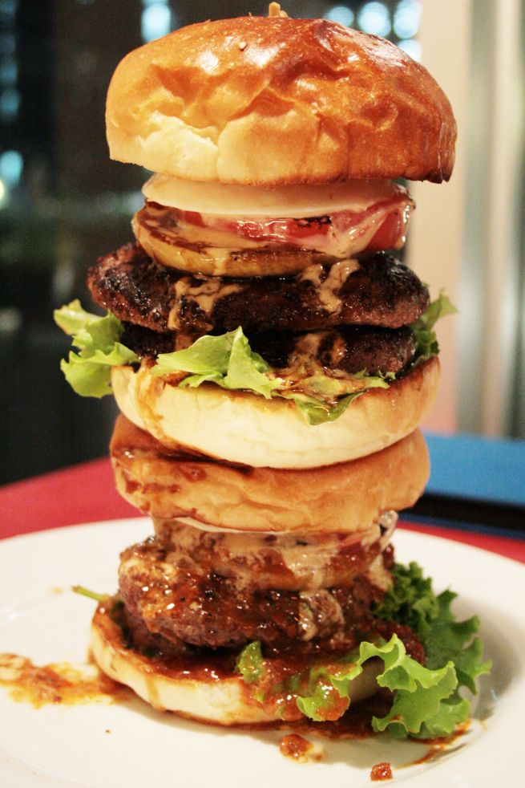
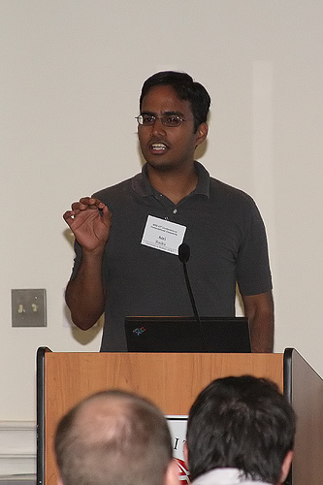
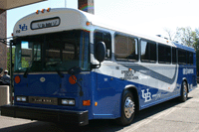
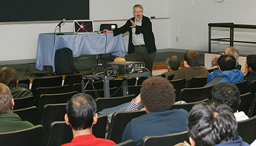
Directed graphs
Model asymmetric relationships
Precedence relationships
u needs to be done before w means (u,w) edge

Slide 13
Directed graphs
Adjacency matrix is not symmetric
Each vertex has two lists in Adj. list rep.

Slide 14
Directed Acyclic Graph (DAG)
No directed cycles
Precedence relationships are consistent

Slide 15
Topological Sorting of a DAG
Order the vertices so that all edges go “forward”

Slide 16
Today’s agenda
DAG ➔ topological sorting
Iteratively pick the node with no incoming edges

Slide 17
Run of TopOrd algorithm

