Slide 1
Lecture 8
CSE 331

Slide 2








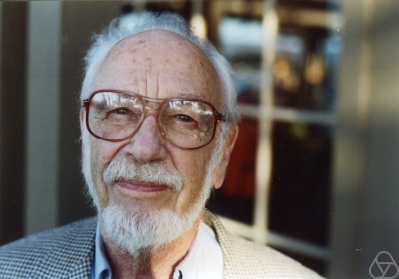
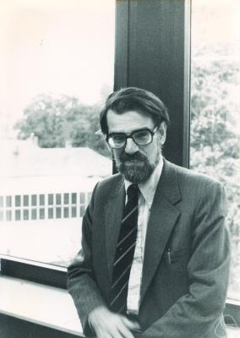
Main Steps in Algorithm Design
Problem Statement
Problem Definition
Algorithm
n!
“Implementation”
Data Structures
Analysis
Correctness+Runtime Analysis

Slide 3
Where do graphs fit in?
Problem Statement
A tool to define problems
Problem Definition
Algorithm
Implementation
Analysis

Slide 4
Rest of the course
Problem Statement
Problem Definition
Three general techniques
Now: Greedy Algorithms
Later: Divide and Conquer
Algorithm
Later: Dynamic Programming
Implementation
Analysis

Slide 5
Greedy algorithms
Build the final solution piece by piece
Being short sighted on each piece
Never undo a decision

Slide 6

End of Semester blues
Can only do one thing at any day: what is the maximum number of tasks that you can do?
Write up a term paper
Party!
Exam study
331 homework
331 HW
Project
Monday
Tuesday
Wednesday
Thursday
Friday

Slide 7
Greedily solve your blues!
Arrange tasks in some order and iteratively pick non-overlapping tasks
Write up a term paper
Party!
Exam study
331 HW
Project
Monday
Tuesday
Wednesday
Thursday
Friday

Slide 8
Ordering is crucial
Order by starting time
Write up a term paper
Algo =1
Party!
Exam study
331 HW
Project
Monday
Tuesday
Wednesday
Thursday
Friday

Slide 9
Another attempt
Order by duration
Ordering by least conflicts doesn’t work
Algo =1
Monday
Tuesday
Wednesday
Thursday
Friday

Slide 10
The final algorithm
Order tasks by their END time
Write up a term paper
Party!
Exam study
331 HW
Project
Monday
Tuesday
Wednesday
Thursday
Friday

Slide 11
Today’s agenda
Prove the correctness of the algorithm

Slide 12
Formal Algorithm
R: set of requests
Set A to be the empty set
While R is not empty
Choose i in R with the earliest finish time
Add i to A
Remove all requests that conflict with i from R
Return A

Slide 13
Algorithm for Interval Scheduling
R: set of requests
Set A to be the empty set
While R is not empty
Choose i in R with the earliest finish time
Add i to A
Remove all requests that conflict with i from R
A is optimal
Return A

Slide 14
Run time analysis
O(n log n) time sort intervals such that f(i) ≤ f(i+1)
O(n) time to iterate over all the intervals
Set A to be the empty set
Do the removal on the fly
While R is not empty
Choose i in R with the earliest finish time
Add i to A
Remove all requests that conflict with i from R
Return A

Slide 15
Algorithm implementation
Go through the intervals in order of their finish time
3
How can you tell in O(1) time if any of 2,3 or 4 conflict with 1?
Check if s[i] < f(1)
2
1
4
O(n log n) run time
In general, if jth interval is the last one chosen
Pick smallest i>j such that s[i] ≥ f(j)

Slide 16
The final algo
O(n log n) time sort intervals such that f(i) ≤ f(i+1)
O(n) time to iterate over all the intervals
Add 1 to A and set f = f(1)
For i = 2 .. n
If s[i] ≥ f
Add i to A
Set f = f(i)
Return A

Slide 17
Proof of correctness
“greedy stays ahead”

