Slide 1
Hicklens Labyrinth
Jesse Hicklen – CS-423

Slide 2
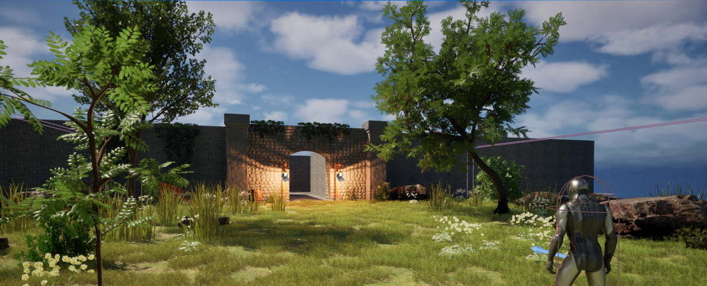
World Layout
Start area: outside courtyard
Entrance to the abandoned labyrinth
1 interactable NPC to set the plot

Slide 3
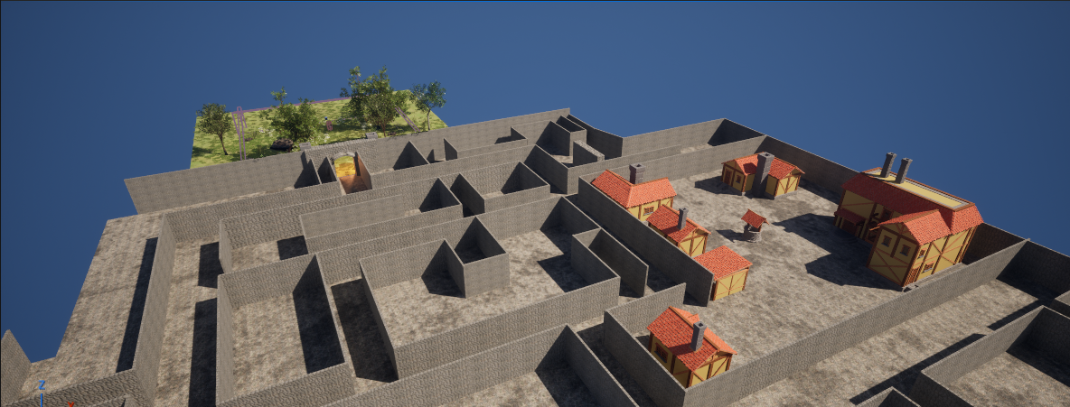
World layout
A maze filled with twisting paths, and dead ends
Scattered throughout the maze are obstacles that must be solved to progress.
Players will encounter enemy creatures guarding key areas.
within the maze lies a small abandoned town with a few towns people still left.

Slide 4
Assets Needed
Environment:
Grass textures, stone maze walls, medieval weapons and props
Characters:
Player model, AI enemy (knight/monster), NPC villagers
Other Assets:
obstacles (locked doors, traps, Keys for doors)

Slide 5
Task Breakdown
World Design: courtyard start area + maze + town layout
Player Controls: movement & collision/trigger detection with NPCs and puzzles
AI Enemy: pathfinding + chase behavior+ animations with combat and death animations
Obstacles: interactive objects that block/slow progress
NPC Interaction: dialog/help system
UI/Win Condition: teleporter animation

