Slide 1
Customer Booking Prediction Model
Summary of Findings

Slide 2
Model Performance and Feature Importance
Model Accuracy: 85.33%
Classification Report:
precision recall f1-score support 0 0.87 0.98 0.92 12784 1 0.51 0.13 0.20 2216 accuracy 0.85 15000 macro avg 0.69 0.55 0.56 15000 weighted avg 0.81 0.85 0.81 15000

Slide 3
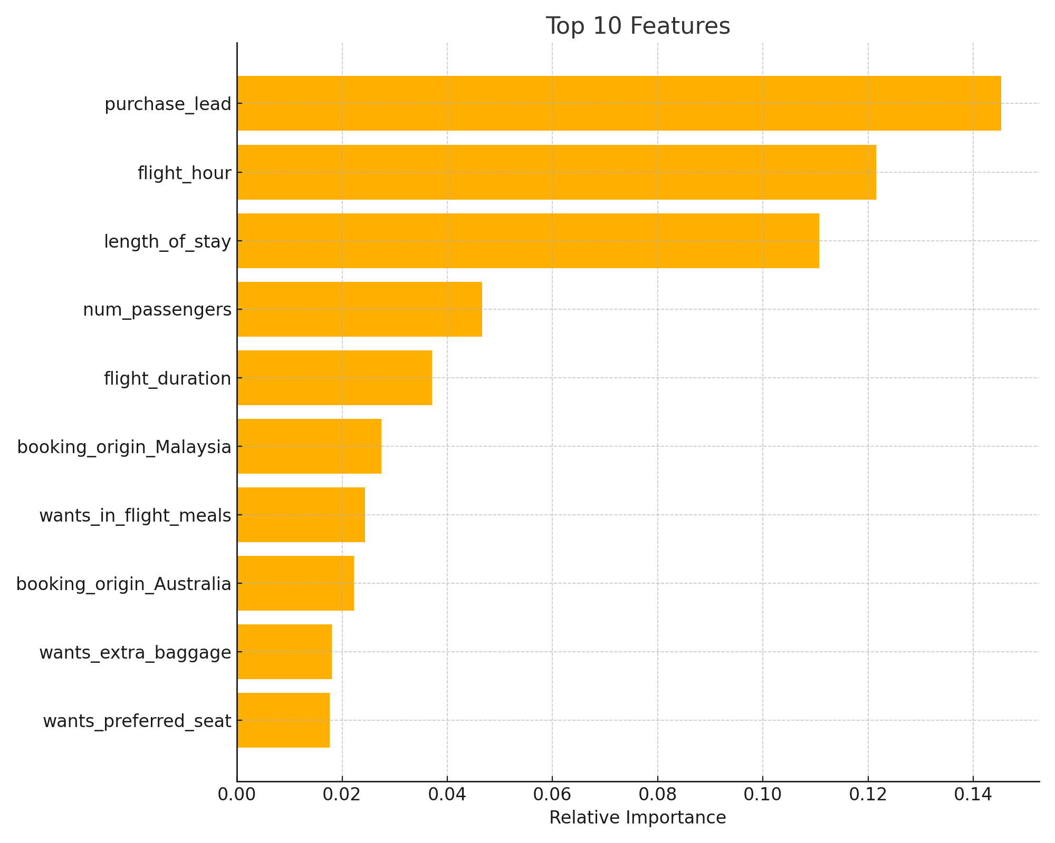
Feature Importance

