Slide 1
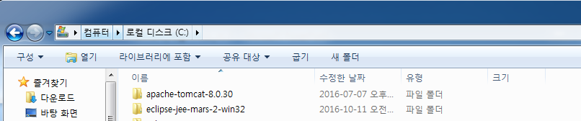
Developer Tool Information
Tool | Name | Version | How to install
IDE | Eclipse | Mars.2 Release (4.5.2) | Compress
WAS | Apache Tomcat | apache-tomcat-8.0.30 | Compress
JVM | JDK | 1.8.0_111 | Install
Dev Tool Location

Slide 2
Framework
System Layer |  | VN | 비고
 |  | WTS Homepage
Web | Sping MVC |  | HTTP Request / Response Process
Web Service | Apache Cxf |  | SOAP Request / Response Process
UI Component | Presentation Layer |  | UI Rendering, Client Side Validation
 | Control Layer |  | Request를 Service Class Distribution
Platform Service Component | Service Layer |  | Transaction, Biz Class
 | Biz Layer |  | Business Logic Process, Server Side Validation
 | Dao Layer |  | Data Access, External interface
Dispatcher
Servlet
JSP,CSS,
JS, IMG,
Flash
Sitemesh
Controller Class
TRExcuter Class
Service Class
Biz Class
getWsHnxUDPSoap12
ChartExcuter
Class
Biz Class
Dao Class
Biz Class
Biz Class
iBatis
Direct Call
※Legend
Dev Area
Set Area
Remote Call
Legacy
System
Oracle DB
External
System
UI Rendering
MS-SQL DB

Slide 3
Developer Server Info
WEB SERVER
Host Name | IP | ID/Password
VN DEV | 10.0.31.9 | root/M@svn01
VN_OPERATION | 10.0.31.2 | root/123456
WEB SERVER
Host Name | TYPE | IP | PORT | SID | ID/Password
VN DEV_DB | ORACLE | 10.0.31.9 | 1521 | MIRAEDB | Root /M@svn01
VN_DEV_DB(NEWS) | MS-SQL | ? | ? | ? | ?
VN_OPERATION_DB | ORACLE | 10.0.31.2 | 1521 | oracledb | Root /123456
VN_OPERATION_DB(NEWS) | MS-SQL | 10.0.31.6 | 1433 | MiraeAsset | Mirae /Mirae123@@@

Slide 4
Class Reference Relationship
BIZ Layer | VN WTS | Rule
Controller class |  | No cross-reference between controller classes Possible to refer to service class of same service area Service classes of other business areas can also be referenced
Service Class |  | No cross-reference between controller classes Possible to refer to service class of same service area Service classes of other business areas can also be referenced
Dao class |  | No mutual reference between dao classes
x
x
x
x
x
x
x
x
x

Slide 5
VN Common Config Guide
File location | Explanation
/com/src/main/webapp/WEB-INF/web.xml | VN Context web setting
/com/src/main/webapp/WEB-INF/spring/appServlet/servlet-context.xml | Spring config enviroment setting
/com/src/main/webapp/WEB-INF/config/decorator/decorator.xml | SITEMESH config enviroment setting
/com/src/main/resources/mappers/web/{DBCON}/sql-mapper-config.xml | Ibatis mapping model enviroment setting
/com/src/main/java/m/config/SystemConfig.java | properties setting
/com/src/main/resources/vn/conf/globals.properties | DB config setting
/com/src/main/java/config/system.properties | Diffrent system config setting
Web.xml
Spring Configuration file Read <context-param> <param-name>contextConfigLocation</param-name> <param-value>/WEB-INF/spring/*-context.xml</param-value> </context-param> All Servlet Mapping Sitemesh Control <filter> <filter-name>sitemesh</filter-name> <filter-class> com.opensymphony.module.sitemesh.filter.PageFilter </filter-class> </filter> <filter-mapping> <filter-name>sitemesh</filter-name> <url-pattern>/*</url-pattern> </filter-mapping> <filter> <filter-name>sitemesh</filter-name> <filter-class> com.opensymphony.module.sitemesh.filter.PageFilter </filter-class> </filter> <filter-mapping> <filter-name>sitemesh</filter-name> <url-pattern>/*</url-pattern> </filter-mapping>
NEXT PAGE

Slide 6
Continue
servlet-context.xml
This Url is Resource not mapping Servlet <resources mapping="/resources/**" location="/resources/" /> <resources mapping="/html/**" location="/html/" /> <resources mapping="/data/**" location="/data/" /> All Request Mapping This Url jsp include views/... Call Page surfix .jsp define <beans:bean class="org.springframework.web.servlet.view.InternalResourceViewResolver"> <beans:property name="prefix" value="/WEB-INF/views/" /> <beans:property name="suffix" value=".jsp" /> </beans:bean> Mapping DB Database SET <beans:bean id="dataSource_web" class="org.apache.commons.dbcp2.BasicDataSource" destroy-method="close"> <beans:property name="driverClassName" value="#{db['Globals.oraweb.DriverClassName']}"/> <beans:property name="url" value="#{db['Globals.oraweb.Url']}"/> <beans:property name="username" value="#{db['Globals.oraweb.UserName']}"/> <beans:property name="password" value="#{db['Globals.oraweb.Password']}"/> </beans:bean> <beans:bean id="txManager_web" class="org.springframework.jdbc.datasource.DataSourceTransactionManager"> <beans:property name="dataSource" ref="dataSource_web"/> </beans:bean> <beans:bean class="org.mybatis.spring.mapper.MapperScannerConfigurer"> <beans:property name="basePackage" value="com.vn.app.webmain.oraweb" /> <beans:property name="sqlSessionFactory" ref="sqlSessionFactory_web"/> </beans:bean> <beans:bean id="sqlSessionFactory_web" class="org.mybatis.spring.SqlSessionFactoryBean"> <beans:property name="dataSource" ref="dataSource_web" /> <beans:property name="configLocation" value="classpath:/mappers/web/oraweb/sql-mapper-config.xml" /> <beans:property name="mapperLocations" value="classpath:/mappers/web/oraweb/**/*_SQL.xml" /> </beans:bean> <beans:bean id="sqlSession_web" class="org.mybatis.spring.SqlSessionTemplate"> <beans:constructor-arg index="0" ref="sqlSessionFactory_web"/> </beans:bean> Interceptor Action Define Define Source com/vn/app/commons/SessionInterceptor.java <interceptors> <interceptor>
NEXT PAGE

Slide 7
Continue
<mapping path="/wts/**" /> <mapping path="/home/account/myasset.do" /> <exclude-mapping path="/trading/**"/> <beans:bean class="com.vn.app.commons.SessionInterceptor"></beans:bean> </interceptor> </interceptors>
Decorator.xml
Call Servlet Define Decorator Page Servlet Url /wts/* matching /views/decorators/ folder find <decorator name="wtsLayout" page="wtsLayout.jsp"> <pattern>/wts/*</pattern> </decorator> Not Mapping sitemesh <excludes> <pattern>/excludes/*</pattern> </excludes>
sql-mapper-config.xml
Mybatis DAO & MODEL mapping Define <configuration> <typeAliases> <typeAlias alias="SearchVO" type="com.vn.app.webmain.oraweb.home.service.SearchVO"/> <typeAlias alias="ResearchVO" type="com.vn.app.webmain.oraweb.home.service.ResearchVO"/> <typeAlias alias="HomeVO" type="com.vn.app.webmain.oraweb.home.service.HomeVO"/> <typeAlias alias="TablesVO" type="com.vn.app.webmain.oraweb.home.service.TablesVO"/> <typeAlias alias="MiraeAssetNewsVO" type="com.vn.app.webmain.oraweb.home.service.MiraeAssetNewsVO"/> <typeAlias alias="JobTitleVO" type="com.vn.app.webmain.oraweb.home.service.JobTitleVO"/> <typeAlias alias="InvestorVO" type="com.vn.app.webmain.oraweb.home.service.InvestorVO"/> <typeAlias alias="ItemVO" type="com.vn.app.webmain.oraweb.home.service.ItemVO"/> </typeAliases> </configuration>
SystemConfig.java
Load properties if("10.0.31.9".equals(ic.getIp())) { in = cl.getResourceAsStream("config/9system.properties"); } else if("10.0.9.43".equals(ic.getIp())) { in = cl.getResourceAsStream("config/43system.properties"); } else if("10.0.31.2".equals(ic.getIp())) { in = cl.getResourceAsStream("config/opt.system.properties"); } else { in = cl.getResourceAsStream("config/system.properties"); }
NEXT PAGE

Slide 8
Continue
globals.properties
Another DB or diffrent Account Setting #mysql - Globals.oraweb Globals.oraweb.DriverClassName=oracle.jdbc.driver.OracleDriver Globals.oraweb.Url=jdbc:oracle:thin:@10.0.9.5:1521:oracledb Globals.oraweb.UserName=QUOTE Globals.oraweb.Password=123456 #mysql - Globals.oranews Globals.oranews.DriverClassName=oracle.jdbc.driver.OracleDriver Globals.oranews.Url=jdbc:oracle:thin:@10.0.9.5:1521:oracledb Globals.oranews.UserName=QUOTE Globals.oranews.Password=123456 #mssql #Globals.mssql.DriverClassName=com.microsoft.jdbc.sqlserver.SQLServerDriver Globals.mssql.DriverClassName=com.microsoft.sqlserver.jdbc.SQLServerDriver Globals.mssql.Url=jdbc:sqlserver://10.0.31.6:1433;databaseName=MiraeAsset Globals.mssql.UserName=mirae Globals.mssql.Password=Mirae123@@@
system.properties
Path or server ip setting ABSOLUTE_PATH=C:/eclipse-jee-mars-2-win32/workspace/com/src/main/webapp DEFINITIONS_PATH=/definitions/tr/ ACTIONS_PATH=definitions/action/ WEBROOT_DIR=/usr/local/server/apache-tomcat-8.5.0/webapps/ SERVERIP=172016150167 SERVERHOST=127.0.0.1 #BPHOST=10.0.31.4 BPHOST=10.0.31.9 BPPORT=15204
NEXT PAGE

Slide 9
Coding Guide Controller - View
SIMPLE PAGE MOVE
Simple Page Move Action Go to page /view/Trading.jsp
[Example] TradingController.java
@RequestMapping(value = "/trading/tradingMain.do", method = RequestMethod.GET) public String Trading(Locale locale, Model model) { return "Trading"; }
SIMPLE PAGE MOVE & SET PARAMETER
Page Move Action and SET Parameter Go to page /view/home/newsAndEvents/market.jsp
NewsAndEventController.java
@RequestMapping(value = "/home/newsAndEvents/market.do", method = RequestMethod.POST) public ModelAndView marketpost(Locale locale, Model model, HttpServletRequest req, HttpServletResponse res) throws UnsupportedEncodingException { HttpSession session = req.getSession(); ModelAndView mav = new ModelAndView(); mav.addObject("type", req.getParameter("type")); mav.addObject("from", req.getParameter("from")); mav.addObject("sid", req.getParameter("sid")); mav.addObject("to", req.getParameter("to")); mav.addObject("searchkey", req.getParameter("searchkey")); mav.addObject("trPage", req.getParameter("trPage")); mav.setViewName(("en_US".equals(session.getAttribute("LanguageCookie")) ? "/home/newsAndEvents/market" : "/vn_home/newsAndEvents/market")); return mav; }

Slide 10
Coding Guide Controller – Data(TR)
[GET DATA FLOW]
JSP Page Load Get Data Object First Dispatch Call Url /trading/view/bid.do Action Second Page Load /view/trading/bid.jsp Third CurrentStock Method Call And Get Axix Data
TradingController.java
@RequestMapping(value = "/trading/view/bid.do", method = RequestMethod.GET) public String Bid(Locale locale, Model model, HttpServletRequest req, HttpServletResponse res) throws UnsupportedEncodingException { return "/trading/bid"; }
bid.jsp
function getData(symbol) { $("#tab31").block({message: "<span>LOADING...</span>"}); var param = { symb : symbol , lang : ("<%= langCd %>" == "en_US" ? "1" : "0") }; $.ajax({ url : "/trading/data/getBid.do", contentType : “application/json; charset=utf-8", data : param, dataType : "json", success : function(data){ setBID(data); } }); }
NEXT PAGE

Slide 11
Continue
TradingController.java
@RequestMapping(value = "/trading/data/getBid.do", method = RequestMethod.GET) public ModelAndView CurrentStock(Locale locale, Model model, HttpServletRequest req, HttpServletResponse res) throws UnsupportedEncodingException { req.setCharacterEncoding("utf-8"); res.setCharacterEncoding("utf-8"); res.setHeader("Content-Type", "text/html; charset=utf-8"); WebInterface webInterface = new WebParam(req, res); JSONObject outputResult1 = new JSONObject(); JSONObject outputResult2 = new JSONObject(); JSONObject outputResult3 = new JSONObject(); ModelAndView mav = new ModelAndView(); try { outputResult1 = new TRExecuter(webInterface, "pibotprc").execute(); outputResult2 = new TRExecuter(webInterface, "pibocurr").execute(); } catch(Throwable e) { e.printStackTrace(); mav.addObject("trResult", "error"); mav.addObject("trMsg", e.getMessage()); return mav; } mav.addObject("tprc", outputResult1); mav.addObject("curr", outputResult2); mav.addObject("trResult", "success"); mav.addObject("trMsg", "success"); mav.setViewName("jsonView"); return mav; }
NEXT PAGE

Slide 12
Continue
TRExecuter.java
public class TRExecuter extends TR{ public TRExecuter(WebInterface req, String trName) throws Exception { super(req, trName); }//end of ChartExecuter(); public JSONObject execute() throws Exception{ try{ this.setStatus(TRManager.SENDED); JSONObject obj = this.send(); this.setStatus(TRManager.RECEIVED); return obj; }catch(Exception e){ this.setStatus(TRManager.ERROR); e.printStackTrace(); throw e; } }//end of execute(); }//end of TRExecuter
Pibotprc.xml
<?xml version='1.0' encoding='utf-8'?> <transaction trcode="pibocurr" servicecode="" type="row"> <value io="in“ name="symb“ type="string“ length="12“ comment="종목코드"/> <value io="in“ name="lang“ type="string“ length="1“ comment="Language 0:VN 1:EN"/> <value io="out“ name="rcod“ type="string“ length="12“ comment="실시간 심볼"/> <value io="out“ name="symb“ type="string“ length="12“ comment="종목코드"/> <value io="out“ name="snam“ type="string“ length="32“ comment="종목명"/> <value io="out“ name="mark“ type="string“ length="12“ comment="시장구분('HOSE','HNX')"/> <value io="out“ name="curr“ type="string“ length="9“ comment="현재가"/> <value io="out“ name="diff“ type="string“ length="7“ comment="대비"/> <value io="out“ name="rate“ type="string“ length="7“ comment="등락율"/> <value io="out“ name="avol“ type="string“ length="9“ comment="누적거래량"/> <value io="out“ name="mrgn“ type="string“ length="5“ comment="Magin Ratio"/> </transaction>

Slide 13
Coding Guide
Controller – Data(SQL Query)
[GET DATA FLOW]
JSP Page Load And Researh Get Data Object First Call getResearchTopList Call Second /getResearchTopList.do Call Third getResearchTopList Method Call Next Service Call Next DAO Call Next Execute Query Call And Result Mapping ResultMap
Index.jsp
function getResearchTopList(){ var param = { nType : 1, lang : "<%= session.getAttribute("LanguageCookie") %>" }; $.ajax({ dataType : "json", url : "/getResearchTopList.do", data : param, success : function(data) { var researchListStr = ""; if(data.jsonObj != null){ researchListStr += ""; for(var i=0; i < data.jsonObj.list.length; i++){ researchListStr += "<li>"; researchListStr += "<a class=\"layer_link\" href=\"/pdfViewer.do?screen=research&ids=" + data.jsonObj.list[i].id + "\" onclick=\"pdfReading('newWin', '" + data.jsonObj.list[i].id + "');return false;\">"; researchListStr += "<p>" + data.jsonObj.list[i].code + "</p>"; researchListStr += "<span>" + data.jsonObj.list[i].created + "</span>"; researchListStr += "</a>"; researchListStr += "<a class=\"new_link\" title=\"Read Detail\" href=\"/pdfViewer.do?screen=research&ids=" + data.jsonObj.list[i].id + "\" onclick=\"pdfReading('newWin', '" + data.jsonObj.list[i].id + "');return false;\">read detail</a>" researchListStr += " </li>"; } }
NEXT PAGE

Slide 14
Continue
$("#researchTopList").html(researchListStr); }, error :function(e) { console.log(e); } }); }
ResearchController.java
@RequestMapping(value = "/getResearchTopList.do", method = RequestMethod.GET) @ResponseBody public ModelAndView getResearchTopList(HttpServletRequest req, HttpServletResponse res) throws Exception { SearchVO searchVO = new SearchVO(); searchVO.setType(req.getParameter("nType")); if(req.getParameter("lang") != null){ searchVO.setLang(req.getParameter("lang")); } else { searchVO.setLang("vi_VN"); } List<ResearchVO> researchVO = researchService.getResearchTopList(searchVO); JSONObject jObj = new JSONObject(); try{ JSONArray jArr = new JSONArray(); for(int i=0; i<researchVO.size(); i++){ JSONObject sObj = new JSONObject(); sObj.put("id", researchVO.get(i).getId()); sObj.put("created", researchVO.get(i).getCreated()); sObj.put("modified",researchVO.get(i).getModified()); sObj.put("code", researchVO.get(i).getCode()); sObj.put("name", researchVO.get(i).getName()); sObj.put("data", researchVO.get(i).getData()); jArr.add(sObj); jObj.put("list", jArr); } }catch(Exception e){ e.printStackTrace(); } ModelAndView mav = new ModelAndView(); mav.addObject("jsonObj", jObj); mav.setViewName("jsonView"); return mav; }
NEXT PAGE

Slide 15
Continue
ResearchService.java
public List<ResearchVO> getResearchTopList(SearchVO sch) { return dao.getResearchTopList(sch); }
ResearchDAO.java
public List<ResearchVO> getResearchTopList(SearchVO sch);
research_SQL.xml
<select id="getResearchTopList" resultType="ResearchVO" parameterType="SearchVO"> SELECT id, created, modified, code, name FROM ( SELECT dd.id, dd.created, dd.modified, dd.title as code, dd.name as name , dd.PUBLISHDATE, ROW_NUMBER() OVER(ORDER BY dd.PUBLISHDATE DESC) AS NUM FROM DATA_RESEARCH dd WHERE SUBSTR(dd.path,1,5) = CASE #{lang} WHEN 'vi_VN' THEN 'vi-VN' WHEN 'en_US' THEN 'en-EN' ELSE 'vi-VN' END AND dd.type = #{nType} ) WHERE NUM &lt;= 3 </select>
sql-mapper-config.xml
<?xml version="1.0" encoding="UTF-8"?> <!DOCTYPE configuration PUBLIC "-//mybatis.org//DTD Config 3.0//EN" "http://mybatis.org/dtd/mybatis-3-config.dtd"> <configuration> <typeAliases> <typeAlias alias="SearchVO" type="com.vn.app.webmain.oraweb.home.service.SearchVO"/> <typeAlias alias="ResearchVO" type="com.vn.app.webmain.oraweb.home.service.ResearchVO"/> <typeAlias alias="HomeVO" type="com.vn.app.webmain.oraweb.home.service.HomeVO"/> <typeAlias alias="TablesVO" type="com.vn.app.webmain.oraweb.home.service.TablesVO"/> <typeAlias alias="MiraeAssetNewsVO" type="com.vn.app.webmain.oraweb.home.service.MiraeAssetNewsVO"/> <typeAlias alias="JobTitleVO" type="com.vn.app.webmain.oraweb.home.service.JobTitleVO"/> <typeAlias alias="InvestorVO" type="com.vn.app.webmain.oraweb.home.service.InvestorVO"/> <typeAlias alias="ItemVO" type="com.vn.app.webmain.oraweb.home.service.ItemVO"/> </typeAliases> </configuration>

Slide 16
Convert TR
AXIX | TR
AXIX Define Method AXIX [PIBOHIDX] struct grid { char rcod[32]; /* RTS Symbol */ char inam[32]; /* Security Name */ char indx[12]; /* Index */ char diff[ 8]; /* Change */ char rate[ 7]; /* % Change */ char flag[ 1]; /* 'V':VN, 'F':Foreign */ char date[10]; /* Date */ char time[ 8]; /* Time */ }; struct mid { char dumy[ 1]; }; struct mod { char nrec[ 4]; /* # of Record */ struct grid rec[1]; }; | TR [pibohidx.xml] <?xml version='1.0' encoding='utf-8'?> <transaction trcode="pibohidx" servicecode="" type="row"> <value io="in“ name="dumy“ type="string“ length="1“ comment=""/> <value io="out“ name="nrec“ type="string" length="4“ comment=""/> <table name="list1" count="nrec"> <value io="out“ name="rcod“ type="string" length="32“ comment="RTS Symbol"/> <value io="out“ name="inam“ type="string" length="32" comment="Security Name"/> <value io="out“ name="indx“ type="string" length="12" comment="Index"/> <value io="out“ name="diff“ type="string" length="8" comment="Change"/> <value io="out“ name="rate“ type="string" length="7“ comment="% Change"/> <value io="out“ name="flag“ type="string" length="1" comment="'V':VN, 'F':Foreign"/> <value io="out“ name="date“ type="string" length="10" comment="Date"/> <value io="out“ name="time“ type="string" length="8" comment="Time"/> </table> </transaction>

Slide 17
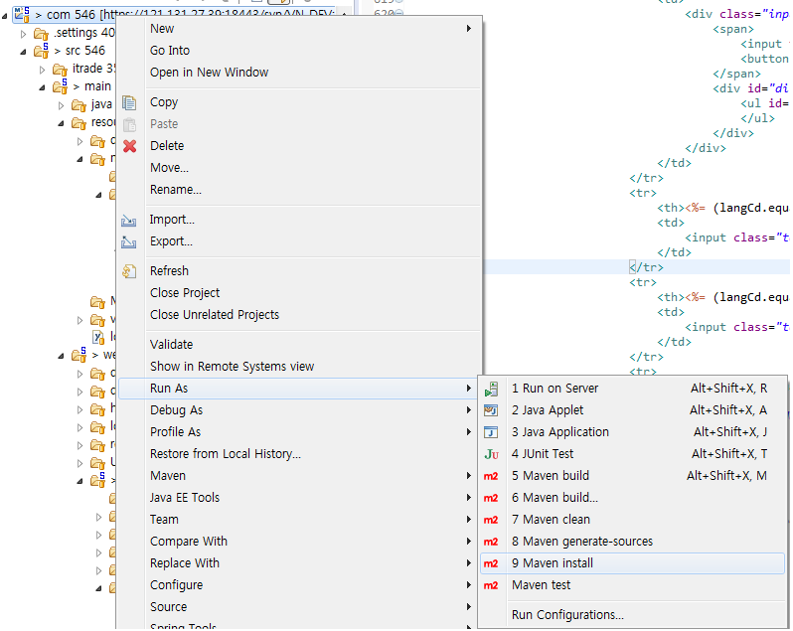
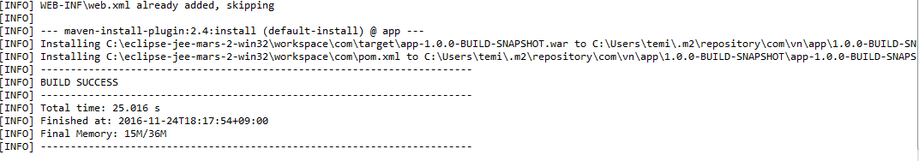
Build Process
Build WAR
Project Select Mouse Right Click Run As > Maven install Click Make THE SnapShot
Build Success CASE
Build Success
Creat War file C:\eclipse-jee-mars-2-win32\workspace\com\target\app-1.0.0-BUILD-SNAPSHOT.war Rename This File name ROOT.war Copy Remote Server webapps folder
NEXT PAGE

Slide 18
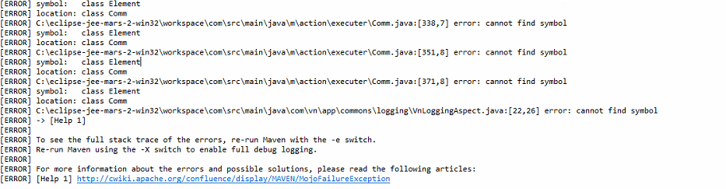
Continue
Build Fail CASE
Build Fail
If Build Error Occoure First project mouse right Click > Rus As > Maven clean Click Second project mouse right Click > Maven > Update Project Click Third Rebuild(install) execute

