Slide 1

The Scrum-Agile Approach
Jesse Jayne CS-250-T4473 7-1 Final Project

Slide 2
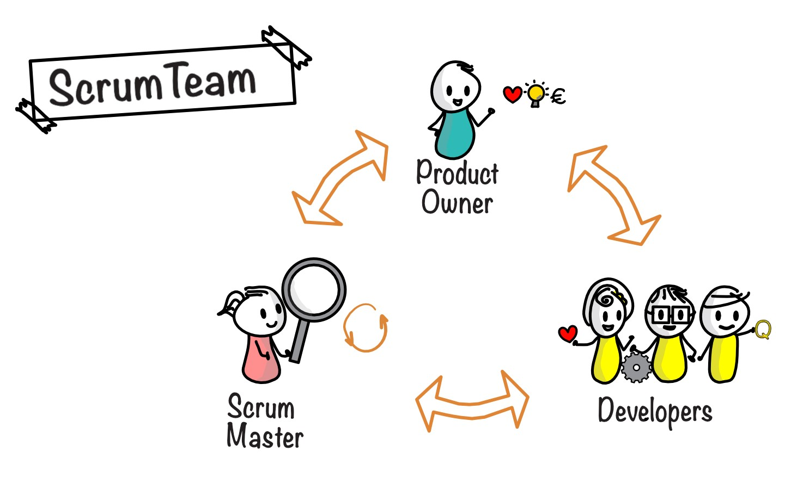
Roles of the Team
There are various equally important roles on each scrum team. The Product Owner – This role is solely responsible for managing the product backlog. One of the main decision-makers and like a project manager, a product owner acts as a representative between the business, the stakeholders, and the developers to drive the product forward with as high quality as possible.
The Scrum Master – This role is that of a servant-leader to the scrum team. Ensuring that the team follows the correct scrum practices and rules and finds the best techniques to work for the team. The scrum master facilitates all scrum events and understands the project and it’s planning. Can also act as a coach to the team members but should always be seen as an equal among the team. Development Team – This role can include a variety of specialized development roles including software developers and testers. Instrumental to bringing the product to life, the point of organizational skills like scrum are to maximize the potential of development. The “boots on the ground” in the team that creates the product increments throughout the product development lifecycle or tests the product as it is being refined or maintained for best practices.

Slide 3
The Agile SDLC
Requirements Gathering & Analysis
Design
Development
Testing
Deployment
Maintenance
The Agile SDLC, or Software Development Lifecycle, is the framework that describes all the actions at each phase of development for a project.
Requirements – Product Owner (and others) meet with customer to decide product requirements, timeline, and goals essential to develop the project.
Design – The team designs the overall structure or blueprint of the product that can then be split among different developers or teams to be constructed by individual experts.
Development – Developers work with the blueprint of the product to translate it into whatever code they are working with to create the actual product.
Testing – Developers (testers) will check all the code and operations to ensure it is working up to par and customer expectation. If issues are found, it can be reworked and retested until working as intended.
Deployment – Once the project has been through rigorous testing, it is tested in the production environment and then launched for customer use upon final verification from customer.
Maintenance – Once the product is live and in use by the real world, the developers will maintain contact with customer to fix or upgrade the product to ensure customer satisfaction and product usability.

Slide 4
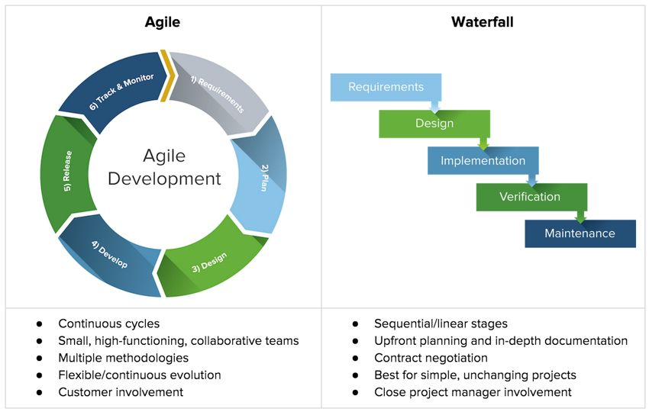
Choosing a methodology
Agile Vs. Waterfall Development Cycle
While many development team members understand the various phases in a development cycle, and they appear to be the same across Waterfall and Agile methodologies, there are important differences. Agile allows for the constant and continuous evolution of the phases, with customer and team input helping to factor into decision making. As many loops through the development cycle as the team needs can happen and can pivot to different phases quickly. Waterfall requires the sequential process and a more all-in and upfront planning without as much change or ability for testing.

Slide 5
Siding with Agile
The communication and planning process brought about with the agile-scrum method are immensely helpful and create a culture in which the team can develop a quality product quickly and with less stress.
The ability to recycle through the SDLC is a benefit that cannot be understated, allowing for more rigorous testing, quickly implementing customer feedback and changes, and improving quality massively over other methodology options.
Overview and Decision

Slide 6
References
Cobb, C. G. (2015). The project manager’s guide to mastering agile : principles and practices for an adaptive approach. John Wiley.
‌
Majumdar, S. (2017, December 12). Shifting Left and Going Beyond Agile and DevOps in SDLC. Kovair Blog. https://www.kovair.com/blog/shifting-left-going-beyond-agile-devops-in-sdlc/
‌
Equality - accountabilities in Scrum. (n.d.). Scrum.org. Retrieved April 17, 2022, from https://www.scrum.org/resources/blog/equality-accountabilities-scrum
‌
What is Agile SDLC? – Complete explanation of Agile SDLC Model» Network Interview. (2021). Networkinterview.com. https://networkinterview.com/what-is-agile-sdlc/
‌

