Slide 1

Master thesis November meeting
Jesse Keränen
07.11.2023

Slide 2
Progress during October
Due to technical difficulties delays in data collection
Participated in the Datastream training
Have been reading related literature
Lot of literature available for US and Europe, struggling to find good sources for Nordic studies
Results from previous literature confirmed initial selecetion of the methodology
Literature review almost ready and set of explanatory variables derived from it

Slide 3
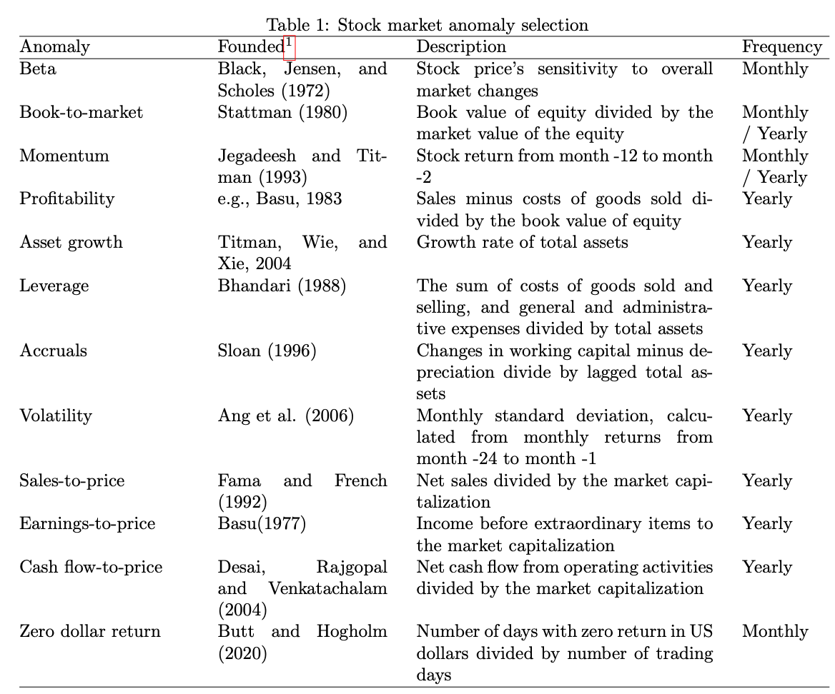
Refined research question
Fama-French factors
Factors shown profitability in Nordics
Value
Momentum
Cash-flow
Liquidity
Should alternative varitions of same factors be included

Slide 4
Next steps
Suggestions for literature I might have missed?
How to register to the seminars?
Euro or Dollar values
Risk free rate
Excluded dead stocks using TIME
Winsorize Datastream data or derived variables?

