Slide 1

Master thesis January meeting
Jesse Keränen
14.01.2024

Slide 2
Progress since the last meeting
Turnover and on-balance-volume variables added
Autocorrelation of the Fama-French factors examined as discussed in the previous meeting
Derived expected returns using Fama-MacBeth regression, random forest and neural networks methods
Based on the expected returns from each method, each month all stocks are divided to ten portfolios
Out-of-sample R² values calculated for different methods

Slide 3
More details on process
Micro-cap stocks are excluded from the portfolio formation
Hyperparameter optimization:
No need in regression approach
In random forest approach number of variables in each split and tree depth is optimized
Due to high computing demand no hyperparameter optimization for neural network approach, but early stopping is applied
Contradictory to previous literature validation sample is randomly selected from the training data, no two disjoint periods
Each model is trained only once a year, but stocks are re-allocated monthly

Slide 4
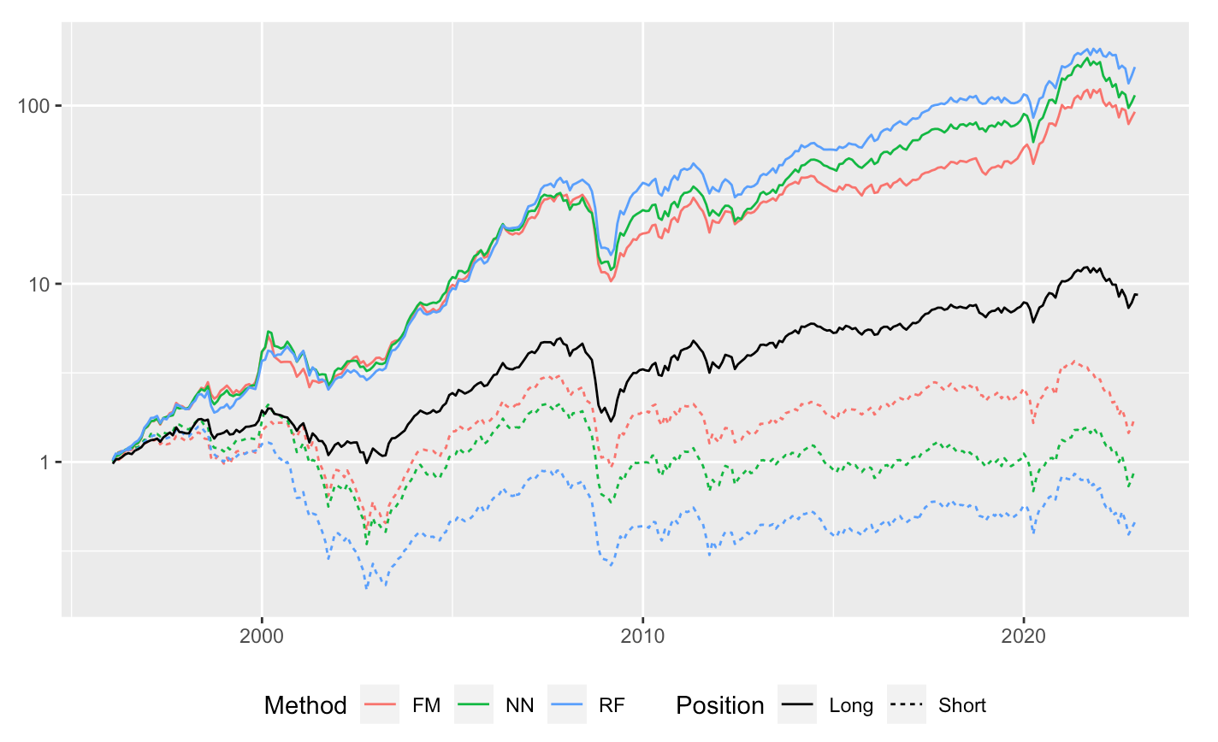
Portfolio returns
For all methods portfolio formed from stocks with highest expected return results higher realized returns than the lowest expected return portfolio
Highest spread for random forest approach

Slide 5
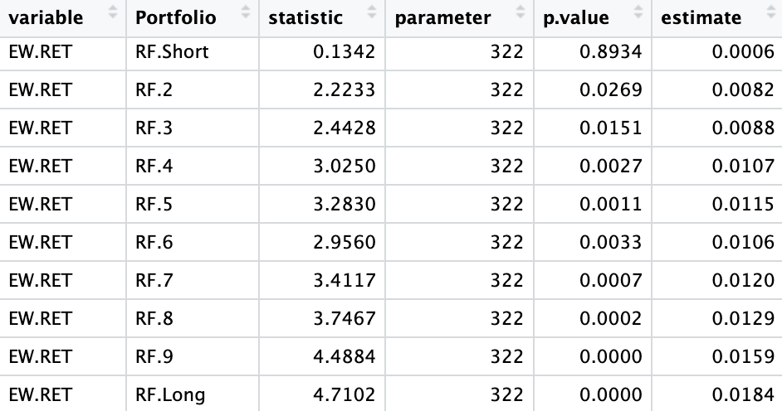
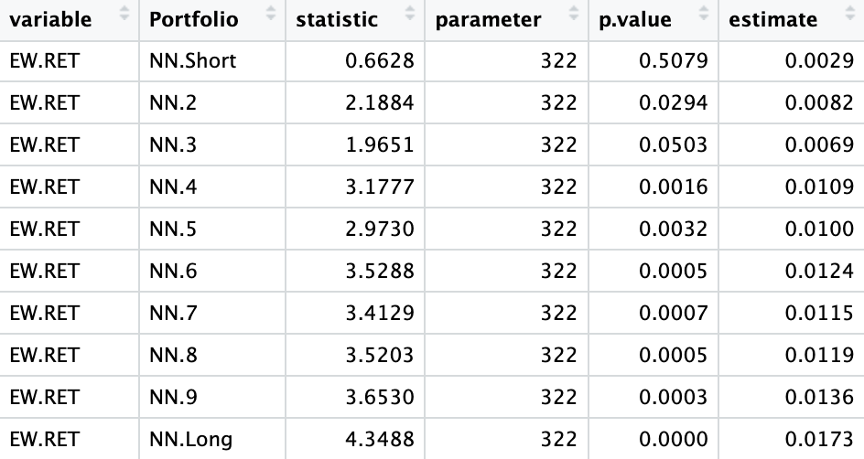
Prediction accuracy
Only random forest approach results positive out-of-sample R²
Random forest: 0.002
Neural network: -0.04
Fama-MacBeth: -0.05
Increasing realized returns across expected return portfolios
Estimate column shows the timeseries mean of the realized return of respective portfolio

Slide 6
Next steps
Double check the code
Sharpe ratio, maximum drawdown, turnover for different portfolios
Correlation between expected returns from different models
Different architectural forms of neural networks to be considered
Investigate what could explain low R² values
Variable importance

Slide 7
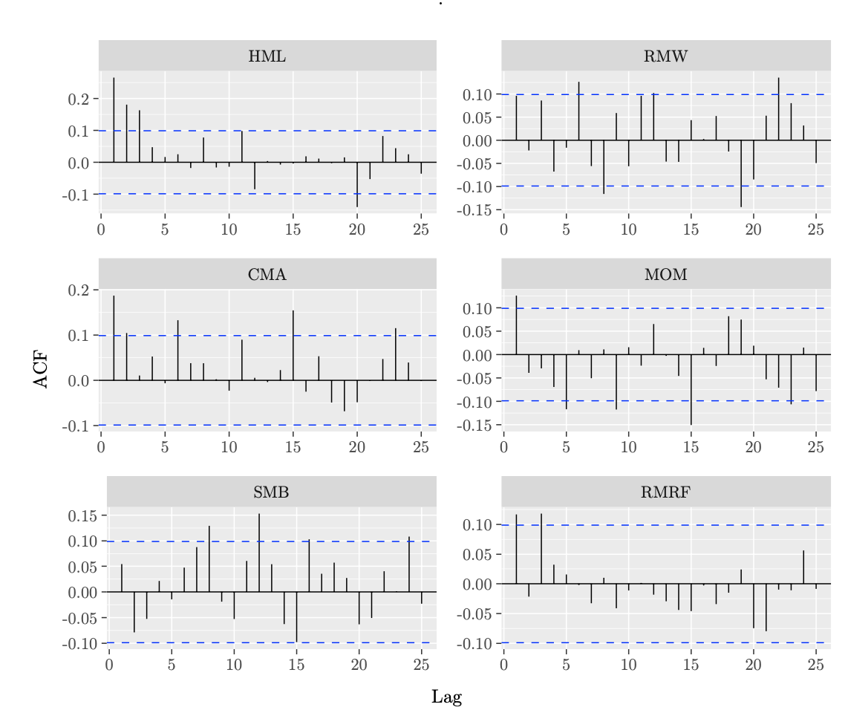
Factor autocorrelation

