Slide 1

Master‘s thesis February meeting
Jesse Keränen
04.02.2024

Slide 2
Research question and previous literature
Attempt to predict individual stock returns from company characteristics in Nordic stock markets using machine learning methods
Previous international literature shows that usage of machine learning methods can significantly improve profitability and accuracy of stock return prediction compared to linear regression
Variables such as momentum and book-to-market value show excess returns in Nordic stock markets
Two-fold contribution to the literature. Extend the machine learning approach to new subset of markets and extend the number of variables examined in Nordic markets
Additionally inspect simultaneously up to 20 stock market anomalies in Nordic market setting

Slide 3
Preliminary results
Stock level characteristics offer explanatory information about cross-section of Nordic stock returns
Machine learning models are able to classify stocks to return categories, but preciseness of the predictions remains quite low
Models seem to overshoot in the predictions, which results in poor out-of-sample R² values
Random forest and Neural network models perform better than traditional linear regression model
Explanatory variables seem to have quite much noise and outliers and therefore models do not show consistent variable importance
Despite the noise in the explanatory variables and the overshooting, models are able to capture signals of stocks returns and generate excess returns that can not be explained by risk positions in Fama and French factors

Slide 4
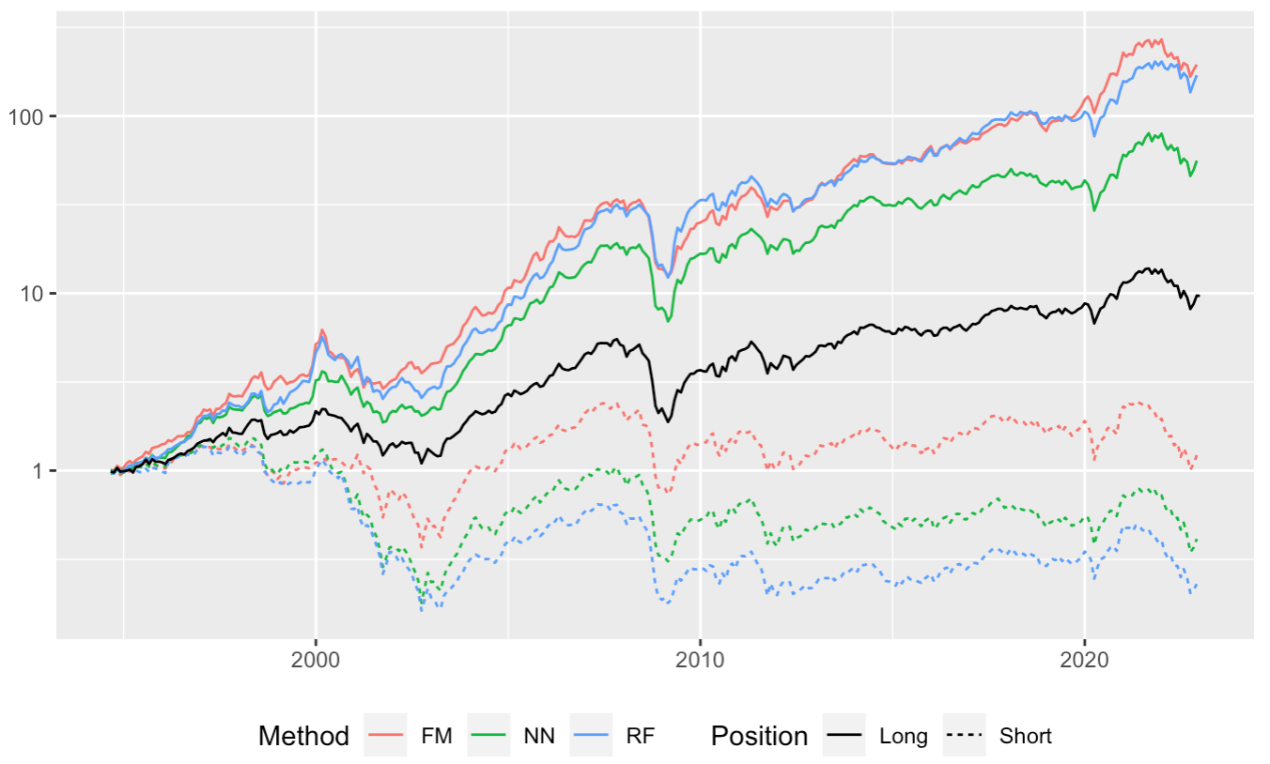
Cumulative portfolio returns
For all methods portfolio formed from stocks with highest expected return results higher realized returns than the lowest expected return portfolio
Highest spread for random forest approach
Linear regression method is able to capture stocks with highest return, but doesn‘t do good job capturing low return stocks
Neural network approach captures better low return stocks, but return of Long portfolio is more modest
Overall market trends can be seen from each portfolio

Slide 5
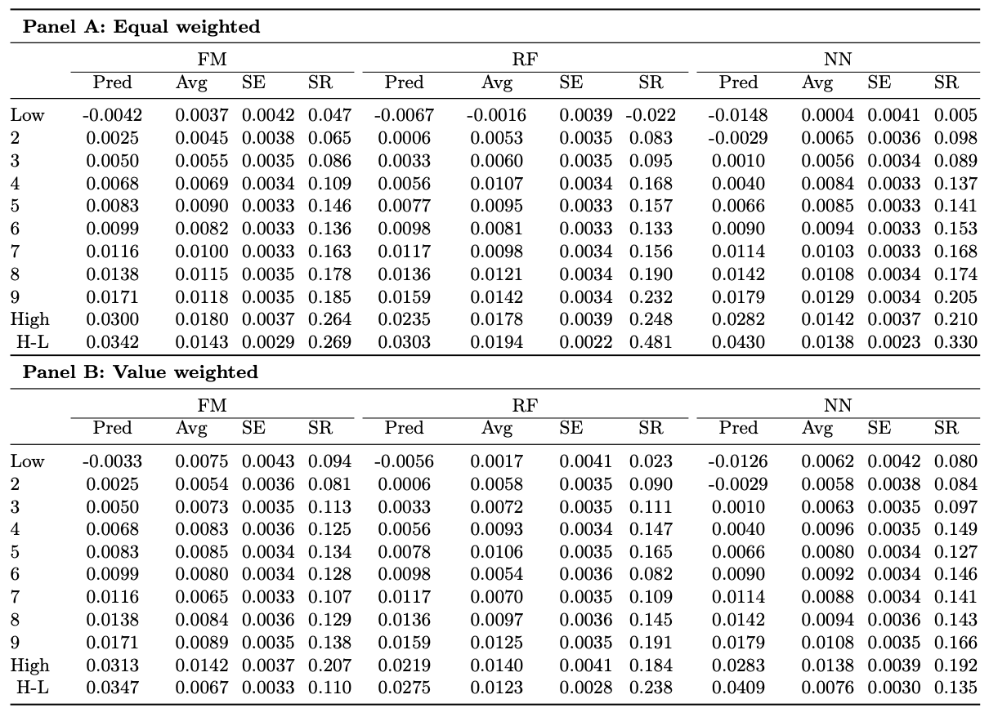
More detailed portfolio performance
Realized returns are increasing with expected returns
Portfolios with high expected returns also have higher Sharpe ratios
Models are able to produce excess return without investing in more volatile and correlated stocks
Neural network approach seems to overshoot in the predictions

Slide 6
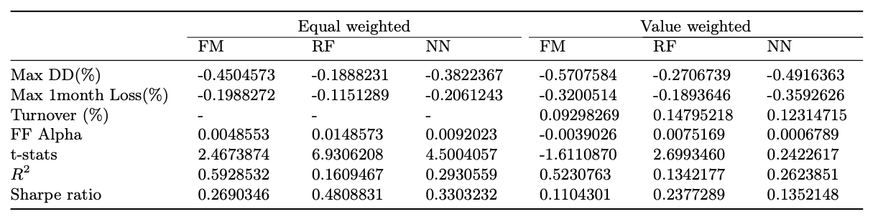
Performance of zero investment portfolios
Further portfolio metrics confirm the superiority of random forest approach
Random forest approach has lowest maximum drawdown, lowest maximum one month loss and highest Sharpe ratio both in equal and value weighted portfolios
Among equally weighted portfolios all methods produce alpha returns that cannot be explained by traditional Fama and French five factors augmented by momentum factor
Turnover of long portfolios is rather low compared to previous literature
Turnover is only calculated for long side portfolio.

Slide 7
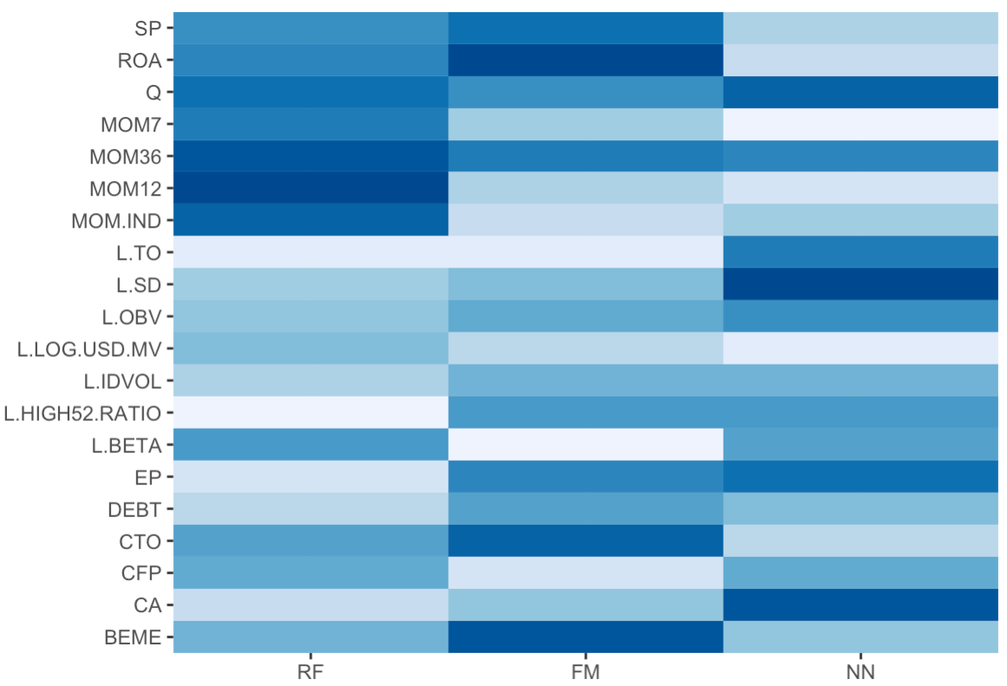
Explanatory variable importance
Variable importance is calculated using following approach:
Variable by variable is set to 0
Model is trained again and returns are predicted using re-trained model
Reduction in out-of-sample R² is calculated between full and reduced model
Finally, R² reductions within each model is normalized to sum to 1
There is discrepancy in which variables are most important for different models
Momentum variables are important to random forest model
Graph shows ranked variable importance of different models

Slide 8
Next steps
Next step would be to focus on writing
Part describing previous literature is ready
Data and methodology chapters are in halfway
Empirical results and conclusion are basically not started
Lewellen 2015

