Slide 1

recipe keeper
by Jesse Kercheval
for Launch School RB189
a complete Sinatra application
using ERB as the templating system
Notes:
Picky Eaters supports quick meal planning. Planning family dinners every week is tough. First we need to find or recall the many dinner recipes, then we need to narrow them down by ingredients on hand and picky family member tastes.
This could be for a mom or dad or anyone cooking for a "family" on a regular basis like a roommate with the best cooking skills of the group.
Most recipe apps solve the problem of *how* to make a recipe. Picky Eaters focuses on *what* to make. That's the key to meal planning every week.

Slide 2
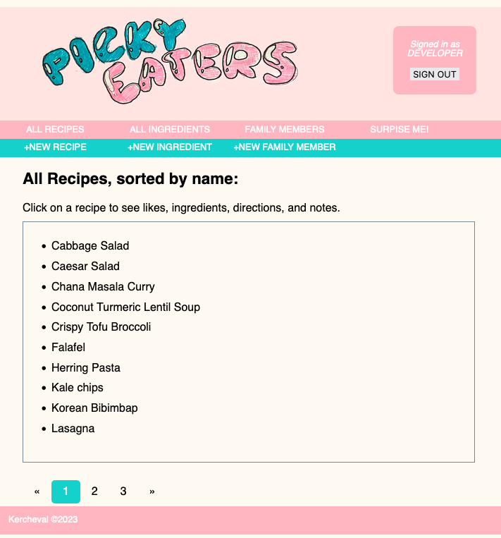
About
Picky Eaters recipe keeper is a web app to support quick meal planning.
It’s for anyone cooking for a family on a regular basis.
Picky Eaters keeps just enough info to help decide what to make.
Notes:
Picky Eaters is a web app designed to support quick meal planning.
Problem - Planning family dinners every week is tough. First we need to find or recall the many dinner recipes, then we need to narrow them down by ingredients on hand and picky family member tastes.
This could be for a mom or dad or anyone cooking for a "family" on a regular basis like a roommate with the best cooking skills of the group.
Most recipe apps solve the problem of *how* to make a recipe. Picky Eaters focuses on *what* to make. That's the key to meal planning every week.

Slide 3
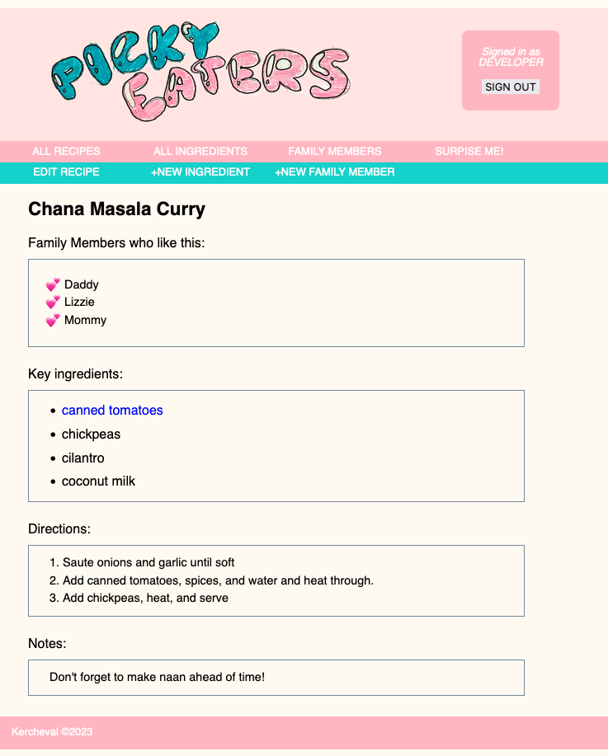
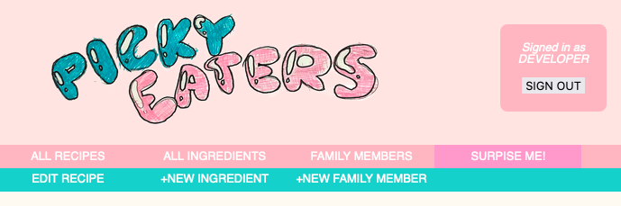
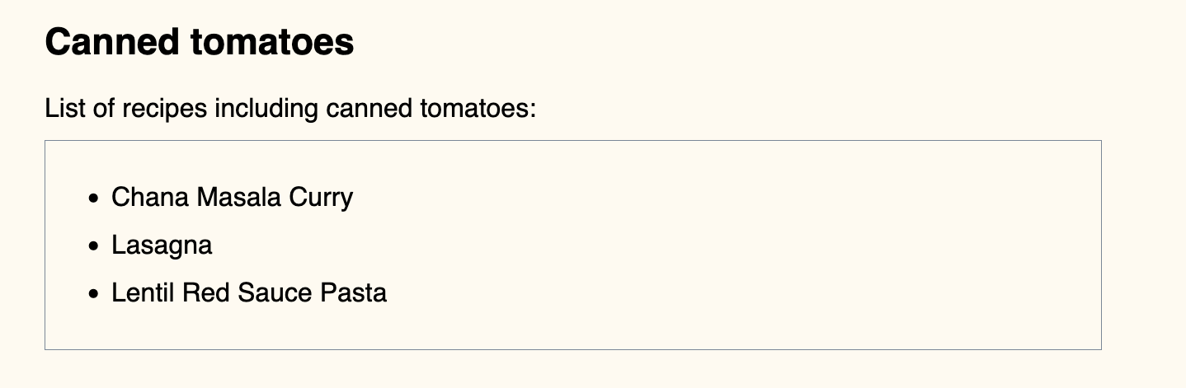
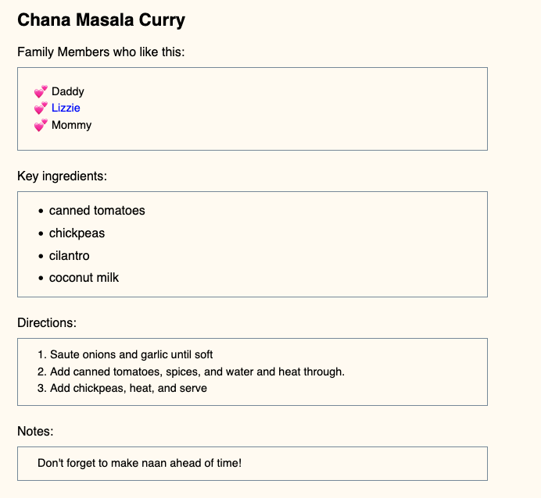
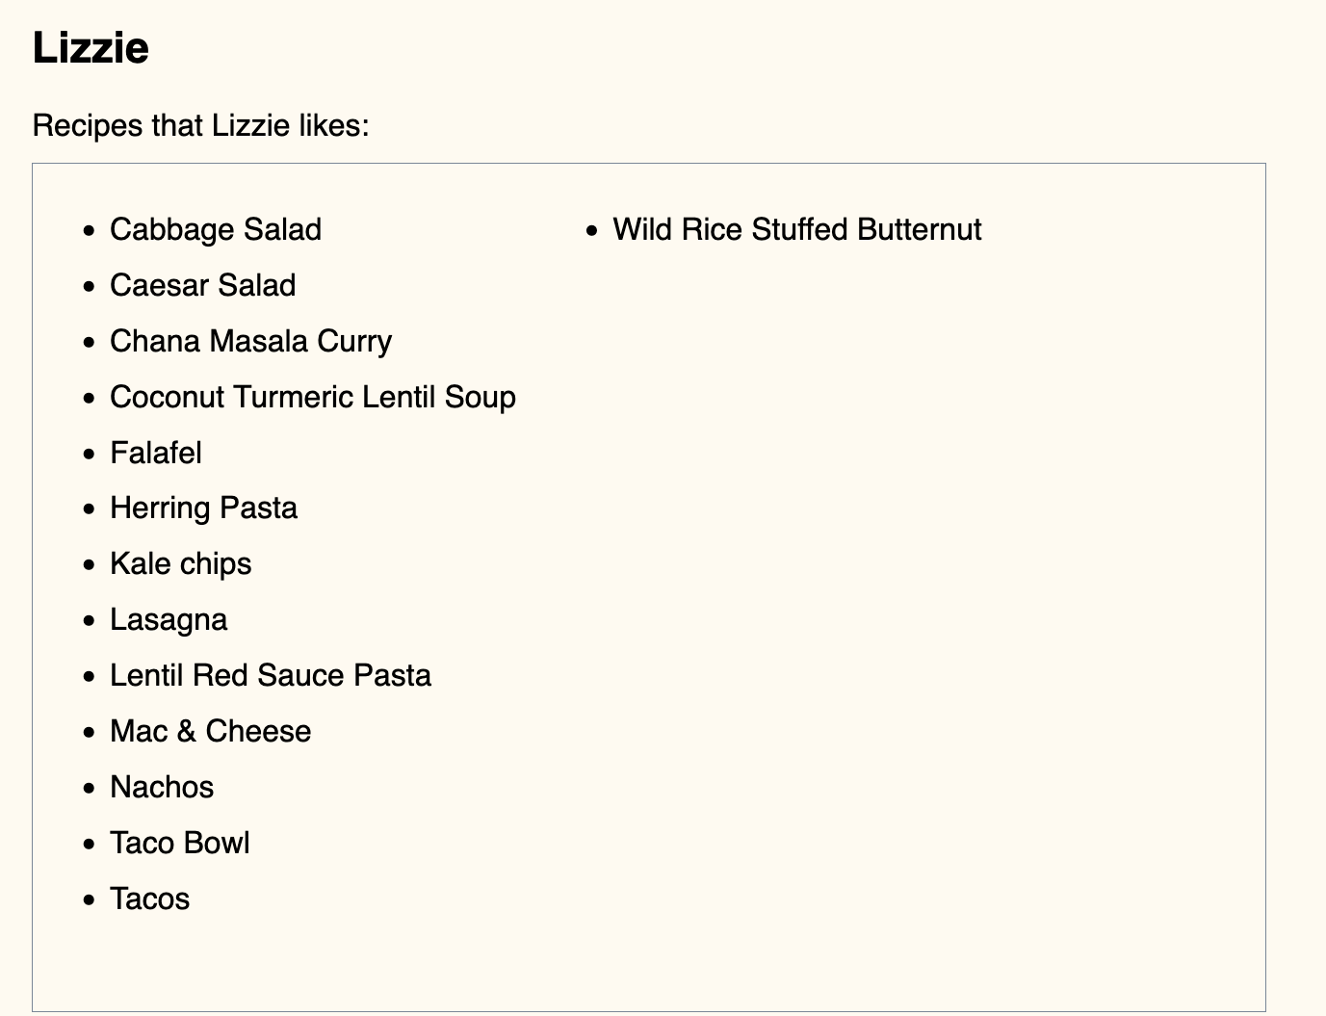
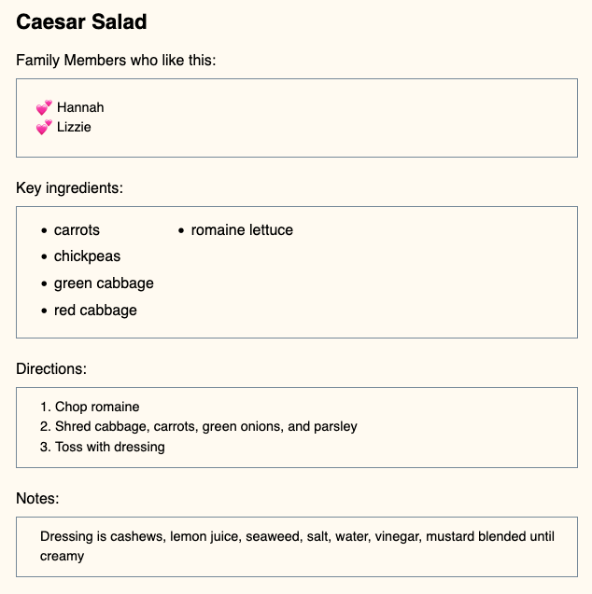
Key Features
Recipe likes for choice based on who likes what
Recipe ingredients for choice based on what you have
Surprise me!
Notes:
Picky Eaters allows logged-in users to save recipes, ingredients, and family members. Then each recipe can be associated with the key ingredients, and which family member enjoys the recipe.
Recipe likes are linked to each family member detail page which shows that person's favorites.
Recipe ingredients are linked to each ingredient detail page which shows recipes that ingredient is included in.
If you need some inspiration, just click on the Surprise Me! link to be shown a random recipe. If your family has as many recipes as I do, there are old favorites that fall out of rotation that deserve another chance.

Slide 4
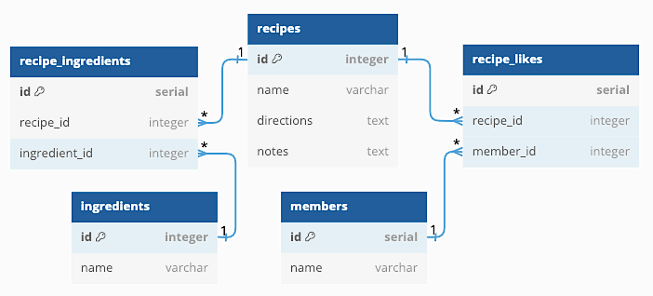
Database Tables
recipes, ingredients, and members
recipe_ingredients
recipe_likes
Notes:
Picky Eaters web app uses PostgreSQL for data.
The database is called "recipes" and there are three tables: recipes, ingredients, and members.
Ingredients and members tables each have a many-to-many relationship to the recipes table. recipe_ingredients and recipe_likes are join tables.
Any row can be viewed, deleted, or updated, and new rows can be added.

Slide 5
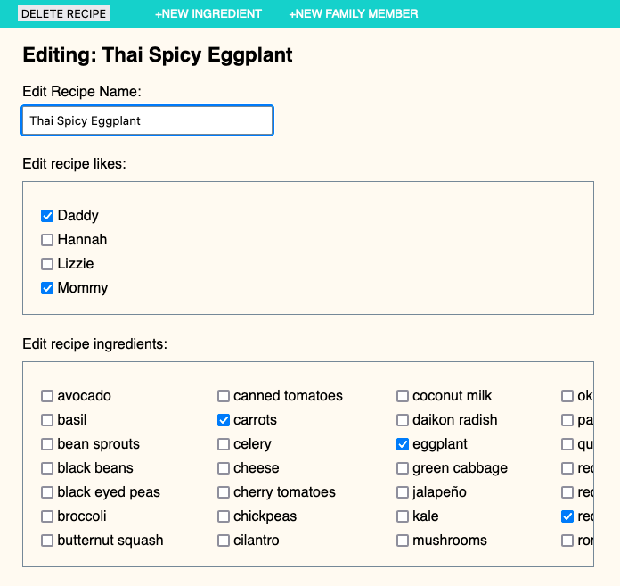
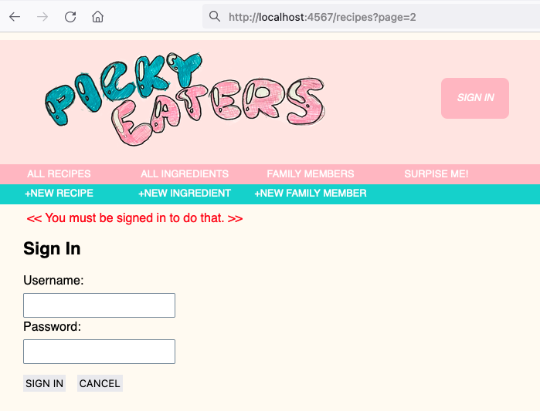
Challenges
<input name=“recipe_name”>
Managing multiple text and checkbox input data for updating objects
Juggling valid and invalid data for creating and updating objects
Retaining requested page location for redirection after login
<input name=“recipe_likes[]”>
<input name=“recipe_ingredients[]”>
<input name=“recipe_id” type=“hidden”>
Notes:
1. The text input was easy to handle, as it was passed as a string. The checkbox inputs were more challenging, as I wanted to know what new checkboxes needed to be added, and what old checkboxes needed to be removed.
I learned that adding square brackets to the input name attribute would pass the values as elements in an array. I could then compare the new array to the previous array to determine the changes.
2. Juggling valid and invalid data for creating and updating objects needed to be handled differently. Especially when updating a recipe object, it helped me to know the id number of the row of data being updated, so I passed that parameter as a hidden input.
3. Finally, I needed to figure out how to retain the requested page location when requiring user login. I used the session feature of Sinatra to retain it and redirect the user.

Slide 6
Thank you!
QUESTIONS?
Notes:
Picky Eaters supports quick meal planning. Planning family dinners every week is tough. First we need to find or recall the many dinner recipes, then we need to narrow them down by ingredients on hand and picky family member tastes.
This could be for a mom or dad or anyone cooking for a "family" on a regular basis like a roommate with the best cooking skills of the group.
Most recipe apps solve the problem of *how* to make a recipe. Picky Eaters focuses on *what* to make. That's the key to meal planning every week.

