Slide 1

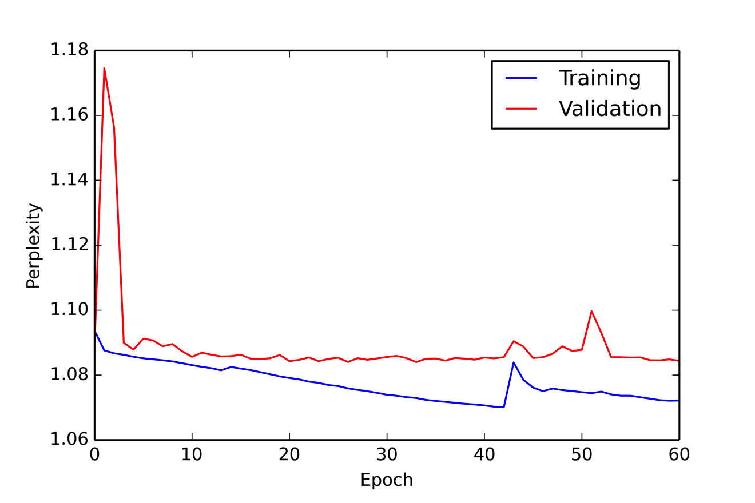
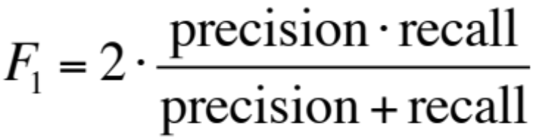
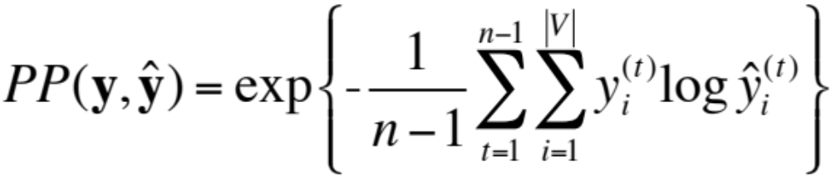
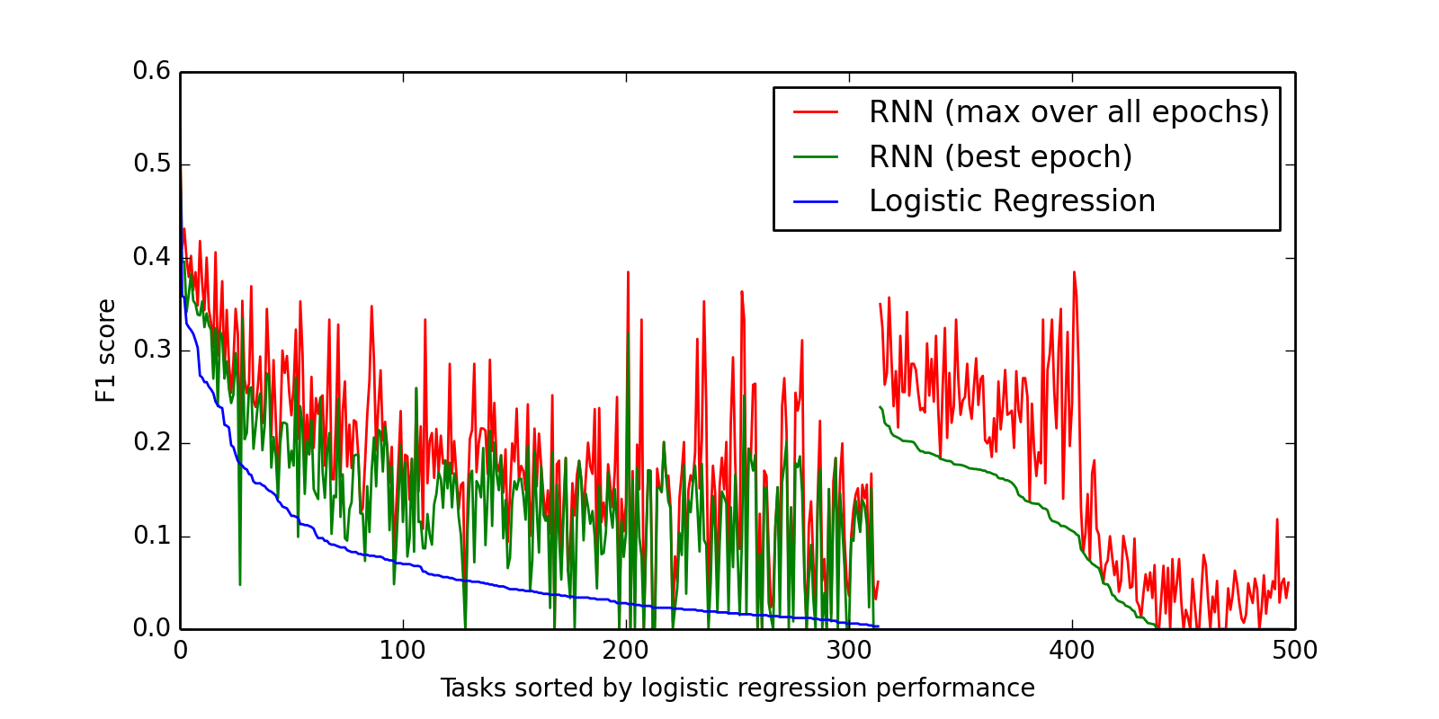
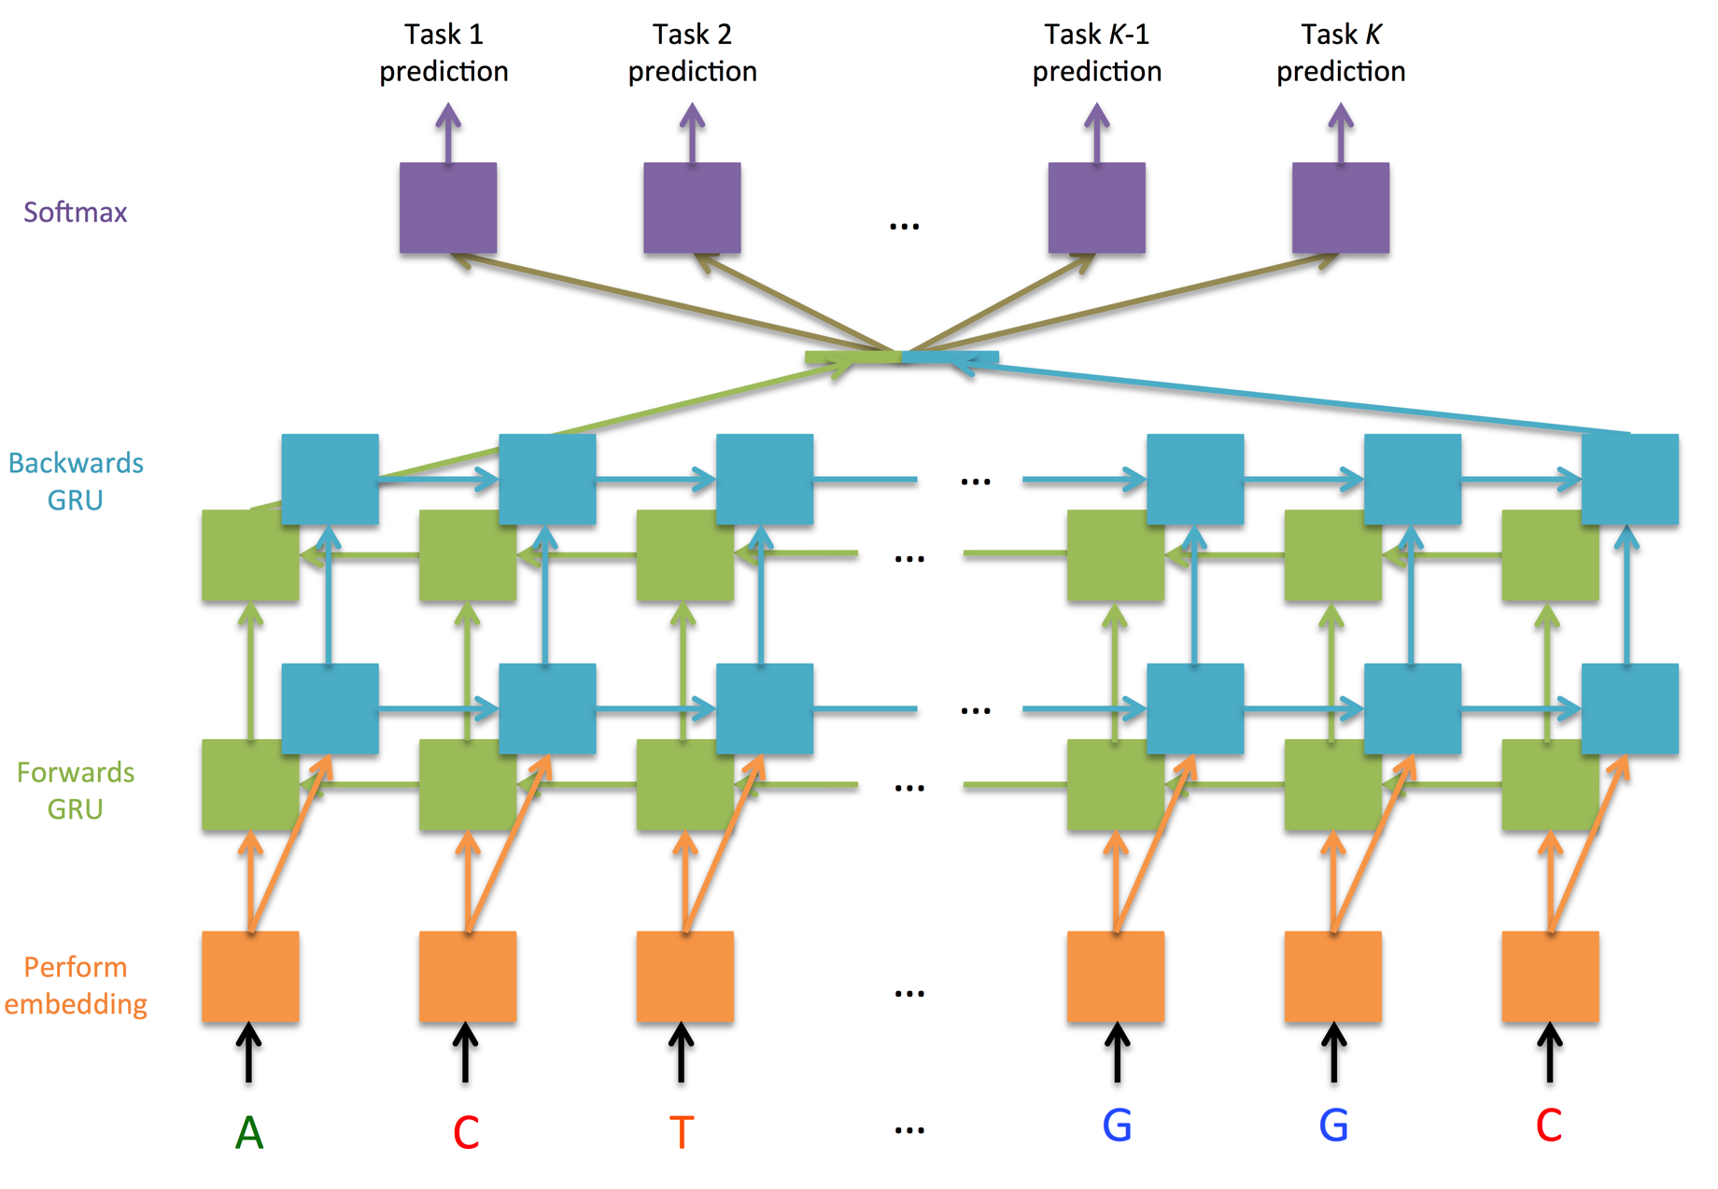
Learning the Language of the Genome Using RNNs
Govinda Kamath and Jesse Zhang
Background
Evaluation Metric
Results
In recent years, deep recurrent neural networks (RNNs) have allowed researchers to tackle a variety of sequence learning problems in the domain of natural language processing. The purpose of this project is to explore how an RNN architecture can be used to learn sequential patterns in genomic sequences. A robust method for modeling the genome can offer insights on genetic patterns related to health and disease.
Compare the F1 score achieved by the model to the F1 score achieved by the baseline: a logistic regression model for each of 919 prediction tasks.
Training & Validation Loss
For the 498 tasks with ≥ 800 training examples:
RNN outperforms LR on 408 tasks (81.9%)
RNN F1 scores are 0.091 points higher on average
Precision: proportion of correct +1 predictions
Recall: proportion of +1 examples that received a +1 prediction
For the RNN, minimize average perplexity across all tasks and examples:
Logistic Regression v. RNN F1 Score
Problem Statement
We explore a sequence classification problem. Epigenetics is the study of how the genome is regulated by external factors. Biological experiments have shown that specific subsequences of the human genome are often regulated by proteins that interact in a specific way. For each of many features, we assess an RNN's ability to predict whether a given feature will be present based solely on the sequence.
Model Architecture
Conclusion
Sequence
Model
Predictions
We empirically showed that a deep network can outperform a baseline model on a significant majority of 919 binary labeling tasks. This confirms how RNNs can leverage correlation between tasks and large amounts of data to make more robust predictions. Unlike LR, RNNs require significantly more training time.
Extensions: Train on more of available data, test an architecture better suited for very long-range information, use genomic word-level RNN
{A,C,G,T}^{L}
{0,1}^{K}
Dataset
The dataset was collected from experiments reported in the ENCODE and Roadmap Epigenomics data releases.
80000 sequence-label pairs for the training dataset,
8000 pairs for the testing dataset
2000 pairs for the validation dataset.
Each sequence has a length of exactly 100 and is a subsequence of the length-3*10⁹ human. The set of labels describes 919 binary prediction tasks, and each indicates whether part of a particular sequence was observed as accessible for a particular experiment.
References
Bidirectionality captures how the genome can potentially be read in either direction. GRUs memorize long-range information. Hidden representations are shared across tasks, but each task uses its own set of softmax weights. Character-level prediction alleviates some computational workload.
B. Alipanahi et al. Nature biotechnology, 2015.
ENCODE Project Consortium et al. Nature, 489(7414):57–74, 2012.
D. R. Kelley et al. bioRxiv, page 028399, 2015.
J. Koutnik et al. arXiv preprint arXiv:1402.3511, 2014.
A. Kundaje et al. Nature, 518(7539):317–330, 2015.
D. Quang et al. bioRxiv, page 032821, 2015.
K. Zhou et al. Nature methods, 12(10):931–934, 2015.

