Slide 1
S₁⁽¹⁾
λ₂⁽¹⁾
λ_{L-1}⁽¹⁾
S_{L-1}⁽¹⁾
…
λ₁⁽¹⁾
λ_{L}⁽¹⁾
S₀
S_{i}
λ₁⁽²⁾
λ_{K}⁽²⁾
S₁⁽²⁾
λ₂⁽²⁾
λ_{K-1}⁽²⁾
S_{K-1}⁽²⁾
…

Slide 2
C
λ₂
A
B
λ₁
λ₃
D

Slide 3
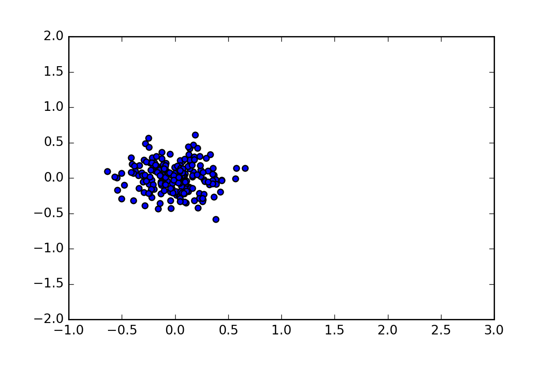
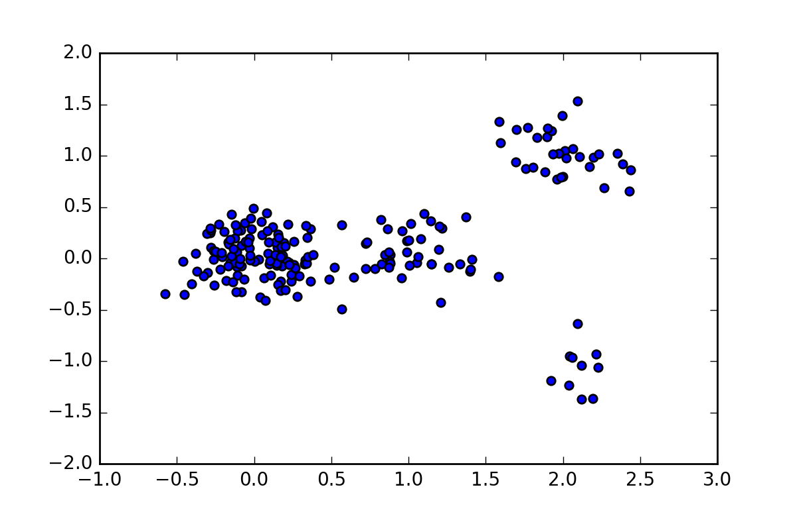
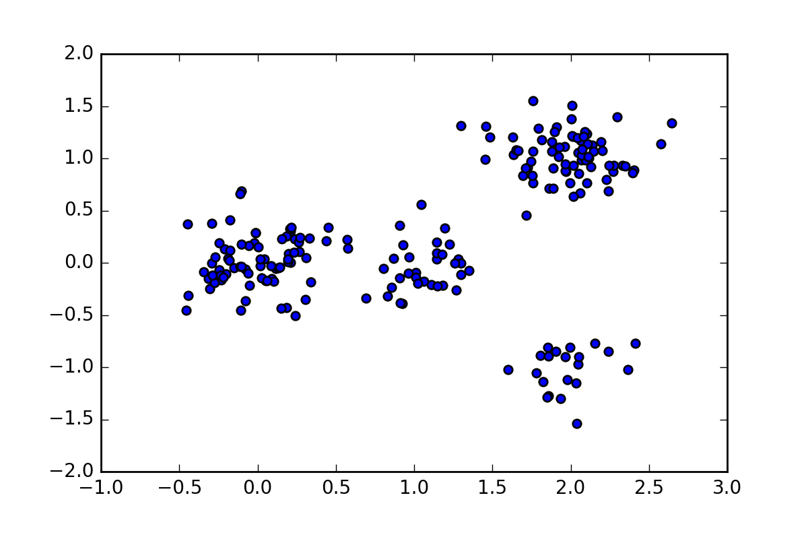
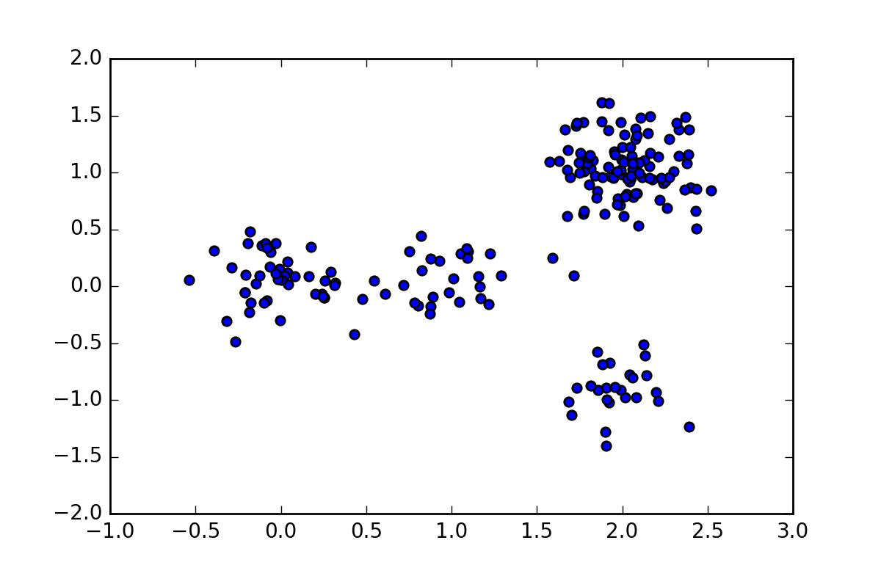
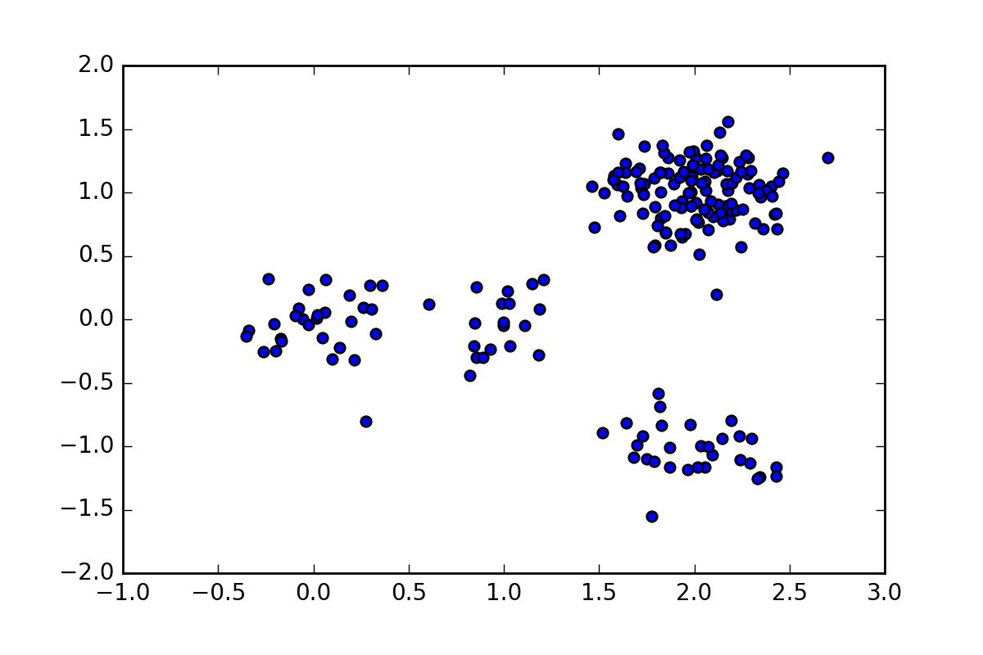
time 0
time 1
time 2
time 3
time 4

Slide 4
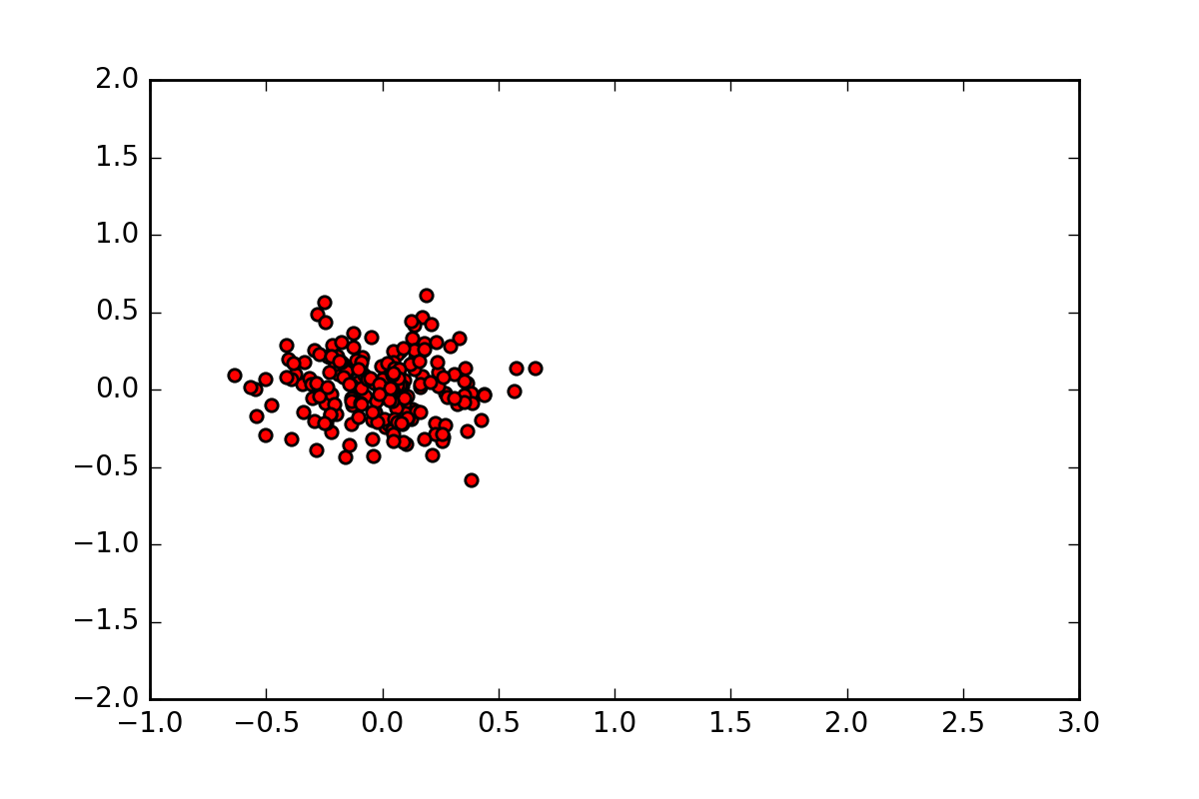
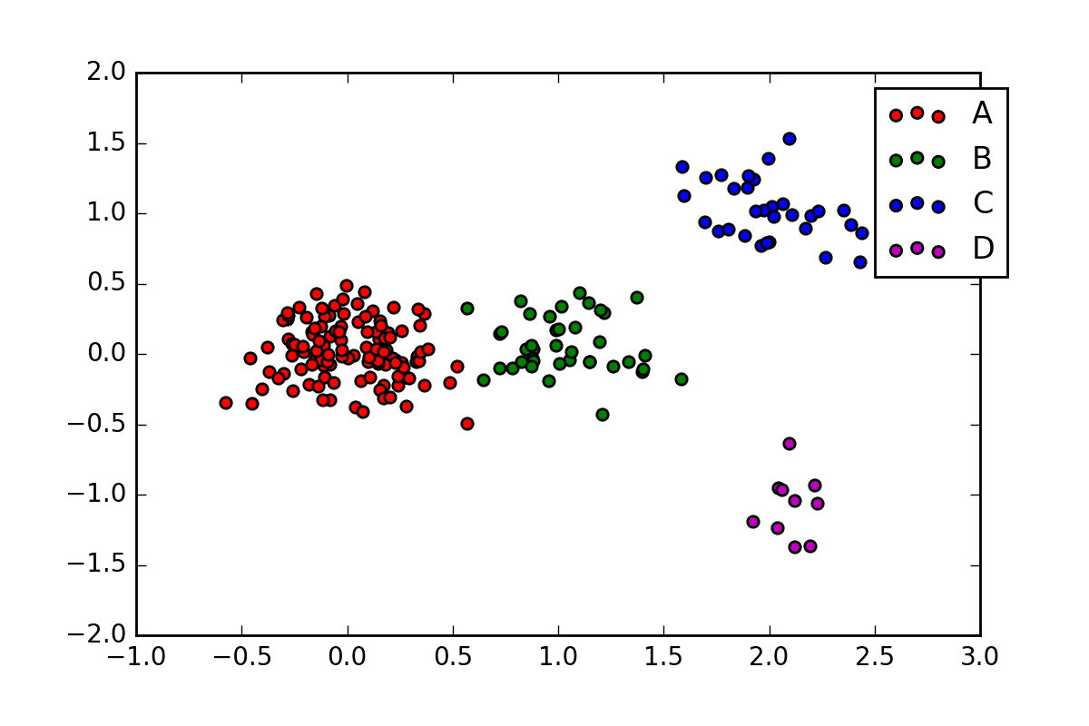
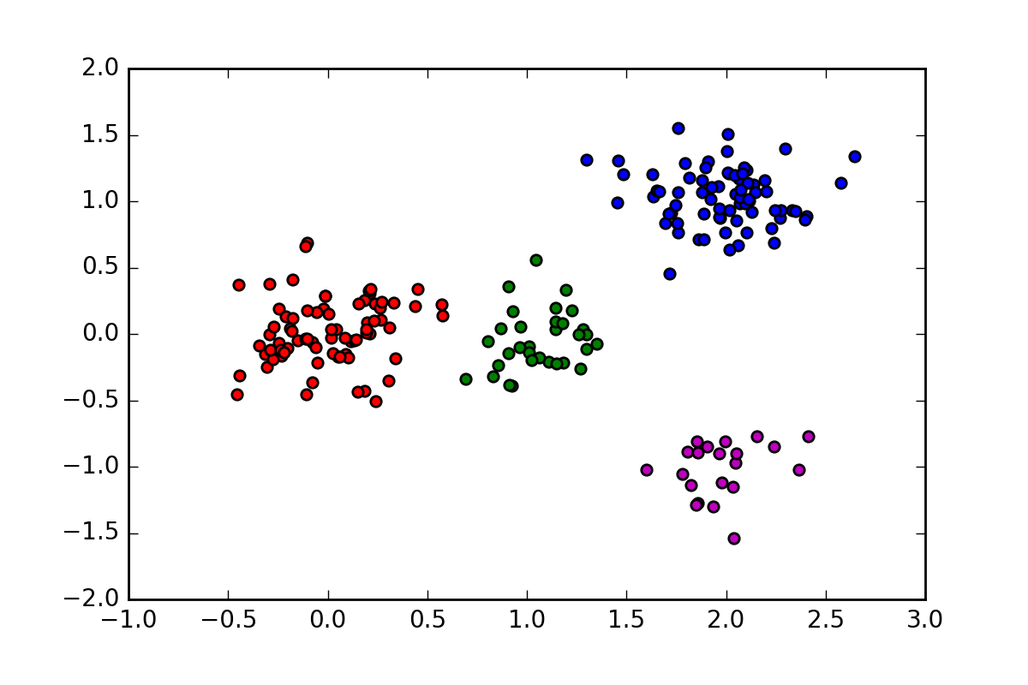
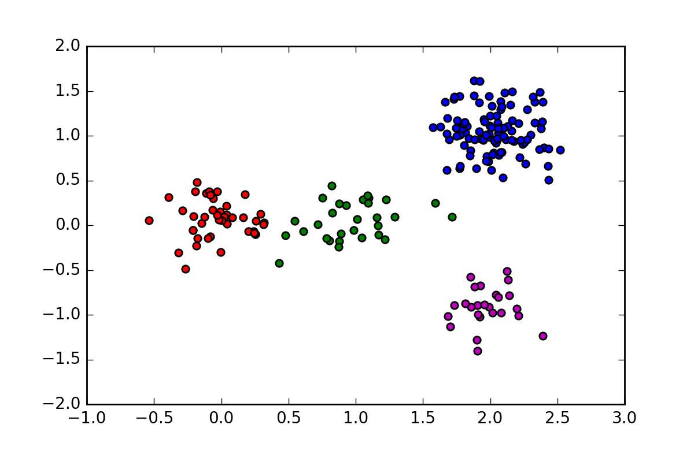
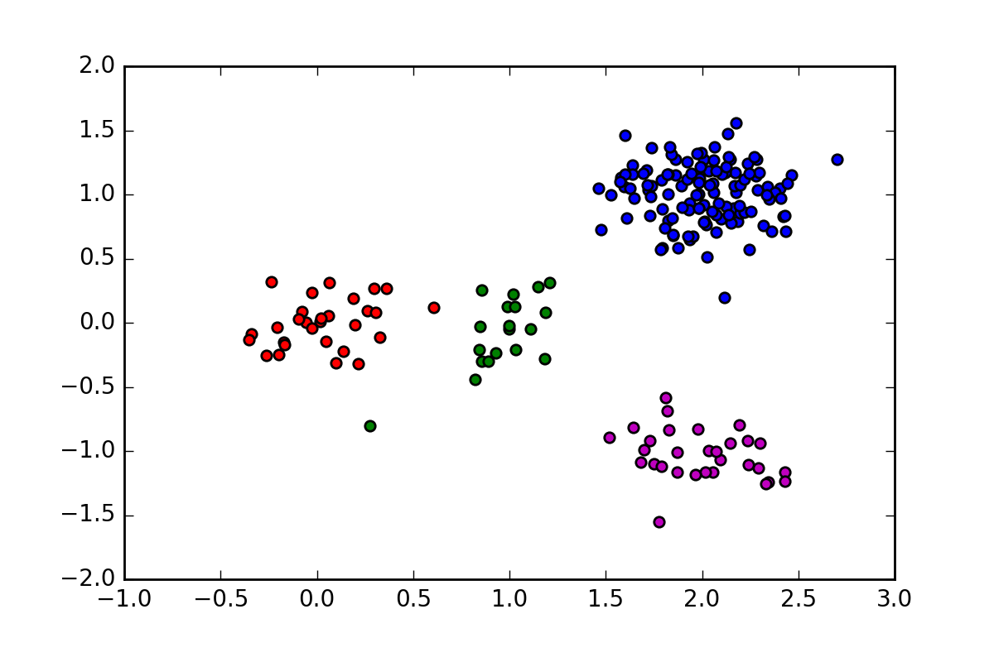
time 0
time 1
time 2
time 3
time 4

Slide 5
S_{k+1}
λ₁^{(k)}
S_{k+1}
S_{k}
λ₂^{(k)}
…
…
λ_{K}^{(k)}
S_{k+K}

