Slide 1
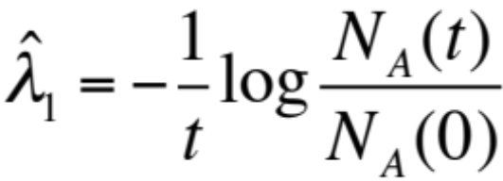
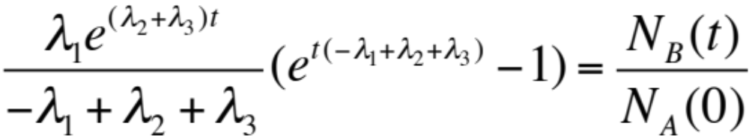
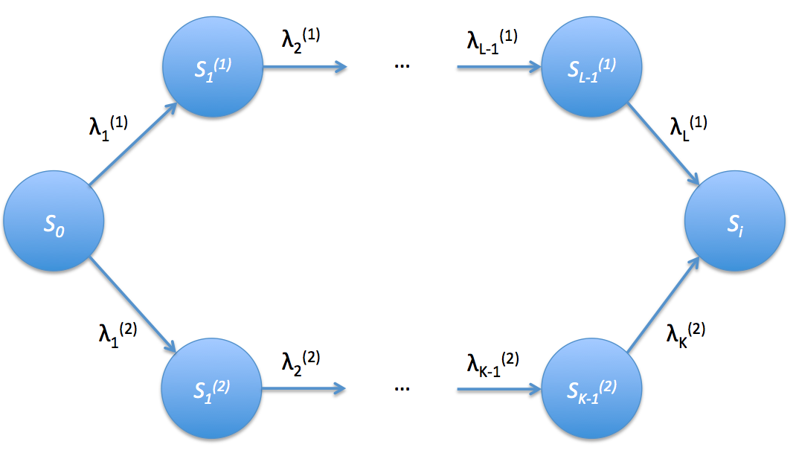
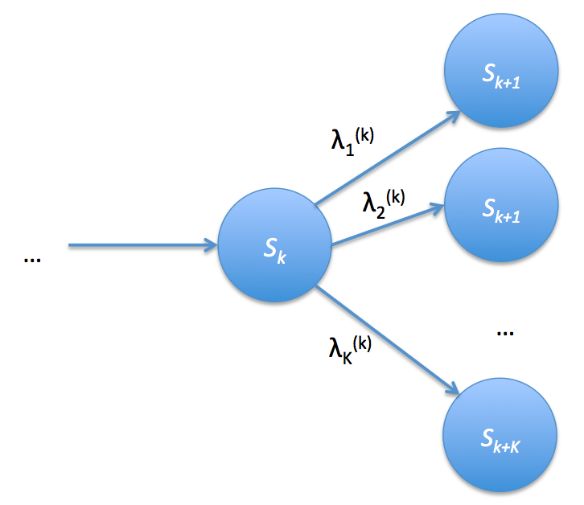
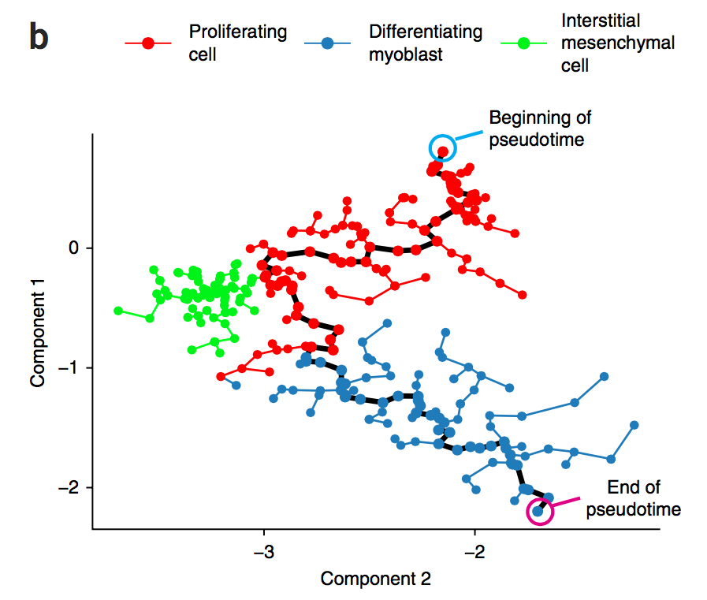

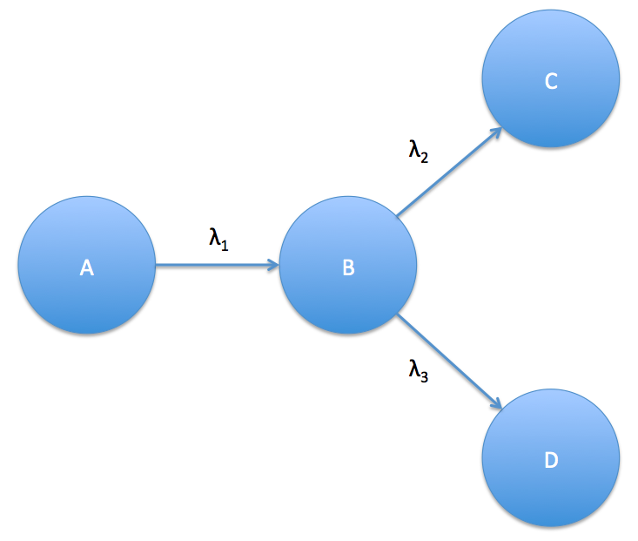
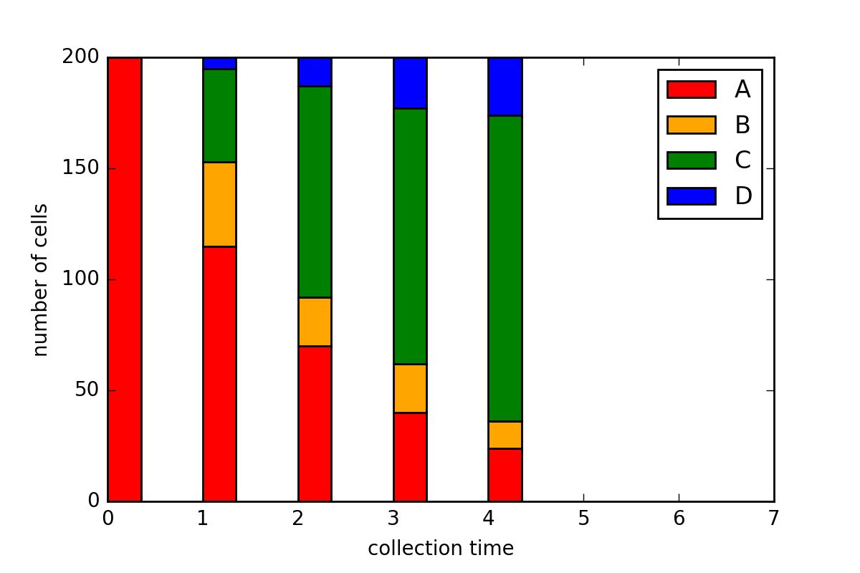
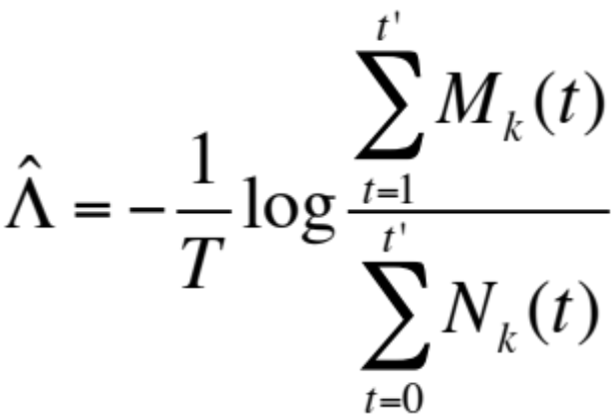
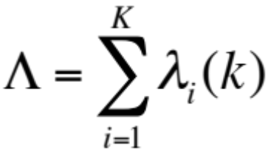
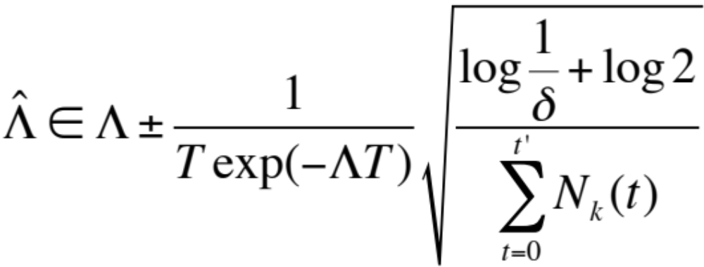
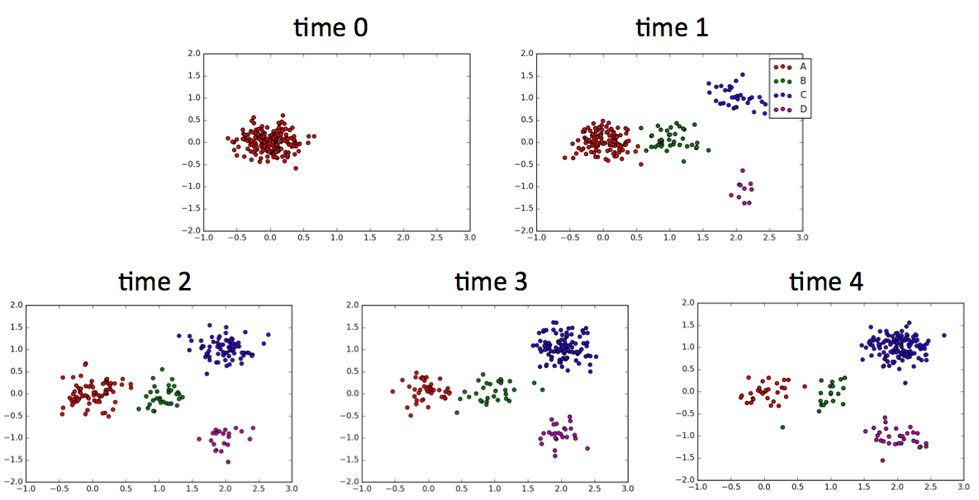
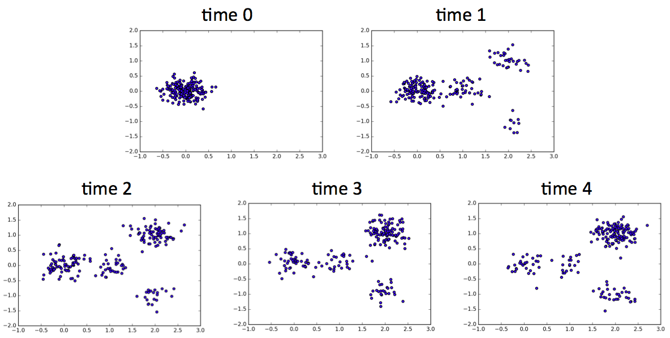

Estimation of rate parameters in a tree-structured CTMC
Govinda Kamath and Jesse Zhang
Problem Statement
One of the most interesting problems in biology is that of determining the differentiation patterns of cells such as the process of a stem cell evolving (or differentiating) into a heart cell. A recent experiment [1] has produced a single-cell RNA-seq dataset consisting of 271 human primary myoblasts collected at four different times, and the authors use a heuristic for recovering a tree structure describing how a cell evolves into one of two end types. For this project, we hope to create and analyze a more statistically sound method of estimating the underlying tree structure. The success of this project could lead to meaningful insights in modeling cell differentiation.
We propose a continuous-time Markov Chain to describe the differentiation process. We estimate the rate parameters for the Markov chain using observations obtained at multiple sampling points.
Identifiability
If the CTMC does not have a tree-like structure, then estimating the exponential rate parameters suffers an identifiability issue. In other words, if the CTMC structure contains multiple paths to the same node, then no number of observations can help us identify the rate parameters.
Rate estimators
To estimate the rates of the CTMC in Figure 3, we used the following equations to estimate the values of the three rate parameters.
If we assume that we can track data points (i.e. we observe the state of each point at each sampling time), we can can derive a simple estimator for each sum of rate parameters leaving the same state.
The expressions for the sum of rate parameters leaving the same state and its estimator are:
Using the Chernoff Bound, we construct a 1-δ confidence interval for our estimator:
Figure 2. Multiple paths from starting node S₀ to some interior node S_{i} results in identifiability issues.
Figure 7. Example of a state node in a general tree-like CTMC. The time a sample spends as state S_{k} is dictated by a race between K exponential distributions with different rate parameters.
Initial simulations
We simulated cell state observations using a CTMC inspired by [1]. The simulations were done using 200 samples, 4 cell types, 5 observation times, and rate parameters of λ₁= 0.5, λ₁= 1, and λ₁= 0.25. The recovered rates were λ₁= 0.501, λ₁= 0.997, and λ₁= 0.283.
Figure 1. Differential pattern uncovered heuristically by [1].
Figure 3. CTMC used to generate simulation points
Figure 4. Proportion of each cell type at 5 simulated observation times.
References
Trapnell, Cole et al. ”The dynamics and regulators of cell fate decisions are revealed by pseudotemporal ordering of single cells.” Nature biotechnology 32, no. 4 (2014): 381-386.
Mueller, Jonas, Tommi Jaakkola, and David Gifford. ”Modeling Trends in Distributions.” arXiv preprint arXiv:1511.04486 (2015).
Ntranos, Vasilis, Govinda M. Kamath, Jesse Zhang, Lior Pachter, and N. Tse David. ”Fast and accu- rate single-cell RNA-Seq analysis by clustering of transcript-compatibility counts.” bioRxiv (2016): 036863.
Future Work
The relaxation of several assumptions made in this project could lead to interesting results. The problem in reality is significantly harder: each data point is only observed once, the data points have very high dimensions, the underlying CTMC is not known a priori, and both the number of samples and the number of observations are small.
Figure 6. Recovered cell states using expectation maximization of Gaussian mixture.
Figure 5. Gaussian noise added to observed expression values for each cell in each observation.

