Slide 1
Statistical inference and statistical testing
Confidence intervals & Hypothesis Testing

Slide 2
Some Basics
Point estimate – a single number calculated from sample data that is the best single guess for a population parameter
Interval estimate – a range of numbers around the point estimate within which the population parameter is believed to fall
Confidence Intervals

Slide 3
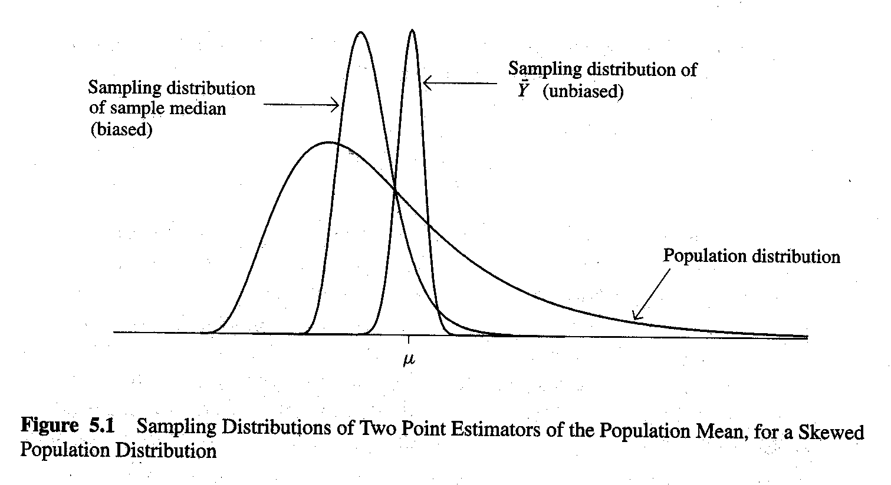
Point Estimation
Figure 5.1
Sampling distribution of sample mean is unbiased because it centers around μ in repeated samples
Sampling distribution of the median in this case is biased because the population distribution is skewed to the right
Attributes of a “good” point estimator
(1) sampling distribution is centered around the parameter unbiased
(2) sampling distribution has as small a standard error (as little spread as possible) efficient
The sample mean and the sample standard deviation are typically used as point estimates of μ and σ.

Slide 4
Confidence intervals
What is a confidence interval?
It is, an interval, based on observed data, that contains an unknown population parameter with some specified probability
So it is a statement about the likelihood that the true parameter value occurs between two bounds, an upper and a lower

Slide 5
Confidence intervals
If we take repeated random samples, over many such samples and calculations of 95% confidence intervals, about 95% of the intervals will contain μ
The higher the confidence level, the wider the confidence interval
The larger the n, the narrower the confidence interval

Slide 6
Critical values
A critical value is a value of a distribution (say a Normal distribution) that occurs with a certain level of probability
For the standard normal distribution, some critical values are:
-1 to 1 = 68% of the density
-1.96 to 1.96 = 95% of the density
-2.58 to 2.58 = 99% of the density

Slide 7
Error Probability
The probability of making a mistake is called α
Confidence Coefficient = 1 - α
So if you want to be wrong, say 5% of the time, then you want a 1- .05 confidence interval that, which gives you 95% confidence that if you were to repeat your data collection, the true population mean would be within this interval 95% of the time
Using the standard normal distribution, we can get confidence intervals for the mean of a sample

Slide 8
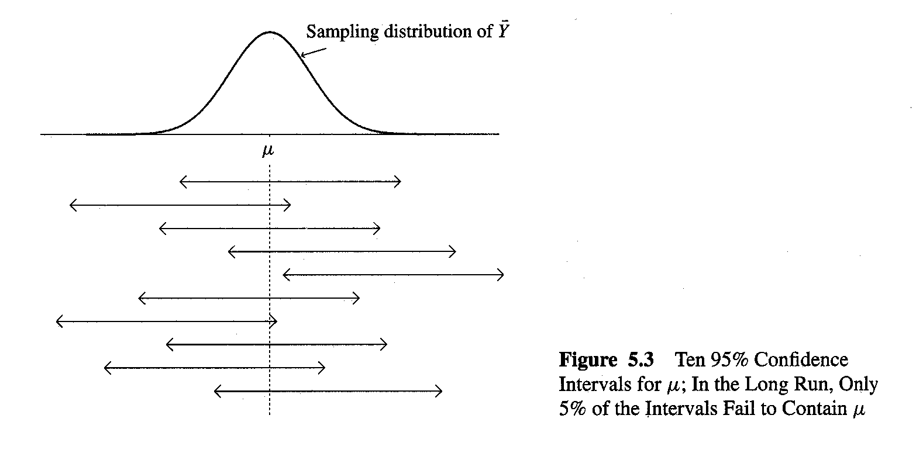
Interval does not
contain μ

Slide 9
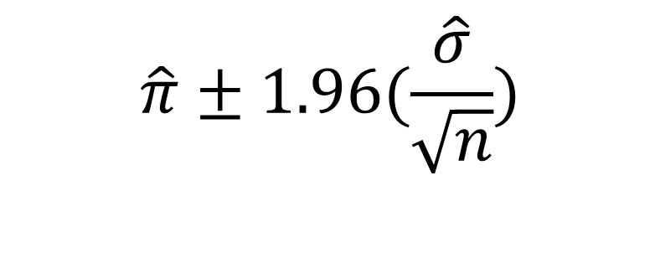
Example
Observed sample mean = 0.36
Observed sample standard deviation = .08
n = 254
95 % CI for the mean, assuming a Normal sampling distribution
(.36−1.96∗(.08/√254) , .36+1.96(.08/√254))
Lower CI = .351 Upper CI = .369
Common values of α, for the standard Normal distribution are
.9 = 1.645
.95 = 1.96
.99= 2.58
$$\hat{π}±1.96(\frac{\hat{σ}}{\sqrt{n}})$$

Slide 10
Example of 95% Confidence Interval: Education in U.S.
From the GSS (with n = 1,510):
Mean adult education = 12.9 years
Standard deviation = 2.98 years
First, estimate standard error with s:
Then, substitute standard error into:
Lower confidence limit (LCL) = 12.75 years
Upper confidence limit (UCL)= 13.05 years
Census: 12.8 years

Slide 11
Samples Large and Small: The t Distribution
Problem: How to do point estimates and confidence intervals for any size sample
When samples are small, s, is a very poor estimate of the population variance, so we don't want to use it for confidence intervals, instead we use the t distribution which takes into account both s and the size of the sample
Solution: Replace z score with t score
“Student’s” t discovered in 1908 by W.S. Gossett, Guinness Breweries. Wrote with a pseudonym to avoid disclosing trade secrets.

Slide 12
Properties of the t distribution
Bell-shaped and symmetric about mean of 0
Standard deviation a bit larger than 1
Exact value depends on degrees of freedom
df for mean inference is n – 1
At df =30, z and t are virtually identical
t-score times estimated standard error provides a margin of error around a population mean

Slide 13
Normal and t distributions with various sample sizes

Slide 14
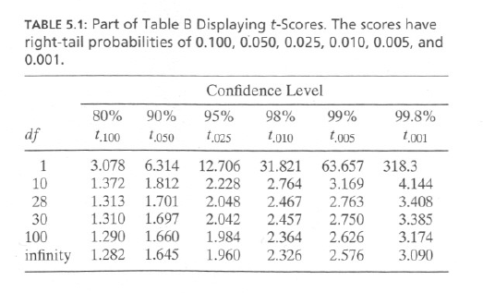

Slide 15
Choice of Sample Size: For a Proportion
Solve for n in the following:
Where:
π = an estimate of true population proportion
π = 0.50 is the most conservative, but will return larger sample than required if actual π is considerable less than .5
Adjust π if additional information is available
z = a z-score such as 1.96 (95%) or 2.58 (99%)
M = error probability of estimation

Slide 16
Sample Size
Recall formula:
What sample size would we need for 99% probability that the sample proportion falls with 0.01 of the population value?
What about a margin of error of 0.02?

Slide 17
Considerations in Determining Sample Size: More than Just a Formula
Precision – acceptable width of the confidence interval
Confidence – the probability that the confidence interval actually contains the population value
Variability – heterogeneity in the population
Complexity of analysis – how many variables to be analyzed
Resources – Time and cost constraints

Slide 18
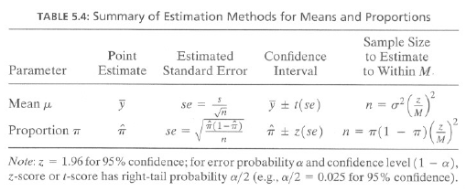

Slide 19
Principals of statistical testing
Generally, when we use statistics, we are hoping to test some idea we have, versus some alternative idea
Research hypothesis vs Null hypothesis
The test is based on the data we have collected
This, in practice, boils down to using some sort of statistical test to examine whether the thing we observe could just as easily arise from random conditions

Slide 20
Hypothesis testing
In experimental work, such as ours, we specify, based on theory, the associations we expect to see in our data
These could be stated simply or very complexly
our research hypotheses (hypothesis), H1
our null hypothesis, H0
In general, our work is oriented around finding support for our research hypotheses in our data.
To test H1 vs H0 we use a test statistic

Slide 21
Hypothesis testing
In principle, we have a few types of hypothesis tests
H0 :θ≥θ0
H0 :θ≤θ0
H0 :θ=θ0
Where θ is some parameter we have estimated from our data

Slide 22
Sometimes we make mistakes
There are two forms of errors made when testing hypotheses
Type I error → Reject the null when in fact it is true. This probability is equal to our α level.
Type II error → We fail to reject the null when in fact it is false. This is called β, and we speak of this in terms of our power to reject the null when it is false, or 1 -β

Slide 23
Possible outcomes for hypothesis tests
Decision | H₀ True | H₀ False
H₀ True | Correct Decision | Type II error (β)
H₀ False | Type I error (α) | Correct decision (power)

Slide 24
Statistical tests
In order to test for differences between groups in our analysis, we rely on test statistics
These are single numbers that summarize the differences that we are interested in.
Often these statistics will have their own distribution that we compare our observed values to, to judge how commonly we observe a difference “this large”
In more formal terms, we use test statistics to make statements about population parameters
Is μ1= μ2 ?
Is μ1= 75.2 ?

Slide 25
Statistical Tests
Do my data come from a normal distribution?
H0 : my data come from a normal distribution
H1: my data do not come from a normal distribution
A common test for this hypothesis is the Shapiro-Wilk test
This test compares the quantiles of your distribution to those of a normal distribution
Generates a test statistic, W, and a p-value which tell us if our data look “normal” or not
In R the code is: shapiro.test(data$var)

Slide 26
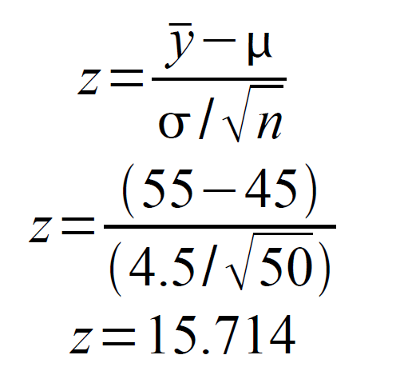
Statistical tests
We employ a z-test for the mean, when we know the population mean and the variance, and these are not estimated from data
The z-test can be used when you want to test a sample mean verses a hypothesized mean value
We want to know if our sample value of 55 is different from the previous sample value of 45.
We have n=50 subjects
We know σ=4.5
We assume our distribution is normally distributed

Slide 27
Statistical Tests
How large is our test statistic?
Our observed value of z was 15.714
How common is it to observe a value this large from a standard normal (z) distribution ?
What is the probability of observing such a value from this distribution?
This is a p-value
In the standard normal distribution, 95% of all values should be within +/-1.96 units of the mean
If we compare our value to those of a standard normal table (like in your book), we see the probability of seeing a value this large is equal to 9.56e-55, thats 0.0 and 54 other zeros, so it is INCREDIBLY uncommon to see a difference like this by random chance.

Slide 28
P-Values
p-values are probabilities
They are generally associated with test statistics
They are what give us the “certainty” in our analysis.
If the probability of seeing a test statistic as large as the one we calculate is large (>.05, for instance), then our test does not negate the null hypothesis
If test statistics like ours occur very rarely then we have a small p value (<.05 or smaller), and we conclude that our research hypothesis has some support

Slide 29
Critical values and p-values
A critical value is the value of a reference distribution that occurs at a certain level of probability
We choose critical values to compare our test statistics to based on how certain we want to be that our observed test statistic is “rare” or “significant”
For example if we want to be 95% certain that our difference (z test) is not simply an artifact of random sampling bias, then we choose a critical value from a standard normal distribution that occurs a very small percent of the time (z=1.96, for a 5% occurrence)
We compare our observed value of the z test to this critical value and see if it is less, equal or larger.
If it is less, then we cannot be certain that our null hypothesis is falsified
If it is greater, then we have evidence that our null hypothesis is falsified, and our research hypothesis is supported

Slide 30
Power of a test
Statistical power is the ability to detect a difference based on the sample data you have
Technically, power is the probability that the test can reject the null hypothesis when it is false
Typically, the power to detect a difference increases as the hypothesized difference and the sample size increase.

