Slide 1
EmoEvalEs Task
Xena Grant, Jesse Mena

Slide 2
Task
EmoEvalEs

Slide 3
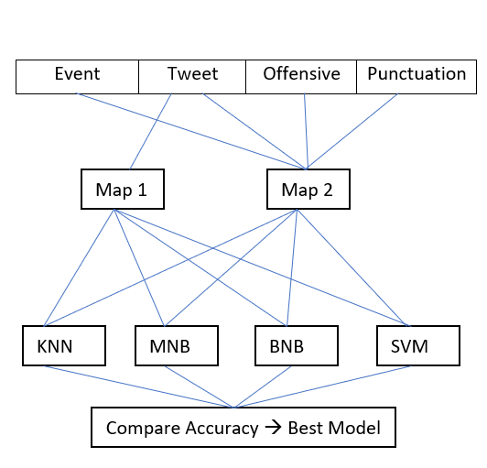
System Architecture

Slide 4
Approach

Slide 5
Issues and Successes

Slide 6
Related Reading

Slide 7
References

