Slide 1
Comparison of BERT and DIET on Query Intent Classification and NER
Jesse Robles
CSCI 6364 – Machine Learning
Spring 2022

Slide 2
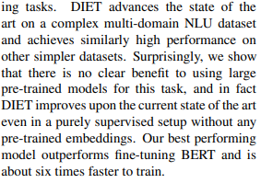
Project Background
From Paper: Bunk, Tanja, Daksh Varshneya, Vladimir Vlasov, and Alan Nichol. 2020. "DIET: Lightweight Language Understanding for Dialogue Systems.“
Goal: Verify results on some of the same datasets, as well as apply the results to new datasets.

Slide 3
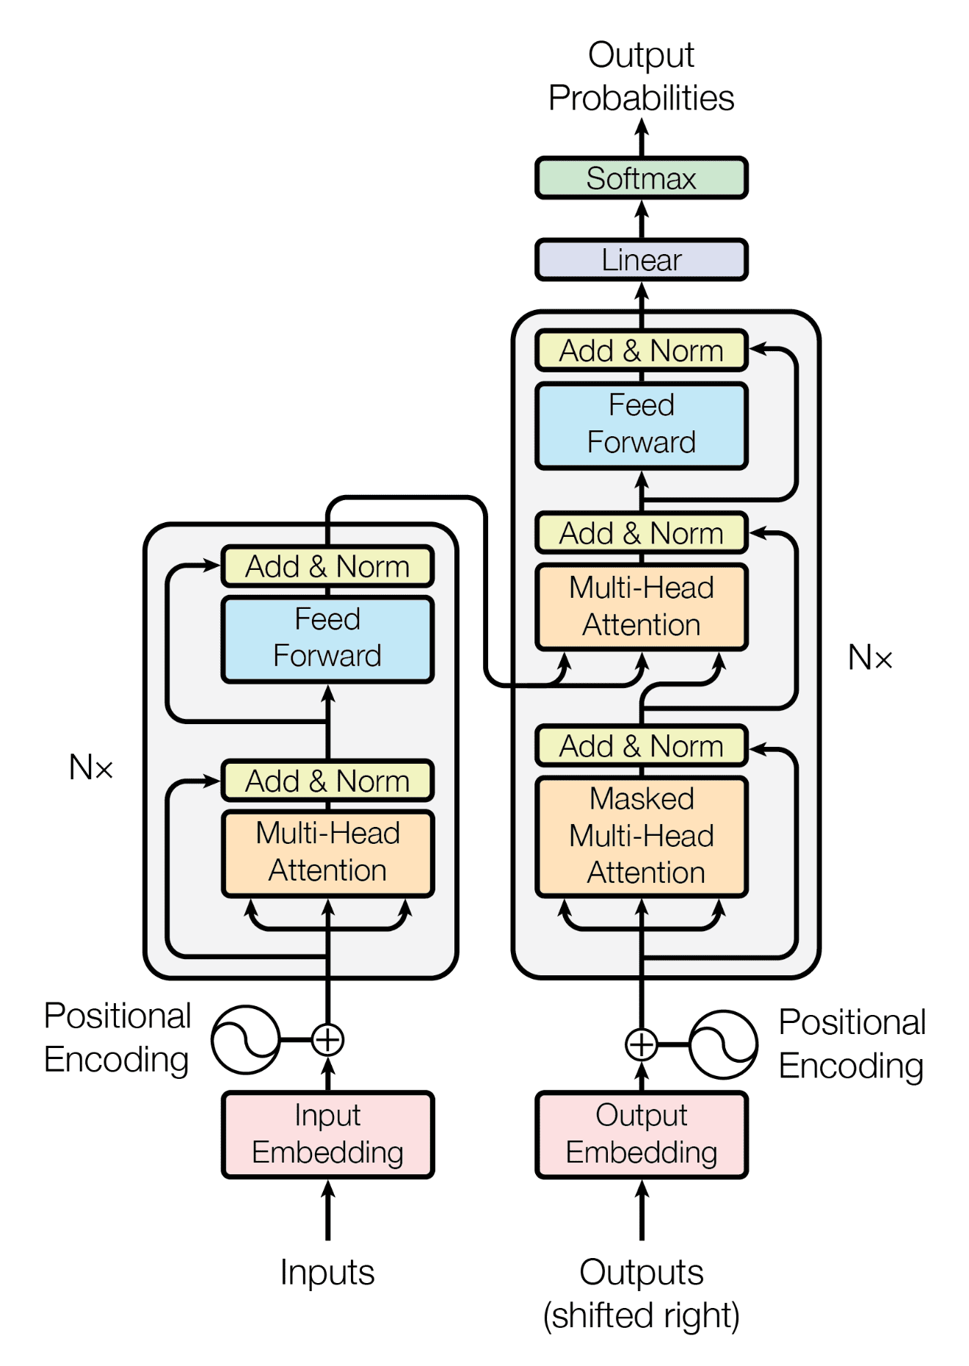
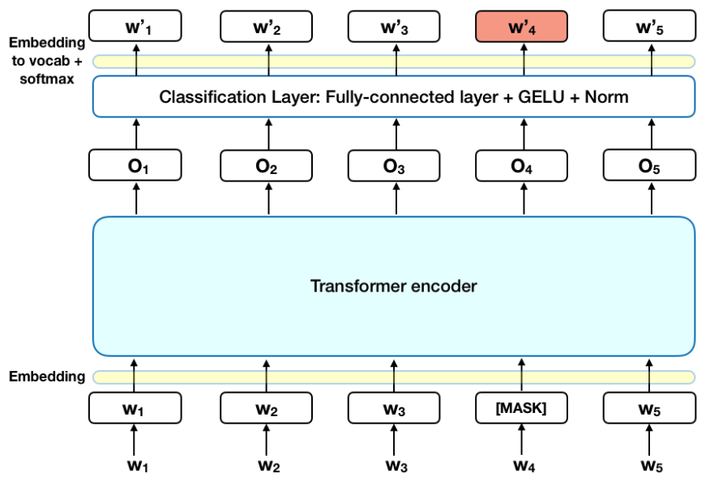
BERT Architecture

Slide 4
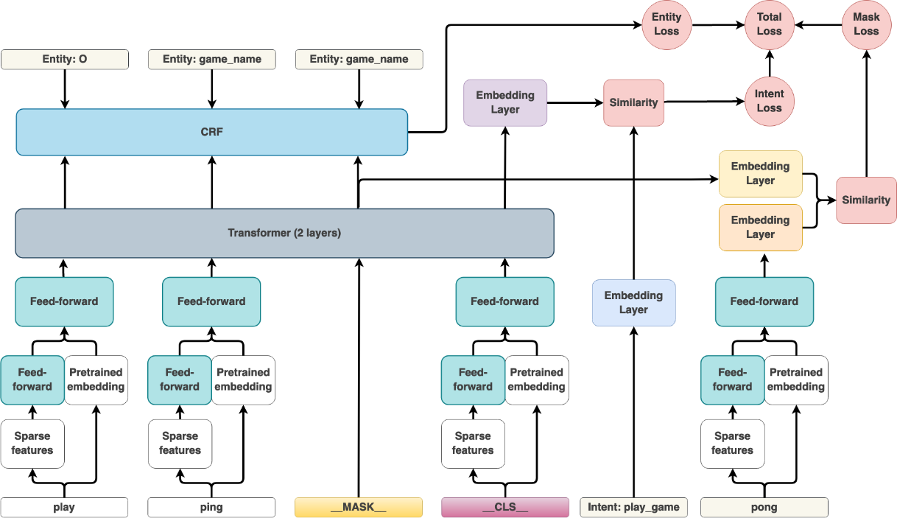
DIET Architecture

Slide 5
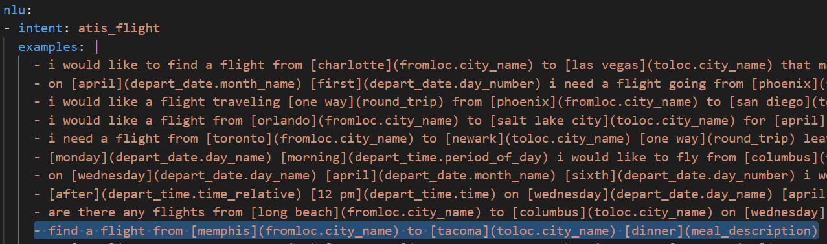
Data Formats
find a flight from memphis to tacoma dinner
Filename |  |  |  |  |  |  |  |  | label
seq.in | find | a | flight | from | memphis | to | tacoma | dinner | atis_flight
seq.out | O | O | O | O | B-fromloc.city_name | O | B-toloc.city_name | B-meal_description

Slide 6
Models
BERT: Distilbert Fine-tuned using Huggingface
One for token classification (NER) for each dataset containing entities
One for sequence classification (Query Intent) for each dataset
DIET
One model with no language model featurization on each dataset
One model with language model (ConverT) featurization on each dataset

Slide 7
RESULTS

Slide 8
Sequence Classification – Query Intent
Intent Classification
Model | precision | recall | f1-score | accuracy
BERT | 0.953135 | 0.952023 | 0.898755 | 0.952023
DIET | 0.941358 | 0.937397 | 0.936648 | 0.937397
DIET (w/ Language Model) | 0.947146 | 0.944301 | 0.943761 | 0.944301
NER
Model | precision | recall | f1-score | accuracy
BERT | 0.947154 | 0.955963 | 0.951536 | 0.975778
DIET | 0.741434 | 0.819272 | 0.777427 | 0.900818
DIET (w/ Language Model) | 0.741452 | 0.823024 | 0.779096 | 0.902911

Slide 9
Token Classification – NER
Intent Classification
Model | precision | recall | f1-score | accuracy
BERT | 0.953135 | 0.952023 | 0.898755 | 0.952023
DIET | 0.941358 | 0.937397 | 0.936648 | 0.937397
DIET (w/ Language Model) | 0.947146 | 0.944301 | 0.943761 | 0.944301
NER
Model | precision | recall | f1-score | accuracy
BERT | 0.947154 | 0.955963 | 0.951536 | 0.975778
DIET | 0.741434 | 0.819272 | 0.777427 | 0.900818
DIET (w/ Language Model) | 0.741452 | 0.823024 | 0.779096 | 0.902911

Slide 10
BANKING77 Dataset
Intent Classification
Model | Type | precision | recall | f1-score | support | accuracy
BERT | macro avg | 0.884329492 | 0.885714286 | 0.881055176 | 1540 | 0.885714286
 | weighted avg | 0.884329492 | 0.885714286 | 0.881055176 | 1540
DIET | macro avg | 0.911498555 | 0.906493506 | 0.906296759 | 1540 | 0.906493506
 | weighted avg | 0.911498555 | 0.906493506 | 0.906296759 | 1540
DIET (w/ Language Model) | macro avg | 0.931394505 | 0.925324675 | 0.925604791 | 1540 | 0.925324675
 | weighted avg | 0.931394505 | 0.925324675 | 0.925604791 | 1540
Model Sizes
BERT | 235M
DIET | 57M

Slide 11
Conclusions
BERT and DIET models provide comparable results out-of-the-box on the six datasets reviewed.
Results from datasets that were not presented in the original paper align with previous results
BERT tends to outperform DIET in NER, which might be the result of more semantic information being available within the model itself that can help with understanding unseen examples.
DIET models showed promising results, particularly when adding a language model to it. Doing so managed to either approach or surpass the performance of BERT on query intent classification.
DIET provides a single model for both tasks, at about 10%-20% the size of a single BERT model.

Slide 12
Thank You for your attention

