Slide 1
Predicting Long-Term Motor Recovery after Spinal Cord Injury
Craig Hospital • ASIA 2025 • Presenter: <Name>

Slide 2
Project Overview
Objective: predict 20 limb motor scores at weeks 26 & 52 using week-1 exam data.
Dataset: 544 patients, ~150 baseline clinical features.
Model: Ensemble of CatBoost, XGBoost, HistGradientBoosting.
Evaluation: macro-averaged RMSE (competition metric).

Slide 3
Data Processing & Feature Engineering
Dropped PID identifier; imputed missing values (median/mode).
One-hot encoded AIS grade, neurological level, and categorical vars.
Derived composite strength scores & age bands.
Scaled continuous predictors (z-score) prior to modeling.

Slide 4
Modelling Methodology
Base models: CatBoost, XGBoost, HistGradientBoosting (20 outputs each).
Hyperparameters tuned via Optuna with 5-fold CV, early stopping.
Final ensemble = equal-weighted mean of per-target predictions.
Validation: patient-level 80/20 split to avoid leakage.

Slide 5
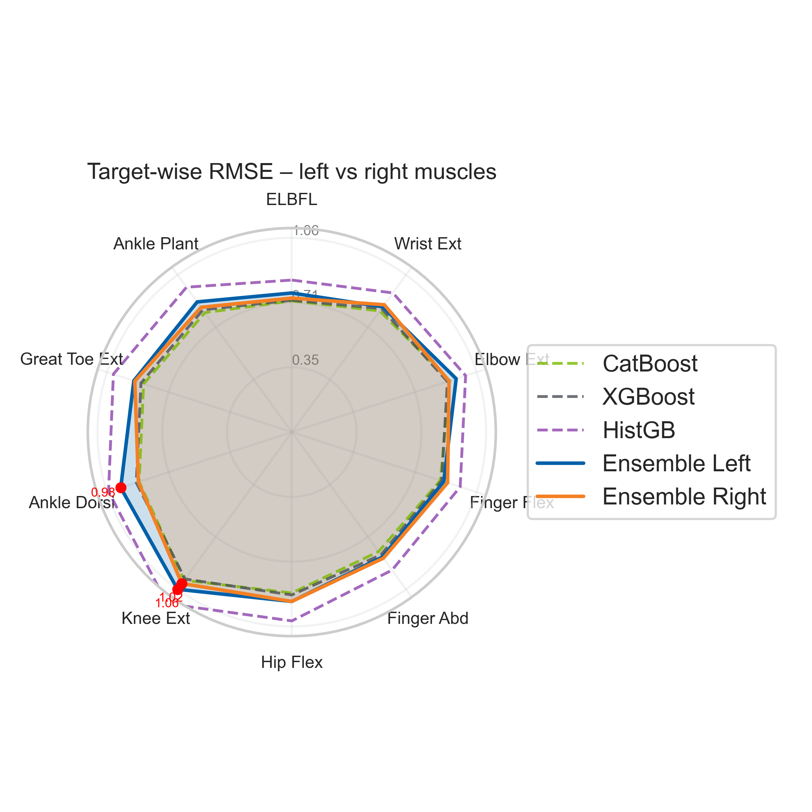
Per-Target RMSE (Radar)

Slide 6
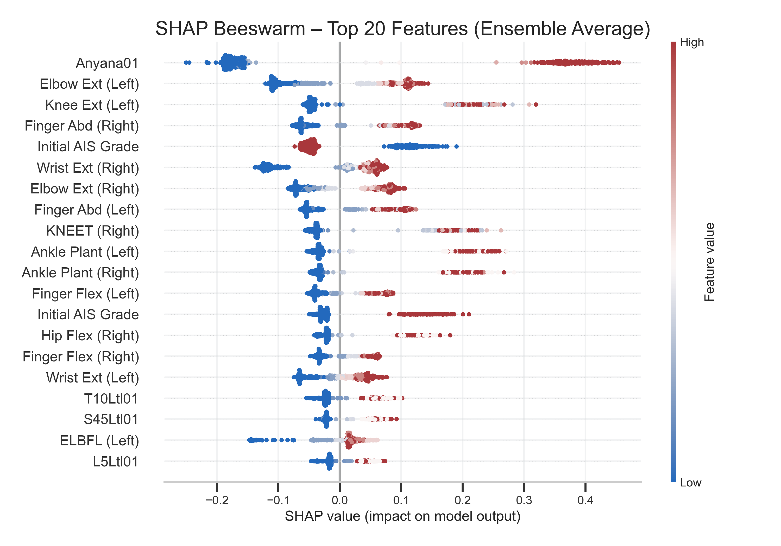
Feature Importance (SHAP Beeswarm)

Slide 7
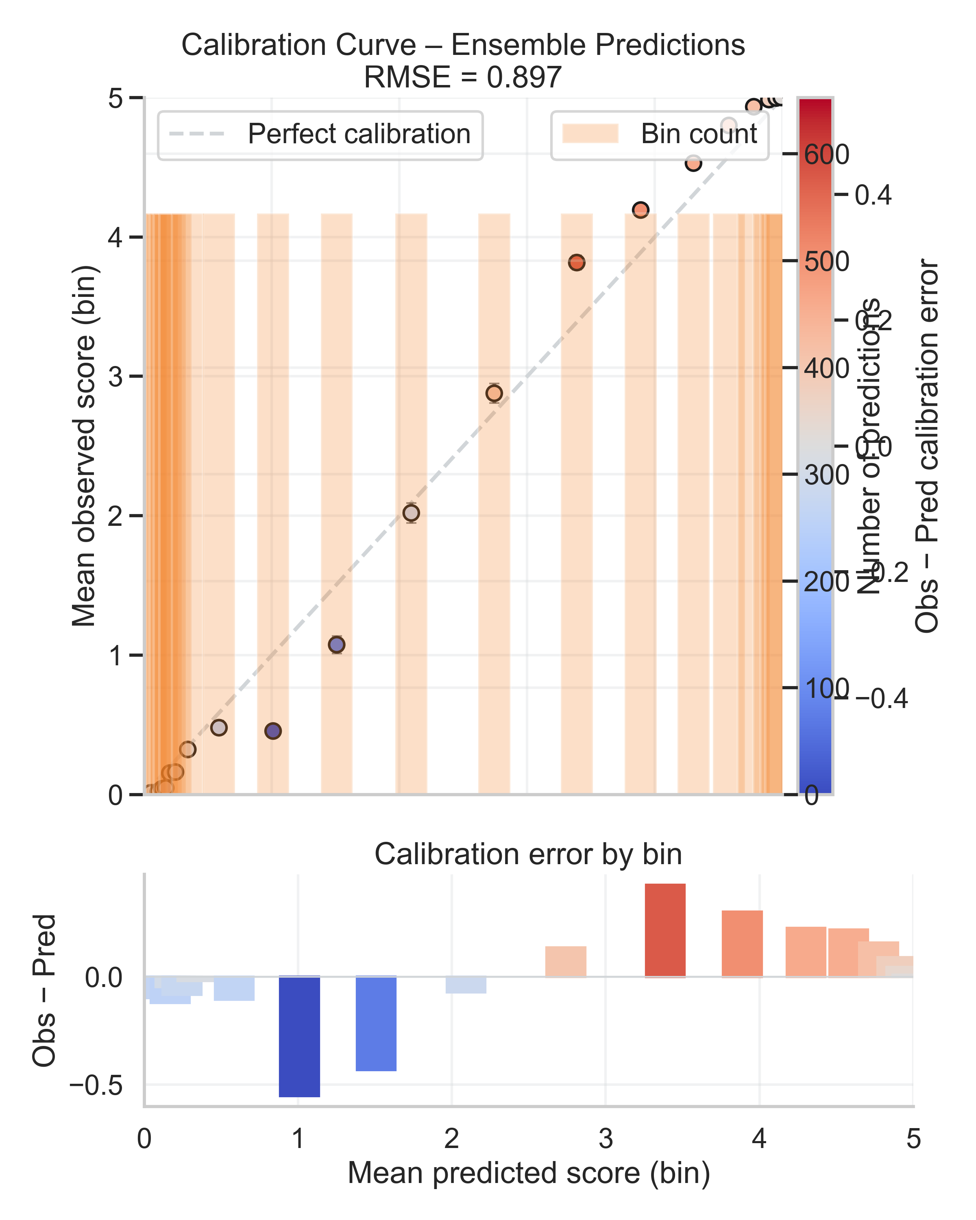
Calibration Curve

Slide 8
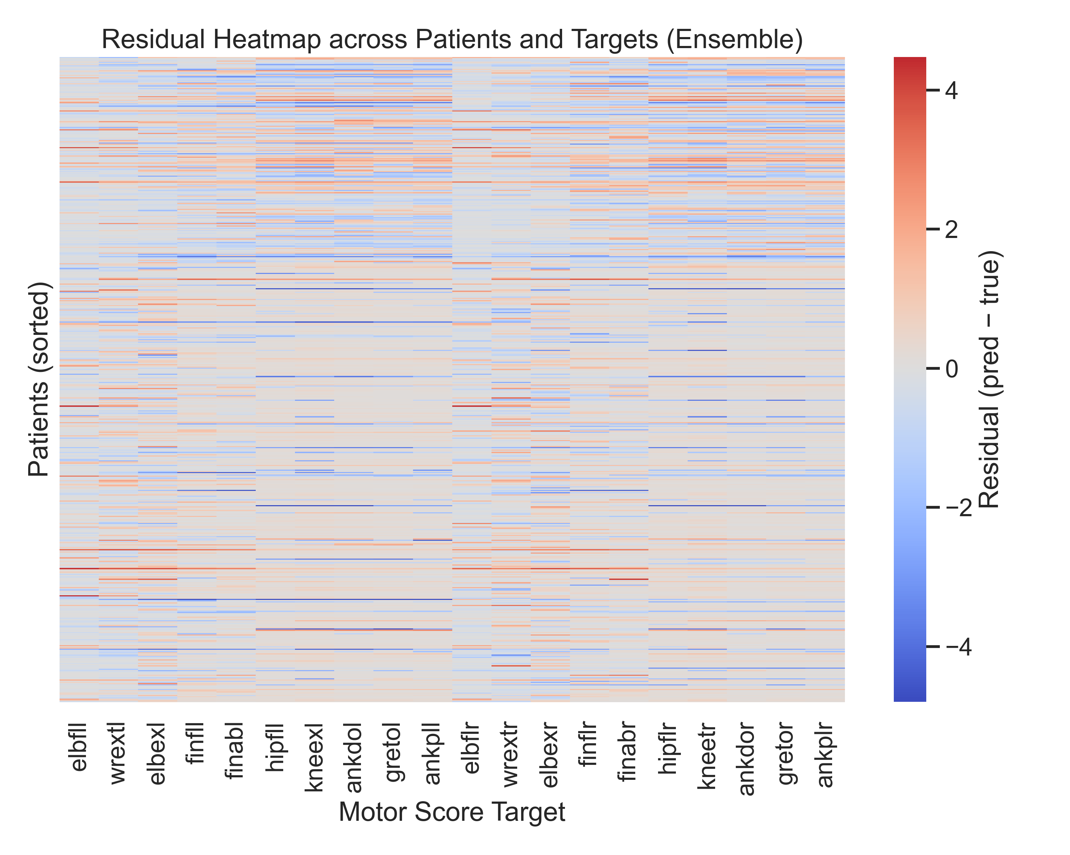
Residual Heatmap

Slide 9
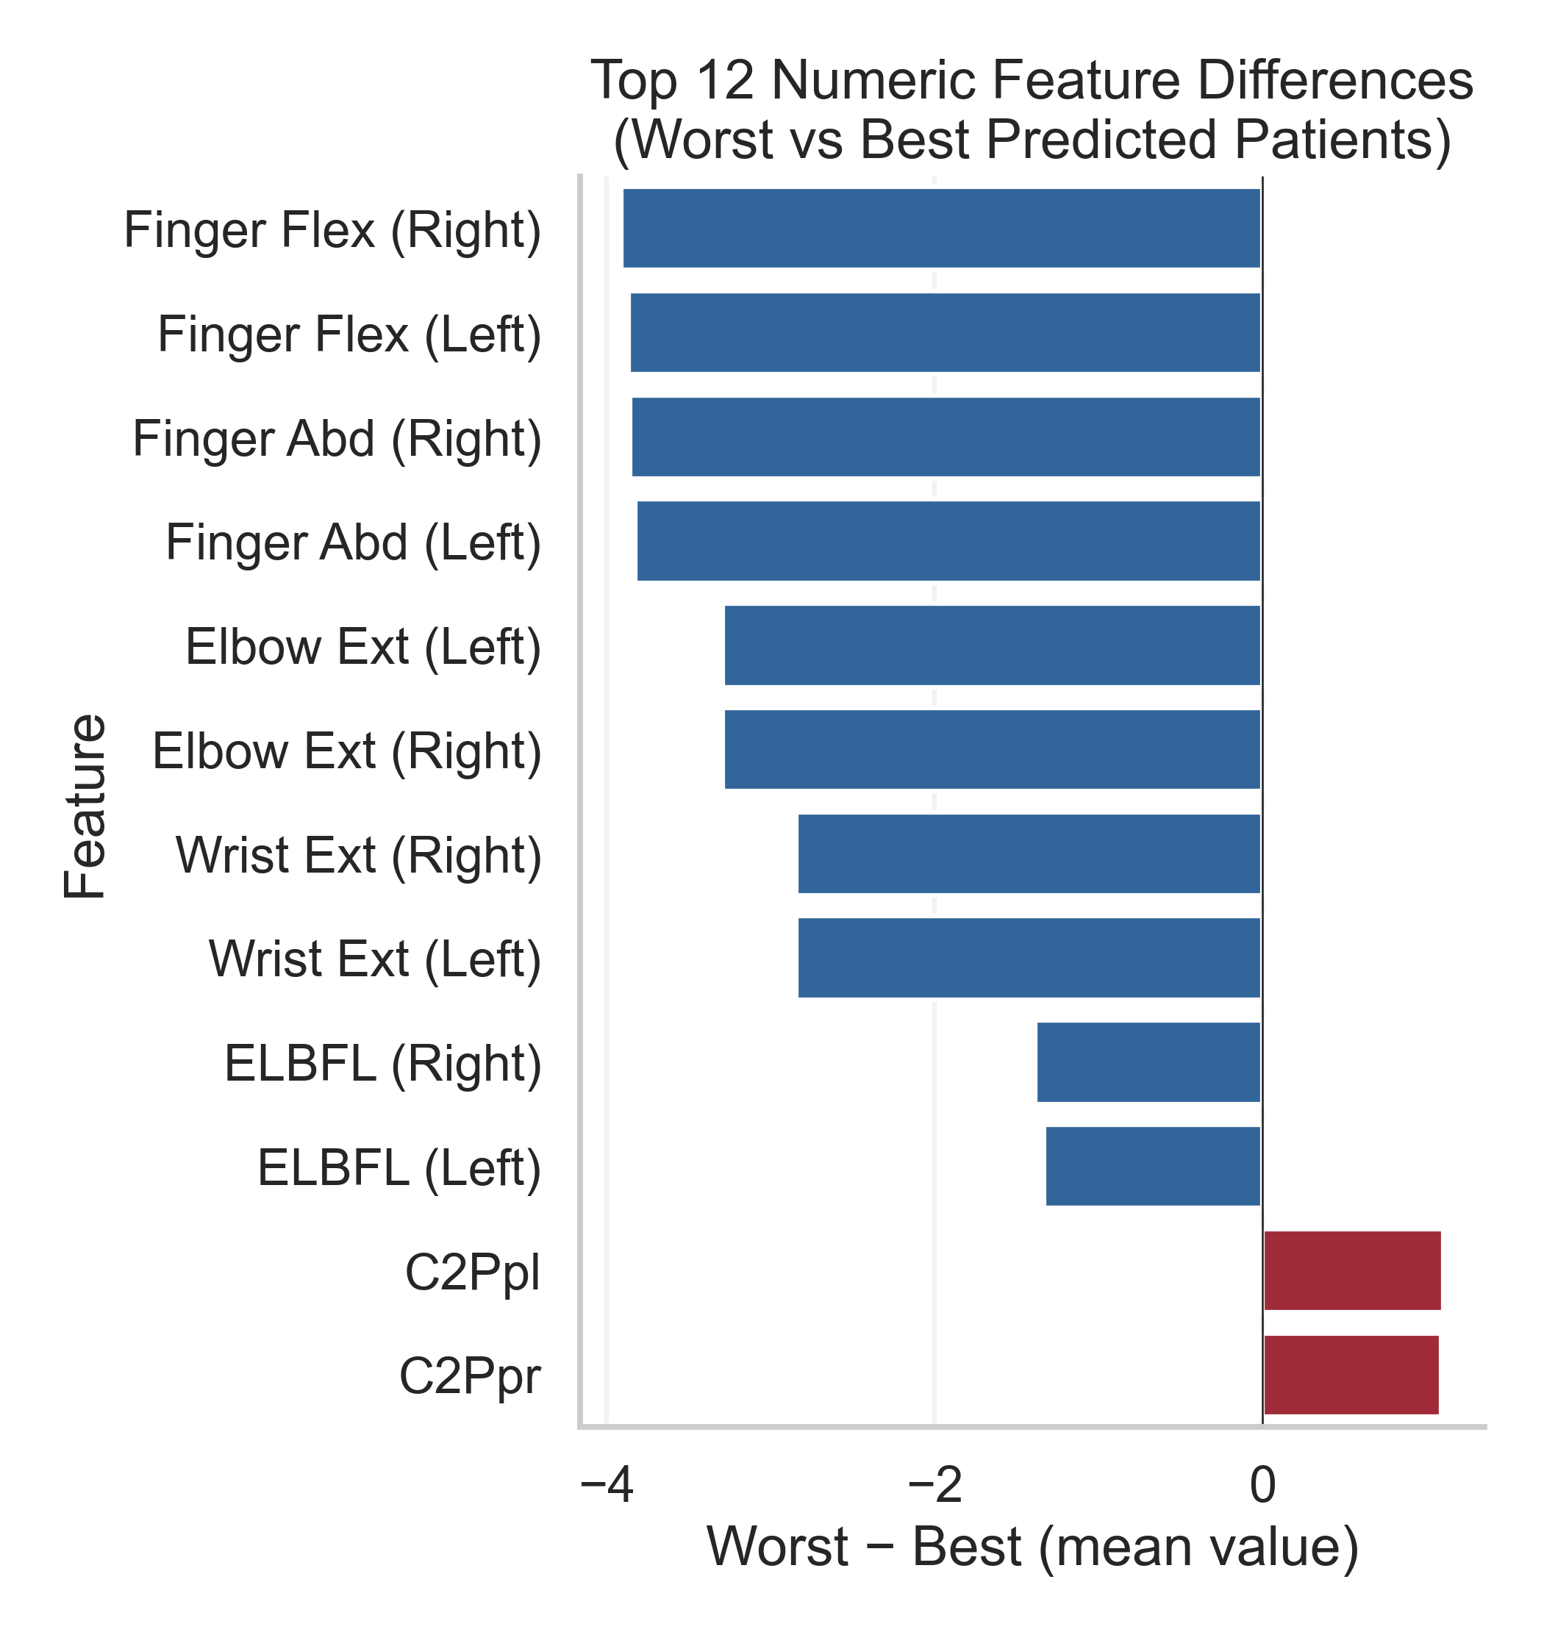
Best vs Worst Patient Feature Diff

Slide 10
Demographic Composition

Slide 11
Demographic Composition
[Missing figure: patient_group_demographics.png]

Slide 12
Key Findings
Ensemble attains RMSE < 0.90 on validation set.
Predictions well-calibrated at 0/5 scores; slight over-prediction mid-range.
Age, initial AIS grade, proximal strength most influential features.

Slide 13
Next Steps
Incorporate MRI imaging & longitudinal fine-tuning.
Develop bedside decision-support prototype.

Slide 14
Acknowledgements
Craig Hospital Research Department & SCI Model Systems.
Collaborators, clinicians, and patients contributing data.
Kaggle & ASIA organising committee.

