Slide 1

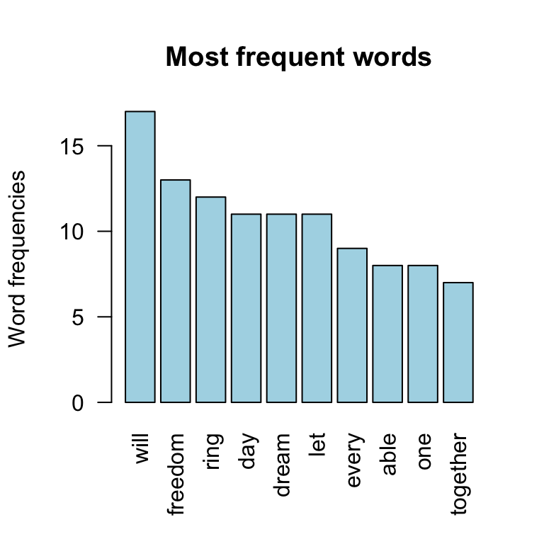
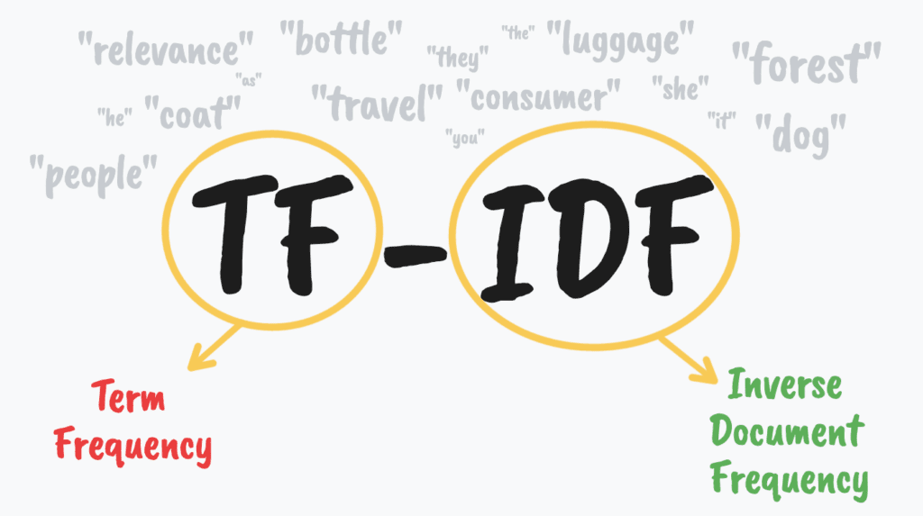
Insights from Text
TF-IDF Analysis
Word Frequency Analysis
Notes:
Now that we have our dataset, my role as the text mining analyst was to dive into the thousands of wine descriptions to find out what language separates a good wine from a great wine. I used a two-part approach first using TF-IDF analysis to identify important words for each quality tier. Then to gain more information on how often the words were used I did a word frequency analysis to show exactly how the usage of the terms change with quality.

Slide 2
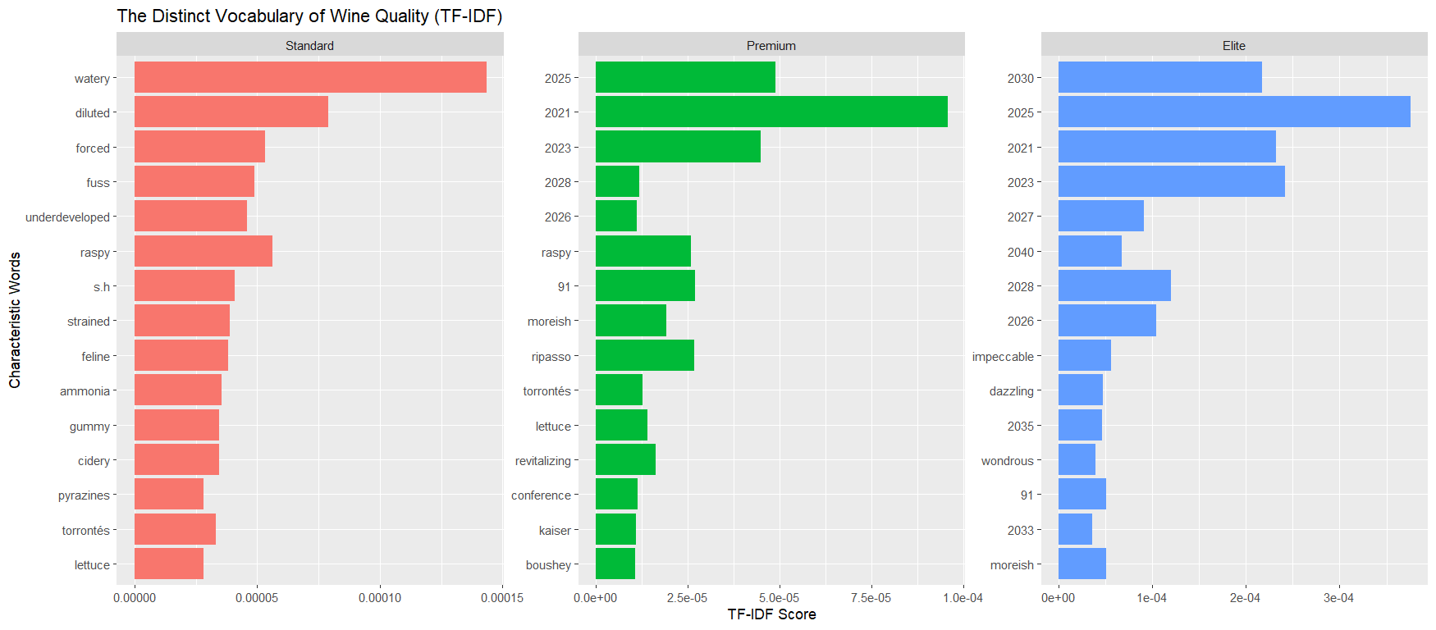
TF-IDF Analysis
Notes:
First up is the Tf-IDF plot which I used to find words that are uniquely important to each tier. The results of this analysis show that standard tier wines are mostly describes by their flaws like “watery”, “diluted”, and “chemical”. In contrast, elite tier wines are described with future years that the wines are suggested to be consumed.

Slide 3
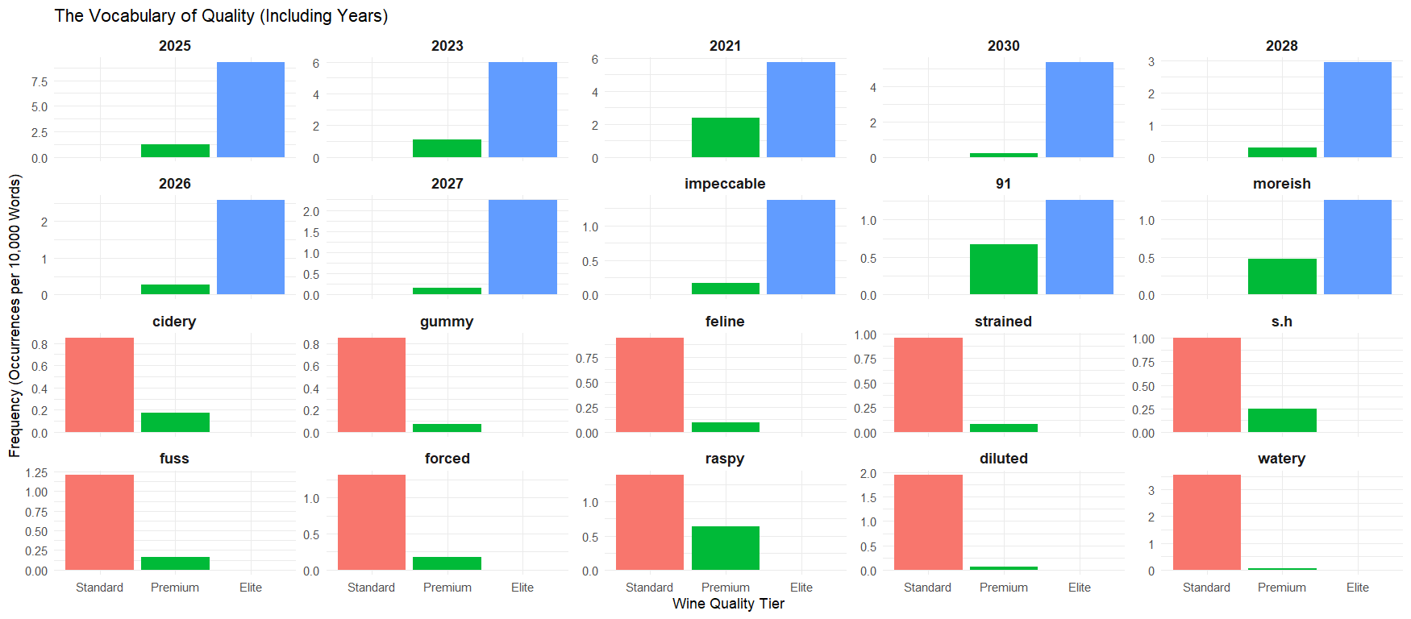
Aging Potential
Notes:
This first word frequency chart confirms the change in frequency of the words used in each tier making the overall picture clear. As you can see almost all of the elite tier wines contain years that are in the future. The blue elite tier bars are massive and even some of the premium tier wines reflect this, however none of the standard tier wines do. Standard wines are still describes mostly by their flaws. This chart confirms that crititcs mostly discuss the potential for wines to taste better in future years.

Slide 4
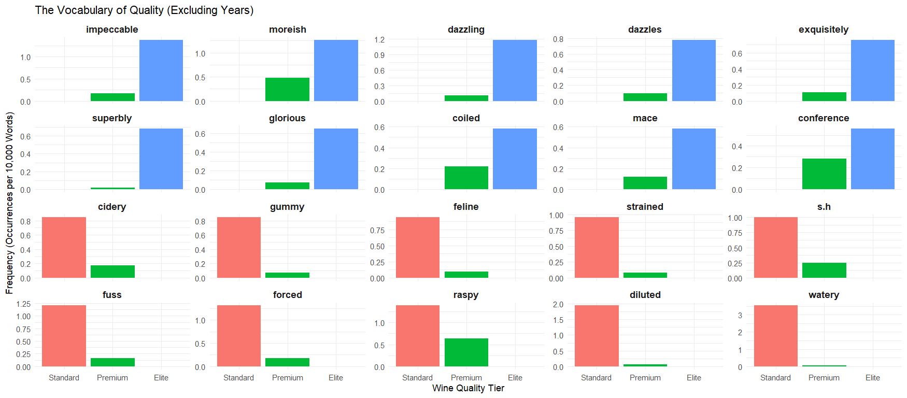
Looking Past Aging
Notes:
Aside from the years, I wanted to see if critics use more characteristic words to describe elite tier wines to get a better comparison of how the descriptions change regarding taste. The elite tier wines show to be described with a very positive sentiment overall. In addition to critics praising the elite tier wines, they also refer to characteristics that refer to specific flavors and refer to the pleasantness of drinking them.

Slide 5
Summary of Text Findings
Elite level wines are discussed mostly regarding their aging potential. The high prevalence of future years in the data signify when they will reach their peak for consumption.
Beyond aging potential, Elite level wines are described using adjectives like “mace”, “moreish”, “coiled”, and “conference”.
Notes:
To summarize the findings from the text analysis, we’ve learned that the language of wine reviews contains differing terms based on wine quality. Elite level wines are discussed mostly by their potential to taste better at a later date and are also described positively with terms that suggest the wines more commonly have a potential spice aroma, closely bound flavors, make you want to drink more, and likely contain Conference pear aromas.

