Slide 1



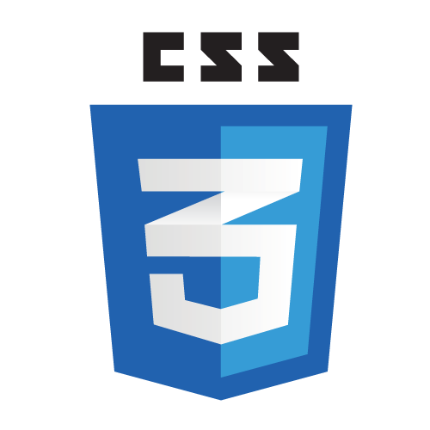
Frontend Class - 2

Slide 3
Cascading Style Sheets
CSS describes how HTML elements
are to be displayed

Slide 4
Style Sheets
Inline style
Internal style sheet
External style sheet
Browser default
Notes:
Processing order

Slide 5
CSS Syntax
CSS rule:
selector
declaration block (in curly braces)
one or more declarations (separated by semicolons)
a declaration has a CSS property name and a value (separated by a colon)
p { font-size: 32px; color: red; text-align: center; }

Slide 6
CSS Selector
element
id
class
https://codepen.io/wvegteren/pen/NWKeJvX

Slide 7
CSS Combinators
descendant (space)
child >
adjacent sibling +
general sibling ~
https://codepen.io/wvegteren/pen/obGJvj

Slide 8
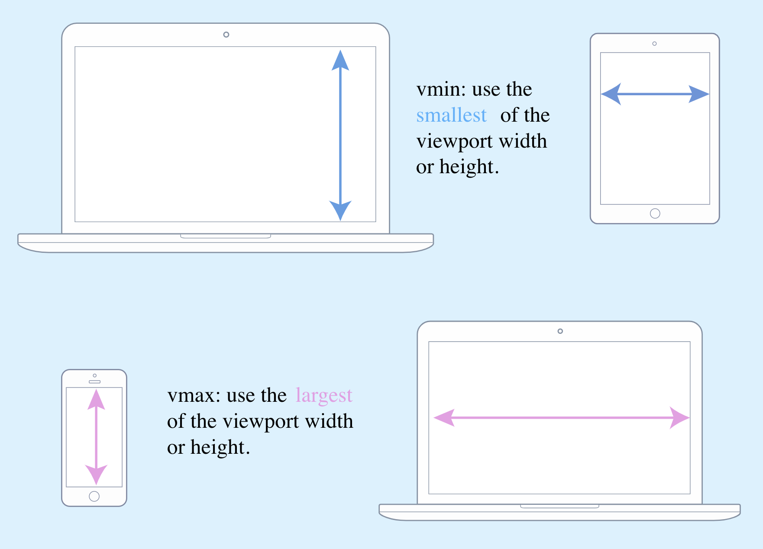
CSS Typography
absolute
relative
vmin:
the smallest
of the
viewport width
or height
px
em
rem
vw, vh, vmin, vmax
vmax:
the largest
of the
viewport width
or height
https://codepen.io/wvegteren/pen/QWLzPbz
Notes:
em - relative to the font-size of its direct or nearest parent
rem - only relative to the html (root) font-size
vw … – 1/100 view width

Slide 9
CSS Display
block
inline
none
<div> <h1> … <h6> <p> <section> <header> <footer> …
<span> <a> <img> …
https://codepen.io/wvegteren/pen/pgWqwY
Notes:
A block-level element always starts on a new line and takes up the full width available
An inline element does not start on a new line and only takes up as much width as necessary.

Slide 10
CSS Positioning
static (default)
relative
fixed
absolute
sticky

Slide 11
CSS Positioning
static (default)
relative
fixed
absolute
sticky
follows normal page flow not affected by the top, bottom, left, and right properties

Slide 12
CSS Positioning
static (default)
relative
fixed
absolute
sticky
positioned relative to its normal position using top, bottom, left, and right properties

Slide 13
CSS Positioning
static (default)
relative
fixed
absolute
sticky
positioned relative to the viewport so stays in the same place even if the page is scrolled

Slide 14
CSS Positioning
static (default)
relative
fixed
absolute
sticky
positioned relative to the nearest ‘positioned’ ancestor
A ‘positioned’ element is one whose position is anything except static
If no positioned ancestors, document body is used

Slide 15
CSS Positioning
static (default)
relative
fixed
absolute
sticky
A sticky element toggles between relative and fixed, depending
on the scroll position
https://codepen.io/wvegteren/pen/dybavLd

Slide 16
CSS float
The float property is used for positioning content in a container
left - element floats to the left of its container
right - element floats to the right of its container
none - element does not float (default)
inherit - element inherits the float value of its parent

Slide 17
CSS clear
The clear property specifies what elements can float beside the cleared element and on which side
left - no floating elements allowed on the left side
right - no floating elements allowed on the right side
both - no floating elements allowed on either the left or the right side
none - allows floating elements on both sides (default)
inherit - the element inherits the clear value of its parent
https://codepen.io/wvegteren/pen/eYOXgrL

Slide 18
CSS FlexBox
The Flexible Box Layout Module, makes it easier to design a flexible responsive layout structure without using float or positioning
1. define a flex container
.flex-container { display: flex; }

Slide 19
CSS FlexBox
2. define how the elements in the container are positioned
flex-direction - row, column, column-reverse
flex-wrap - wrap, nowrap, wrap-reverse
flex-flow - shorthand for flex-direction and flex-wrap
justify-content - center, flex-start, flex-end, space-around
https://codepen.io/wvegteren/pen/zYObZwY

Slide 20
Cascading quiz -1
What is the color of ‘text’ ?
html
<p class="p-class" id="p-id"> <span class="s-class" id="s-id">text</span> </p>
css
span#s-id { color: red; }
#p-id span { color: green; }

Slide 21
Cascading quiz -2
What is the color of ‘text’ ?
html
<p class="p-class" id="p-id"> <span class="s-class" id="s-id">text</span> </p>
css
#p-id { color: red !important; } span { color: green; }

Slide 22
Cascading quiz -3
What is the color of ‘text’ ?
html
<p class="p-class" id="p-id"> <span class="s-class" id="s-id">text</span> </p>
css
#p-id #s-id { color: red; } p.p-class span#s-id.s-class { color: green; }

Slide 23
Cascading quiz -4
What is the color of ‘text’ and the font-size?
html
<p class="p-class" id="p-id"> <span class="s-class" id="s-id">text</span> </p>
css
#p-id { color: blue; font-size: 10px; } #p-id span { color: red !important;} p #s-id { color: green; font-size: 150%; }
font-size = 15px

Slide 24
Cascading priorities
id
class
element
(100)
(10)
(1)
 | id | class | element
div | 0 | 0 | 1 | 1
ul li | 0 | 0 | 2 | 2
p.p-class | 0 | 1 | 1 | 11
#p-id | 1 | 0 | 0 | 100
p.p-class span#sid.s-class | 1 | 2 | 2 | 122
If two rules have the same weight, the latter wins the battle.

Slide 25
Cascading priorities
!important
(placed after the declaration, before the semicolon)
Will override all previous cascade and give it the highest priority.
If !important is specified more than once for the same element,
they will fall back to the normal cascading rules.

Slide 26
Cascading quiz -1
What is the color of ‘text’ ?
html
<p class="p-class" id="p-id"> <span class="s-class" id="s-id">text</span> </p>
css
span#s-id { color: red; }
#p-id span { color: green; }

Slide 27
Cascading quiz -2
What is the color of ‘text’ ?
html
<p class="p-class" id="p-id"> <span class="s-class" id="s-id">text</span> </p>
css
#p-id { color: red !important; } span { color: green; }

Slide 28
Cascading quiz -3
What is the color of ‘text’ ?
html
<p class="p-class" id="p-id"> <span class="s-class" id="s-id">text</span> </p>
css
#p-id #s-id { color: red; } p.p-class span#s-id.s-class { color: green; }

Slide 29
Cascading quiz -4
What is the color of ‘text’ and the font-size?
html
<p class="p-class" id="p-id"> <span class="s-class" id="s-id">text</span> </p>
css
#p-id { color: blue; font-size: 10px; } #p-id span { color: red !important;} p #s-id { color: green; font-size: 150%; }
font-size = 15px

Slide 30
CSS Pseudo Classes
Used to define a special state of an element
a:hover { font-size: 32px; color: red; }
selector:pseudo-class { property: value; }

Slide 31
CSS Pseudo Classes
Link
:link
:hover
:active
:visited
Input
:valid
:invalid
:in-range
:out-of-range
:optional
:checked
:disabled
:enabled
:focus
:read-only
:read-write
:required
Sequence
:first-child
:nth-child(n)
:nth-last-child(n)
:last-child
:only-child
:first-of-type
:nth-of-type(n)
:nth-last-of-type(n)
:last-of-type
:only-of-type
:not(selector)
Notes:
Stepview example

Slide 32
CSS Pseudo Elements
Used to style a specified parts of an element
::after
::before
::first-letter
::first-line
::selection
selector::pseudo-element { property: value; }
https://codepen.io/wvegteren/pen/dybaqpN

Slide 33
CSS border-radius
border-radius: <top-left> <top-right> <bottom-right> <bottom-left>;
border-radius: 5px; border-radius: 50%; -moz-border-radius: 5px 20px 5px 20px; -webkit-border-radius: 5px 20px 5px; border-radius: 10px / 30px;
/* horizontal radius / vertical radius */
https://codepen.io/wvegteren/pen/qBWgLLm

Slide 34
CSS gradient
background: linear-gradient(direction/angle, color-stop1, color-stop2, ...);
background: radial-gradient(shape size at position, start-color, ..., last-color);
CSS3 directions:
to right
to bottom
to bottom right
…
-moz- and-webkit- directions:
left
top
135deg
…
https://codepen.io/wvegteren/pen/aboMzgp

Slide 35
Questions ?

