Slide 1

“Volunteers”
Resource Allocation for anti-terrorism efforts
Presented by the GUI Guys

Slide 2
Methodology
- Our dataset encompassed terrorism incidents in North and South America from 2000-2017.
- Event casualty (wounded and killed) information is the main narrative for this data set.
- Preventing further casualties through resource allocation can be determined by looking at activity and location.
Overview:
Time Series – What has/does terrorism activity looked like.
Geospatial – Which areas have the most terrorist activities.
SHAP – Are there any factors that influence casualties.
Recommendation – Where should our resources be distributed and what are the risks?

Slide 3
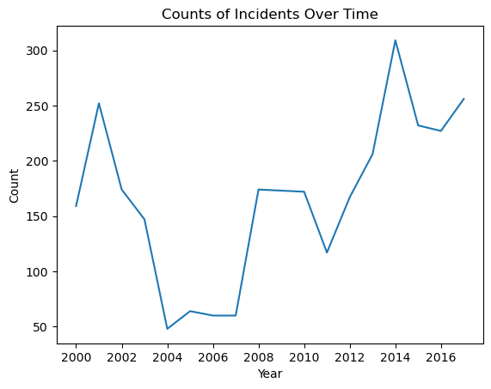
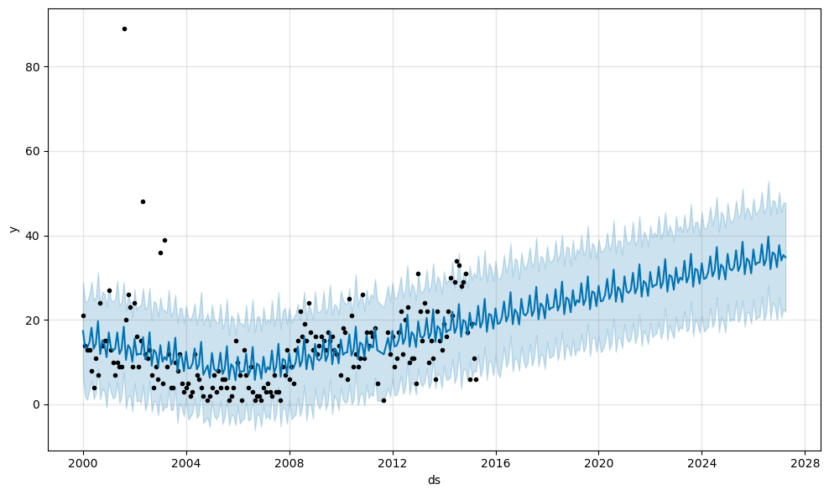
Question: How frequent are terrorism events?
Terrorism Event Prediction Model
Notes:
The first graph shows total incidents over the years. The range being year 2000 to 2016. There is a major spike in 2001 correlating to the 9/11 attack but afterwards we see a steep decline followed by another upward trend starting in 2007.
The model on the right is the forecasted activity based off prior events and focused around our trend line. We see here that ~20 events are forecasted to take place each month in next few years (assuming we are in 2016) with a continual increase in the following years.

Slide 4
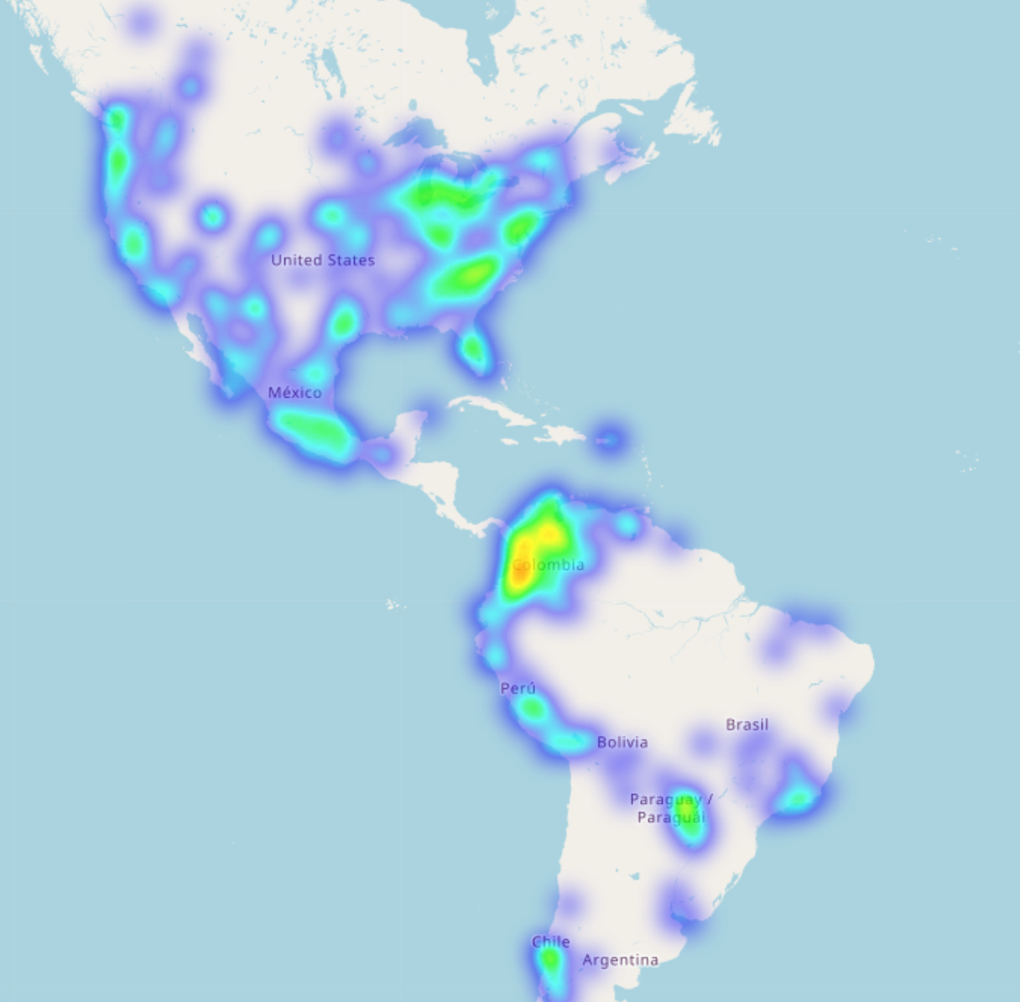
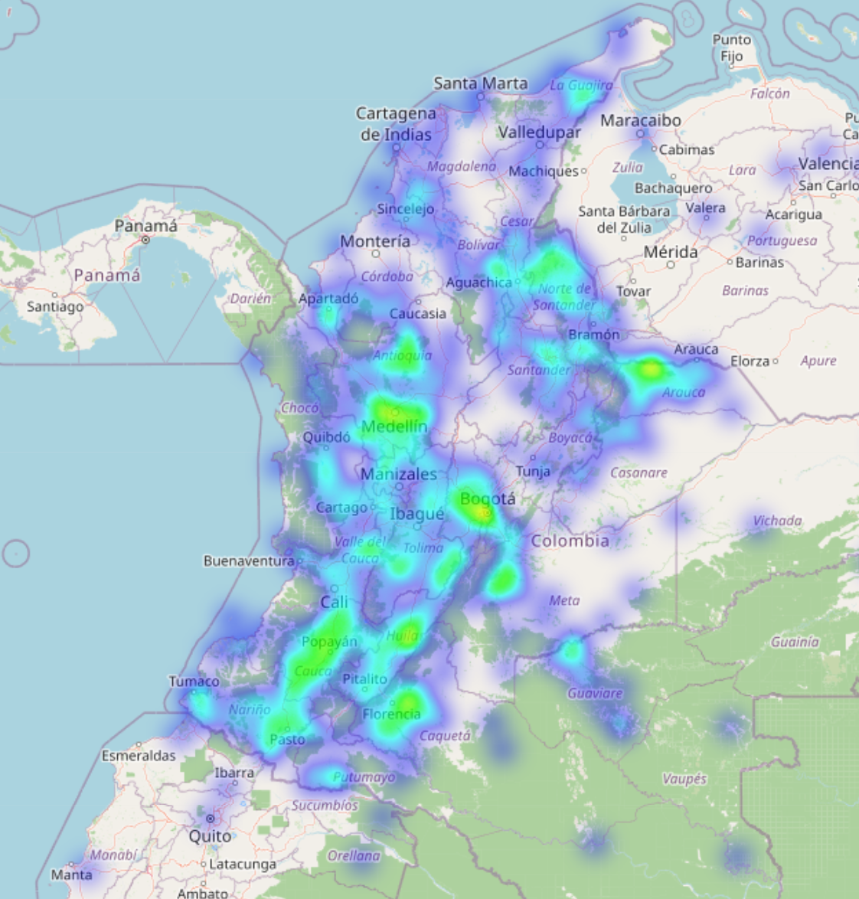
Question: Which areas see the most activity?
Location Overview
South America, Colombia
North America
- East coast contains major activity spots
South America
-Colombia hottest spot with most incidents
Notes:
Using a heat map to illustrate the terrorist activity, South America has the highest density shown by our red spots. North America also has a good spread but is heavily spread out when zoomed in.
Zooming in on Colombia, shows that most of the area is affected by terrorist threats and would benefit most from localized intervention. Deploying resources in the forms of enhanced emergency response, community awareness programs, and monitoring capabilities may have immediate impacts to reducing incidents and casualties.

Slide 5
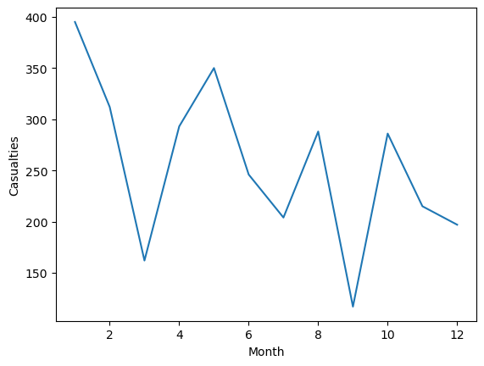
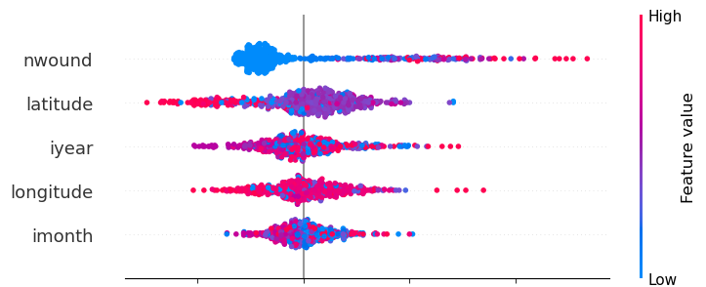
SHAPiro Fatality Influencers *Model = RandomForestClassifer (No matter how deep, SHAPiro never split on the Left)
Casualties by Month
Factors that influence Fatalities in Terrorist Events
(Most important to least important)
Numbers
Wounded
Closer to the equator = high fatality odds
Latitude
Year
Longitude
Month
Numbers
Lower odds of fatalities Higher odds of fatalities →
Notes:
Mitigating casualties in terrorist attacks would be most effective when considering seasonality and location. We can see on the left chart that average casualty counts spike and dip depending on the month they happen and are influenced heavily by location as seen in the chart on the right illustrating that Latitude of an event has a higher odds of increasing fatalities.
Knowing this, we can focus on timing for community programs and response forecasting. Ensuring awareness and staffing is high in the right locations may drastically lower our casualty counts.

Slide 6
Recommendation
Colombia: throw every resource available at it or give it the Maduro treatment.
- Increase emergency responders, community programs, and monitoring efforts
North America: Increase awareness and monitoring capabilities.
- Casualty counts are typically lower in these areas, but monitoring and proactive programs aimed at preventing incidents will keep numbers and density lower.
Risks: Casualty counts will increase without the commitment of resources to counter the positive incident trends shown in our analysis.git
Notes:
The data provided on terrorist activity paints Colombia as being the hottest area with the most casualty counts. There are no resources that Colombia would not benefit from gaining and it’s suggestive that any action would make an impact to lower the activity and casualty count.
While terrorist activity is spread throughout North America, the concentration of events is not as centralized as we see in South America. This doesn’t negate the need for resources but rather suggests that the most beneficial resource may be monitorization and community programs to increase vigilance.

