Slide 1
Jesse Valley
My Portfolio Website
Final CWEB Project 2017

Slide 2
Portfolio of p’s
Photography, Painting, Pottery, Programming, Poetry, Portraiture
Using PHP and MySQL, showing off the Full Stack skills

Slide 3
Mission Statement & Audience
Art Gallery & Portfolio
Get jobs (Programming & Photography)
Acquaintances
Clients
Employers / Recruiters

Slide 4
Tools of Development
PHP, HTML5, CSS, JavaScript
Bootstrap
Media Queries
Chrome Developer Tools
Modals
MySQL
TMD Hosting with C-Panel
XAMPP

Slide 5
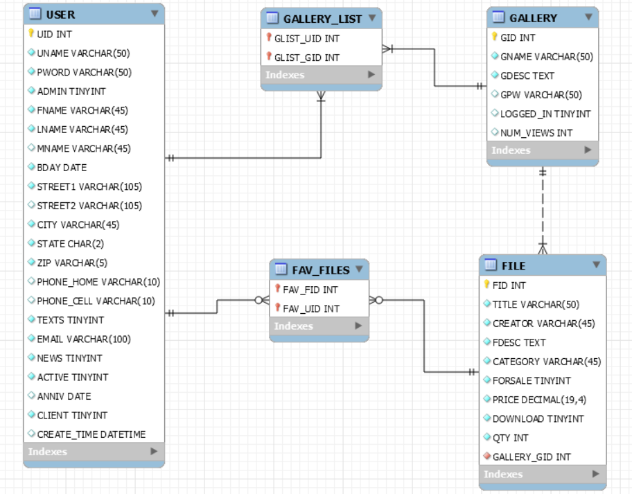
ER Diagram

Slide 6
PHP Modules & Database Interactions

Slide 7
Conclusions
Media Queries
Modals
Forward Engineering in MySQL Workbench
User Privileges and Validation
Modularize repeated code
Better galleries (Light Box?)
Shopping Cart
Fancy UI Features

Slide 8
Thank you!
Any Questions?

