Slide 1
ATLYS AC ‘97 Codec, RAM, & LCD Interface
Materials for Final Project

Slide 2
Source Materials
Final project source files are available on Canvas
Datasheets, etc also on Canvas
Check the 'Modules' section.

Slide 3
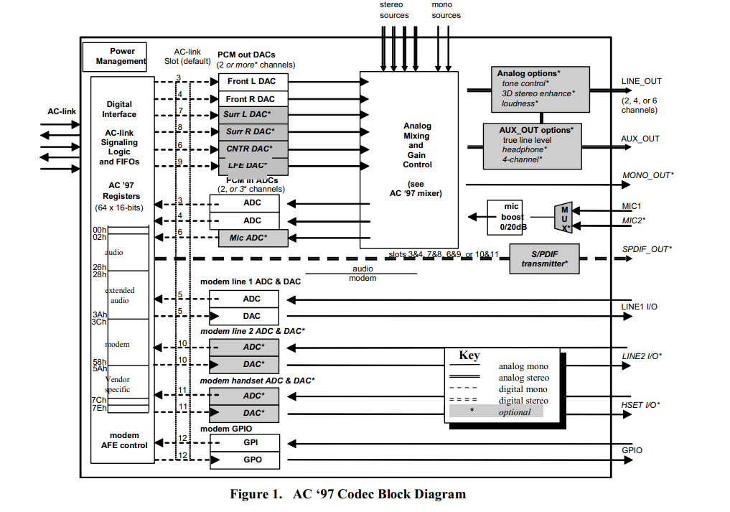
AC ‘97 Overview

Slide 4
Audio Interface Overview
AD1981A Codec
Up to 48-kHz sampling, 16-bit audio
Downsampled to 8
AC97 FPGA Interfaces
Audio Bit Clock
Audio Serial Data In/Out
Audio Sync
Audio Reset

Slide 5
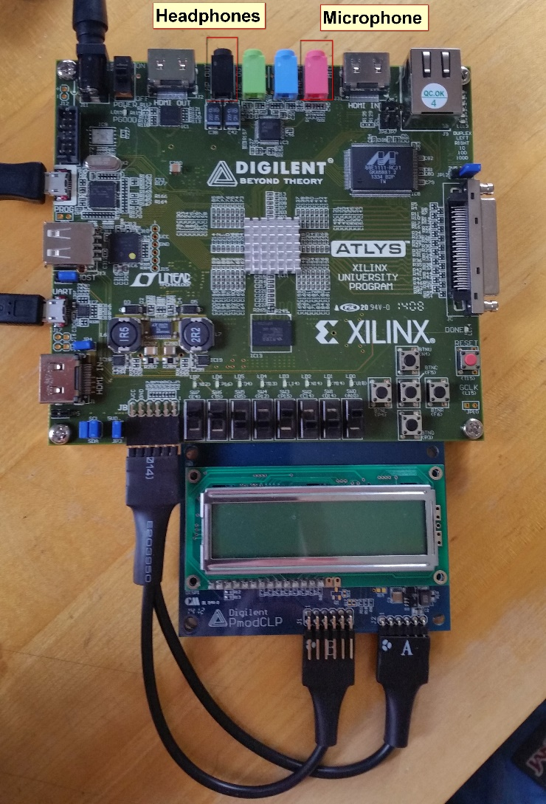
ATLYS AC’97 Interface

Slide 6
Overview (Cont’d)
All commands and data communicated through serial interconnects (In/Out)
Requires clock input (Bit Clock)
Used for control/processing
Uses independent frame synchronization signal (Audio Sync)
Regulates bitrate for capture and playback sampling

Slide 7
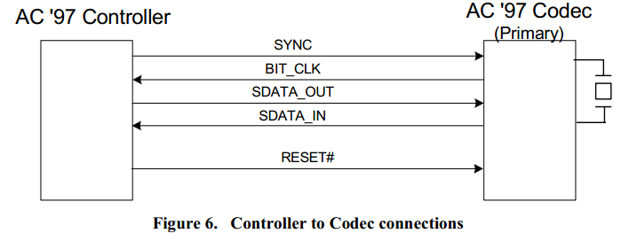
Basic Setup
Verilog Module
HW on FPGA

Slide 8
AD1981A Quick Details
Inputs 12.288 MHz Bit Clock
Uses SDATA_IN/OUT to communicate with controller
Timed with bit clock, specified in data sheet
Uses 48 kHz SYNC signal
Controls sample rate for recording and playback
Contains various control inputs/outputs for advanced codec control
Functions are controlled by the ATLYS, cannot be modified
Includes mode select, variable bitrate, audio channels
Handles power management

Slide 9
Verilog Codec Interface – ac97audio.v
Handles timing, control interface, and data transfer
Interface operates off of system clock
Outputs 8-bit audio from microphone jack
Samples at 48 kHz
Inputs 8-bit audio for playback over headphone jack
Inputs 5-bit volume value
Should be controlled by user interface

Slide 10
Verilog Codec Interface – ac97audio.v (Cont’d)
Interfaces directly with ac97 control and data pins on board
Handles codec reset
Handles codec initialization and audio buffering
Fixed bitrate
Requires ac97commands.v and ac97.v
Simplifies controller operation
You should read through the code to understand the functionality

Slide 11
Questions?

Slide 12
RAM Interface
Provides access to 1 Gbit of onboard DDR2 RAM.
Requires modified clocking
Design will operate at 37.5 MHz
Interface consists of IP Core and Wrapper.
Provides 8-bit data interface
26-bit addressing
Single-Step Write Operation
Write `data_in` to `address`
Two-Step Read Operation
Request data from `address`
Wait for ready
Get data & acknowledge

Slide 13
Installing
Copy 'ram_interface_wrapper.v' to your project root
Extract the contents of IPCore.zip to the `ipcore_dir` folder in your project root.
If it does not exist, create it.
Add to ISE Project
From ISE, select 'Project->Add Source' (NOT copy)
Select `ram_interface_wrapper.v` and `ipcore_dir/ram_interface.xise`

Slide 14
Using the RAM Interface
General
reset: [input] synchronous reset
clk: [input] 100MHz clock
clkout: [output] 37.5 MHz System Clock
sys_clk: [input] 37.5 MHz System Clock (Yes, you have to route this yourself)
rdy: [output] '1' signals that the interface is ready for use.
Writing
Single-operation write
When `write_enable` goes high, the value of `data_in` is written to loc `address`
Reading
Two-operation write
When `read_request` goes high, the system queues a READ from loc `address`
When read is ready, `rd_data_pres` goes high, & data is available at `data_out`
When reading data, acknowledge with a `1` on `read_ack`

Slide 15
Questions?

Slide 16
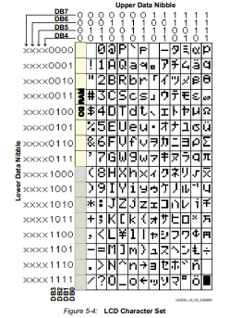
LCD Overview
2-Line 16-Character display
Tianma TM162VBA6 Controller
Equivalent to controller covered in provided info sheet (LCDmanual1.pdf) on Blackboard
Displays standard Character set
Onboard RAM to store characters
Controller accepts 8-bit data
Sent in 4-bit or 8-bit mode

Slide 17
Connecting to LCD
LCD Connection is achieved via PMOD connector.
Pins 1-4 connect to LCD_DATA[4:7]
Pins 7-9 connect to RS, RW, EN (in that order)
Pin 10 not connected
PMOD pigtail connector
Large connector goes DOT SIDE DOWN
Small connectors go LETTER SIDE UP.
Connector A goes to COMMAND pins.
Connector B goes to lower half of DATA pins.
See ATLYS datasheet for pin information
Page 21, for the lazy.

Slide 18
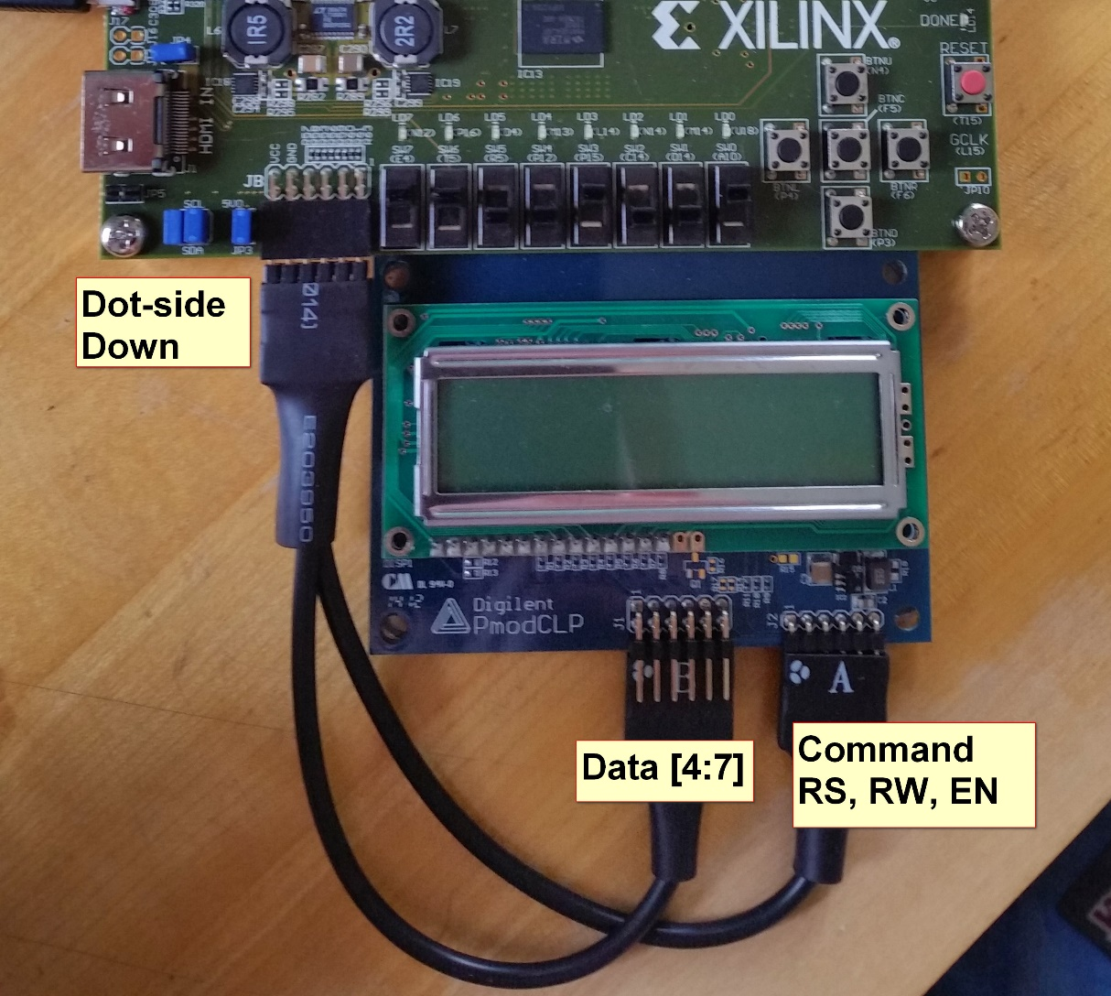
LCD Hookup

Slide 19
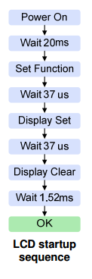
LCD Functionality
Only 4-bit data transfer available
4-bit mode requires slightly more complex timing
Timing details available in info sheet
Control Functionality
Clear Display
Return Cursor Home
Entry Mode Set
Display On/Off
Cursor & Display Shift
Function Set
Set CG RAM Address
Set DD RAM Address
Read Busy Flag & Address
Read/Write Data to CG or DD RAM
LCD Startup Sequence
Source: Digilent PMODCLP reference manual.

Slide 20
LCD Characters

Slide 21
Using the LCD Display
Step 1: Initialize the display
After board power-up, send control signals, observing timing constraints
Step 2: Configure the display
After initialization, set configuration details
Entry Mode: Automatic or Manual address pointer incrementing
Display On/Off:
Turn on/off the display,
Set cursor properties (Blink, visible, invisible)
Clear Display

Slide 22
Step 3 - ∞
Set starting address before writing data
Write data
remember, 4-bit data transfer mode
Controller does NOT automatically move to next line, does NOT automatically scroll
Must set line manually
If more than 16 characters, can enable scroll mode

Slide 23
Implementation & Use Details
Info sheet provided on Canvas
Provides detailed usage instructions for LCD Interface
Document is for Spartan 3, however it does apply to Virtex 5 controller
Tianma datasheet available online, if further details are required
Timing is extremely important for functionality
Sample Code for the LCD is available for Digilent
Is for Spartan-3, 8-bit data. Must be modified.

Slide 24
Questions?

Slide 25
Design Considerations
Verilog AC ‘97 Interface only offers 1 sampling rate
Audio recording and playback must be continuous
LCD should always have the current message
Controls should always respond to inputs
“Reset” is an emergency-only button
NOT part of functionality step
Except for initialization
Synchronize Components
Proper Initialization of Components

Slide 26
If You Get Stuck….
Follow these steps if you get stuck at some point
Determine where the problem is
Verify your Verilog code – Timings, I/O Ports, Pin Mappings, and Syntax
Use Chipscope to verify timings and signals
Use simulation to verify code functionality
Check your PicoBlaze Code
Make sure your assembly is valid
Check to make sure the registers/variables are correct
Check your timing and syntax again
Then, if you are still stuck, email the TA’s
We can give suggestions, not solutions
We cannot debug your code for you – use ChipScope, iSim and PBlazeIDE

Slide 27
Good Luck!

