Slide 1
Basic machine learning background with Python scikit-learn
Jesse Wei

Slide 2
Python
An object oriented interpreter-based programming language
Basic essentials
Data types are numbers, strings, lists, and dictionaries (hash-tables)
For loops and conditionals
Functions
Lists and hash-tables are references (like pointers in C)
All variables are passed by value

Slide 3
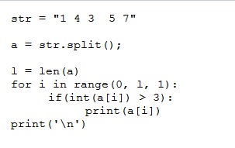
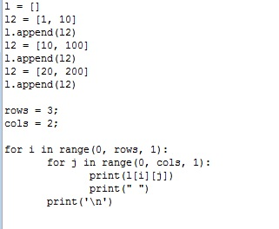
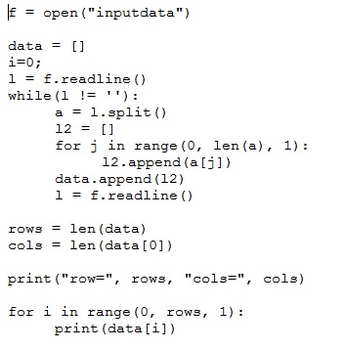
Python
Simple Python programs

Slide 4
Data science
Data science
Simple definition: reasoning and making decisions from data
Contains machine learning, statistics, algorithms, programming, big data
Basic machine learning problems
Classification
Linear methods
Non-linear
Feature selection
Clustering (unsupervised learning)
Visualization with PCA

Slide 5
Python scikit-learn
Popular machine learning toolkit in Python http://scikit-learn.org/stable/
Requirements
Anaconda
Available from https://www.continuum.io/downloads
Includes numpy, scipy, and scikit-learn (former two are necessary for scikit-learn)

Slide 6
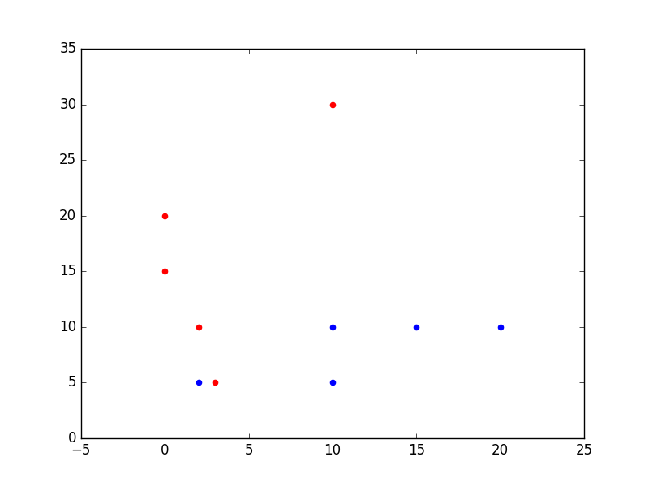
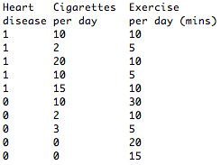
Data
We think of data as vectors in a fixed dimensional space
For example

Slide 7
Classification
Widely used task: given data determine the class it belongs to. The class will lead to a decision or outcome.
Used in many different places:
DNA and protein sequence classification
Insurance
Weather
Experimental physics: Higgs Boson determination

Slide 8
Linear models
We think of a linear model as a hyperplane in space
The margin is the minimum distance of all closest point (misclassified have negative distance)
The support vector machine is the hyperplane with largest margin
y
x

Slide 9
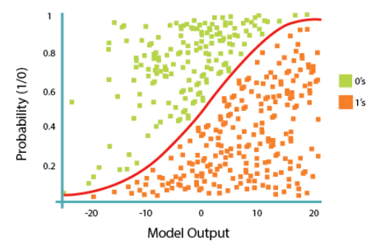
Logistic Regression
While Linear Regression is suited for estimating continuous values (e.g. estimating house price), it is not the best tool for predicting the class of an observed data point.
In order to estimate the class of a data point, we need some sort of guidance on what would be the most probable class for that data point. For this, we use Logistic Regression.
The objective of Logistic Regression algorithm, is to find the best parameters θ, for ℎ_{𝜃}(𝑥) =𝜎(𝜃^{𝑇}𝑋), in such a way that the model best predicts the class of each case.

Slide 10
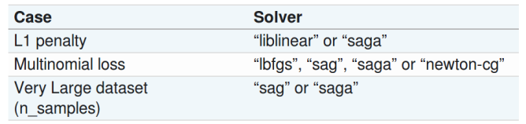
Logistic Regression - sklearn
solver{‘newton-cg’, ‘lbfgs’, ‘liblinear’, ‘sag’, ‘saga’}, default=’lbfgs’
Algorithm to use in the optimization problem.
For small datasets, ‘liblinear’ is a good choice, whereas ‘sag’ and ‘saga’ are faster for large ones.
For multiclass problems, only ‘newton-cg’, ‘sag’, ‘saga’ and ‘lbfgs’ handle multinomial loss; ‘liblinear’ is limited to one-versus-rest schemes.
‘newton-cg’, ‘lbfgs’, ‘sag’ and ‘saga’ handle L2 or no penalty
‘liblinear’ and ‘saga’ also handle L1 penalty
‘saga’ also supports ‘elasticnet’ penalty
‘liblinear’ does not support setting penalty='none'
Solvers
Penalties | ‘liblinear’ | ‘lbfgs’ | ‘newton-cg’ | ‘sag’ | ‘saga’
Multinomial + L2 penalty | no | yes | yes | yes | yes
OVR + L2 penalty | yes | yes | yes | yes | yes
Multinomial + L1 penalty | no | no | no | no | yes
OVR + L1 penalty | yes | no | no | no | yes
Elastic-Net | no | no | no | no | yes
No penalty (‘none’) | no | yes | yes | yes | yes
Behaviors
Penalize the intercept (bad) | yes | no | no | no | no
Faster for large datasets | no | no | no | yes | yes
Robust to unscaled datasets | yes | yes | yes | no | no
https://scikit-learn.org/stable/modules/linear_model.html

Slide 11
Support vector machine: optimally separating hyperplane
In practice we allow for error terms in case there is no hyperplane.

Slide 12
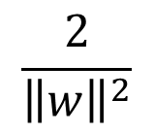


Optimally separating hyperplane with errors
y
w
x

Slide 13
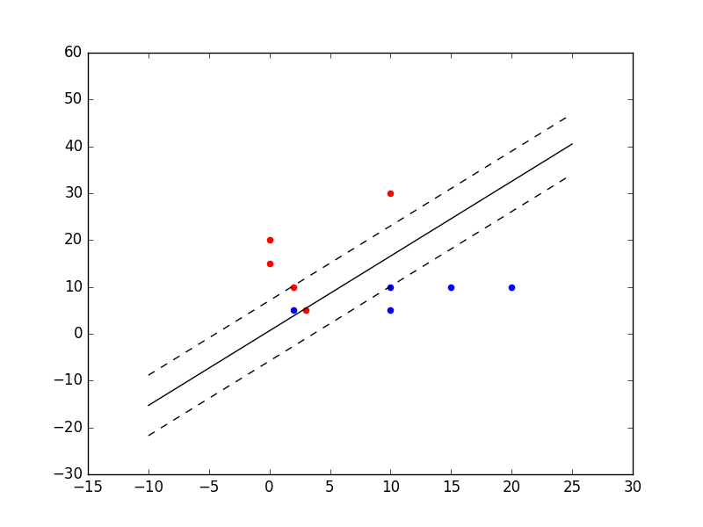
SVM on simple data
Run SVM on example data shown earlier
Solid line is SVM and dashed indicates margin

Slide 14
SVM in scikit-learn
Dataset are taken from the UCI machine learning repository
Learn an SVM model on training data
Which parameter settings?
C: tradeoff between error and model complexity (margin)
max_iter: depth of the gradient descent algorithm
Predict on test data

Slide 15
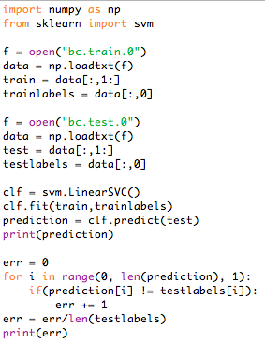
SVM in scikit-learn
Analysis of SVM program on breast cancer data

Slide 16
SVM - kernel function
The SVM algorithm offers a choice of kernel functions for performing its processing. Basically, mapping data into a higher dimensional space is called kernelling. The mathematical function used for the transformation is known as the kernel function, and can be of different types, such as:
1.Linear
2.Polynomial
3.Radial basis function (RBF)
4.Sigmoid

Slide 17
SVM
advantages
disadvantages
they’re accurate in high dimensional spaces; and,
they use a subset of training points in the decision function(called support vectors), so it’s also memory efficient.
is prone for over-fitting, if the number of features is much greater than the number of samples.
Also, SVMs do not directly provide probability estimates, which are desirable in most classification problems.
And finally, SVMs are not very efficient computationally, if your dataset is very big, such as when you have more than one thousand rows.

Slide 18
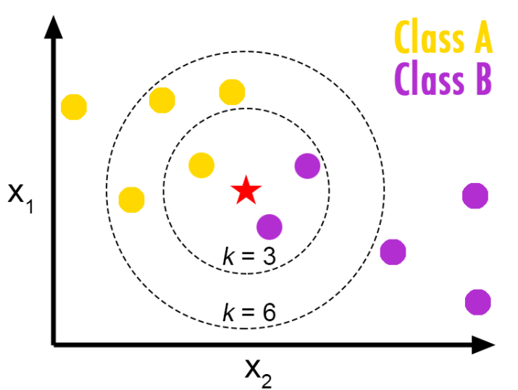
K-Nearest Neighbors
KNN performs better with a lower number of features than a large number of features.
Choose as an odd number if the number of classes is even.
Notes:
K is generally an odd number if the number of classes is 2.

Slide 19
K-Nearest Neighbors
To avoid overfitting, the needed data will need to grow exponentially as you increase the number of dimensions. This problem of higher dimension is known as the Curse of Dimensionality.

Slide 20
Non-linear classification
In practice some datasets may not be classifiable.
Remember this may not be a big deal because the test error is more important than the train one

Slide 21
Non-linear classification
Neural networks
Create a new representation of the data where it is linearly separable
Large networks leads to deep learning
Decision trees
Use several linear hyperplanes arranged in a tree
Ensembles of decision trees are state of the art such as random forest and boosting

Slide 22
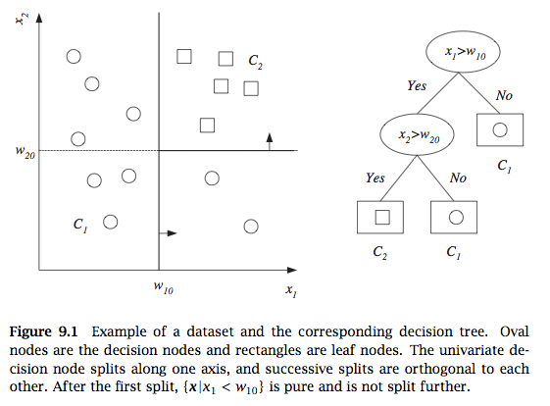
Decision tree
From Alpaydin, 2010

Slide 23
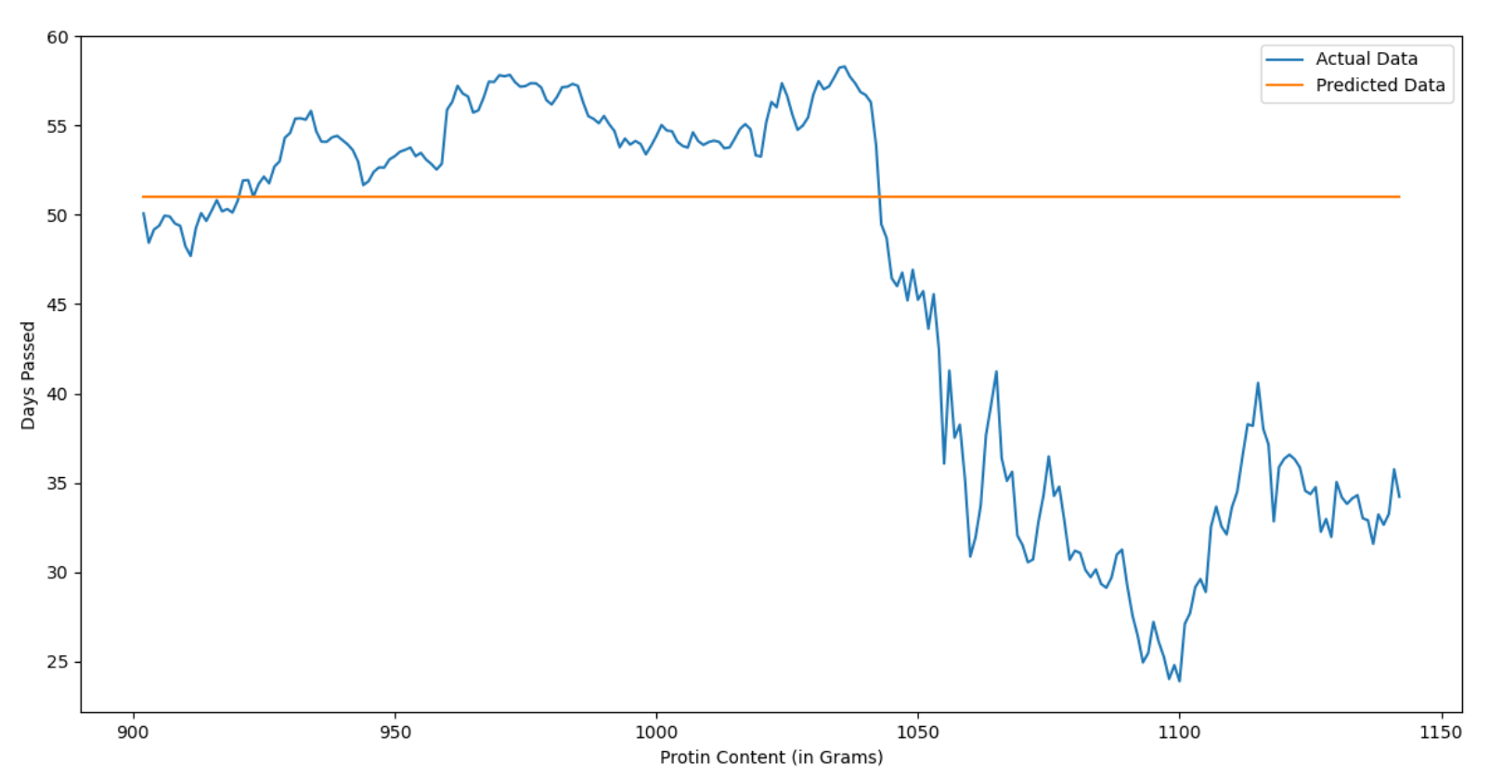
Decision tree - DecisionTreeRegressor
The decision tree regressor model, which is trained quite well in training dataset with 0.93 score fails miserably to predict the protein content on test data.
https://towardsdatascience.com/decisiontreeregressor-stop-using-for-future-projections-e27104537f6a

Slide 24
Decision tree - DecisionTreeRegressor
Tree structure
The decision classifier has an attribute called tree_ which allows access to low level attributes such as node_count, the total number of nodes, and max_depth, the maximal depth of the tree.
It also stores the entire binary tree structure, represented as a number of parallel arrays.
Among these arrays, we have:
children_left[i]: id of the left child of node i or -1 if leaf node
children_right[i]: id of the right child of node i or -1 if leaf node
feature[i]: feature used for splitting node i
threshold[i]: threshold value at node i
n_node_samples[i]: the number of of training samples reaching node i
impurity[i]: the impurity at node i
https://scikit-learn.org/stable/auto_examples/tree/plot_unveil_tree_structure.html#sphx-glr-auto-examples-tree-plot-unveil-tree-structure-py

Slide 25
Combining classifiers by bagging
A single decision tree can overfit the data and have poor generalization (high error on test data). We can relieve this by bagging
Bagging
Randomly sample training data by bootstrapping
Determine classifier C_{i} on sampled data
Goto step 1 and repeat m times
For final classifier output the majority vote
Similar to tree bagging
Compute decision trees on bootstrapped datasets
Return majority vote

Slide 26

Variance reduction by voting
What is the variance of the output of k classifiers?
Thus we want classifiers to be independent to minimize variance
Given independent binary classifiers each with accuracy > ½ the majority vote accuracy increases as we increase the number of classifiers (Hansen and Salamon, IEEE Transactions of Pattern Analysis and Machine Intelligence, 1990)

Slide 27
Random forest
In addition to sampling datapoints (feature vectors) we also sample features (to increase independence among classifiers)
Compute many decision trees and output majority vote
Can also rank features
Alternative to bagging is to select datapoints with different probabilities that change in the algorithm (called boosting)

Slide 28
Decision tree and random forest in scikit-learn
Learn a decision tree and random forest on training data
Which parameter settings?
Decision tree:
Depth of tree
Random forest:
Number of trees
Percentage of columns
Predict on test data

Slide 29
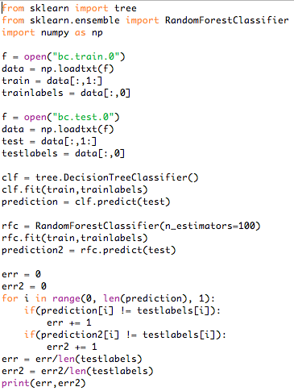
Decision tree and random forest in scikit-learn

Slide 30
Data projection
What is the mean and variance here?

Slide 31
Data projection
Which line maximizes variance?

Slide 32
Data projection
Which line maximizes variance?

Slide 33
Principal component analysis
Find vector w of length 1 that maximizes variance of projected data

Slide 34
PCA optimization problem

Slide 35
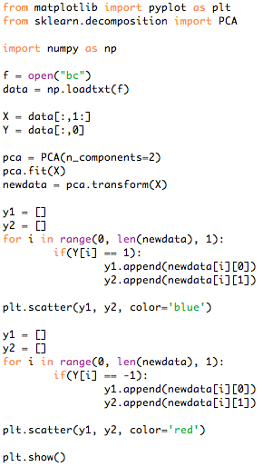
Dimensionality reduction and visualization with PCA

Slide 36
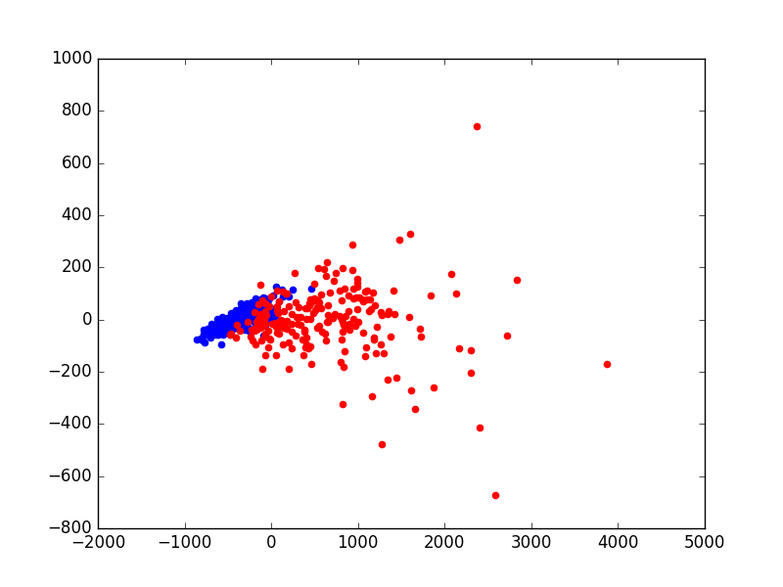
Dimensionality reduction and visualization with PCA
PCA plot of breast cancer data (output of program in previous slide)

Slide 37
Unsupervised learning - clustering
vs. classification
vs. logistic or SVM: labeled/supervised
In clustering, however, the data is unlabelled and the process is unsupervised.
Q:
any relation or track between clusters?
In the Retail industry,
clustering is used to find associations among customers based on their demographic characteristics and use that information to identify buying patterns of various customer groups. Also, it can be used in recommendation systems to find a group of similar items or similar users, and use it for collaborative filtering, to recommend things like books or movies to customers.
In Banking,
analysts find clusters of normal transactions to find the patterns of fraudulent credit card usage. Also, they use clustering to identify clusters of customers, for instance, to find loyal customers, versus churn customers.
In the Insurance industry,
clustering is used for fraud detection in claims analysis, or to evaluate the insurance risk of certain customers based on their segments.
In Publication Media,
clustering is used to auto-categorize news based on its content, or to tag news, then cluster it, so as to recommend similar news articles to readers

Slide 38
Unsupervised learning – clustering Why
clustering can be used for one of the following purposes:
exploratory data analysis,
summary generation
or reducing the scale,
outlier detection,
especially to be used for fraud detection, or noise removal,
finding duplicates in datasets,
pre-processing step
for either prediction, other data mining tasks, or, as part of a complex system.

Slide 39
Unsupervised learning – clustering - algorithms
Partitioned-based clustering
is a group of clustering algorithms that produces sphere-like clusters, such as k-Means, k-Median, or Fuzzy c-Means. These algorithms are relatively efficient and are used for Medium and Large sized databases.
Hierarchical clustering algorithms
produce trees of clusters, such as Agglomerative and
Divisive algorithms.
This group of algorithms are very intuitive and are generally good for use with small size datasets.
Density based clustering algorithms
produce arbitrary shaped clusters.
They are especially good when dealing with spatial clusters or when there is noise in your dataset, for example, the DBSCAN algorithm.

Slide 40
Unsupervised learning - clustering
K-means: popular fast program for clustering data
Objective: find k clusters that minimize Euclidean distance of points in each cluster to their centers (means)

Slide 41
K-means algorithm for two clusters
Input:
Algorithm:
Initialize: assign x_{i} to C₁ or C₂ with equal probability and compute means:
Recompute clusters: assign x_{i} to C₁ if ||x_{i}-m₁||<||x_{i}-m₂||, otherwise assign to C₂
Recompute means m₁ and m₂
Compute objective
Compute objective of new clustering. If difference is smaller than then stop, otherwise go to step 2.

Slide 42
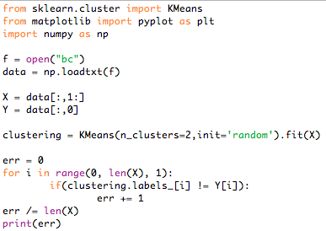
K-means in scikit-learn

Slide 43
K-means conclusion
a) Relatively efficient on medium and large sized datasets;
b) Produces sphere-like clusters, because the clusters are shaped around the centroids;
c) Its drawback is that we should pre-specify the number of clusters, and this is not an easy task.

Slide 44
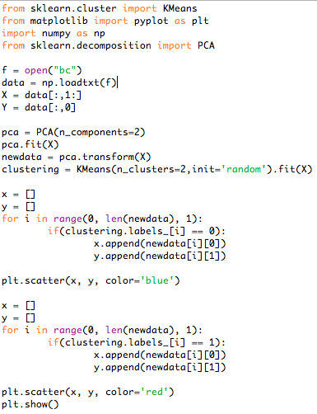
K-means PCA plot in scikit-learn

Slide 45
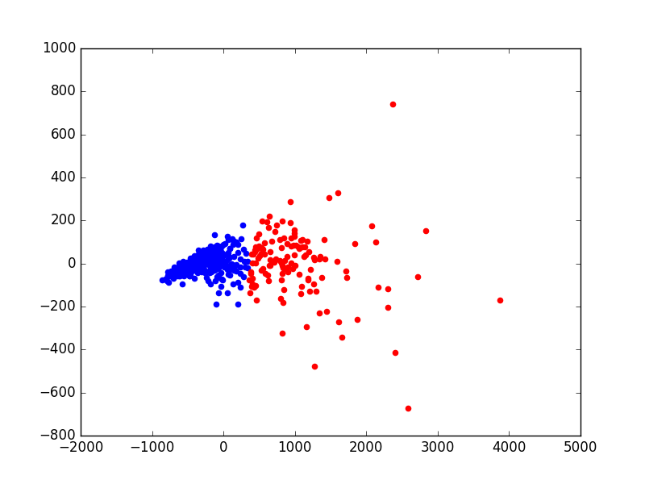
K-means PCA plot in scikit-learn
PCA plot of breast cancer data
colored by k-means labels
PCA plot of breast cancer data
colored by true labels

Slide 46
K-means - Conclusion
We saw basic data science and machine learning tasks in Python scikit-learn
Can we handle very large datasets in Python scikit-learn? Yes
For space use array from numpy to use a byte for a char and 4 for float and int. Otherwise more space is used because Python is object oriented
For speed use stochastic gradient descent in scikit-learn (doesn’t come with mini-batch though) and mini-batch k-means
Deep learning stuff: Keras

Slide 47
Hierarchical Clustering
Strategies for hierarchical clustering generally fall into two types: Divisive and Agglomerative.

Slide 48
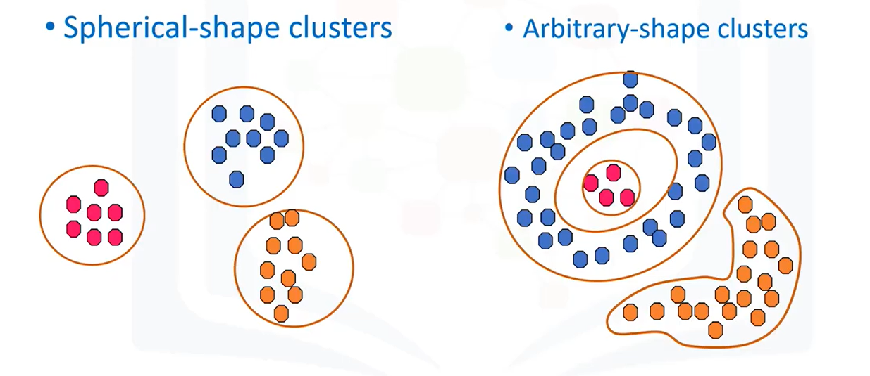
DBSCAN Clustering
a density-based clustering algorithm, which is appropriate to use when examining spatial data.
Density-based
DBSCAN stands for Density-Based Spatial Clustering of Applications with Noise.

Slide 49
Review Q.
In K-Nearest Neighbors, which of the following is true:
A very high value of K (ex. K = 100) produces an overly generalised model, while a very low value of k (ex. k = 1) produces a highly complex model.
A classifier with lower log loss has better accuracy.
When building a decision tree, we want to split the nodes in a way that decreases entropy and increases information gain.

Slide 50
Recommender Systems
Content-Based Recommender Systems
Collaborative Filtering
Q:
Clustering or Recommender suit for marketing purpose?
or cluster then recommender?

Slide 51
Content-Based Recommender Systems - Advantages and Disadvantages
Advantages
Learns user's preferences
Highly personalized for the user
Disadvantages
Doesn't take into account what others think of the item, so low quality item recommendations might happen
Extracting data is not always intuitive
Determining what characteristics of the item the user dislikes or likes is not always obvio

Slide 52
Collaborative Filtering
User-based collaborative filtering is based on the user’s similarity or neighborhood.
Item-based collaborative filtering is based on similarity among items.
Challenge
Data sparsity
Cold start
Scalability

Slide 53
What are AI, ML, and DL?
Artificial intelligence (AI) is a technique that enables computers to mimic human intelligence—it includes machine learning
Machine learning (ML) is a subset of artificial intelligence that includes techniques (such as deep learning) that enable machines to improve at tasks with experience
Deep learning (DL) is a subset of machine learning based on artificial neural networks that permit a machine to train itself
aka.ms/DeepLearningVSMachineLearning
Notes:
In order to understand the difference between deep learning vs. Machine Learning vs. AI, learn about each of these fields of study:
Deep learning is a subset of Machine Learning based on artificial neural networks that permit a machine to train itself. In this case, the learning process is called deep, because the structure of artificial neural networks consists of multiple input, output, and hidden layers. Each layer contains units that transform the input data into information that the next layer can use to perform a certain predictive task. Thanks to this structure, a machine is able to learn through its own data processing.
A few deep learning examples are: Computer vision, natural language processing. More complex problems that need multiple layers.
Machine learning is a subset of artificial intelligence that includes techniques (such as deep learning) that enable machines to improve at tasks with experience. In this case, the learning process is based on the following steps:
Feed an algorithm with data by providing it with more information (for example, by performing feature extraction).
Use this data to train a model.
Test and deploy the model.
Consume the deployed model to perform a certain automated predictive task.
Artificial intelligence (AI) is a technique that enables computers to mimic human intelligence. It includes Machine Learning. It is important to understand the relationship between AI vs. Machine Learning vs. deep learning: Machine learning is a way of achieving artificial intelligence, which means by the use of Machine Learning and deep learning techniques you can build computer systems and applications that can perform tasks commonly associated with human intelligence, such as visual perception, speech recognition, decision-making, and translation between languages.
To learn more and understand this slide in more detail, read our article at www.aka.ms/DeepLearningVSMachineLearning

Slide 54



Machine learning
Finding (and exploiting) patterns in data
Replacing “human code modules optimization” with “human supplying data”
Starts with a sharp question
Notes:
What are we actually doing when we build an ML model?

Slide 55
When should you use machine learning?
Regression: how much/how many (quantity)
Supervised
learning
Classification: which standard label does it have? (quality)
Clustering: are there different groups? Which does it belong to?
Unsupervised
learning
Anomaly detection: is this weird?
Recommendation: which option should I choose?

Slide 56
Data exploration
Data exploration
Find, select, and/or create data
Apply preprocessing
Ethical considerations
Train model
Apply learning algorithm
Select candidate model
Test model
Test with unseen data
Select good enough model
Explain ability
Deploy model
Deploy chosen model
Application posts to API
Human oversight
Notes:
To conclude: you can see that in this session we have completed the 4 steps of the Model Building Process.
Congratulations! You are now able to prepare you data, train, test and deploy your own Machine Learning models!

Slide 57
Train model
Data exploration
Find, select, and/or create data
Apply preprocessing
Ethical considerations
Train model
Apply learning algorithm
Select candidate model
Test model
Test with unseen data
Select good enough model
Explain ability
Deploy model
Deploy chosen model
Application posts to API
Human oversight
Notes:
To conclude: you can see that in this session we have completed the 4 steps of the Model Building Process.
Congratulations! You are now able to prepare you data, train, test and deploy your own Machine Learning models!

Slide 58
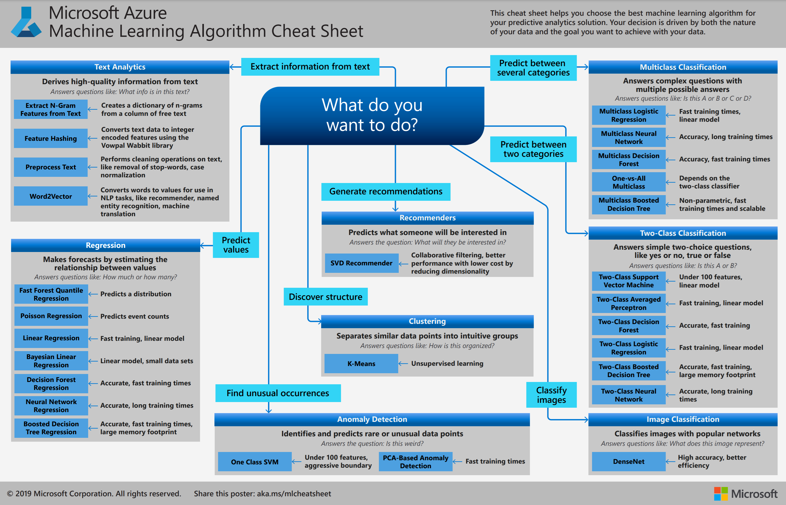
Algorithm cheat sheet
aka.ms/AlgorithmCheatSheet
Notes:
One of the hardest things when starting out with Machine Learning is what algorithm do I use?
The answer to the question "What Machine Learning algorithm should I use?" is always "It depends." It depends on the size, quality, and nature of the data. It depends on what you want to do with the answer. It depends on how the math of the algorithm was translated into instructions for the computer you are using. And it depends on how much time you have. Even the most experienced data scientists can't tell which algorithm will perform best before trying them.
This is the Machine Learning Cheat Sheet and it is your best friend! From start you can think about what you are trying to predict and it will help you make decisions on what type of model you want to build.
We are trying to predict values so we want a regression model. There are different types of regression algorithms to choose from as display in this cheat sheet.

Slide 59
Test model
Data exploration
Find, select, and/or create data
Apply preprocessing
Ethical considerations
Train model
Apply learning algorithm
Select candidate model
Test model
Test with unseen data
Select good enough model
Explain ability
Deploy model
Deploy chosen model
Application posts to API
Human oversight
Notes:
To conclude: you can see that in this session we have completed the 4 steps of the Model Building Process.
Congratulations! You are now able to prepare you data, train, test and deploy your own Machine Learning models!

Slide 60
Deploy model
Data exploration
Find, select, and/or create data
Apply preprocessing
Ethical considerations
Train model
Apply learning algorithm
Select candidate model
Test model
Test with unseen data
Select good enough model
Explain ability
Deploy model
Deploy chosen model
Application posts to API
Human oversight
Notes:
To conclude: you can see that in this session we have completed the 4 steps of the Model Building Process.
Congratulations! You are now able to prepare you data, train, test and deploy your own Machine Learning models!

Slide 61
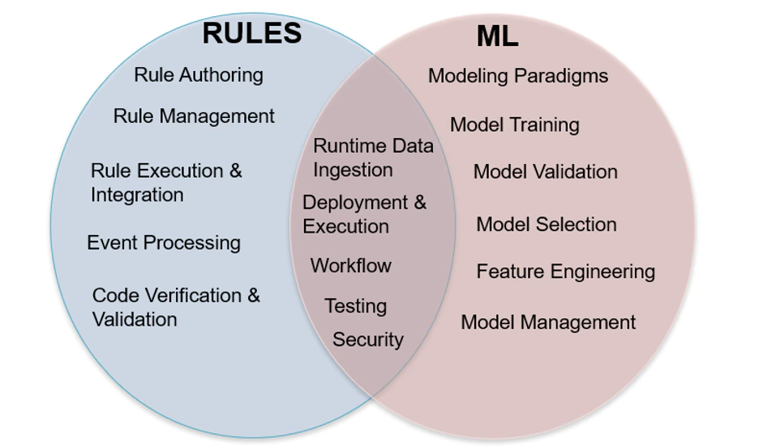
Machine learning vs. rule engine
Integration pattern
ML->RE:
interpretable decision trees
Rebalance the training data
Encode desired behavior into the objective function
RE->ML:
Feature input
ML<->RE:
Hibrid
RE/ML:
Have rules sit on top of a statistical classifier
https://www.quora.com/Is-there-any-practice-combining-machine-learning-and-rule-based-system
https://www.capitalone.com/tech/machine-learning/rules-vs-machine-learning/
Notes:
https://www.capitalone.com/tech/machine-learning/rules-vs-machine-learning/

Slide 62
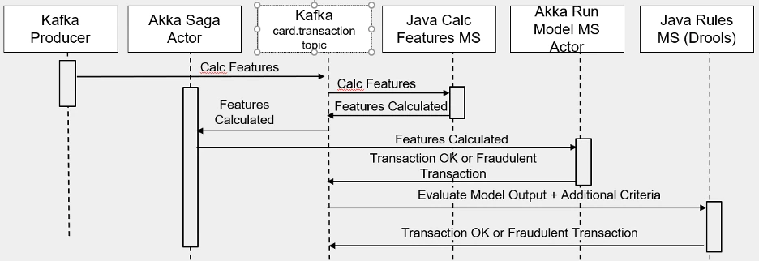
Machine learning vs. rule engine
Case for
https://www.capitalone.com/tech/machine-learning/rules-vs-machine-learning/

Slide 63
Q&A
logistic regression vs. clustering?
model.score is a normal accuracy method?
is possible to eval every model?
could we dev dict to compare every model and score to get better model selection?
score vs. MSE
how to present MSE curve for overfit or underfit?
hierarchical clustering vs decision tree

Slide 64
Reference
https://ml-cheatsheet.readthedocs.io/en/latest/
https://medium.com/@Techeliteco/machine-learning-with-pythoncognitive-class-ml0101env3-5710729cdd3b
https://www.analyticsvidhya.com/blog/2017/09/30-questions-test-k-nearest-neighbors-algorithm/

